Slide 1

UWinsite Student - Update
Administrative Heads
July 18, 2018
Alice Miller
University Registrar
UWinsite Student Lead

Slide 2
For Today
Where we are….
Where we are going….
First days in the new system….
Proposed registration schedule
Sample business changes
System Fundamentals
Demo….

Slide 3
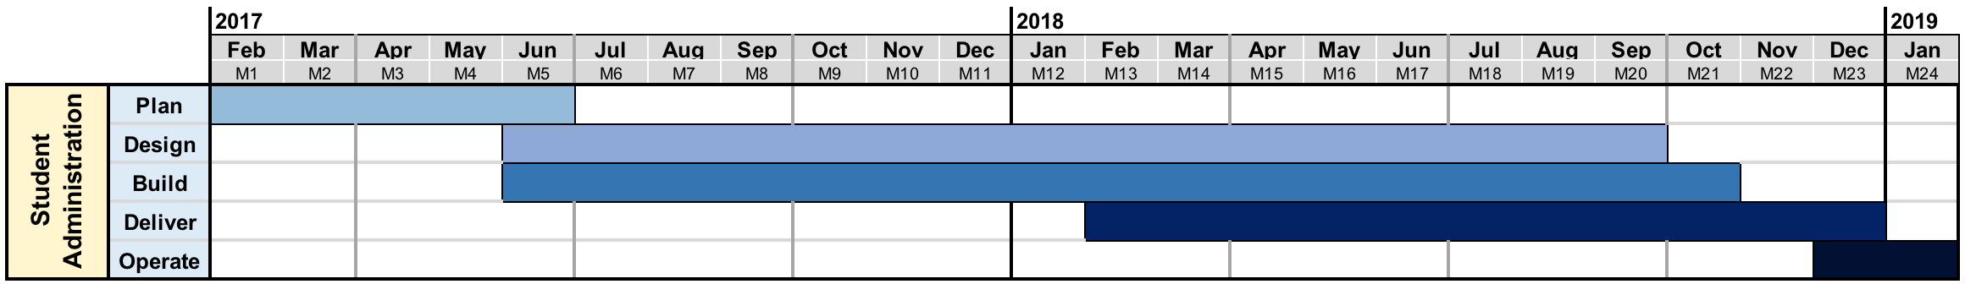
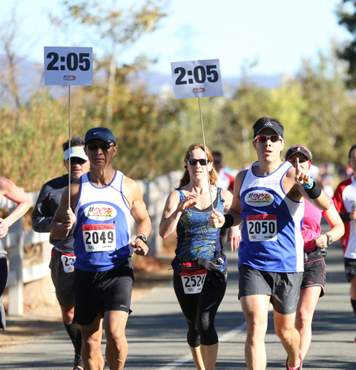
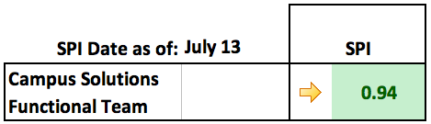
Go-Live Date: November 26, 2018
CIT1
CIT2
CIT3
Go- Live
SIT1
SIT2
UAT
We are here
Release
Many tools to manage & track activities
MS Project Daily Scrums
PMC, ALM Systems Heat Maps
SharePoint SPI Index
On
Track

Slide 4
Project Update
May - July
System Integration Testing
July 9- Sep 21
User Acceptance Testing
Sept 24 - Oct 25
Go Live!
Oct – Nov 26
Critical configuration complete/unit tested; secondary configuration nearing completion
Academic Advisement (2011)
System Security
Business Process Planning
SIT scenario development
End-to-end testing of the critical build by the core team
Report development
Secondary configuration complete
End-to-end testing by key UWindsor personnel
Report development continues
Cutover/Go Live plan designed / implemented
Go Live!
Support
Process changes operationalized
TRAINING Sep ’18 onwards
ONGOING COMMUNICATION WITH ALL STAKEHOLDERS

Slide 5
SIT Faculty of Nursing Example
Business Process | Scenario | Navigation | Task Description
Manage Enrollments | Enrol nursing students in winter clinicals prior to reg appt time then run term limits (validation/appointment times) | Records and Enrollment>Career and Program Information:Process Student Groups | Add Student Group NURS to students to be block enrolled in clinical courses using an external file load
Manage Enrollments | Enrol nursing students in winter clinicals prior to reg appt time then run term limits (validation/appointment times) | Records and Enrollment>Term Processing>Term Activation>Term Activation Batch Process | Run Term Activation Batch process to term activate nursing students in the NURS Student Group
Manage Enrollments | Enrol nursing students in winter clinicals prior to reg appt time then run term limits (validation/appointment times) | Records and Enrollment>Student Term Information>Term Activate a Student | Verify that term was activated by checking some of the students in the nursing group.
Manage Enrollments | Enrol nursing students in winter clinicals prior to reg appt time then run term limits (validation/appointment times) | Records and Enrollment>Enroll Students>Block enrollment>Create Class Block | Verify class block exist with correct courses
Manage Enrollments | Enrol nursing students in winter clinicals prior to reg appt time then run term limits (validation/appointment times) | Records and Enrollment>Enroll Students>Block enrollment>Create Student Block | Verify student block exist with correct students Selection tool: External File Upload file : Choose CVS file File Mapping: Nursing Hit Preview Selection Results
Manage Enrollments | Enrol nursing students in winter clinicals prior to reg appt time then run term limits (validation/appointment times) | Records and Enrollment>Enroll Students>Block enrollment>Block Enroll Merge | Add New Value Academic Institution : UWin1 Choose the Student and Class Block Click Merge Hit Submit
Manage Enrollments | Enrol nursing students in winter clinicals prior to reg appt time then run term limits (validation/appointment times) | Curriculum Management>Class Roster> Class Roster | Validate that students are registered on class roster
Manage Enrollments | Enrol nursing students in winter clinicals prior to reg appt time then run term limits (validation/appointment times) | Records and Enrollment>Enroll Students>Block enrollment>Create Class Block | Verify class block exist with correct courses
Manage Enrollments | Enrol nursing students in winter clinicals prior to reg appt time then run term limits (validation/appointment times) | Records and Enrollment>Enroll Students>Enrollment | Verify that students were registered in the correct block of courses.
Manage Enrollments | Enrol nursing students in winter clinicals prior to reg appt time then run term limits (validation/appointment times) | Records and Enrollment>Term Processing>Appointments>Assign Appointments | Assign Appointment times to Nursing students to be registered in clinicals
Manage Enrollments | Enrol nursing students in winter clinicals prior to reg appt time then run term limits (validation/appointment times) | Records and Enrollment>Term Processing>Appointments>Student Enrollment Appointment | Check that the correct registration appointment time was applied
Manage Enrollments | Enrol nursing students in winter clinicals prior to reg appt time then run term limits (validation/appointment times) | Records and Enrollment>Student Term Information>Update Enrollment Limits | Update enrolment limits for 2nd and 3rd year Nursing students block enrolled in clinical courses
Manage Enrollments | Adjust Program level enrollment limits for Nursing and enroll | Main Menu > Records and Enrollment > Student Term Information > Update Enrollment Limits | Find an existing run control and if none exist create a new one. Check the Population Selection box. Select 'PS Query" in Selection Tool field. Select correct query. Click on Edit Prompts link and input TERM. Preview Selection Results and record a student number from the list. Check the Override Unit Limits box; input 18 in the Max Total Units field. Click Run
Manage Enrollments | Adjust Program level enrollment limits for Nursing and enroll | Main Menu > Records and Enrollment > Student Term Information > Term Activate a Student > Enrollment Limit Tab | Confirm student's Max Total Units has changed to 18
Manage Enrollments | Enrol nursing students in winter clinicals prior to reg appt time then run term limits (validation/appointment times) | Records and Enrollment>Student Term Information>Term Activate a Student | Check that maximum FT load was updated for the nursing students in 2nd and 3rd year block enrolled in clinical courses
Manage Enrollments | Enrol nursing students in winter clinicals prior to reg appt time then run term limits (validation/appointment times) | Student Self Service | Register nursing students in the rest of their courses through SSS. Include a course that would conflict with a clinical course. Include all courses up to the increased max load limit

Slide 6
November 26th
Students will have access to their program planner
  Registration will begin November 30th
  Registration will not conflict with final examinations
Resources will be available across the campus to assist in the use of the tool

Slide 7
Winter 2019 Proposed Registration Times
Category | SubCategory | Anticipated Registration Load | 2019 start date | Sum per day | Start time
NEW |  | 600 | 30-Nov-18 |  | 9:00
NEWG (incuding M.Eng) |  | 600 | 30-Nov-18 |  | 9:00
MBA |  | 55 | 30-Nov-18 |  | 9:00
DE |  | 100 | 30-Nov-18 |  | 9:00
GRAD Non Meng |  | 1950 | 30-Nov-18 |  | 11:20
ATH |  | 330 | 30-Nov-18 |  | 14:00
CEPE |  | 1000 | 30-Nov-18 |  | 14:00
Returning Nursing | SM5 | 360 | 30-Nov-18 | 4995 | 19:00
MSWP |  | 220 | 03-Dec-18 |  | 9:00
Meng Returning |  | 1250 | 03-Dec-18 |  | 9:00
UGrad | 38 + | 900 | 03-Dec-18 |  | 9:50
UGrad | 35-38 | 900 | 03-Dec-18 |  | 11:20
Returning Nursing | SM7 | 340 | 03-Dec-18 |  | 12:00
Returning Nursing | SM3 | 140 | 03-Dec-18 |  | 12:00
UGrad | 30-35 | 1000 | 03-Dec-18 |  | 15:50
Degree completion 2yr | 20 + | 40 | 03-Dec-18 | 4790 | 15:50
UGrad | 26-30 | 880 | 04-Dec-18 |  | 9:50
UGrad | 24-26 | 950 | 04-Dec-18 |  | 11:20
UGrad | 19-24 | 1100 | 04-Dec-18 |  | 12:50
Degree completion 2yr | 10-20 | 20 | 04-Dec-18 |  | 12:50
Degree completion 3yr | 10 + | 50 | 04-Dec-18 |  | 12:50
UGrad | 16-19 | 800 | 04-Dec-18 |  | 14:00
Degree completion 3yr | 0-10 | 20 | 04-Dec-18 |  | 14:00
Degree completion 2yr | 0-10 | 100 | 04-Dec-18 |  | 14:00
Returning Nursing | SM1 | 120 | 04-Dec-18 |  | 15:50
UGrad5 (Engineering) | ENG | 400 | 04-Dec-18 | 4380 | 15:50
UGrad | 14-16 | 900 | 05-Dec-18 |  | 9:50
UGrad | 6-14 | 1000 | 05-Dec-18 |  | 11:20
UGrad | 5-6 | 800 | 05-Dec-18 |  | 12:50
UGrad5 (Business/HK) | BUS-HK | 400 | 05-Dec-18 |  | 12:50
UGrad | 0-5 | 1600 | 05-Dec-18 |  | 14:00
Non Degree |  | 170 | 05-Dec-18 | 4870 | 15:50
EDUC |  | 500 | 10-Dec-18 |  | 9:00
LAW | LW5 | 220 | 02-Jan-19 |  | 9:00
LAW | LW3 | 230 | 03-Jan-19 |  | 9:00

Slide 8
Example changes to our business:
Offer letters will be online
All course work completed at other PSI’s will be in the system
Service Indicators
  Financially ineligible
Minors/Specializations through self-service
Waitlists
Concurrent Education students GPA’s
Infosilem
  Final exam schedule – Winter 2019
  Timetabling – Fall 2019

Slide 9
System Fundamentals

Slide 10
Academic & program structure
Institution
University
(UWIN1)
Academic Group
Faculty
Academic ”Org” (Organization)
Department
Career
Undergrad, Grad, Law, Education
That’s a Program/Plan Stack!
Plan
Major, Minor
”I’m doing an Honours BSc” (the degree that is attached to the plan)
Sub Plan
Tracks within major e.g. co-op, thesis
“It’s a BSc in Chemistry” (the Chemistry is the plan)
”with a Music minor” (that’s another Plan)

Slide 11
Course Codes
Current
Course Code
New
Course Code
03-60-104
COMP-1047
Subject Code
Course Number
Subject Code
Catalog Number
http://www.uwindsor.ca/registrar/courses/translation

Slide 12
Let’s head to the construction site…

Slide 13

Questions and feedback are always welcome!
uwinsite@uwindsor.ca
http://www.uwindsor.ca/uwinsite

