Slide 1
Autoclave Training Guide
University of Windsor
Chemical Control Centre
B37 Essex Hall.
Telephone : 519-253-3000 ext 3523
www.uwindsor.ca

Slide 2
Training Outline
Autoclave Overview
Hazards
What you CAN & CAN’T Autoclave
How to Autoclave
Performance Indicators
Quiz

Slide 3
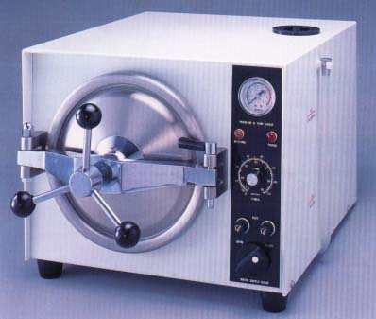
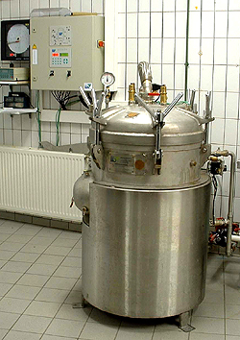
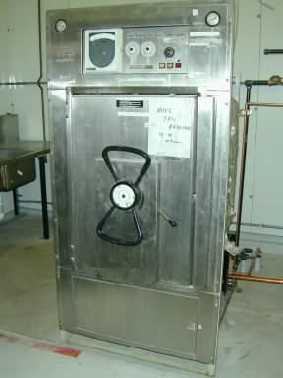
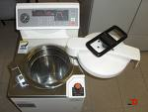
Autoclave Overview
Pressurized device that uses heat, steam and pressure to achieve sterilization or decontamination

Slide 4
Autoclave Overview
Typically operated at 121ºC (250ºF), 15 psi, for 15-45 minutes.
Allows the heating of liquids above boiling point.
Uses moist heat (steam) to increase efficiency of sterilization.
Heat is used to kill microorganisms by coagulation of essential proteins.
Autoclaves are expensive instruments! Proper training ensures that they continue to be operational and used properly with minimal issues.

Slide 5
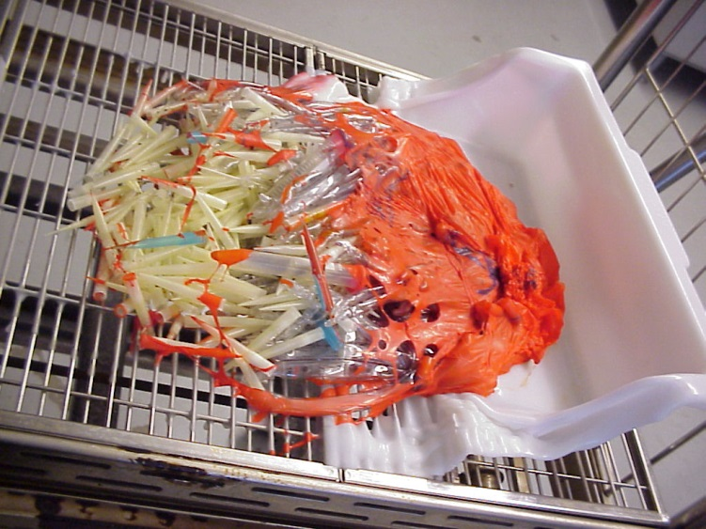
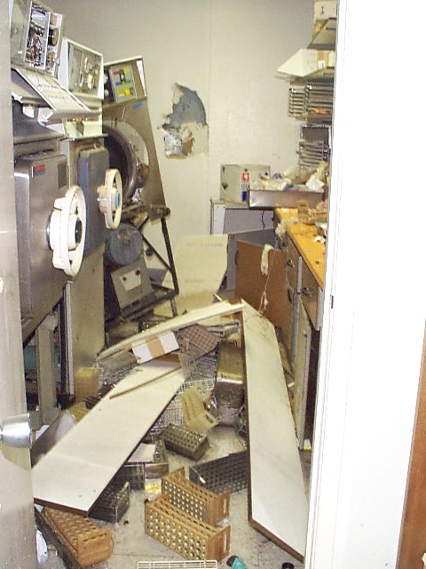
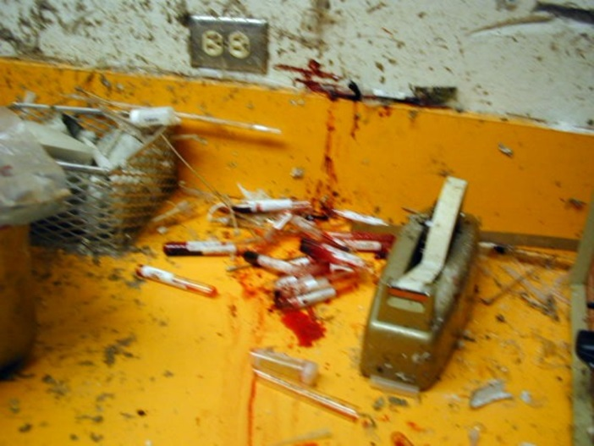
Hazards

Slide 6
Hazards
Tremendous pressure from steam in chamber provides explosive potential.
High temperatures creates potential for burns and scalding.
Potential exposure to hazardous fumes.
Inadequate decontamination allows for the potential of biological hazards to contaminate personnel and the environment.

Slide 7
What you CAN Autoclave
  Biological waste that can be autoclaved:
  Microbial stocks and cultures
  Items contaminated with such waste: petri dishes, pipette tips, pipettes, gloves, paper towel
  Autoclaving is also used for:
  Sterilization of items such as; glassware, media, buffers, etc.

Slide 8
What you CAN’T Autoclave
    Human/animal anatomical or blood waste
    Cytotoxic waste
    Sharps waste
    Radioactive waste
    Hazardous chemical waste
      Material contaminated with toxic, volatile, corrosive, or mutagenic chemicals
      Material containing solvents, chlorinated compounds (HCl, bleach)
      Chemicals (such as: phenol, trichloroacetic acid, ether, chloroform, ethidium bromide, glutaraldehyde.)

Slide 9

What you CAN’T Autoclave
SOME PLASTICS
  Poor Choices:
Polystyrene (PS), polyethylene (PE) and high-density polyethylene (HDPE) do not resist heat well.
  Good Choices:
Borosilicate glass (Pyrex) has very low thermal expansion properties and are resistant to breaking due to heat.
Polypropylene (PP) and polycarbonate (PC) are heat resistant plastics.
Stainless steel is a good heat conductor and thus facilitates sterilization.

Slide 10
Preparing your items
PRIMARY CONTAINERS
  This is the container that comes into direct contact with the contaminated or non-sterilized material or fluid.
  Do not fill more than 75% of holding capacity.
  Must NOT be a tightly sealed container – must permit heat (steam) penetration.
  Do not use polystyrene (PS), polyethylene (PE) and high density polyethylene (HDPE) (do not resist heat well).

Slide 11
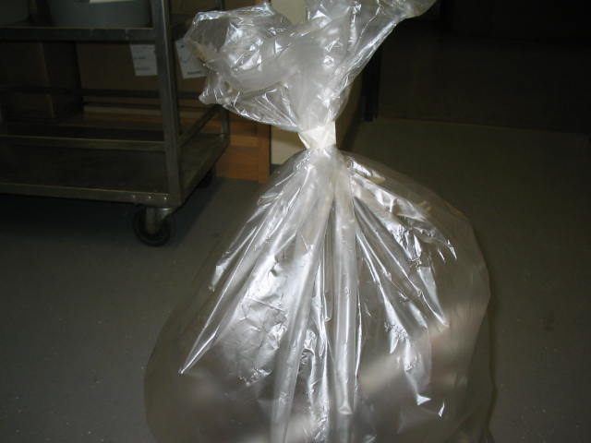
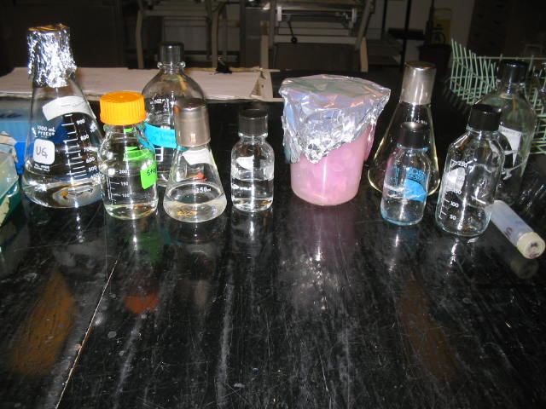
Preparing your items
PRIMARY CONTAINERS (cont’d)
    Loosen screw caps or use self venting caps.
    Cap open containers with aluminum foil or muslin.
    If using plastic waste bags, leave a small opening.
Small opening
Loosen screw caps

Slide 12
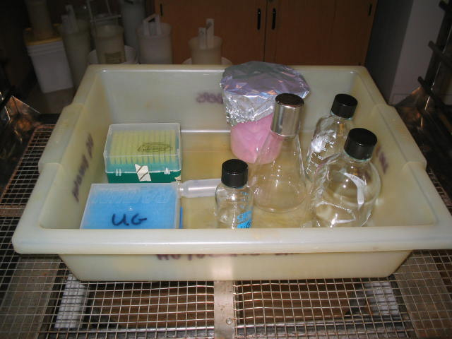
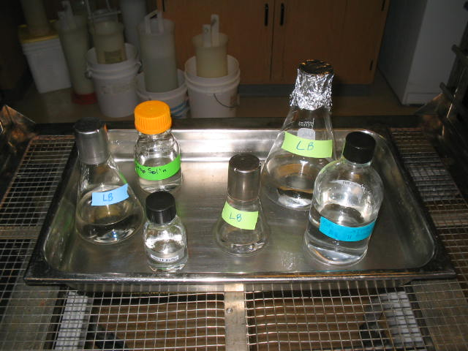
Preparing your items
SECONDARY CONTAINERS
  Used to contain any spills
  The sides of the secondary container must be sufficiently high to contain any spill that may occur
  Tray MUST be autoclave safe

Slide 13
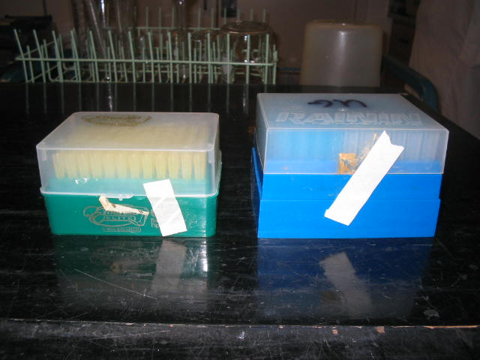
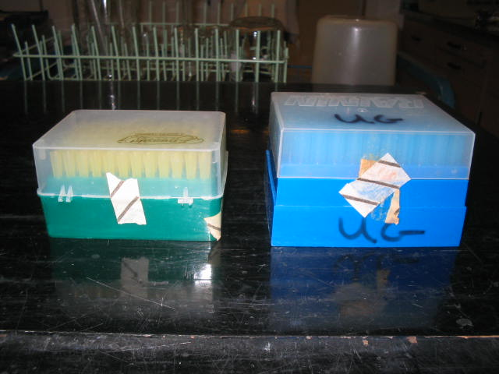
Preparing your items
TEMPERATURE SENSITIVE TAPE
  Indicates that high temperature has been achieved
  Does not prove that decontamination or sterilization was successful
  Assists in tracking autoclaved items
Before
After

Slide 14
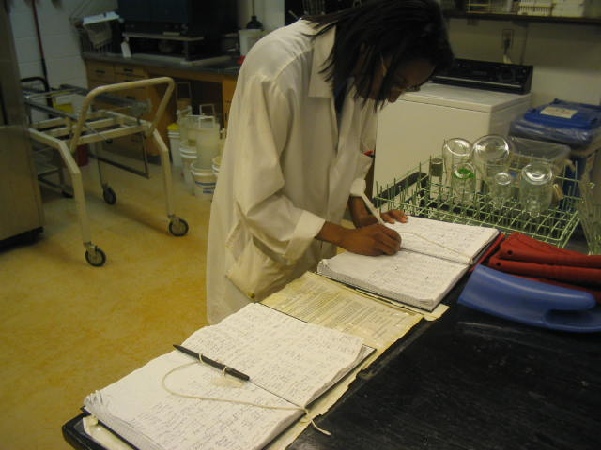
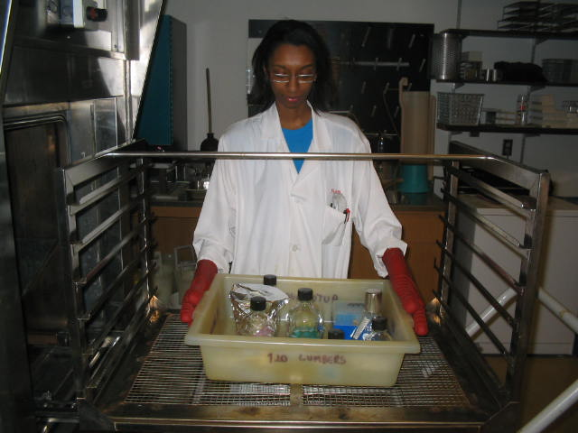
Preparing your items
Sign into log book
  Keeps track of autoclave use for maintenance records
Use personal protective equipment
  Eye protection
  Heat resistant gloves
  Lab coat
  Close-toed shoes

Slide 15
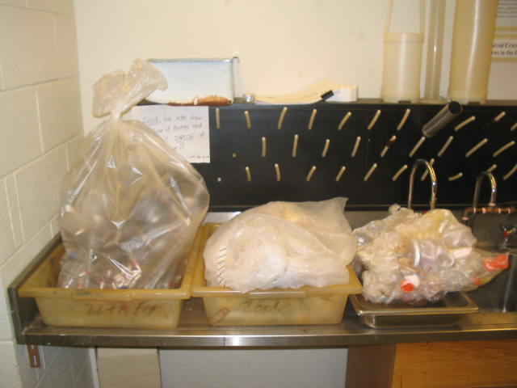
Loading
Autoclave biohazardous waste separately
Do not overload primary or secondary containers
  Allow for sufficient steam penetration
  Do not fill more than 75% to allow expansion without overflow
Autoclaved (regular)
Unautoclaved
Autoclaved (due to being compressed & sealed)
Notes:
Principle behind autoclave bag over-compression:
Expansion occurs during the high temperature cycle. If the bag is tightly sealed so steam is unable to escape, the risk of explosion may occur.
Compression occurs when the temperature begins to drop. If the bag is sealed so steam is unable to escape when the temperature drops, the steam inside cools quickly and creates a vacuum. This causes the bag to compress around the contained contents to potentially puncture and break the bag.
Take home message: Do NOT tightly seal autoclave bag – allow steam to enter and escape. Do NOT compress contents to allow bag expansion and compression as well as more steam penetration.

Slide 16
Autoclave Cycle
Username and password are lab specific.
  Do not use the username and password of another lab.
  Do not give out the username and password to non-trained personnel.
Charging autoclave takes 10 minutes – be patient.
Avoid aborting the cycle – it will take 10 minutes to go through all the cycle steps.
  If you forget to place an item in the load: just add the item to the next load to avoid tying up the autoclave.

Slide 17
Choosing a Cycle
The type of cycle depends on what is being autoclaved:
Liquid (L) | SLOW EXHAUST Controlled vacuum exhaust For autoclaving liquids Prevents liquids from boiling over
Gravity (G) and Waste (W) | FAST EXHAUST Passive exhaust Dry goods (i.e. glass/plastic ware and waste)

Slide 18
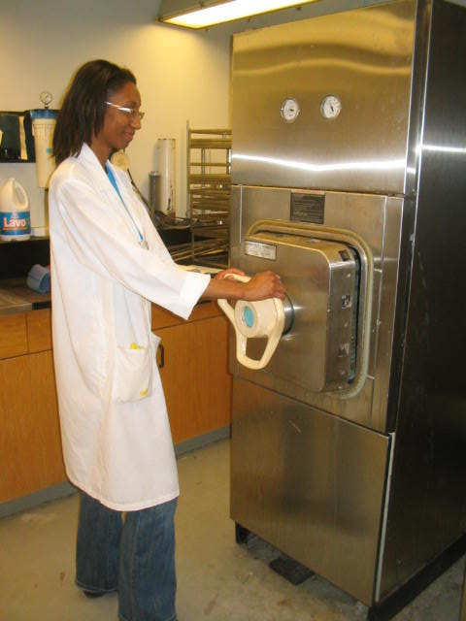
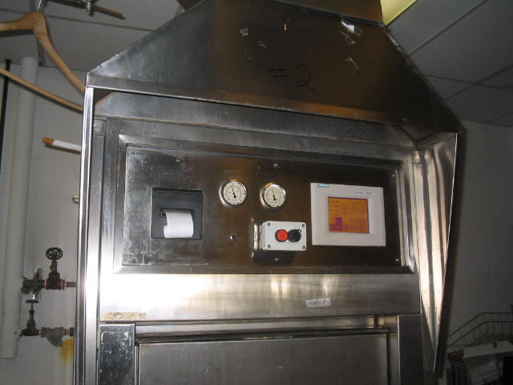
Unloading
Use PPE. Always use heat protective gloves.
Wait for autoclave to state END CYCLE before opening door.
When opening the door, stand away to avoid any residual heat and steam.

Slide 19
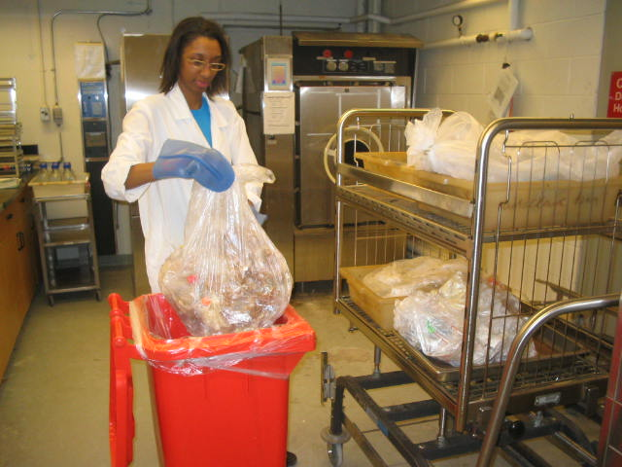
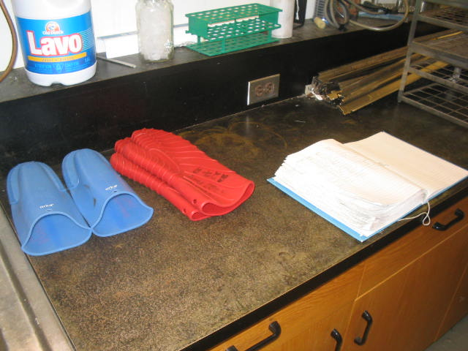
Unloading
Unmark biohazard signs from waste bags/boxes.
Dispose of waste in proper bin or location.
Please put back heat resistant gloves for other users.
Keep autoclave doors shut when not in use.

Slide 20
Autoclave Performance Indicators
How to know if autoclave is functioning correctly:
Physical | Annual testing by certified technician Pressure, Temperature, Cycle times, recorded on paper
Chemical | Heat sensitive autoclave tape changes colour at 121ºC Not an indicator of successful sterilization, useful to keep track of autoclaved and unautoclaved items
Biological | Biological Indicators test ability of autoclave to sterilize effectively Weekly tests performed by technician. Bacillus stearothermophilus spore strips often used because they are resistant to steam sterilization.

Slide 21
Emergency Response Plan
In case of emergency:
  If possible, push the emergency stop button to stop autoclave.
  Exit room immediately: if possible, ensure doors are closed.
  Follow the CORe shared emergency response plan protocols.
  In case of spill, follow the biological spill procedure. Spill kit is located inside room 219.
  Do not re-enter the room or use autoclaves unless it is cleared to do so.

