Slide 1
Education Society
Get involved with the Faculty of Education!

Slide 2
Agenda
Education Society Introduction
Events to expect
Available Positions in Education Society
Frequently Asked Questions
Chance to win some prizes!
Teacher Candidate Panel Q & A

Slide 3
What is the
Education Society?
The Education Society is a student body that represents and advocates for all students at the Faculty of Education. We act as a bridge between faculty and students to provide important and relevant information. Whether you are in Concurrent or Consecutive, teach PJ/JI/IS, or in years 1 through 5, there is always a place for you!

Slide 4
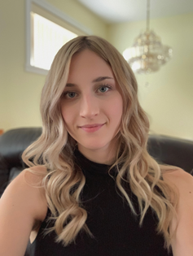
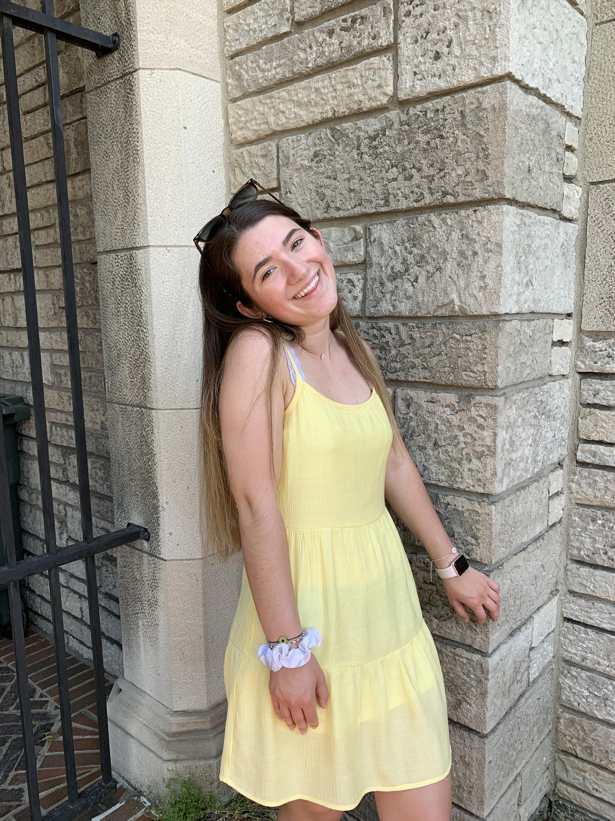
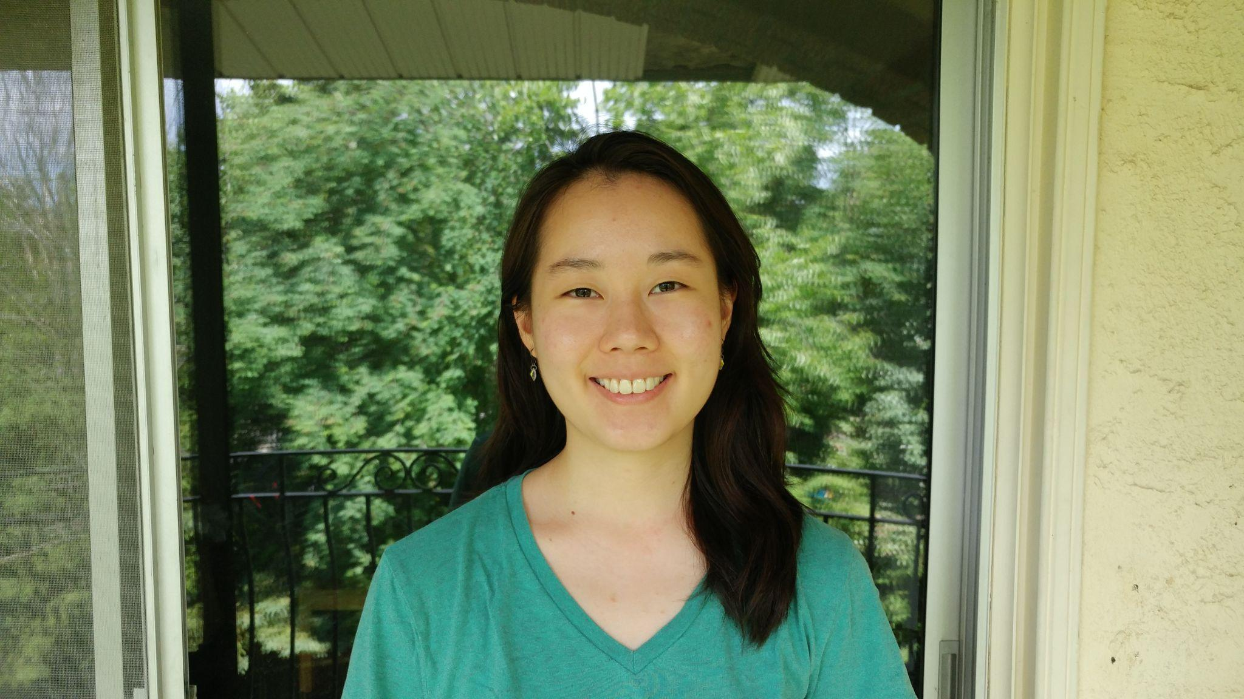
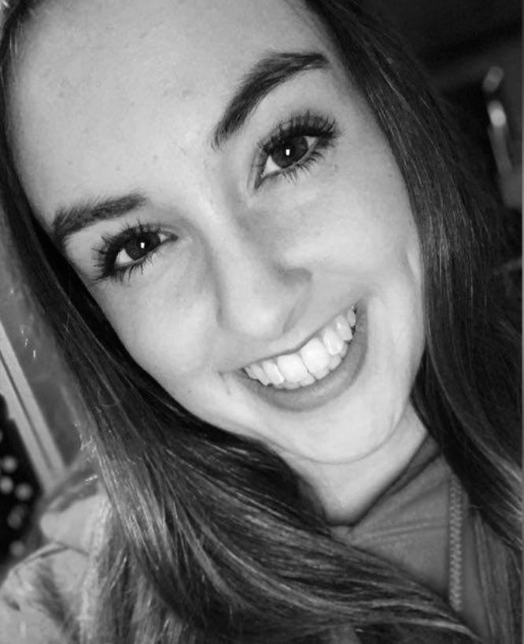
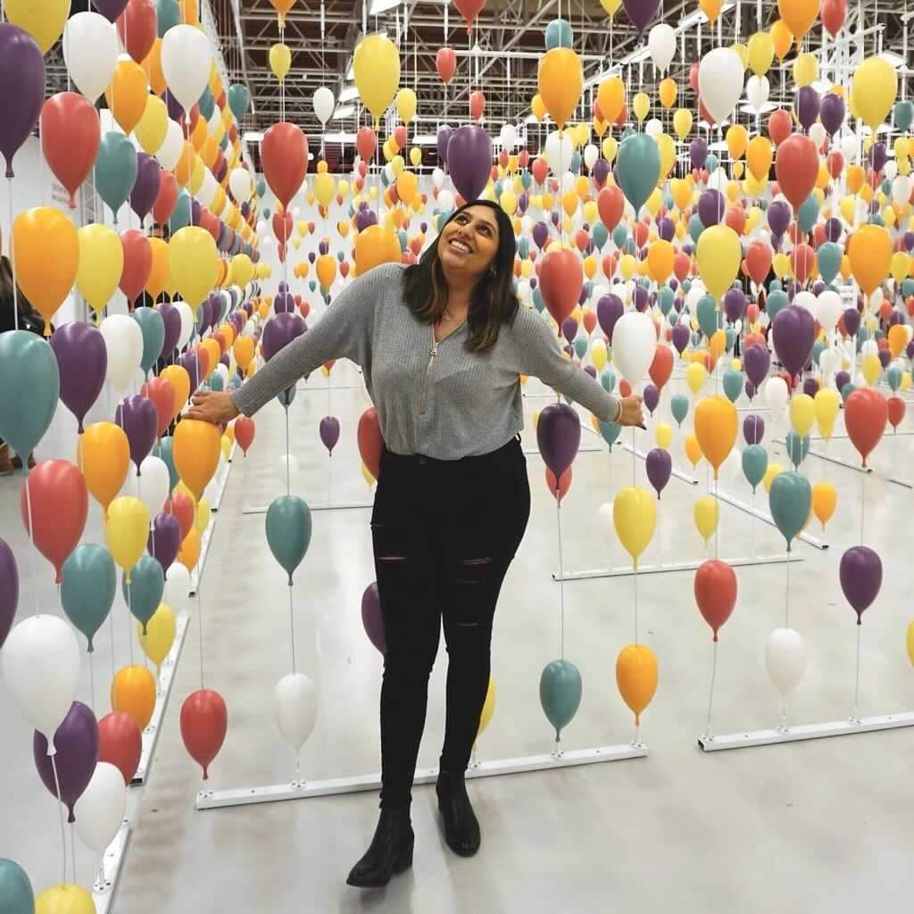
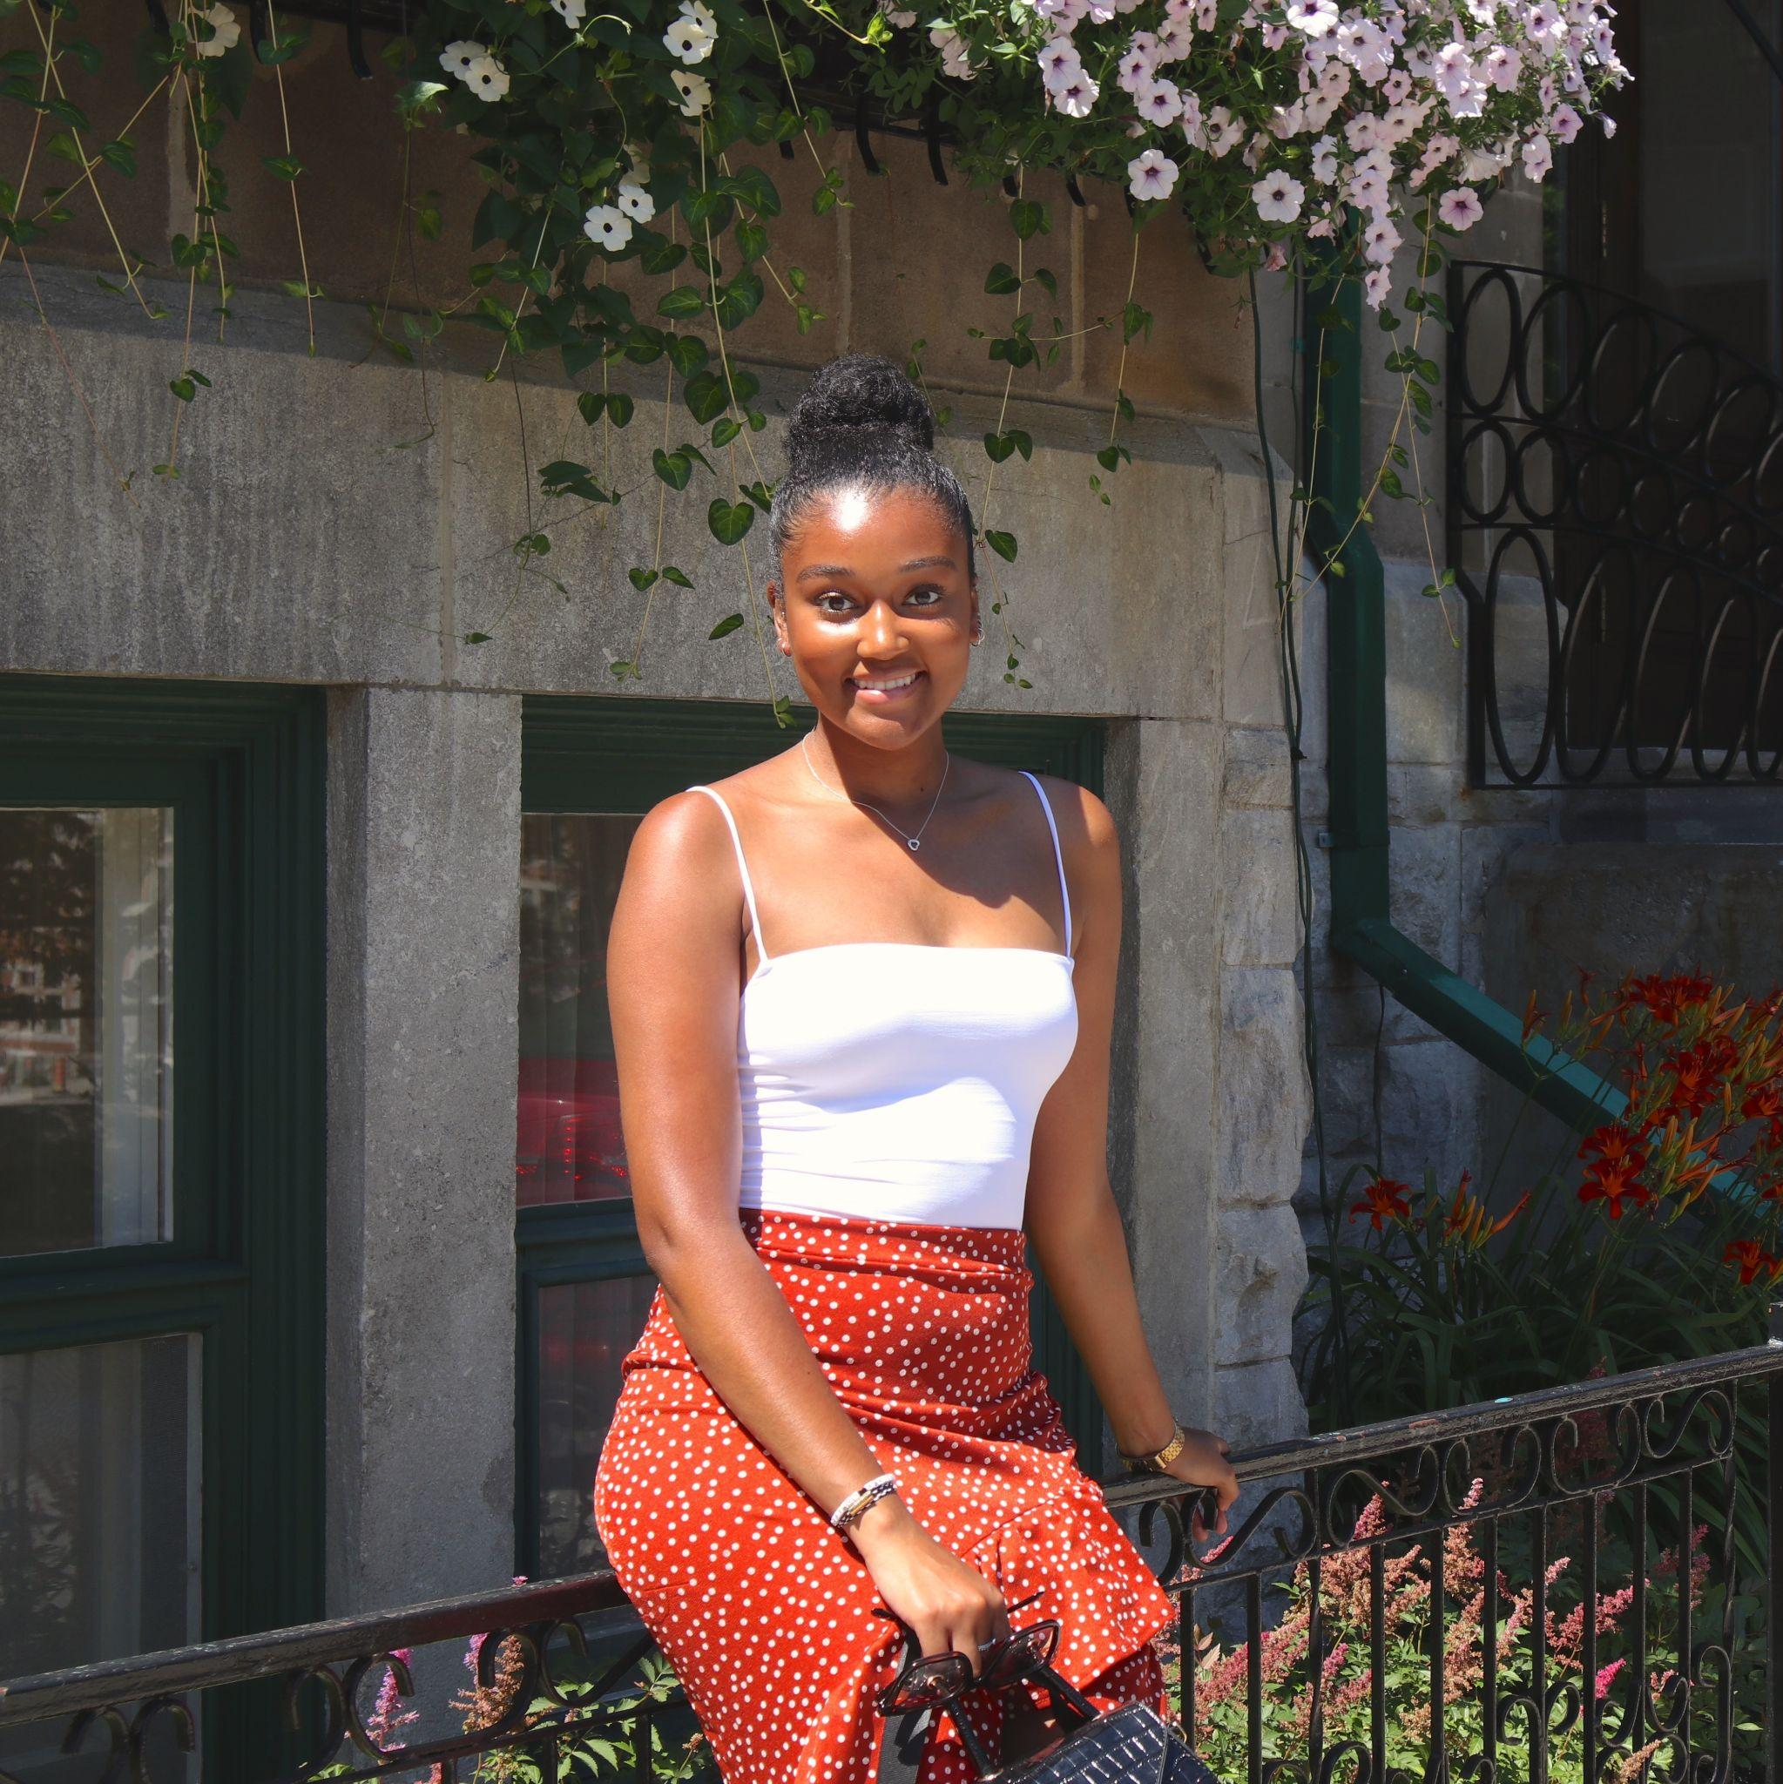
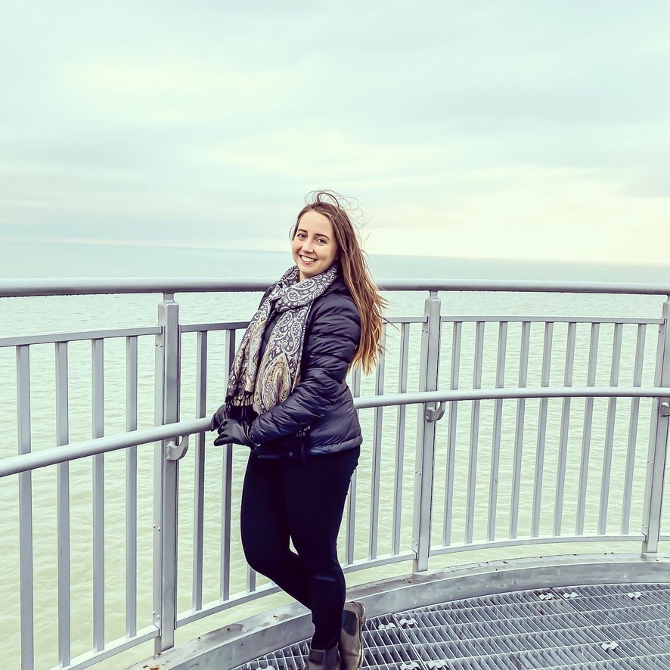
Lucie Kim
- Secretary
Elizabeth Jevdic
- Treasurer
Savannah Jovanovski
- Social Media Rep.
Mikayla Bornais & Serena Maini
- Mental Health Representatives
Shayna Brissett-Foster & Shaelynne Vanoorschot-Fowler
- Student Equity, Diversity, & Inclusion
Representatives
Notes:
J

Slide 5
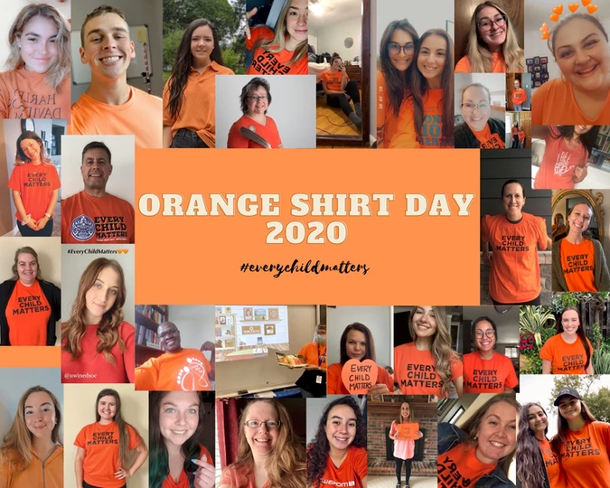
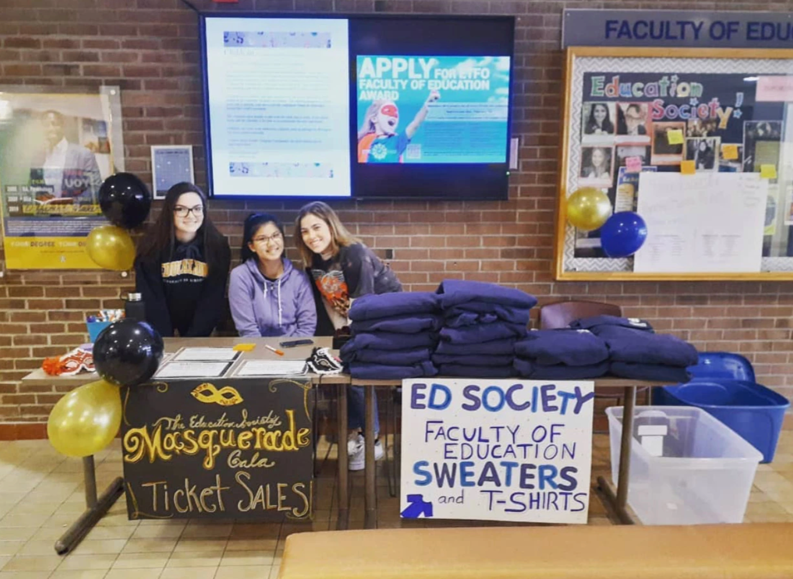
Past and Future Events
Fundraisers
Community Involvement
Orange Shirt Day (September 30!)
Social Events -- Game nights, movie nights, and paint nights!
Workshops
Notes:
J

Slide 6
How Can You Get Involved with Education Society?

Slide 7
Available Positions in the Education Society
Pre-Service Committee Positions
P/J Student Representative
I/S Student Representative
Concurrent Student Representative
Ontario Teacher Federation Representatives
ETFO
OECTA
OSSTF
Concurrent Representatives
ECE Student Representative
I/S Student Representative
Society Members
Be part in making your voice is being listened to in the faculty!
Notes:
T

Slide 8
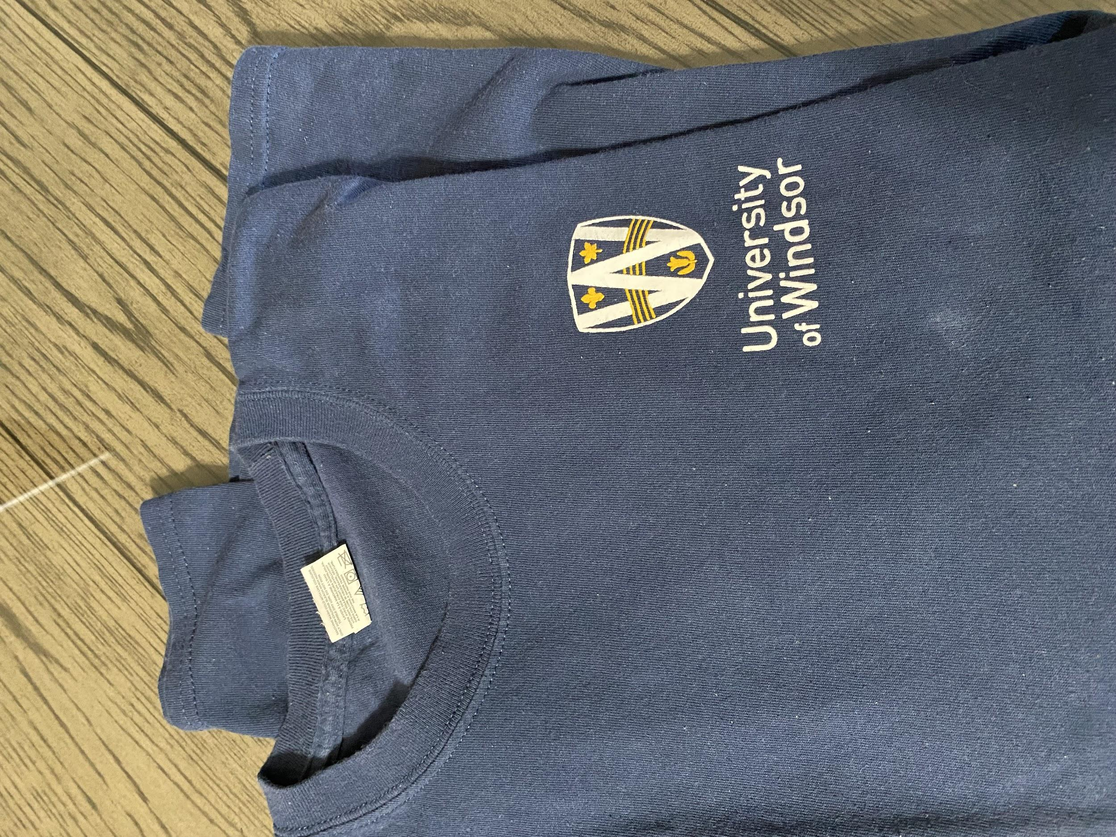
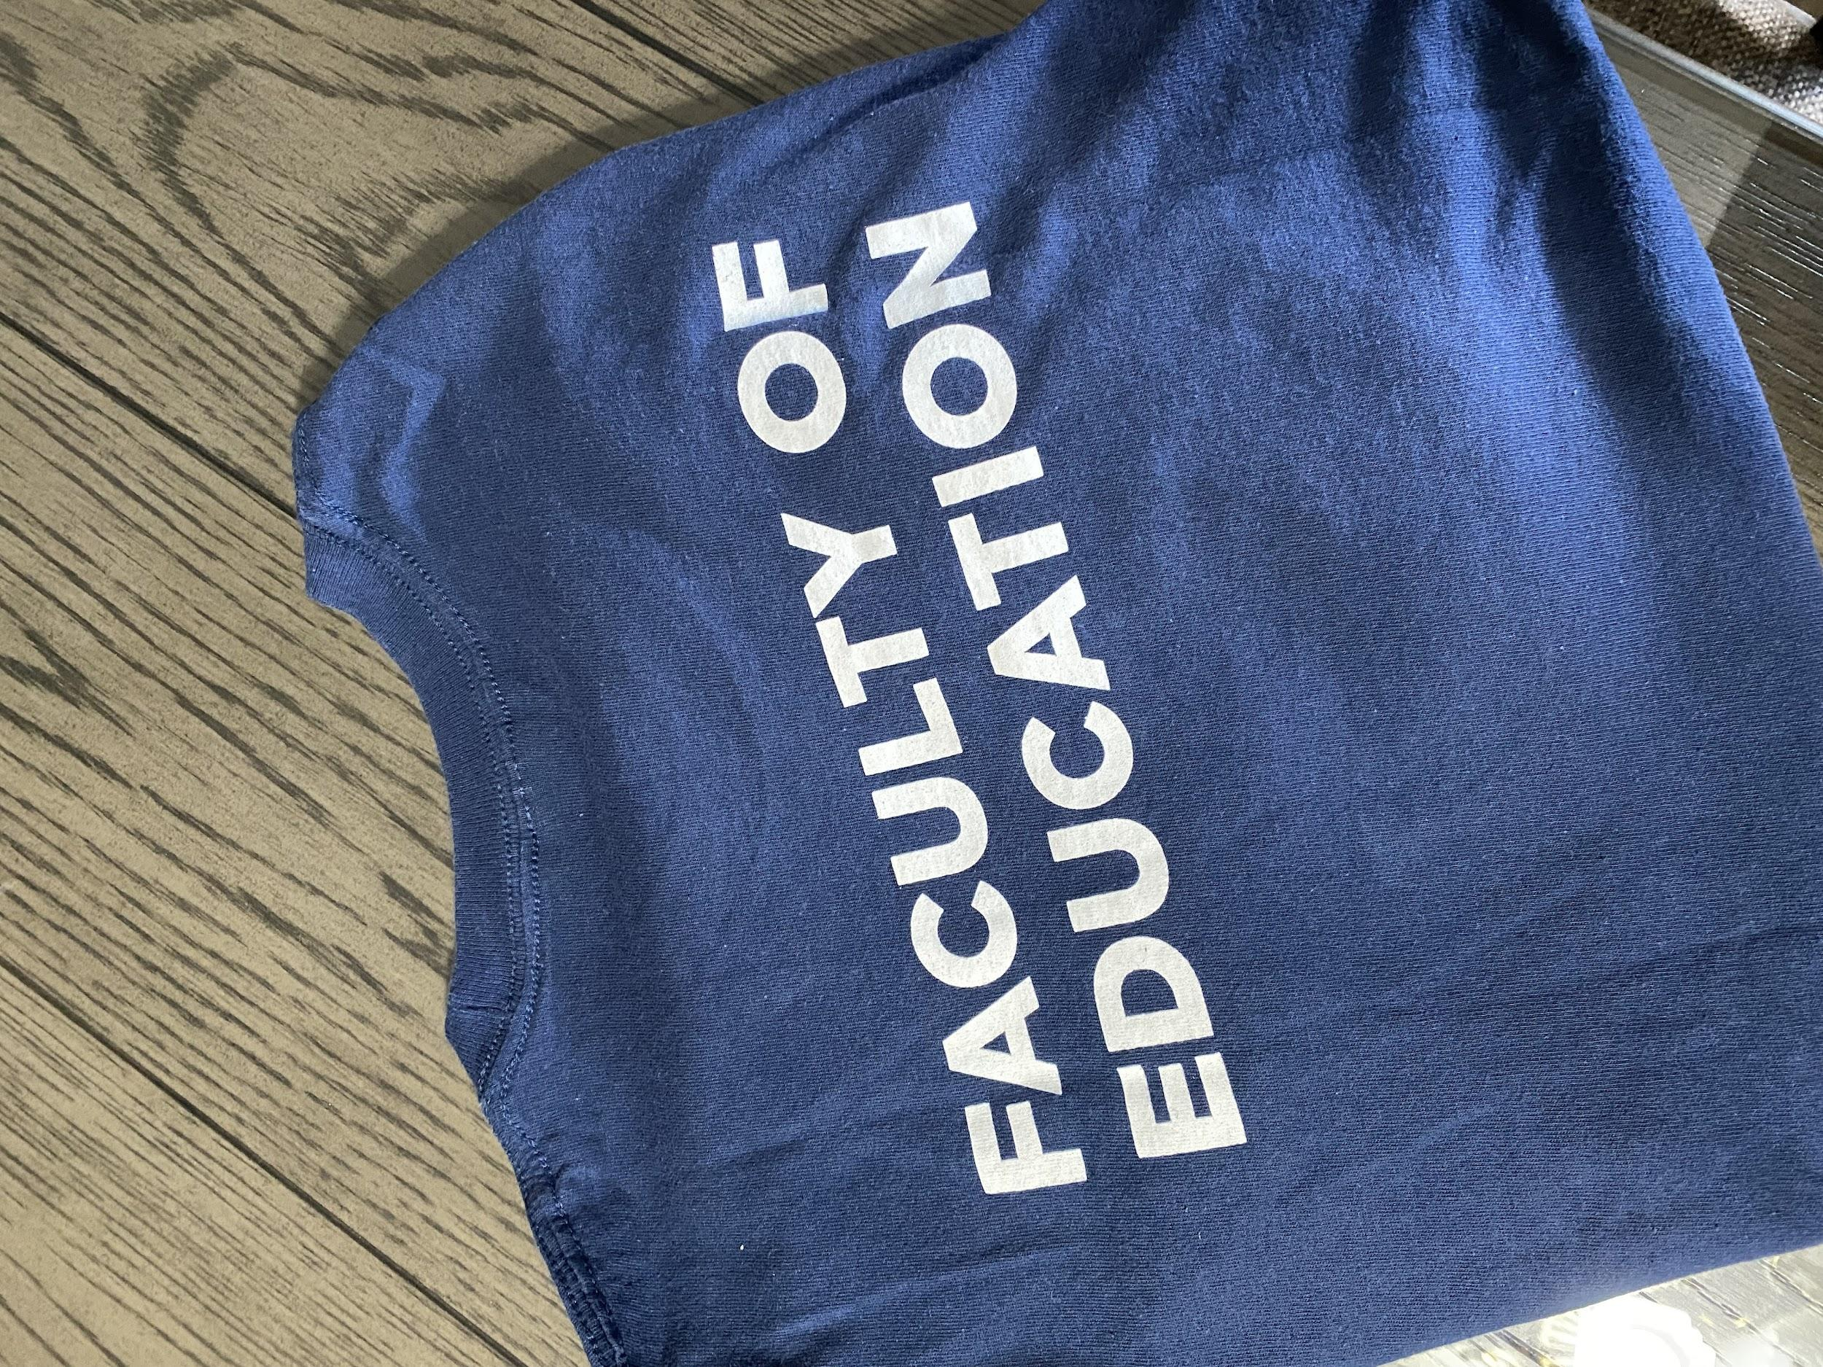
Frequently Asked Questions
Here’s your chance to win FREE Ed Soc merchandise!
Notes:
J

Slide 9
Teacher Candidate Panel
Build connections and ask questions with those who have been in your position!
Notes:
T

Slide 10
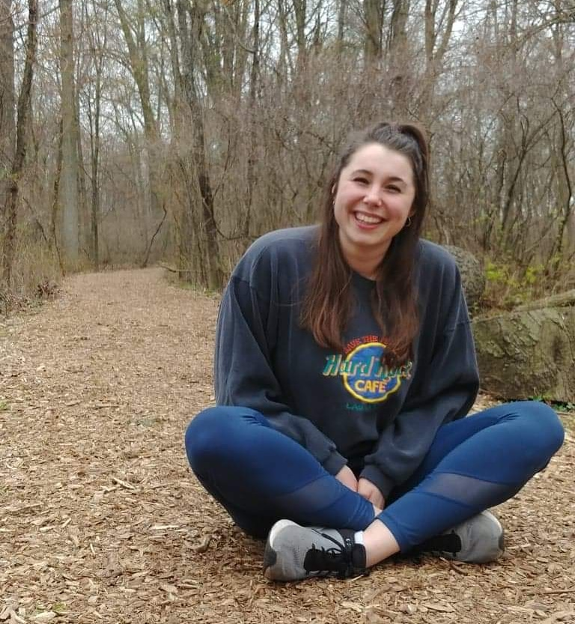
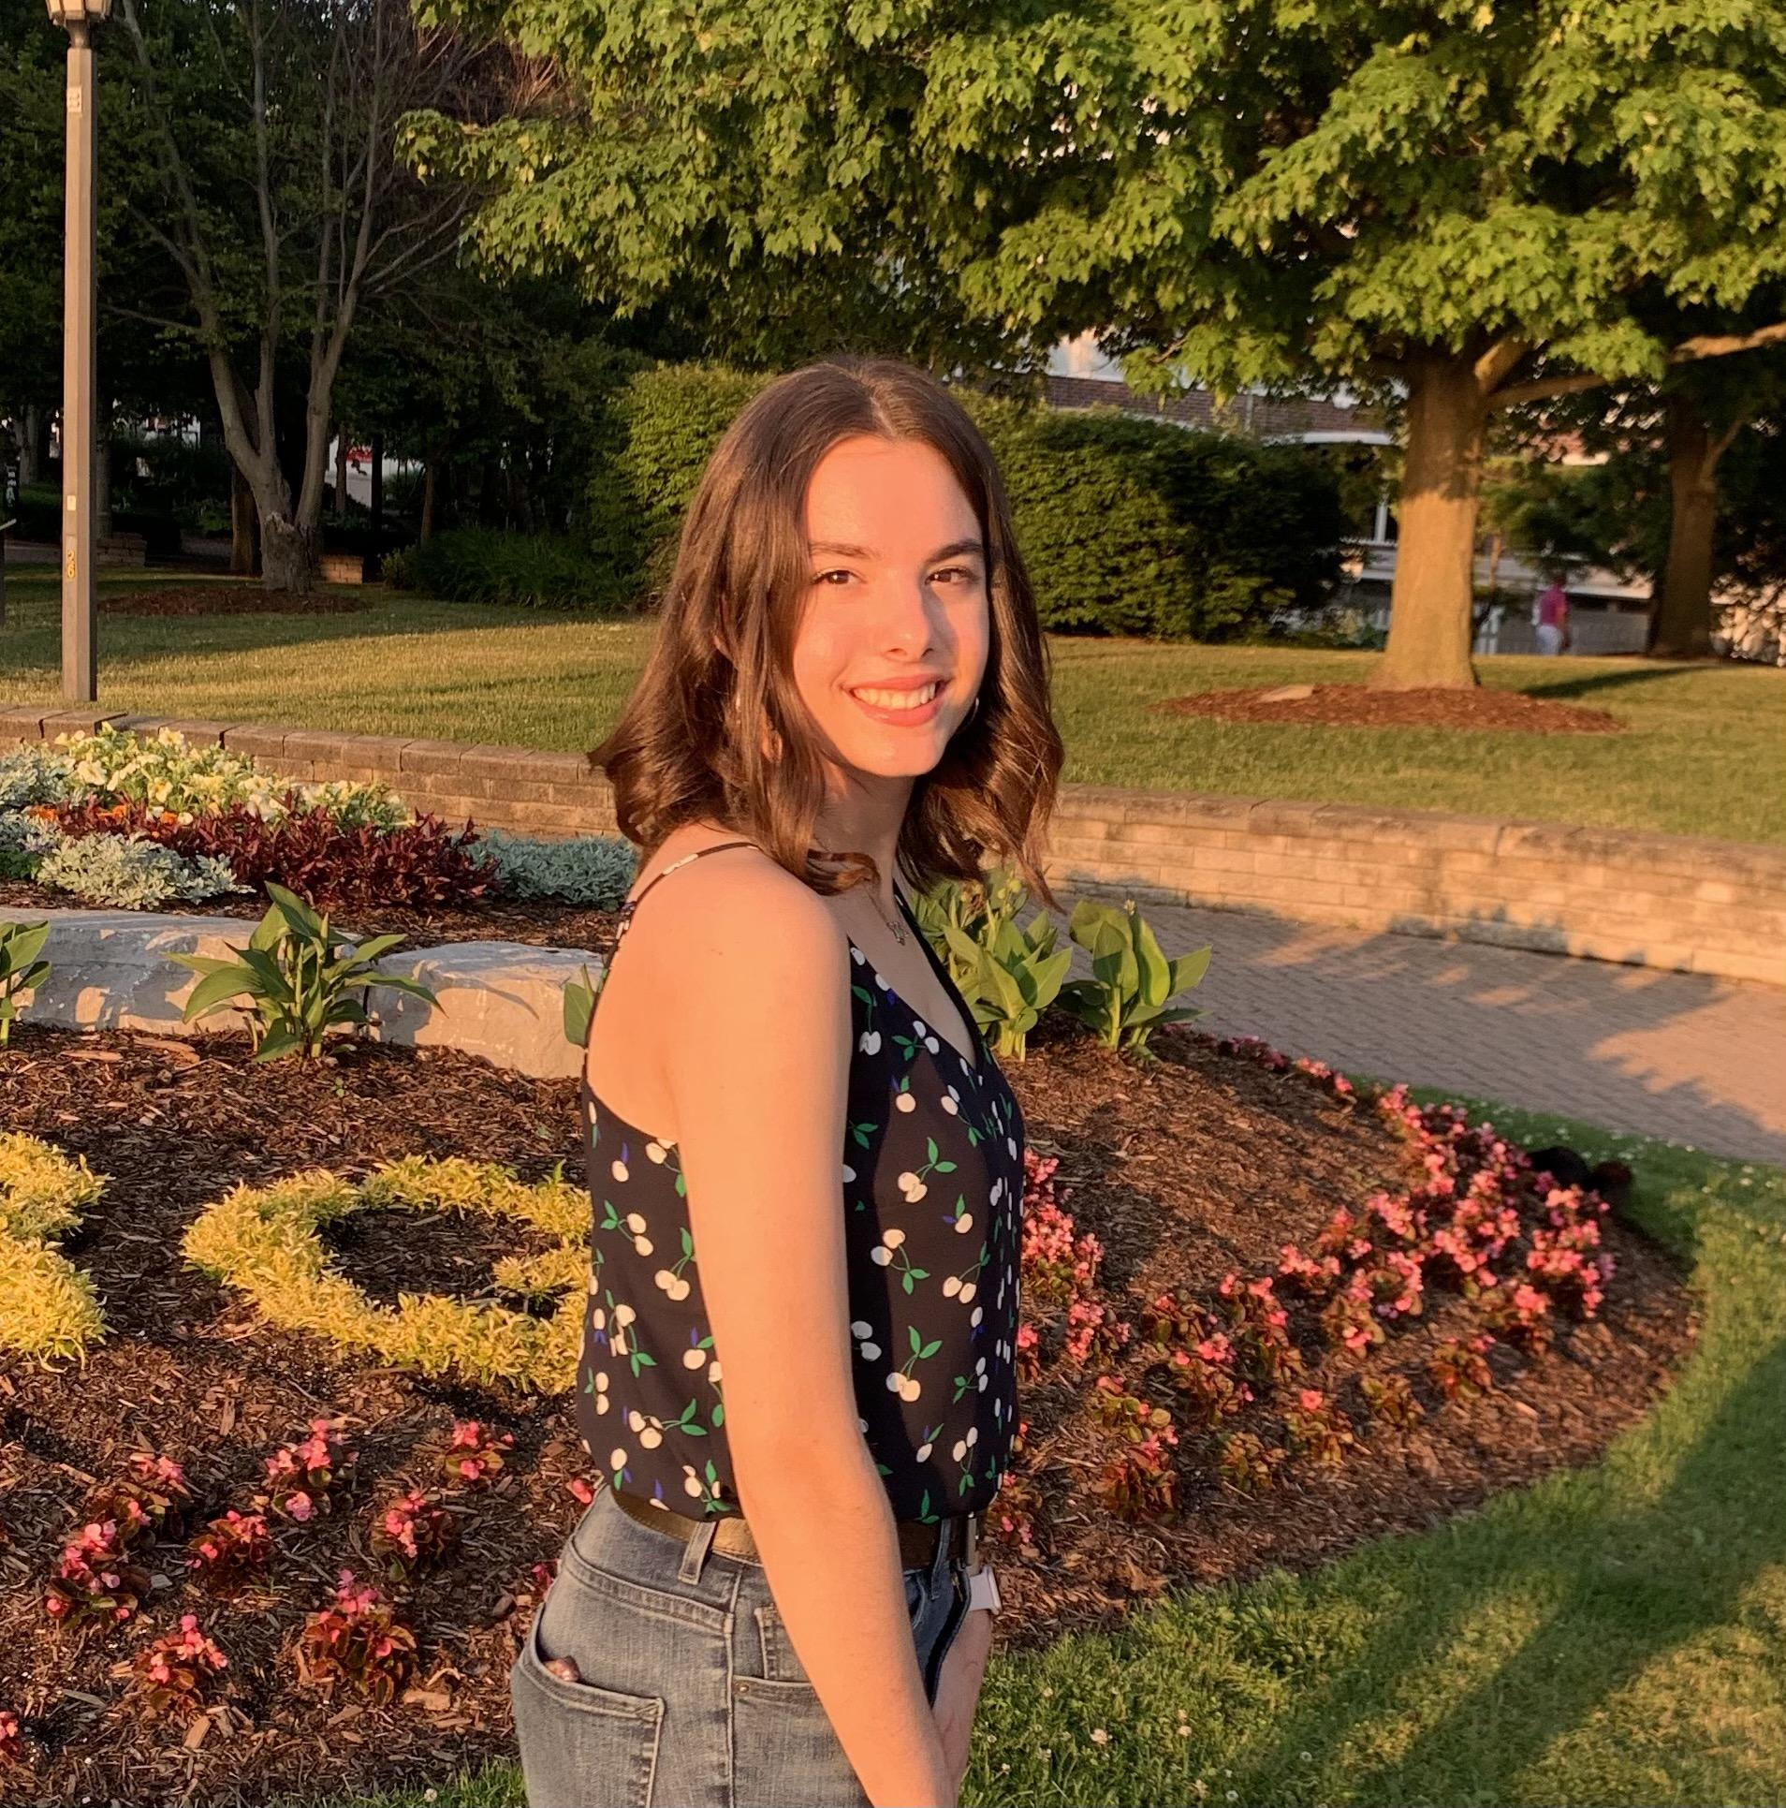
Shayna Brissett-Foster Consecutive Primary/Junior B.Ed. Candidate
Savannah Jovanovski Concurrent Primary/Junior/ECE B.Ed. Candidate
Bri Macpherson
Consecutive Junior/Intermediate
B.Ed. Candidate
Daniela Papac
Consecutive Intermediate/ Senior B.Ed. Candidate
Mikayla Bornais
Concurrent Intermediate/ Senior B.Ed. Candidate

Slide 11
Find the Education Society Online
Facebook
UWindsor Education Society
Twitter
@UWinEdSoc
Instagram
@UWinEdSoc
Email
edsociety@uwindsor.ca
Website
https://uwinedsoc.wixsite.com/edsoc
Notes:
J

Slide 12
Get Added to Our Email List!
Email
edsociety@uwindsor.ca
Theriza Veloro (President)
veloro@uwindsor.ca
Jessica Spratt (Vice President)
spratt11@uwindsor.ca
Education Society First Meeting!
Thursday, September 7th @4:00PM
via MS Teams
Notes:
T

