Slide 1

Welcome to ENGL!

Slide 2
Undergraduate Advising
Dr. Nicole Markotić
email: markotic@uwindsor.ca
phone#: 2302
office hours: Online – by appointment

Slide 3

Four-Year (Honours) Degree
40 courses (3.0 credit = 1 semester course)
20-24 in your major
16-20 in other subjects, including 7 required options/electives

Slide 4
REQUIRED (HONOURS) COURSES: * 3 1000-level courses: 1002, 1003 & 1004 * GART 1500 (but not GART 1510) * 5 (specific) 2000-level courses * 2 more ENGL courses (2000-level or up) * 8 (anything) 3000-level (or 4000-level) courses * 2 4000-level courses * 6 (area-specific) courses outside ENGL * 9 other courses outside ENGL * 4 other courses (ENGL or other)

Slide 5


Degree Programs
B.A. Honours English Language and Literature
B.A. Honours English and Creative Writing
B.A. Combined Honours
B.A./B.Ed. Concurrent

Slide 6

Important Dates:
* September 21: Last day for late registration & change of courses (add/drop date)
* Oct 4: Financial Drop Date
* October 10-14: Reading Week (study hard, but also take some time off!)
* November 16: Voluntary Withdrawal Date
* December 7: Last Day of Fall Classes
* December 10-21: Exam Period
* January 5: Winter Classes begin…

Slide 7
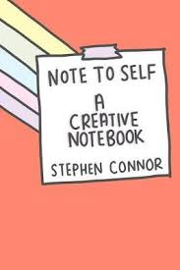
Creative Writing Classes:
Creative Writing begins in your second year, with the two-term 2710. Spend your first year reading widely, going to public readings, and visiting the WIR.
Admission to CW workshop courses is by portfolio only — for 2710, this is a 15-20 page sample of your very best work, submitted in May, right after end of first year.
Note that “ENGL 1006: Writing Creatively” counts towards the English degree but not as a CW course. It is open to any student and requires no portfolio.
Be creative… and eat cake!

Slide 8

2710 (two-semester) 3710 (one-semester, can repeat) 4710 (two-semester)
CW Courses:
Sometime in February or March, the English Department presents a seminar on “How to Apply for 2710,” as well as tips on how to prepare a portfolio, what to expect from the classes, etc. You will receive an email about this information seminar.
Some tips for how to submit a “winning” portfolio:
Go to as many readings as you can. Write NEW stuff! Try experimenting in different styles. Read contemporary writers. Meet with the Writer-in-Residence to discuss your material. READ. WRITE. READ.

Slide 9
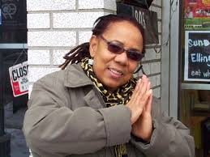
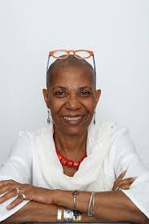
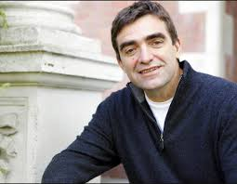
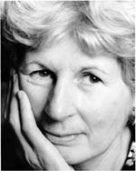
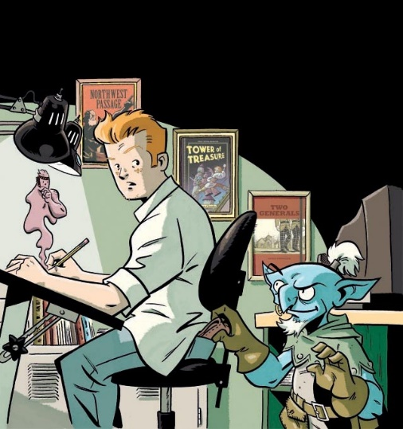
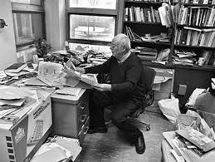
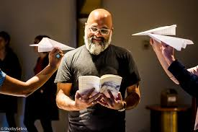
Nino Ricci
Lillian Allen
Daphne Marlatt
Past WIR authors at University of Windsor
Marlene NourbeSe Philip
Scott Chantler
Nasser Hussain
Alistair MacLeod

Slide 10
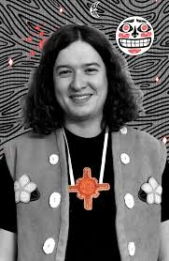

Winter 2023 WIR: Cole Pauls
Cole Pauls is a Tahltan comic artist, illustrator and printmaker hailing from Haines Junction (Yukon Territory) with a BFA in Illustration from Emily Carr University.
Pauls focuses on his two comic series, the first being Pizza Punks: a self contained comic strip about punks eating pizza, the other being Dakwäkãda Warriors.
Cole Pauls lives and writes in Vancouver. He will give readings, class visits, meet with emerging writers in one-on-one sessions, and participate in our end-of-year GALA reading.

Slide 11
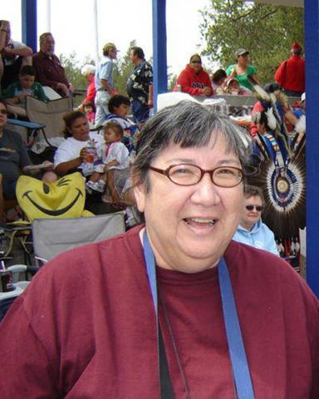
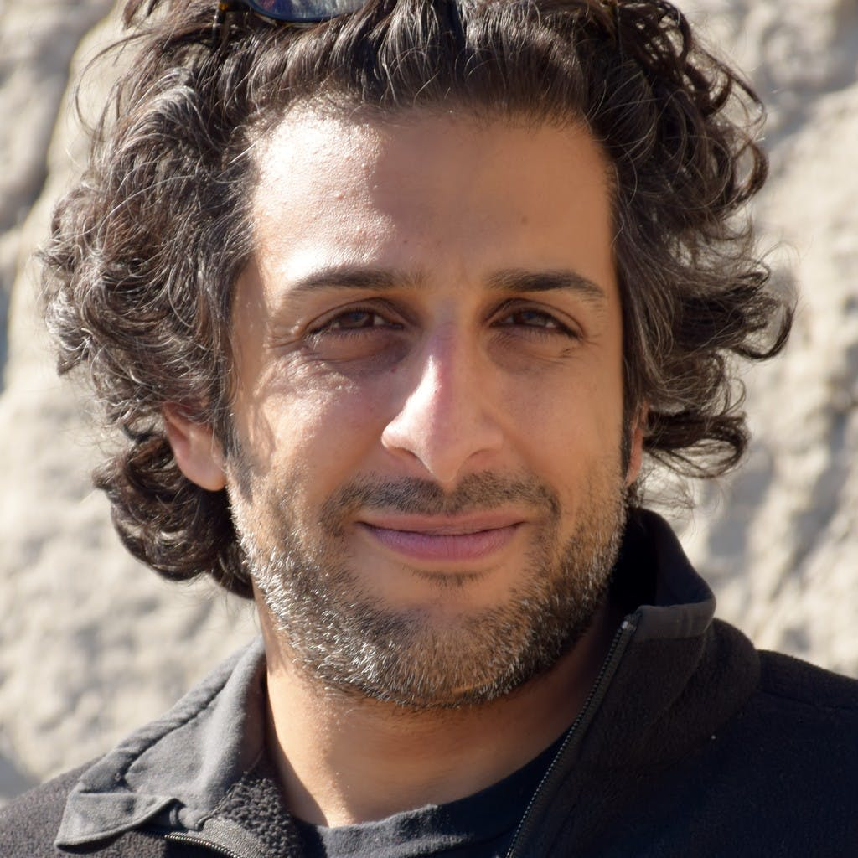
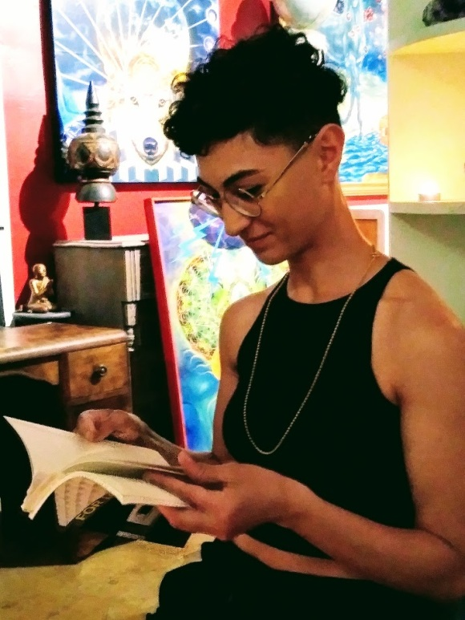
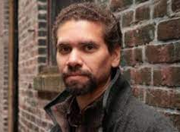
This academic year, ENGL is pleased to present FOUR writers who will give public (online) readings, talks, Q&A, or offer open, class visits:
FALL 2022
Toronto-based artist and writer Moez Surani (Reticent Bodies, 2009); Floating Life, 2012; Are the Rivers in Your Poems Real, 2019), and ةيلمع Operación Opération Operation Oперация, 2016)
WINTER 2023
Marie Annharte Baker, from Little Saskatchewan First Nation (Coyote Columbus Cafe,1994; Indigena Awry, 2013; Miskwagoode, 2022)
Anahita Jamali Rad, recently moved to Windsor from Montréal (For Love and Autonomy, 2016; Still, 2021)
Wayde Compton, from Vancouver
(The Outer Harbour, 2014; 49th Parallel Psalm, 1999; Performance Bond, 2004)

Slide 12

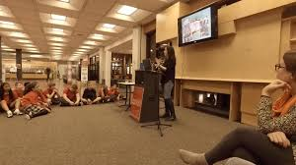
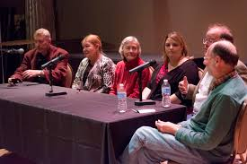
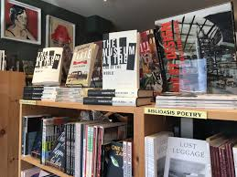

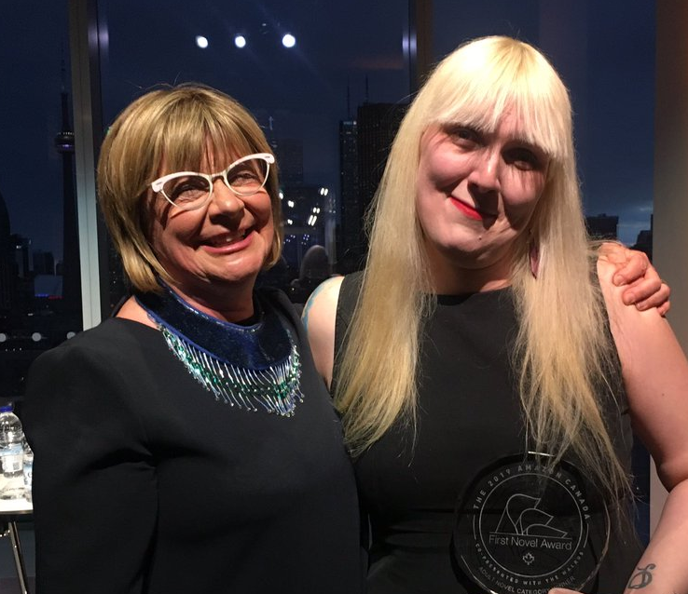
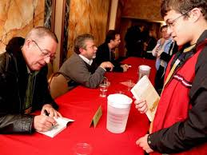
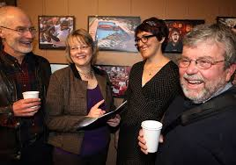
Windsor BookFest 2022 October 13-16

Slide 13
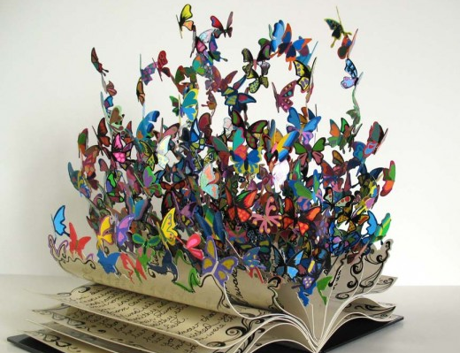
Now, take flight!

