Slide 1
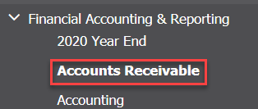
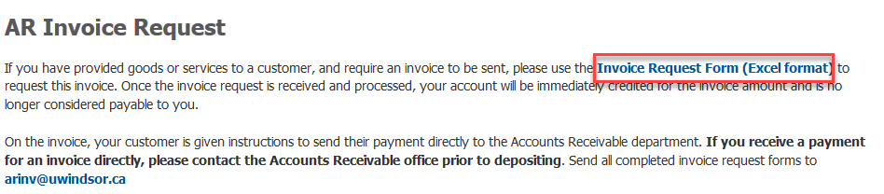
How To Request an Invoice
NOTE: ALL invoicing done for the University of Windsor must go through the Finance Accounts Receivable office. No unauthorized department should be issuing invoices without the sole permission of the Financial Controller or Senior Accountant.
From the University of Windsor, Finance Department webpage (www.uwindsor.ca/finance), click on Accounts Receivable– located in the left hand column under Financial Accounting & Reporting. Alternatively, you may go directly to http://www.uwindsor.ca/finance/cash-and-accounts-receivable.
2. On the Accounts Receivable page, scroll down until you reach the AR Invoice Request section. Click Invoice Request Form (Excel format). An excel worksheet should download
Pg. 1/5

Slide 2

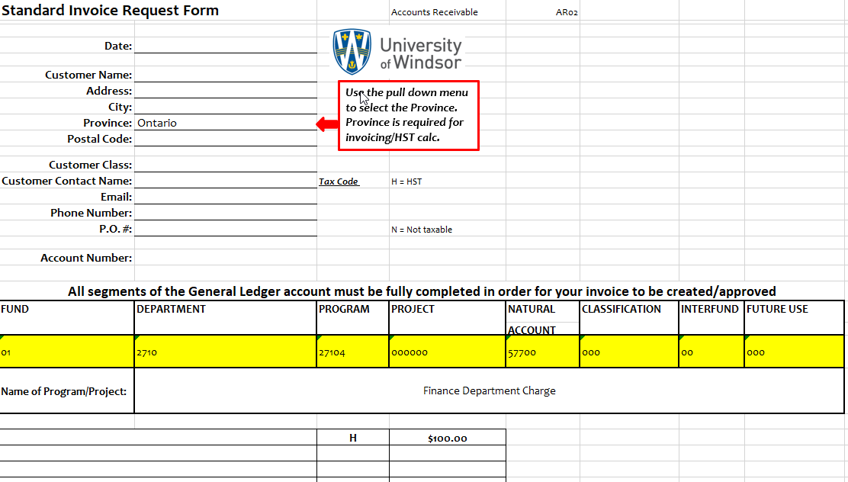
3. Click on Enable Editing in Yellow at the top of the excel workbook.
4. Fill out all available information in the request form. The items highlighted in yellow are your GL string that you want your sales to go to. Unless this is a direct reimbursement of expenses, your natural account should begin with a 5 series. Under no circumstance can your Natural account begin with a 7 or a 6. In order for the numbers to display proper, put an apostrophe ( ‘ ) before typing the number. That way the zeroes will show properly.
Ensure if your item is HST exempt you put N where the H is. If the item is taxable you may put an H on each line item. You may have as many line items on one invoice as you wish. If you want to have these line items go to different natural accounts just highlight the row underneath “Fund” and right click > Insert Row.
5. Lastly, email your completed request form to arinv@uwindsor.ca.
Pg. 2/5

Slide 3
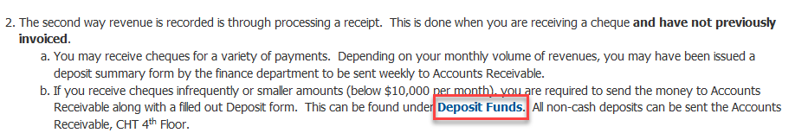
How To Process a Payment
NOTE: If you receive a payment for a previously requested invoice, please ensure these are sent directly to Accounts Receivable noting the invoice number. A Deposit form is not necessary for a payment towards an invoice already done in the system.
For all non-invoiced receipts, from the University of Windsor, Finance Department webpage (www.uwindsor.ca/finance), click on Accounts Receivable– located in the left hand column under Financial Accounting & Reporting. Alternatively, you may go directly to http://www.uwindsor.ca/finance/cash-and-accounts-receivable. There is a lot of valuable information posted on this site including our cash handling policy. Please be sure to read through all of the information on the website before proceding
2. On the Accounts Receivable page, scroll down until you see the section “Here are 4 ways Revenue is recorded:” Go to Number 2 and click on Deposit Funds. Fill out the form with all information indicated.
3. Send the completed form with your cheques to CHT 4th Floor Accounts Receivable through internal mail. If you have cash, please ensure it is in a sealed envelope and dropped in the dropbox in Chrysler Hall North outside of the Cashiers office.
Pg. 1/5

