Slide 1

UWinsite Finance | Fiscal Year End Training

Slide 2
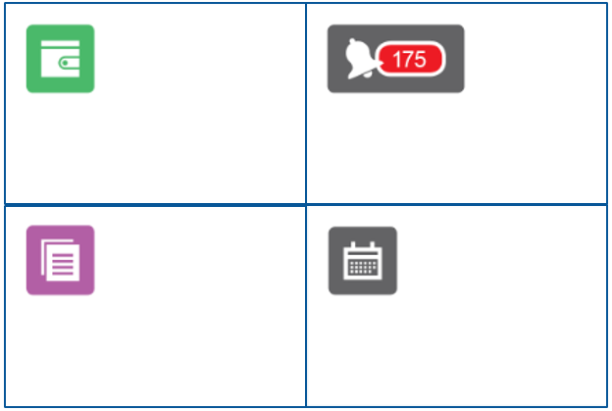
FISCAL YEAR END OVERVIEW
THE WAY TO HAVE A SUCCESSFUL YEAR END IN 2026 IS TO ENSURE REVIEWERS HAVE REVIEWED EXPENSE REPORTS, PO’S AND PAYMENT REQUESTS BEFORE THE END OF APRIL.
Submit your travel and Expense Reports for payment as soon as possible.
Approve any Expense Reports, Requisitions, and Payment Requests before April 24, 2026.
Receive any goods or services you’ve ordered in the system before April 30, 2026. There is no longer an extended date as this has caused cut-off issues in the past.
Review your April month-end statements and request adjustments before May 8, 2026.
Notes:
Jen
Good morning, everyone, and welcome to our annual Fiscal Year End Training session.
We’re thrilled to see such a great turnout again this year, and we appreciate you taking the time to join us.
Today’s session is designed to walk you through the key deadlines and requirements as we approach our April 30th fiscal year end and prepare the 2025/2026 financial statements. Following the timelines outlined in this presentation is essential to help the Finance team meet our financial reporting requirements.
As always, our Finance team is here to support you through this process and answer any questions you may have. Our goal is for today’s session to provide you with a clear understanding of what’s expected during this busy time of year, and to help make the year end process as smooth as possible for everyone involved.
We encourage you to use this time to ask questions—but to keep things running on schedule, we kindly ask that you hold your questions until the end of the presentation. We've built in time for Q&A, and any questions we don't get to can be sent to the contacts listed at the end of the slide deck. You can also submit questions in the chat throughout the presentation, and we'll address them during the Q&A portion.
Before diving in, I’d like to introduce the members of the Finance team who’ll be guiding you through today’s session:
I am Jenifer Gritke, Financial Controller. I am responsible for consolidation of all year end financials.
Your main point of contact will be Eric Gee, Senior Accountant, who will help me to oversee the process and ensure deadlines are followed. He will also help guide any questions or training needs on campus.
Paige Sowerby, our Director Financial Reporting, will guide us through any capital asset related deadlines and also manages the procurement department.
Isabel Giurdanella our Senior Accounts Payable Coordinator will provide key information on travel expense reports, invoice deadlines, and AP-related matters.
Lili Smallwood-Dragaca, representing Procurement, will speak to the purchasing card requirements and deadlines.
And finally, Dario Pavia, our Corporate Buyer, will walk you through the purchase order process, payment requests, and procurement procedures.
You’ll receive a copy of the presentation slides after the session. As a quick reminder, please mute your microphones and use the “raise hand” feature for any questions during the Q&A.
And with that, I’ll hand things over to Lili, who will kick us off with an overview of Purchasing Cards.

Slide 3


SCOTIABANK VISA PURCHASING CARD
STATEMENT CYCLE ENDS
Transactions incurred between April 16 and April 30 will be recorded in the next fiscal year's general ledger.
Keep transactions between April 16 and April 30 to a minimum.
Large purchases are to be communicated to the Procurement Department so the necessary accruals can be arranged.
APRIL
15
CENTRE SUITE COSTS DEADLINE
Any costs needed to be moved in Centre Suite for the statement cycle ending April 15, must be moved by April 23.
APRIL
23
Note: The value from a PCARD transaction, will show up in your account as the Non-Recoverable Cost of the expenditure (Cost Before Tax plus the Non-Recoverable HST of 3.41%) not what you paid. This amount expensed can also be calculated as the Total Paid (after tax amount) divided by 0.13 multiplied by 1.0341.
ADDITIONALLY: IF YOU MAKE PURCHASES THAT SHOULD BE NON-TAXABLE, SUCH AS GIFT CARDS OR GRATUITIES, PLEASE NOTIFY FINANCE BEFORE THE END OF THE MONTH IN WHICH THE PURCHASE WAS MADE.
Notes:
Lili
As a reminder, only transactions incurred between March 16 and April 15 will hit this year's budget.
Transactions incurred between April 16 and April 30 will be recorded in the next fiscal year's general ledger
Please keep transactions between April 16 and April 30 to a minimum
Any large purchases are to be communicated to the Procurement Department so the necessary accruals can be arranged.
CentreSuite Allocations Deadline is April 23rd.
Any transactions needing to be allocated in Centre Suite for the statement cycle ending April 15, must be allocated by April 23
Additionally if you make non-taxable purchases such as gift cards or gratuities, please notify finance before the end of the month in which the purchase was made.

Slide 4
SCOTIABANK VISA PURCHASING CARD
RECORD RETENTION AND APPROVAL
Year end is a great time to perform a final check that all necessary documents are retained:
- Each of your monthly statements had been reviewed and approved by your one-up
- There are no missing receipts or approvals
- The signed monthly statements, along with the receipts are retained electronically and accessible for audit purposes
ACCOUNT UPDATES FOR NEXT YEAR
Review your current allocations and submit a Team Dynamix Ticket to have a department, program, or project account removed or added to your Centre Suite allocation options.
Note: if you are not the owner of the account, ensure you have attached the PI’s or Account Owner’s approval to be added to their account
Ensure one-up’s approval is added for all other program adds
Ensure only active accounts are available to prevent incorrect charges
Submit updates early to avoid delays in the new year
Notes:
Lili
Year end is a great time to review purchasing card statements to ensure all statements have been signed and back up for all purchases has been retained
Cardholders should remain compliant with the retention and approval processes
If you normally keep paper files for your credit card backup, we encourage you to keep electronic files of their statements and all supporting documentation.
Statements are emailed to you and can be downloaded directly from CentreSuite. Most invoices come electronically for online orders. However, if you have hard copies of invoices, please make a digital copy.
Having the files electronically allows them to be easily emailed or shared with your one-up approver for monthly approvals.
The One-up approver can then provide an approval over email once they have reviewed the documents.
Please remember, once the statements are approved via email save a copy of the approval email with your credit card files for audit purposes.
If you need a department, program, or project account added to your Centre Suite allocation options, please submit a Team Dynamix Ticket

Slide 5


PURCHASE REQUISITIONS & PAYMENT REQUESTS
PR’s and Payment Requests
All Purchase Requisitions and Payment Requests should be approved on the system by the Procurement department by the end of business day to ensure budget funds are encumbered.
Purchase Requisitions approved after this date may be applied against next year’s fiscal budget.
Reach out to Buyers via email for assistance, or Book Finance Training for Procure to Pay (PO’s) or Payment Requests
APRIL
29
UWINSITE TIPS FOR SUBMITTERS
UWINSITE TIPS FOR APPROVERS
- - - - - - - - - - - - - - - - - - - - - - - - - - - - - -
- - - - - - - - - - - - - - - - - - - - - - - - - - - - - - - - - - -
Before April 29, check in the Purchase Requisitions Module to ensure all your requisitions show a Funds Status of “Approved” and a PO number is visible.
Check the Notification Bell and act on any expense reports by approving or rejecting in advance of April 29.
NOTE: PURCHASE REQUISITIONS MUST BE APPROVED FOR THEM TO APPLY AGAINST THE CURRENT YEARS BUDGET.
Notes:
Dario
Thank you Lili. Good morning everyone.
All Purchase Requisitions and Payment Requests should be approved on the system by the Procurement department no later than end of business day April 29 to ensure that budget funds are encumbered in fiscal the 2025-2026 year end. This means that Purch Reqs and Payment Requests must be submitted by the requester and approved by the approver. Please ensure you review the Pending approval link, as depending on the value the REQ may require multiple approvals requiring more time.
A Purchase Requisition must be approved, for it to apply against your current year budget. Any Purchase Requisition pending after this date may be applied against the next year’s fiscal budget.
It would also be a good idea to check in the Purchase Requisitions Module to ensure all of your requisitions show a Funds Status of “Approved” rather than pending approval.
If you are approver of payment request or purchase requisition: Please make sure you are Checking your Notification Bell and act on any requisitions, by approving or rejecting them, in advance of April 29.
We also want to take some time to clarify what will occur from after the April 29th deadline and onward, for common situations related to Requisitions, Payment Request and Invoices: Paige will now speak a bit about invoice deadlines and accounting requirements.
PAIGE: Thanks Dario
For example: Your Requisition or Payment request was on the system prior to May 1, but you have not yet “received” it (on the system) or sent the invoice to AP (apinvoices@uwindsor.ca).
If the goods/services were physically received or provided to you in the 2025/26 fiscal year, please “receive” them with an effective date of April 30th or earlier. Regardless of when you send in the invoice for payment, your invoice will applied against the 2025/26 budget and the expense will be properly reflected in our audited financial statements. It is ALL of our responsibilities to ensure an invoice is recorded in the proper fiscal year, regardless of the budget. An expense incurred, that is, a service received or product received on or before April 30th must be reflected in the financial statements as at April 30th even if we do not have the actual invoice yet.
What to do with Payment Requests/Invoices Before May 12th:
For example, You have an invoice related to 2025/26 fiscal year in hand. No Payment Request was on the system before April 30th related to this invoice (meaning you missed the cut off date).
Please go about the normal process (create a Payment Request, “receive” the payment request, and email the invoice to apinvoices@uwindsor.ca). Unfortunately, the system will not allow you to “receive” the invoice with a date earlier than the date the Payment Request was created, so the invoice will not be automatically applied to 2025/26.
However, until we close AP for the year on May 12th, we will review all invoices sent to apinvoices@uwindsor.ca and, regardless of when they were “received”, AP will change the GL date to the 2025/26 fiscal year if the goods/services relate to this fiscal year. Please help us by writing on the invoice that it applies to the 2025/26 fiscal year. Finance will review and will apply to the correct fiscal period based on accounting standards only.
Accounts Payable will close for fiscal 25/26 on May 12th.
The next scenario is what to do with Payment Requests/Invoices AFTER May 12
For example, you have an invoice related to the 2025/26 fiscal year in hand OR you are aware of a service rendered/product received on or before April 30th in which you have not yet been invoiced. No Payment Request or Purchase Requisition was on the system before April 30th related to this invoice (meaning you missed the cut off date).
After May 12th , invoices cannot be applied to 2025/26 without a manual accrual done by the Finance team. If the invoice relates to a Capital or Repair project, please inform myself, Paige Sowerby immediately with a copy of your invoice.
If the invoice relates to any other type of account (operating, trust, research grant), please email Eric Gee, Senior Accountant with a copy of your invoice, if it is over $10,000.
All of these invoices will be reviewed on a case by case basis for manual accrual.
This should be a rare situation but if A Purchase Requisition was submitted before April 30th, but it was rejected because of errors/issues. But you require the requisition to be applied to the 2025/26 fiscal budget
Please work our Procurement team directly (Rita or Dario) to get a requisition issued. We cannot back date requisitions, but we commit to working with the Budget office to ensure that the funds required are carried forward to 2025/26.
I will now pass the presentation back to Dario to discussing receiving on PO’s.

Slide 6
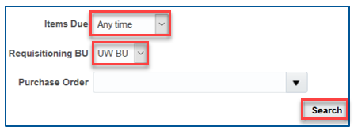
RECEIVING GOODS & SERVICES
Please review your “My Receipts” space on the system to ensure that you receive anything you have physically received before the year-end deadline.
When receiving the goods or services, please ensure that you choose a Transaction Date of April 30th. if the goods or services were actually supplied on or before April 30th.
APRIL
30
UWINSITE TIP
- - - - - - - - - - - - - - - - - - - - - - - - - - - - - - - - - - - - - - - - - - - - - - - - - - - - - - - - - - - - - - - -
1. From the Home Screen, click on My Receipts.
2. Set Items Due to Any Time.
3. Set Requisitioning BU to UW BU.
4. Click Search to see anything outstanding for receiving in your account.
Notes:
Dario
As with Requestions, it is recommended you review your open receipts. For invoices to be applied against purchase orders and payment requests, it is critical that goods and services be received in the system (click “My Receipts”) before end of business day April 30. This would only apply to goods and services actually received and approved.

Slide 7
PURCHASE ORDERS
BLANKET PURCHASE ORDERS
All Blanket Purchase Orders for fiscal 2025/2026 will be closed.
If departments wish to have new blanket PO’s issued, they should initiate these by submitting a Purchase Requisition in May 2026.
APRIL
30
REGULAR PURCHASE ORDERS
Any amounts still open (meaning not yet “received” in the system) on Regular Purchase Orders, after the Accounts Payable cut-off date of April 30th, will remain open on the system as of April 30th, 2026 and carried forward to the next fiscal year.
The budget dollars will also be carried over to next year for that commitment.
APRIL
30
MAY
01
Notes:
Dario
If you are one of the users on campus that utilizes blanket purchase orders, these orders will close as at April 30th and a new blankets can submitted in May of 2026 if required.
For the vast majority of users, regular PO’s also have a cut-off of April 30th. If an order remains open because the goods or services have not yet been received, they will automatically carry forward into budget year 26/27 as a commitment.
Thank you for your time and I will now turn this over to my colleague Isabel to discuss how your invoices will be paid by Accounts Payable.

Slide 8
PAYMENT RUN SCHEDULE
PAYMENT RUNS
Cheques are run 1st week of each month
EFT and ACH (USD payments) are biweekly
Payment terms are net 30- net 60
RA Scholarships, EFT Expenses & VPA (VISA Payable Automation) are run weekly
Suppliers enrolled in VPA have the advantage of getting paid timelier
Suppliers interested in enrollment please contact apinvoices@uwindsor.ca
EFT Expenses refer to employee expense claims
Please contact any suppliers you are expecting invoices from and have them email invoices to apinvoices@uwindsor.ca. This will ensure that the invoice is received by Accounts Payable and processed before May 12th, 2026.
Our Payment Calendar can always be referenced for up-to-date dates of when payment runs will commence. NOTE: These dates refer to when the payment run process starts and not necessarily the date it is loaded in the bank. Our payment runs go through a thorough audit process as well as compliance on higher level approvals before their final release of payment. They typically take from 1-5 business days to complete depending on the volume and complexity of the payment run.
Notes:
Isabel – Thank you Dario.
After your invoices are sent to A/P and recorded, we now have the duty of physically paying those invoices.
Over the years, we have adapted to changing trends as well as ensured we are utilizing best efforts for cash management practices. In doing so, our payment run schedules have changed over time.
Payment runs by cheque are occurring once per month whereas EFT and ACH (USD payments) payments are biweekly, and EFT Expenses, RA Scholarships Visa Payables Automations (VPA) payments are weekly. With VPA, suppliers who choose to opt in will receive a credit card account and an email notification for each payment informing them of the amount to process using their Point-of-Sale device or software.
Suppliers have the advantage of getting paid timelier. If any suppliers are interested in enrollment, please contact AP.
We are happy to advise that we have improved the employee expense claim payment run process by adding an additional EFT run that captures EFT Expenses on a biweekly basis, opposite the regular EFT schedule of biweekly. This means that expense claims are now being processed on a weekly basis by either the regular EFT biweekly run or the EFT Expenses run specifically. This allows for more timely expense claim reimbursements.
NOTE: Expense reimbursement timeliness highly depends on the accuracy and compliance of the claimant to ensure all proper documentation is provided when submitting their expense claims. Additional information is provided on the next slide.

Slide 9

TRAVEL EXPENSE CLAIMS & NON-TRAVEL EXPENSE REIMBURSEMENTS
REIMBURSEMENTS VIA EXPENSES MODULE
All travel and non-travel reimbursements pertaining to the current fiscal year should be submitted and approved at both approval levels - one up approval and budget owner approval - before end of business.
Expense reports not approved by this date may be charged against next year’s budget.
APRIL
24
TRAVEL ADVANCES
Travel advances that apply to travel that would have occurred before the University’s fiscal year end must be settled by the claimant before April 24th, 2026.
Unused travel advances related to travel that has been cancelled or postponed should be settled with the University as soon as possible.
Further details on how to handle cancelled travel and travel advances can be found on the Finance website.
UWINSITE TIPS FOR SUBMITTERS
UWINSITE TIPS FOR APPROVERS
- - - - - - - - - - - - - - - - - - - - - - - - - - - - - -
- - - - - - - - - - - - - - - - - - - - - - - - - - - - - - - - - - -
Before April 24th, check the Expenses Module (Green Wallet) to ensure any open reports are showing a status of “Pending Expense Auditor Approval”.
Check the Notification Bell and act on any expense reports by approving or rejecting them in advance of April 30th.
Notes:
Isabel
All travel expenses and non-travel reports pertaining to the current fiscal year should be submitted and approved before end of business April 24th. Remember that some of you have two levels of approval before an expense report is formally APPROVED, including One-up approval and also the Budget owner approval, so the process may take longer.
Any expense reports not approved by April 24 may be charged against the next year’s budget.
Just a reminder, if you are a submitter of the expense reports please make sure that Before April 24, you check in the Expenses Module (Green Wallet) to ensure any open reports are showing a status of “Pending Expense Auditor Approval.” (this status means that they have been approved by your one-up and have made their way to Accounts Payable for their final review and processing.
Just a reminder, if you are an approver of the expense reports please make sure that you are Checking your Notification Bell and act on any expense reports by approving or rejecting in advance of April 24.
Travel Advances:
Travel advances that apply to travel dates that would have occurred before the University’s fiscal year end, must be settled by the claimant before April 30, 2026. Settled means that an expense report for the travel expenses is submitted to clear the travel advance.
If you had travel booked that was cancelled, any unused travel advances related to this travel should be settled with the University as soon as possible, and before April 30, 2026 if the travel was to have occurred before year end.
For example, If you applied for a travel advance from Accounts Payable to pay for a flight and conference fee, and the conference has now been cancelled and you received a refund in cash from your Travel Provider for the flight and conference fee, you will be required to refund the University these funds in order to settle the travel advance outstanding. To do this you can simply issue a cheque to the University for the amount of the advance received. Send the cheque to the University of Windsor, ATTN Accounts Receivable (note: please include the Travel Advance Expense Report number on the memo line of the cheque). Once received Accounts Payable will ensure that your cheque is applied to the correct travel advance and that the Travel Advance is settled. Etransfer is also available for refund.

Slide 10
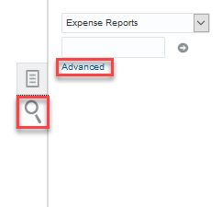
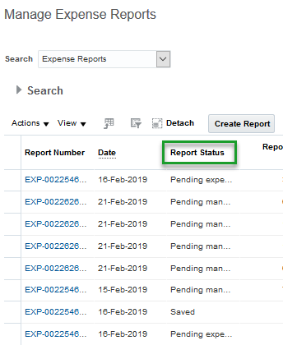
TRAVEL EXPENSE CLAIMS & NON-TRAVEL EXPENSE REIMBURSEMENTS
Link for Booking a Training Session
Book Finance Training
To see an inventory of all of your Expense Reports in any status (Saved, Submitted, Approved, Pending):
From the Home Screen, click on Expenses.
In Expenses Module, click the Magnifying Glass.
Click Advanced.
Manage Expense Reports page will be displayed.
NOTE: IF SOMEONE HAS DELEGATED TO YOU, YOU CAN DO THIS FOR THEM AS WELL. ENSURE YOU CHOOSE THEIR NAME FROM YOUR DROP-DOWN MENU BEFORE CLICKING THE MAGNIFYING GLASS.
Notes:
Isabel
This slide just shows you how to look up the status of your submitted expense reports. Finance is now offering in person or online expense claim or travel advance training. The booking link is shown on the slides. They can be individual or group sessions. We ask that each individual attending uses the booking link to book the time so it is known who will be in attendance.
Thank you for listening and I’m always available to help through our booking portal. I will now move the presentation to Eric Gee, Senior Accountant, who will discuss Accounts Receivable and General Accounting related topics.

Slide 11
ACCOUNTS RECEIVABLE INVOICE REQUESTS
REQUESTS FOR BILLING
Goods or services rendered in fiscal 2025/2026 must be received via email at arinv@uwindsor.ca before May 6th, 2026. Gail Puskas is our Accounts Receivable Clerk.
Invoice Request Form
MAY
6
CASH RECEIPTS DEPOSITED CENTRALLY
DEPOSITS VIA DISTRIBUTION SERVICES OR ACCOUNTS RECEIVABLE
This should be rare, but if you do have cheque or cash deposits, please arrange to drop off to distribution services to be sent to A/R by April 24th.
NOTE: cheques do become stale-dated.
Please ensure the Deposit Form is filled out with your deposits. This allows us to properly record the revenue. NOTE: only required if an invoice request was not previously submitted
APRIL
24
Notes:
Eric
Thanks Isabel
If your department needs to issue an invoice for any goods or services rendered in the 25-26 fiscal year, you must send the request to Accounts Receivable by Wednesday, May 6th. When requesting invoices, please ensure you are using the invoice request template, it is available online in the Accounts Receivable section of UWIN Finance. If invoices are not submitted on time or do not contain the correct information, there is a risk that revenue will not be recorded in the proper fiscal year.
Even though we have moved to a cashless model, there may be rare instances still where cash is used on campus. In those cases, we request that departments must submit a formal request for approval at least 5 business days in advance. The cash request can be sent to myself or Jenifer Gritke.
If you have any cheques on hand, please review the issue date before submitting to Accounts Receivable. Cheques will become stale-dated after 60 days, and we want to avoid delays or rejections due to timing. Please note cheques must also be made out to the University of Windsor in order to be processed. Any cheques made out to a faculty, trust or research accounts, will need to be reissued as payable to the University of Windsor.
Cash Deadline: April 24, 2026

Slide 12
DEPOSIT SUMMARIES FOR DEPOSITS MADE BY DEPARTMENTS
All Deposit Summaries must be submitted to the Accounts Receivable department by end of business day May 6^{th.}
Any other revenue transactions that need to be recorded such as electronic incoming payments must also be received by May 6th
If you need to make arrangements for any cash or cheque deposits sitting on campus, please contact Gail Puskas in Accounts Receivable.
MAY
6
Notes:
Eric
Any revenue-based transactions such as deposit summaries must be sent to the Accounts Receivable department by May 6th
If alternate arrangements are needed—for example, if you are offsite or expecting a large deposit—please coordinate in advance with Gail Puskas in Accounts Receivable.
I will now pass to Jen to discuss Journal Entries and Budget Transfer deadlines.

Slide 13
JOURNAL ENTRIES & BUDGET TRANSFERS
JOURNAL ENTRIES FOR PROCESSING
Journal entries related to 2025/2026 submitted for processing via Team Dynamix Tickets should be submitted before May 8th
Please check your entries to ensure you’ve selected an accounting date of April 30th or earlier
MAY
8
BUDGET TRANSFERS FOR PROCESSING
Budget transfer entries related to 2025/2026 should be submitted before May 13th
MAY
13
NOTE: THERE IS A NO TOLERANCE POLICY FOR LATE JOURNAL ENTRIES IMPACTING TRUST FUNDS (04/06/07/09). ANY ENTRY NOT POSTED BY THE DEADLINES CANNOT BE POSTED TO 2025/2026
Notes:
Jen – Thanks Eric.
If you're submitting journal entries for items related to fiscal year 2025/2026, make sure those entries are submitted via Team Dynamix by May 8th. The accounting date on the template must be April 30th or earlier for it to be posted in the correct fiscal year. This is a critical detail—please double-check it before submitting. We have a tighter timeline with the auditors this year and we need the campus to ensure they are adhering to these deadlines.
For budget transfers, anything related to 2025/2026 must be in by May 13th.
As a reminder for anyone working with trust funds (funds beginning in 04, 06, 07, or 09)—there is a strict no-tolerance policy for late entries. If the journal entry isn't submitted on time, it will not be posted.
I’ll pass the presentation back over to Eric to discuss month end reports and inventories.

Slide 14

PRELIMINARY MONTH-END REPORTS
DEPARTMENTAL REVIEW
You will receive a preliminary April month-end report for departmental review
MAY
5
REVIEW RESUBMIT
Please review the preliminary month-end reports to identify any missing entries and complete entries as required before end of business day
MAY
8
IF YOU REQUIRE ASSISTANCE, PLEASE CONTACT YOUR BUDGET ANALYST
Notes:
Eric
On Tuesday, May 5th, I will be sending out preliminary April month-end reports. These preliminary reports are your opportunity to review activity and spot anything missing before the FY25-26 books close.
If you notice an error or something has been omitted, you have until Friday, May 8th (4 business days) to submit the correcting entry through Team Dynamix.
If you need help understanding the reports or identifying issues, feel free to reach out to your Budget Analyst or contact me directly to assist.

Slide 15
INVENTORIES
A MEMO OUTLINING SPECIFIC YEAR END INVENTORY PROCEDURES HAS BEEN FORWARDED UNDER SEPARATE COVER TO THOSE DEPARTMENTS HOLDING INVENTORY
SUBMIT
Inventory Report Deadline
MAY
7
Notes:
Eric
An inventory memo was sent out at the end of March to all departments that manage inventory and provides the year end inventory procedures. This includes guidance on how to perform counts, document quantities, and report results. I will be following up with those specific departments in the coming weeks to support this process.
I will now pass this back over to Jen to talk about recent updates, reminders and upcoming enhancements in Finance
Deadline: Thursday, May 7, 2026

Slide 16
Recent Updates and Process Reminders From Finance
Notes:
Jen
We have a few key updates and process reminders to share with you this year, all aimed at improving how we work together and support the University's financial operations.

Slide 17
UPDATES AND FUTURE CHANGES
UWINSITE PEOPLE
Launched January 6th, 2025
The platform continues to be enhanced as we implement Phase 2 and 3 of the project; Research Assistant and Faculty hiring and Talent Management
Further info can be found at https://www.uwindsor.ca/uwinsite/people/
POLICY CHANGES
In May 2025, the board of governors approved changes to our travel, hospitality and procurement policies
All employees that submit travel and expense claims or submit purchase orders must comply with these policies.
These policies can be found on the policies database as well as on our Finance website
PAYMENT FREQUENCY CHANGES
Earlier this year, Finance has implemented increased frequency of expense claim reimbursement payment runs to provide a quicker process to receive funds for our employees
Notes:
Jen
As we are all aware, UWinsite People officially launched on January 6, 2025. The project was launched in phases with the first being the hiring to payroll process for the majority of campus. The next few phases are starting to be launched including faculty and RA recruitment. Phase 3 involves talent management and will involve a training module.
Policy changes
In May of 2025, the board of directors approved changes to our travel, hospitality and procurement policies. These changes have not yet been communicated to the broader campus but do remain in effect. Communication is planned although has been slow as discussions are occurring with ELT and the Dean’s on the changes. It is important to note that as a traveller or a member on campus that is involved in purchasing, the most up to date policies should be followed and are available on the University policies database.
The major changes to take note of on the travel policy include:
Requirement to have receipts for incidental claims
Requirement to receive approval from a one up or budget owner for travel (this is mainly related to global safety)
I do want to point out that despite these changes; we continue to have issues with claims not having proper receipts for expenses that have NOT had changes to requirements in the policies. Receipts missing, boarding passes not provided, lump sum claims instead of itemizing, etc. all lead to delays in claims. These items should be reviewed by the managers prior to approval, so they are corrected prior to reaching A/P as when there are changes, it is rejected and it goes through the approval process again.
The major changes on general expense claims and procurement:
Any ITS related software will be going to ITS for approval. There are many softwares around campus that are duplicating efforts with softwares we already pay for
As at May 1, we will not be covering CHATGPT, any document storage software like Drop Box, Zoom, or any other software that we currently have available via other services such as Microsoft 365 CoPilot, Teams, Sharepoint and BrightSpace
There was an increase to the thresholds of purchasing card purchases
The major change on hospitality include a preapproval prior to entertainment by the budget approval or one-up manager. Otherwise, it was just enhancing and cleaning up wording. That being said, as a public service body, that is, an organization that is using tax payer dollars to fund operations, it is all of our duty to utilize funds with fiduciary responsibility. Consider the question: if I was spending this money from my own pocket, would I choose this expense?
Payment Frequency
As mentioned earlier in our presentation, Finance has implemented an additional pay run such that employee expense claims are now paid out weekly as opposed to biweekly. The aim is to ensure our internal customers receive funds for reimbursement quicker than has been in the recent past.

Slide 18
FUTURE CHANGES
FINANCE TRAINING ENHANCEMENT AND UPDATE PROJECT
The finance training materials and website will be undergoing a major overhaul over the next year.
Materials will be updated, enhanced as well as various methods of training mediums offered to the campus
We believe this is a long overdue project and are actively working to make financial transactions less complicated, easier to understand and faster to navigate through
Finance Training Booking Link is Up and Running
Book Finance Training
PROCUREMENT UWINSITE UPGRADES
New Look coming to Procurement Module called “RedWood”
Punch out catalogs for commonly purchased items will be introduced later in the year
Notes:
Jen
Finance Training
We are very aware of how outdated the finance website training materials and resources are. With the changes on campus, people in different roles, it has become quite apparent that we need an overhaul. We are actively working on this project over the next year to streamline, update, re-imagine and provide better methods of training to the campus. More to follow as they become available and launched.
The first of this is live and includes our booking link for Procure to Pay services. This provides options to book in person or online training for commonly used services in finance.
As we go through the update on training modules, we will also be going through an upgrade of Uwinsite finance to a new look and feel. Each module will be updated separately and is a requirement pushed through by Oracle. As these modules are upgraded, the training materials will be updated to reflect this new look. The first module to undergo these changes will be the procurement module. In addition to the new look, we will be implementing what we call “punch out” catalogs where commonly purchased items will be available, such as laptops, office supplies and other commonly procured low value items.
The next few slides relate to common reminders and procedures within finance that will help year end. These include links to submitting journal entries, how to open a trust account, how to ask for changes on a pcard, what to do with incoming donations, how to rent a POS terminal for an event, etc. I will not be reviewing these, however, you will all be sent these slides to go over at any time. There are also how-to slides in this deck to review. This concludes the formal presentation and we welcome any questions at this time.

Slide 19
TEAM DYNAMIX AND FINANCE FORMS
SUPPLIER REQUEST FORM
A self-service Supplier Portal was launched in February 2022.
To request a new supplier, campus users will submit a UWinsite Finance Ticket through Team Dynamix. (Ticket: UWinsite Finance, Request Type: Add a New Supplier)
Using the UWinsite Finance Team Dynamix ticketing system has significantly streamlined the Supplier Request process, with built-in workflow and real-time status updates
Only begin the Requisition/P.O. process once the supplier ticket has been completed with the supplier number, to avoid delays and errors.
OPEN A TRUST
A TDX ticket is to be used for opening a new trust. It has a built-in workflow and provides real-time status updates
Ticket location: UWinsite > UWinsite Finance – Open or Modify a Trust Account
INCOMING DONATIONS
A TDX ticket is to be used to process incoming donations. This is for any cheques received or online donations received or planned to be received
Ticket location: UWinsite > Advancement/Gift Processing Ticketing System
PCARD/BTA/TRAVEL CARD CHANGE REQUESTS/APPLICATIONS
TDX Ticket process is now live
Any requests for new cards, funding account adds, changes or increases please use the following ticket system to enter your requests TDX Ticket
Notes:
Miguel

Slide 20
JOURNAL ENTRIES AND ACCOUNTS RECEIVABLE
SUBMITTING A JOURNAL ENTRY
A TDX ticket is to be used for submitting a journal entry.
It has built-in workflow and real time status updates
Ticket location: Finance > UWinsite Finance
POS TERMINAL RENTALS
If you require a POS terminal to accept debit/credit transactions, an application form needs to be completed and returned to finance for approval.
Form location: https://www.uwindsor.ca/finance/763/cashless-campus
TDX form for POS terminal rentals coming
ACCEPTING CASH
We understand that there may be circumstances in which cash transactions need to take place in order to conduct business effectively
Departments are required to be approved for cash transactions by finance at minimum 5 business prior to event
Notes:
Jen
The next few slides may look familiar to many of you, as they’ve been carried over from previous year end training sessions. While they’re not new, we felt it was still important to keep them in this year’s presentation because they cover foundational finance processes that are helpful to reference during year end.
I won’t be walking through each point line-by-line today, but I encourage you to take some time to review them on your own. If anything stands out or if you have questions about these slides—whether it’s about submitting journal entries, AR processes, or cash handling—please don’t hesitate to reach out to me directly.

Slide 21
CAPITAL ASSET AUDITS & PRINT/STATIONARY
CAPITAL ASSET AUDITS
A new audit procedure has been implemented whereby capital assets on campus need to be identified, photographed and tagged
There have been 3 audits performed since last year. If you are contacted regarding an audit, please note this is a board mandated internal audit and your cooperation and response in assisting with organizing is appreciated.
A list of equipment will be sent out prior to the audit and a time convenient for both Finance and the department can be worked out to do the physical review
PRINT & STATIONARY
The government of Ontario passed a bill in 2016 that requires corporations to report all materials in which our logo is present and could end up in a blue box
For example, flyers we print, envelopes we send out, campaigns we run for donations, etc.
Similar to PDF funds (professional development funds), a new classification code is being created that would allow this type of purchase to be classified. The new code is REC for Recycling
If you purchase recyclable products that will bear our logo on it, please change your GL strings on your purchase orders to include this classification code (ex. 01.2700.27100.000000.82220.REC.00.000
Alternatively, a journal entry to reallocate to this classification code can be done similar to PDF funds
Notes:
Miguel
That said, there is one item I want to highlight, and that’s in regard to print and stationery purchases.
Under a provincial regulation passed in 2016, all corporations in Ontario—including universities—are required to report materials that bear the organization’s logo and could potentially end up in a blue box, such as flyers, envelopes, or printed promotional materials.
To support this reporting requirement, we’ve created a special classification code—“REC” for recycling—that should be included in your GL string when placing these types of purchase orders. If you forget to include the REC classification during the purchase process, that’s okay—we can correct it afterward using a journal entry, similar to how we handle PDF reallocations.
Just let us know, and we’ll help make the necessary adjustments.

Slide 22
How to Create a Journal Entry
Notes:
Miguel
The remaining slides in the deck, from Slides 21 through 36, are meant to serve as a reference guide. These provide step-by-step instructions on some of our key financial processes, including:
How to create and submit a journal entry
How to match internal natural accounts
How to request an invoice
How to process payments made to the University
While I won’t go through these in detail during today’s session, they’re there to help guide you through the more technical aspects of these workflows if and when you need them. As always, if you’re unsure about any of the steps or would like some clarification, I’m happy to walk through it with you one-on-one—just reach out by email or submit a support ticket if needed.

Slide 23
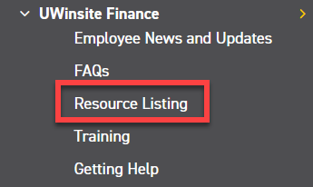
HOW TO CREATE A JOURNAL ENTRY
Journal Entries are the record for transactions taking place such as:
Reimbursements/transfers between departments
Internal charges between departments within the University
For example, parking charging for services
From the University of Windsor, Finance Department webpage (www.uwindsor.ca/finance), click on Resource Listing – located in the left hand column under UWinsite Finance

Slide 24
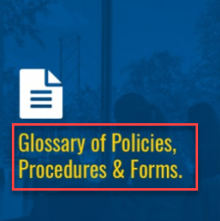
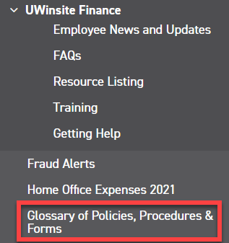
HOW TO CREATE A JOURNAL ENTRY
2. In a new tab open the University of Windsor, Finance Department webpage (www.uwindsor.ca/finance), click on Glossary of Policies, Procedures & Forms – from the button on the front page or in the left-hand column

Slide 25
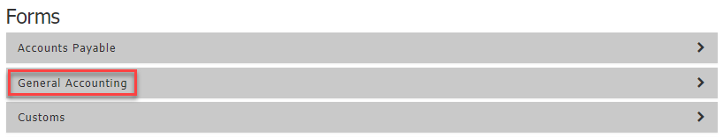
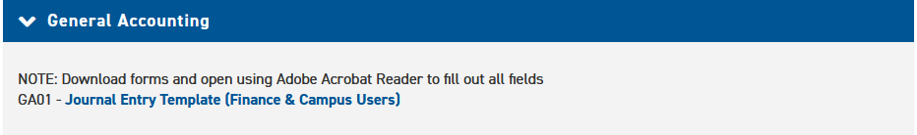
HOW TO CREATE A JOURNAL ENTRY
3. In the Forms, Policies & Reference Guides page, under the Forms section, click General Accounting
4. Click GA01 – Journal Entry Template (Finance & Campus Users) to download

Slide 26
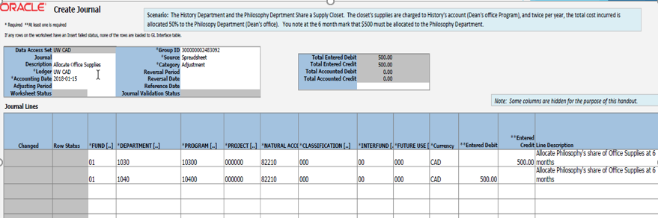
HOW TO CREATE A JOURNAL ENTRY
5. Fill in all necessary fields
Fund – 2 numbers
Department – 4 numbers
Program – 5 numbers
Project – 6 numbers
Natural Account – 5 numbers
Classification – 3 numbers
Interfund – 2 numbers
Future Use – 3 numbers
Currency, Entered Debit/Credit and Line Description (not mandatory but highly recommended)
NOTE: Projects and programs are mutually exclusive, if you have one, you cannot have the other
Each Line should have Either a Debit OR a Credit

Slide 27
HOW TO CREATE A JOURNAL ENTRY
6. Once completed, save spreadsheet and back up.
NOTE: What Constitutes Proper Backup?
Emails from departments approving a charge and/or providing an account number
Meeting minutes
Working copy of spreadsheets calculating amounts
Invoices/receipts
Any internal forms you may have
External system reports (external to UWinsite Finance such as Forte or Bookware)
System Generated Account Analysis Report
Or simply a detailed description of what the entry is trying to accomplish
7. Open a ticket through Team Dynamix
NOTE: For any additional help:
Visit the knowledge-based article: https://uwindsor.teamdynamix.com/TDClient/1975/Portal/KB/ArticleDet?ID=146078

Slide 28
Matching Natural Accounts
to Internal Charges

Slide 29
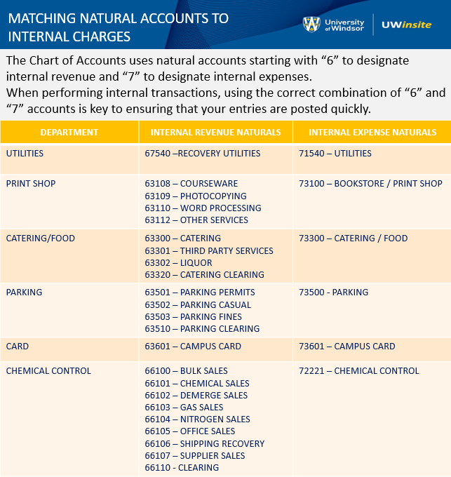

Slide 30
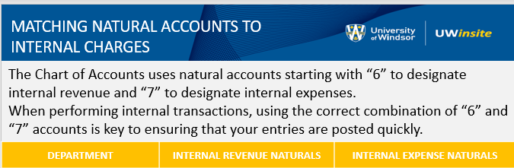
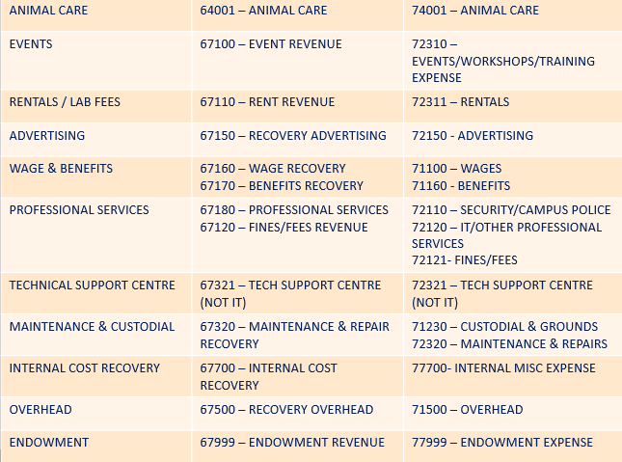

Slide 31
How to Request an Invoice

Slide 32
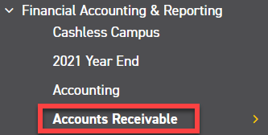
HOW TO REQUEST AN INVOICE
NOTE: ALL invoicing done for the University of Windsor must go through the Finance Accounts Receivable office. No unauthorized department should be issuing invoices without the sole permission of the Financial Controller or Senior Accountant.
From the University of Windsor, Finance Department webpage (www.uwindsor.ca/finance), click on Accounts Receivable– located in the left hand column under Financial Accounting & Reporting. Alternatively, you may go directly to http://www.uwindsor.ca/finance/cash-and-accounts-receivable.

Slide 33
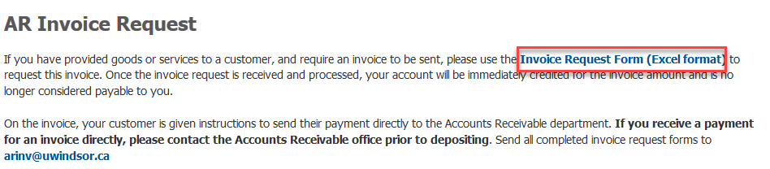

HOW TO REQUEST AN INVOICE
2. On the Accounts Receivable page, scroll down until you reach the AR Invoice Request section. Click Invoice Request Form (Excel format). An excel worksheet should download
3. Click on Enable Editing in Yellow at the top of the excel workbook

Slide 34
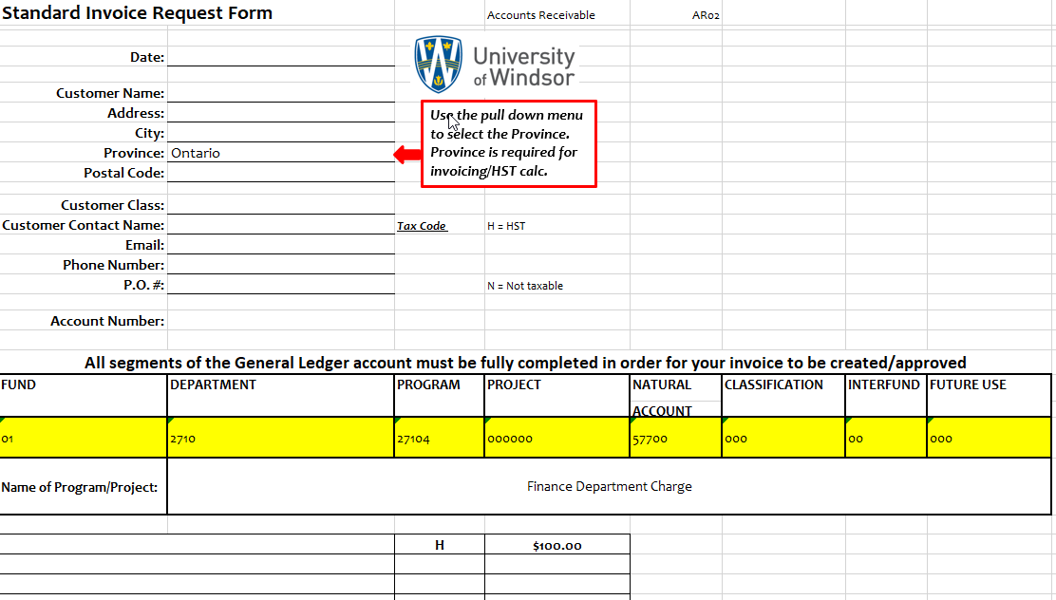
HOW TO REQUEST AN INVOICE
4. Fill out all available information in the request form. The items highlighted in yellow are your GL string that you want your sales to go to. Unless this is a direct reimbursement of expenses, your natural account should begin with a 5 series. Under no circumstance can your Natural account begin with a 7 or a 6. In order for the numbers to display proper, put an apostrophe ( ‘ ) before typing the number. That way the zeroes will show properly.
Ensure if your item is HST exempt you put N where the H is. If the item is taxable you may put an H on each line item. You may have as many line items on one invoice as you wish. If you want to have these line items go to different natural accounts just highlight the row underneath “Fund” and right click > Insert Row.
5. Lastly, email your completed request form to arinv@uwindsor.ca.

Slide 35
How to Process a Payment to UW

Slide 36
HOW TO PROCESS REVENUE
NOTE: If you receive a payment for a previously requested invoice, please ensure these are sent directly to Accounts Receivable noting the invoice number. A Deposit form is not necessary for a payment towards an invoice already done in the system.
For all non-invoiced receipts, from the University of Windsor, Finance Department webpage (www.uwindsor.ca/finance), click on Accounts Receivable– located in the left hand column under Financial Accounting & Reporting. Alternatively, you may go directly to http://www.uwindsor.ca/finance/cash-and-accounts-receivable. There is a lot of valuable information posted on this site including our cash handling policy.

Slide 37
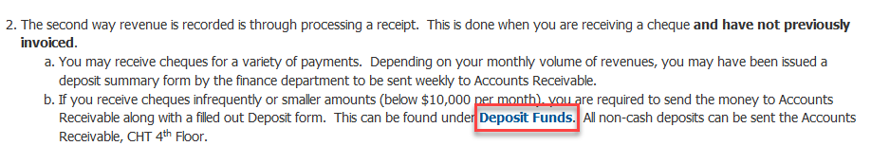
HOW TO PROCESS REVENUE
2. On the Accounts Receivable page, scroll down until you see the section “Here are 4 ways Revenue is recorded:” Go to Number 2 (Receipts) and click on Deposit Funds. Fill out the form with all information indicated.
3. Send the completed form with your cheques to CHT 4th Floor Accounts Receivable through internal mail.

Slide 38
For up-to-date information about the 2026 year end, please visit:
http://www.uwindsor.ca/finance/year-end

Slide 39

Trusts, Endowments, Donations: donations@uwindsor.ca
Research Finance: resfinance@uwindsor.ca
General Accounting, Journal Entries, Chart of Accounts: Eric Gee, Senior Accountant ericgee@uwindsor.ca
Accounts Payable & Vendor Payment Requests:
Isabel Giurdanella, Senior Accounts Payable Coordinator isabelg@uwindsor.ca
Accounts Receivable Billing and Receipts: Gail Puskas, Accounts Receivable Clerk arinv@uwindsor.ca or postmyreceipt@uwindsor.ca
Purchasing Card: pcard@uwindsor.ca
Procurement: procurement@uwindsor.ca
If you are having any trouble accessing UWinsite Finance, please open a ticket: UWinsite Helpdesk Ticket

