Slide 1

Are you Confused Yet?
Basics for Success in First Year
Presented by
Annette Demers BA LLB MLIS
Reference Librarian

Slide 2
Introduction
Introduction
(Terms used in law school & the profession)
Agenda
(Legal Systems, Jurisdiction)

Slide 3
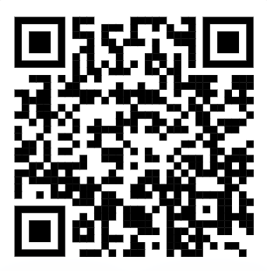
Getting Ready for Law School
Uwin ID and password
Uwin Card
https://www.uwindsor.ca/uwincard
Notes:
Go over the Objectives above.
Law has its own language – hard to get oriented during first days of law school.
Here are some commonly-used terms in law school and the practice of law.
We teach law students using examples, but this is all practical for the real world.

Slide 4
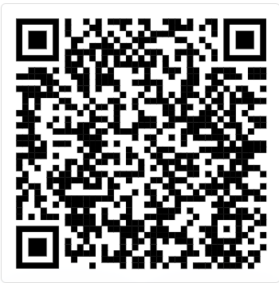
Getting Ready for Law School
https://www.uwindsor.ca/law/library
Westlaw and Lexis+ passwords
Notes:
Go over the Objectives above.
Law has its own language – hard to get oriented during first days of law school.
Here are some commonly-used terms in law school and the practice of law.
We teach law students using examples, but this is all practical for the real world.

Slide 5
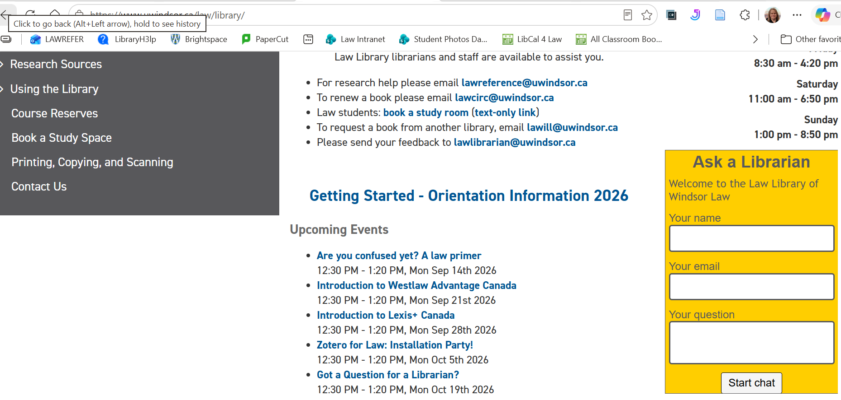
Chat with a Librarian!
Notes:
Go over the Objectives above.
Law has its own language – hard to get oriented during first days of law school.
Here are some commonly-used terms in law school and the practice of law.
We teach law students using examples, but this is all practical for the real world.

Slide 6
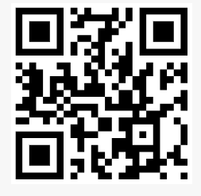
Getting Ready for Law School
Omni - University of Windsor Libraries
Textbooks in the library.
Notes:
Go over the Objectives above.
Law has its own language – hard to get oriented during first days of law school.
Here are some commonly-used terms in law school and the practice of law.
We teach law students using examples, but this is all practical for the real world.

Slide 7
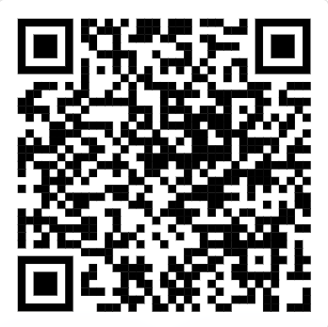
Getting Ready for Law School
https://www.uwindsor.ca/law/library
Research training sessions.
Notes:
Go over the Objectives above.
Law has its own language – hard to get oriented during first days of law school.
Here are some commonly-used terms in law school and the practice of law.
We teach law students using examples, but this is all practical for the real world.

Slide 8
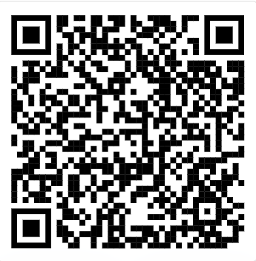
Getting Ready for Law School
https://uwindsor-law.libguides.com/c.php?g=736195&p=5302622
Legal dictionaries and encyclopedias.
Notes:
Go over the Objectives above.
Law has its own language – hard to get oriented during first days of law school.
Here are some commonly-used terms in law school and the practice of law.
We teach law students using examples, but this is all practical for the real world.

Slide 9
Agenda for this Section
Jurisdiction
Legal Systems

Slide 10
Legal Systems
Military
Law
International Law
Common Law
Civil Law
(Québec)
Indigenous Law
Related terms discussed later:
stare decisis
Notes:
See Common Law and Civil Law definitions page. Example: 2002 Supreme Court Case: The Whitens experienced a fire that totally destroyed their home. The fire happened at night in the dead of winter in minus eighteen degrees Celsius temperature. While saving themselves and going for help, Keith Whiten experienced frostbite requiring hospitalization for a period. The Whitens secured rental accommodation in the vicinity of their home and sought to re-establish themselves. Their insurer, Pilot Insurance, initially provided a lump sum of $5000, but then took an aggressive and hostile approach to further payouts, claiming that the Whitens had set fire to the home themselves. The fire chief who investigated the fire refuted this, as did the defendant’s own experienced insurance adjustor, who clearly found the fire to be accidental. When the insurance company refused to pay out, the Whitens commenced a claim for breach of contract (this is a common law action – there's no statute governing this). In a jury trial, the plaintiffs were awarded $318,000 compensatory damages and $1 million punitive damages. The trial judge noted that while the punitive damages amount was unprecedented, it was neither perverse nor unreasonable. Pilot had forced the plaintiffs to litigate while in financially difficult circumstances; to suffer an indignity of living in temporary rental accommodation when they had paid a premium insurance policy for ‘piece of mind’ insurance; and, against a background of Pilot mounting a defence to paying out, which had been specifically refuted by their own experts.
Military law is a separate legal system in Canada governed by both domestic and international law.
International law is effectively an umbrella legal system that operates over our Canadian legal system. This is the law between nations (treaty law).

Slide 11
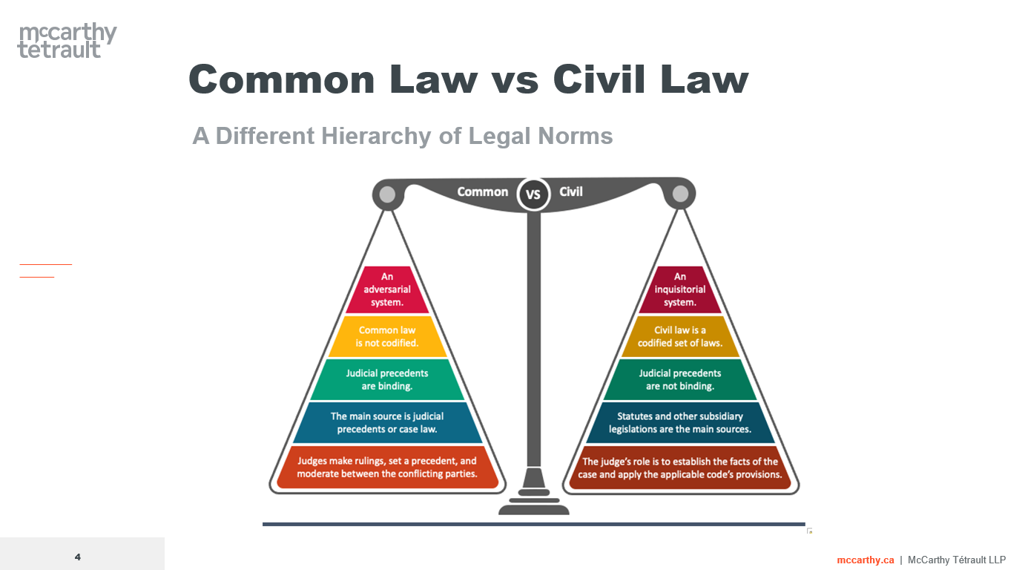
Copyright Jean-Sebastien Danis, 2024.

Slide 12
Jurisdictions
Federal
Provincial / Territorial
Municipal
Constitution Act, 1867, section 91
Constitution Act, 1867, section 92
Municipal Act of each province / territory
Indigenous

Slide 13
Jurisdictions - Examples
criminal law, trade, post office, military, currency, banking, airports, marriage/divorce
Federal
Provincial / Territorial
Municipal
Prisons, Hospitals, Schools, Roads, Courts Administration
City roads, public transport, waste management, local parks, business licences, parking
Local health, fishing / hunting, economic / social development, local infrastructure
Indigenous

Slide 14
Case Law / Cases
Case Law / Cases – One source of law that we use in law school; it is also used by lawyers and by judges. Case law is a collection of past decisions made by judges. Case law collections are organized by jurisdiction first, and then by level of court. See Ontario | CanLII for examples from Ontario.

Slide 15
Legal Terms – Teaching Approach
Term
Common terms we use
Meaning
What it means
Example
What’s a practical example of this?
Tools
Tools used by professionals to answer questions.
Notes:
Terms that we use: Law has its own language, here are some common terms used in legal education and practice.​
​
What it means: A very basic summary of what we mean by it.​
​
Tools Used: What do we use in the legal profession to sort out questions.​
​

Slide 16
Legal Terms – Teaching Approach
Related Questions
It’s often more complicated than it seems!
Lawyer / Judge To Decide
What the lawyer or judge is trying to accomplish
Learn More!
Your learning opportunities
Notes:
Questions Arising: It’s usually more complicated than it seems!​
​
Considerations: What is the lawyer (or judge) trying to accomplish?​
​
How Can You Learn More? Learning opportunities in law school.

Slide 17
Term
“The Facts”
Meaning
The human situation causing the legal dispute.
Notes:
As a lawyer, when you first meet with a client, you are automatically fact gathering. You are asking very detailed questions.
You are gathering up their paperwork and documents, etc.
As a judge, the “facts” are usually important questions to sort out also.

Slide 18
Term
“The Issues”
Meaning
What questions need to be answered to solve this dispute?
Notes:
As a student, we teach you how to spot the legal issues.
These are central to the dispute itself.
What questions need to be answered to help reach an outcome?
When meeting with clients, lawyers are automatically going through their knowledge of the law to figure out what questions need to be sorted out.
If a matter makes it to court, judges are also figuring out what the main issues are.

Slide 19
Types of Issue Questions
Term
Questions
Meaning
Questions that help us sort out what happened.
Example
Did the car stop at the stop sign?
Tools
Evidence (witness testimony, documents, recordings or photos)
of Fact
Some facts may be disputed.
Notes:
There are two main types of issues that can arise:
Questions of Fact and Questions of Law.
First, let’s talk about the TERM: Questions of Fact.
Meaning: When we use this phrase, we are asking:
What actually happened? Using the “who, what, when, why and how” questions can be helpful. Examples include: what was the date, what was the time, what was the weather, who was involved, were there witnesses, etc.
The trouble comes up when some facts are be disputed.
Is there good evidence to support one story over the other?
Sometimes the parties have both contributed to the problem.
Example of a Question of Fact: “Did the car stop at the stop sign?”
Tools that lawyers and judges use to sort out what happened are primarily evidence, including: witness testimony, documents, recordings or photos.

Slide 20
Types of Issue Questions
Term
  Questions
  of Fact
Related Questions
What rules of evidence apply?
Lawyer / Judge To Decide
What actually happened.
Learn More!
Evidence Law (upper year course)
Notes:
Continuing to talk about “questions of fact”:
We know that the judge will use evidence to figure out what actually happened.
Well, it is more complicated than this.
Related questions that arise: What rules of evidence apply?
We have a federal Evidence Act and provincial Evidence Acts that set up the rules for how to admit (or not allow) evidence to be “adduced” (put before) the judge. The judge decides what rules of evidence apply and how to interpret them to the evidence before him or her.
Questions about whether evidence can be admitted can also be disputed.
So regarding questions of fact, what is the lawyer or judge actually trying to do?
The lawyer is thinking about whether they have enough evidence to prove their client’s story.
The judge has to decide who has the most reliable evidence, and then uses the evidence to decide what happened on those disputed facts.
How will you be able to learn more about this? Take a course on Evidence Law in upper years.

Slide 21
Types of Issue Questions
Term
Questions
Meaning
Questions that help us sort out what law applies.
Example
Is a person required to stop at a stop sign?
Tools
Legal research to determine what statutes, regulations and judicial decisions apply.
of Law
Notes:
The other phrase that you’ll hear is “Questions of Law”.
This is otherwise known as the “legal issue”.
Meaning: These are questions that help us sort out what law applies.
This will include:
-the law governing the substance of the matter, what we call “substantive law”. Think: criminal, contract, tort, constitutional
-as well as procedural rules (we’ll talk about later)
-can also include remedies (all of the rules about what kinds of resolutions are available
Example: Is a person required to stop at a stop sign? To answer this question, we need to find the statute that says this.
Tools: To answer legal questions, we must do legal research to determine what statutes, regulations and judicial decisions apply.

Slide 22
Types of Issue Questions
Term
  Questions
  of Law
Related Questions
Statutes and decisions have nuances.
Lawyer / Judge To Decide
What law will apply and how will it be interpreted.
Learn More!
LRW (first year)
and Advanced Legal Research (upper years).
Courses on contract, tort, criminal, remedies, etc.
Related terms:
stare decisis
remedies
rules of procedure
Notes:
Continuing to talk about questions of law – you might think that the law is black and white, but often it is not.
Even statutes, regulations and case law have nuances. Sometimes we must also look at how the law was applied by previous case law to help us interpret it.
We will discuss “stare decisis / precedent / binding authority” and “persuasive authority” later.
After gathering all the law, the lawyer must sort through everything to figure out what laws apply to the situation. The lawyer must make an honest assessment of whether the client “has a good case” -is the law going to resolve the dispute in their favour? The judge is the ultimate decider of what law applies.
How will you learn about this: LRW and ALR for how to do legal research.
Rules of Civil Procedure, Rules of Criminal Procedure, other courses on contract, tort, criminal to learn substantive law. A course on remedies to learn about what kinds of resolutions are available.

Slide 23
Term
Apply the facts to the law
Meaning
How will the law apply in this situation?
Example
Judge accepts witness testimony and determines she did not stop at the stop sign.
Law required her to stop.
She is convicted.
Notes:
This is done by a judge if a case goes to court.
​
This process occurs after they decide: ​
-the facts (what happened – see above) and ​
-the law that applies
The last step is to figure out how the law will apply in this particular situation?
Example: After accepting the witness testimony, the judge determines that the defendant did not stop at the stop sign. The law required her to stop. She is convicted.

Slide 24
Which Case To Submit?
  -the most current state of the law
  -articulated by the highest level of court
  -in the relevant jurisdiction
  -that is relevant to the facts and issues
  We may need to read more than one case together in order to get the full picture.

Slide 25
Other Terms
Term
stare decisis
Meaning
“A court must follow earlier judicial decisions when the same points arise again in litigation.”
Example
In deciding whether to accept the child witness’ testimony, the judge followed the rule stated in
Tools
Case law research.
/
precedent
/
binding authority
R v Bannerman.
-Black’s Law Dictionary
/
vertical precedent
Case law research is the process of locating relevant judicial decisions.
As opposed to “persuasive authority”
Related terms:
ratio decidendi
Notes:
Stare decisis means “A court must follow earlier judicial decisions when the same points arise again in litigation”. This is the basis of our common law system. The intent is to provide certainty, so that judges are not deciding things differently every time the same problem presents itself. On the next slides, we’ll briefly remind you how higher court decisions are binding on lower courts. In our common law system, lower court judges within the same jurisdiction are bound to follow the legal reasoning (binding authority) expressed in the higher court’s decision unless it can distinguish the earlier decision on its facts or its issues.
The doctrine of precedent involves considering decided cases that have applied a legal principle to facts and issues similar to those of the client.
Example: In deciding whether to accept the child witness’ testimony, the judge followed the rule states in R v Bannerman.
The tools used to locate the binding authority or that precedent-setting case, is to locate relevant judicial decisions (doing case law research).
We also have a term called “persuasive authority” shown in the yellow box. A related term that we’ll discuss is “ratio decidendi”; also to discuss later.

Slide 26
Other Terms
Term
stare decisis
/
precedent
/
binding authority
Related Questions
Is the case still “good law”?
Lawyer / Judge To Decide
What is the current legal principle or interpretation to be applied?
Learn More!
LRW
It may have been overruled or changed.
Torts
and other courses
Contracts
Related terms for next class:
“noting up”
case history
Notes:
When a judge or lawyer reviews case law, they need to decide if the case is “still good law”. It may have been overruled or changed over time.
In LRW, you’ll learn more about the process of “noting up” a case, and locating its history, which are necessary for figuring this out.
Ultimately, the judge examines previous judicial decisions to find out what is the current legal principle or interpretation that he or she is bound to apply in this case (as appropriate).
You’ll learn more about case law research, noting up, and case histories in LRW.
Contract, tort and other courses will give you tons of legal principles and binding case law to be applied in various areas of law.

Slide 27
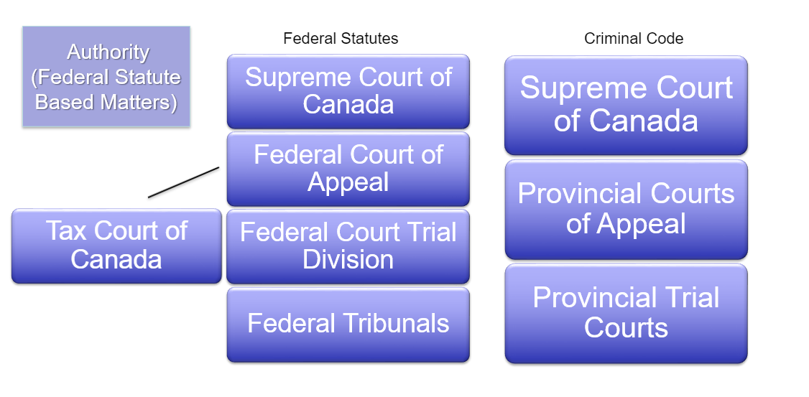
Court Hierarchy (Federal Statute-Based Matters)

Slide 28
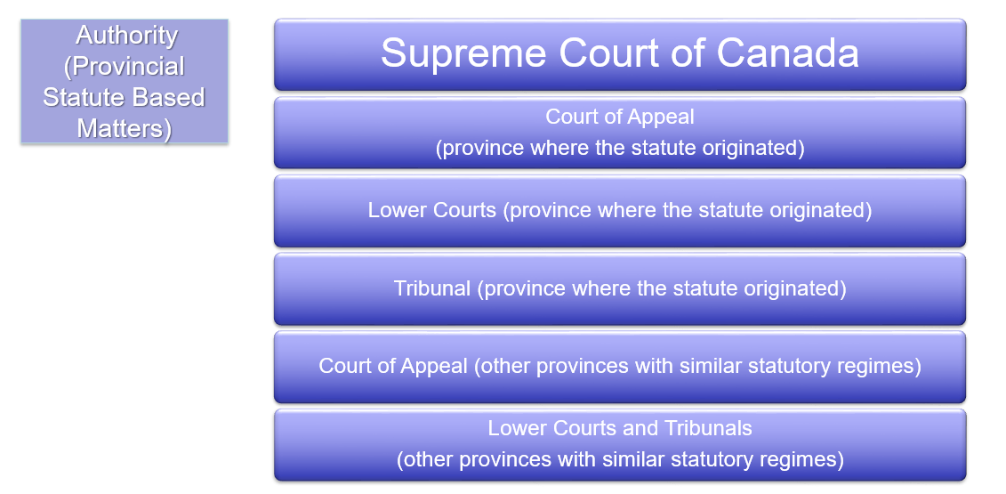
Court Hierarchy (Provincial Statute-Based Matters)
Persuasive authority only.

Slide 29
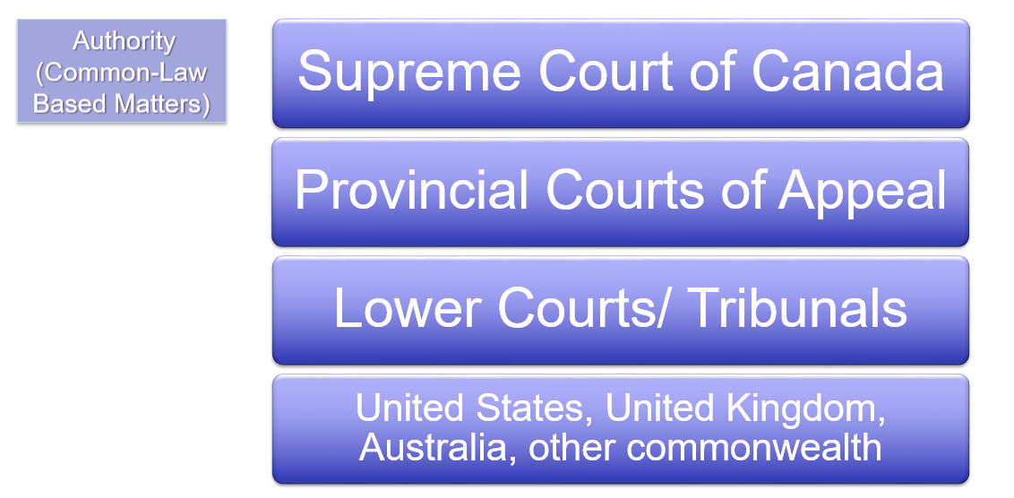
Court Hierarchy (Common Law-Based Matters)
Persuasive authority only.

Slide 30
Other Terms
Term
Rules of Procedure and Court Practice Directions
Meaning
What process needs to be followed to go to court?
Example
Police issue a ticket to “commence” the traffic proceeding.
Deadline for responding?
How to dispute?
Tools
Rules of Procedure
(civil, family, criminal, court-specific)
Notes:
(IF WE HAVE TIME)
In a previous slide, I mentioned that some legal issues or questions of law that might come up, could be regarding the procedures to follow to go to court, or to get through the trial process.
Rules of Procedure are normally established by regulation.
They really govern the entire process that needs to be followed.
Example: Police issues a ticket to “commence” the proceeding in traffic court. The rules of procedure will tell the defendant their deadline for responding, what form to use to dispute the charges, etc.
The tools used by lawyers and judges to sort the procedures out, are called the Rules of Procedure. There are normally different rules of procedure for each court.

Slide 31
Other Terms
Term
  Rules of Procedure
Related Questions
Some procedures are firm, others can be changed with permission of the judge.
Lawyer / Judge To Decide
Any request for changes to, or interpretations of the procedures.
Learn More!
Courses in Civil Procedure, Criminal Procedure
Working at a Clinic.
Notes:
When looking at procedural rules, some of them can be firm, but others can be changed with permission of the judge, so again, they can be nuanced.
An example is that sometimes the rules will permit a judge to extend or waive a filing deadline.
In this area, the judge is deciding on any requests for changes to the rules, and they might be interpreting the rules.
You’ll learn more from a course in civil or criminal procedure, and if you decide to work for one of our clinics.

Slide 32
Summary
Understand legal systems in Canada
Understand jurisdiction
Understand legal terms

Slide 33
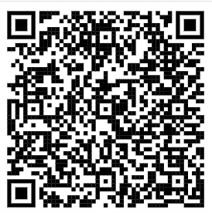
Get these slides!
https://www.uwindsor.ca/law/library/277/annette-demers-law-reference-librarian
Presented by
Annette Demers ademers@uwindsor.ca

