Slide 1

Research Refresher for Moot Teams
By Annette Demers
Reference Librarian
ademers@uwindsor.ca

Slide 2

Agenda
At the end of this session, you should be able to:
Visualize the research process
Identify key facts / gaps in the facts / disputed facts
Identify key legal issues
  Stems from legal research
  Can point to further questions of fact
General tips for all mooters
Key tips for:
  Case law research
  Statutory research (including regulations)
  Secondary sources
  Other

Slide 3
Starting Your Research
Review facts and evidence
Formulate Legal Issue Questions
Plan and execute legal research strategies

Slide 4
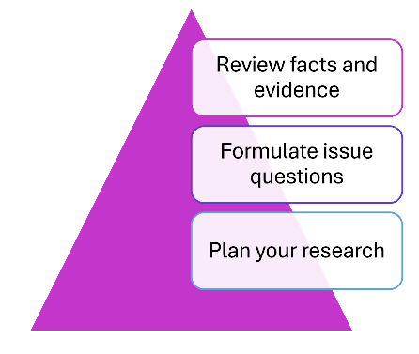

Review the Facts
Identify:
Key facts
Missing Facts
Disputed Facts
Factual assumptions
Questions of Fact

Slide 5
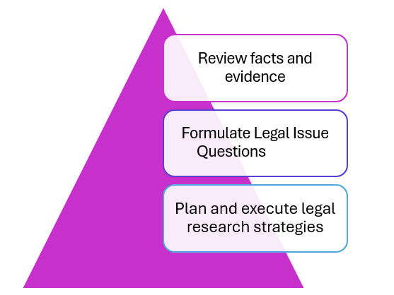
Formulate Legal Issue Questions / Questions of Law
Do you know:
-is the problem statute or common law based
-if statute based, the sections of the Act that govern
-are there any regulations to review
-does the statute language need interpretation
-if so, note-up the statute to locate case law
-if common-law based
-what is the key legal principle or test that governs
-if so, locate the leading case that defines it
Issue questions are ultimately the questions that the judge needs to answer to decide the case.

Slide 6
Your Theory of the Case
Your “theory of the case” is how you will advocate for the judge to answer these questions.
Watch the other side’s materials as well.

Slide 7
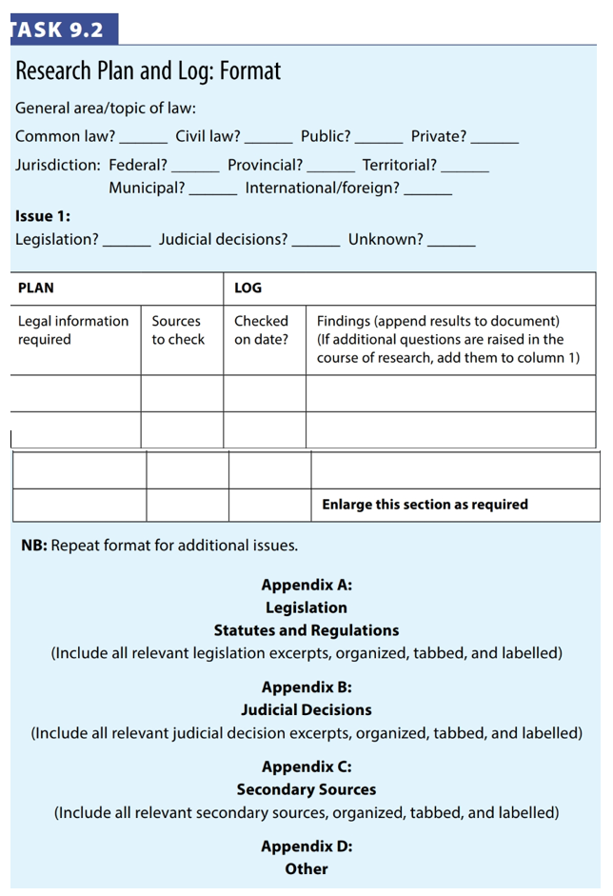
PLAN YOUR RESEARCH
Do this for each question of law that you’ve identified.

Slide 8
PLAN YOUR RESEARCH
(Make a step-by-step approach)
The footnotes lead to important sources!
Information Source | Example
secondary resources | Encyclopedia entries, textbooks, journal articles, online reports
Primary sources - legislation | Statutes, regulations, rules and bills, treaties
Primary sources – judicial decisions | Case law, noting case history and subsequent judicial consideration (note up)
Apply the law to the facts too!

Slide 9
LOG YOUR FINDINGS
Keep a shared document that:
List the secondary resources that you found
List the legislation that you found
List the judicial decisions that you found
Provide the excerpts (Quote or page from the book / section of the Act / paragraph or page from the case)

Slide 10
LOG YOUR FINDINGS and
CREATE THE CITATION IMMEDIATELY
PREPARE A PROPER CITATION FOR EVERYTHING
Keep the pinpoint quotes WITH the citations
Link to the pinpoint if you can (CanLII allows para level linking for newer cases)
Conform with moot rules
Ask a librarian
Use the tools (folders on CanLII/ Westlaw / Lexis)

Slide 11
LOG YOUR FINDINGS and CREATE YOUR CITATIONS
For case law:
  If citing a trial or CA case, you MUST provide its subsequent history as part of the citation.
  For newer cases, use the neutral citation alone. (You should never attempt to make up your own neutral citation).
  For older cases where there was no neutral citation or paragraph numbering, you may need to use page numbers for pinpoint citations instead of paragraph numbers.
    SCC decisions prior to 2000 must be cited to page numbers in the original Supreme Court Reports (SCR) as found on SCC Lexum or pdf on CanLII.
    CanLII may also provide PDFs for certain older cases. Cite to those page numbers as shown on the PDF (there likely won’t be paragraph numbering for older cases). Example:
    Molson Companies Ltd. V John Labatt Ltd. (1994) 58 CPR (3d) 527 at 529, 1994 CanLii 19514 (FCA).

Slide 12
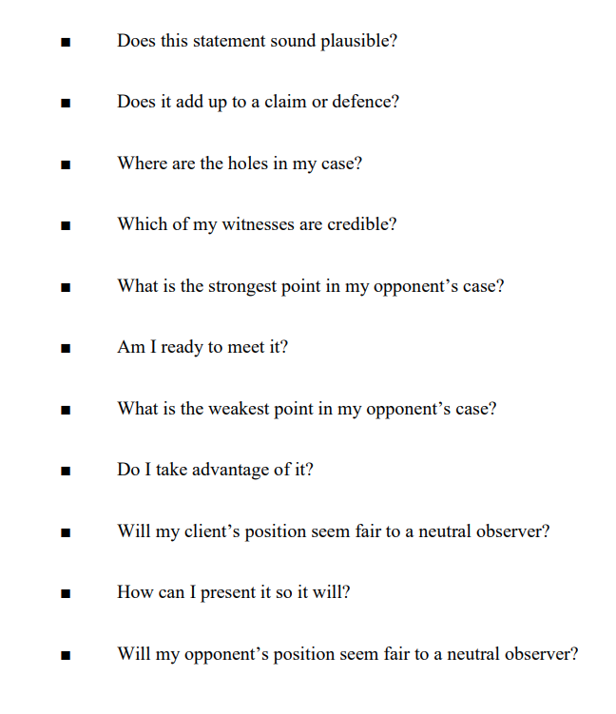
Apply the Facts to the Law to develop your
THEORY OF THE CASE
Read more:
Martin Sclisizzi, “Theory of the Case: How and Why Developed –An Overview”

Slide 13
Sample Theory of the Case Diagram
Legal Principle or Test | Relevant Facts and Evidence | Apply Facts to Law – Our Strengths and Weaknesses* | Apply Facts to Law – Their Strengths and Weaknesses* | Our Response to their Strengths and Weaknesses+ | Our Response to Our Weak Points+
Test Part One
Test Part Two
Test Part Three
*e.g. missing facts, missing evidence, unfriendly interpretations in the case law, etc.
+e.g. different (equally persuasive case), alternative interpretation of the law, factual explanations

Slide 14
POLL
ABOUT YOUR MOOT PROBLEM:
Very little research (confined to specific materials)
Statutory
Legislative
Case law or common law
Secondary materials
Treaty law / international materials
Other?

Slide 15
Secondary Sources
OMNI – for textbooks and e-books
Westlaw / Lexis/ Hein / CanLII for articles
CED / Halsbury's for research starting point
*REVIEW FOOTNOTES FOR FURTHER HELP*
Westlaw also has subscription products.

Slide 16
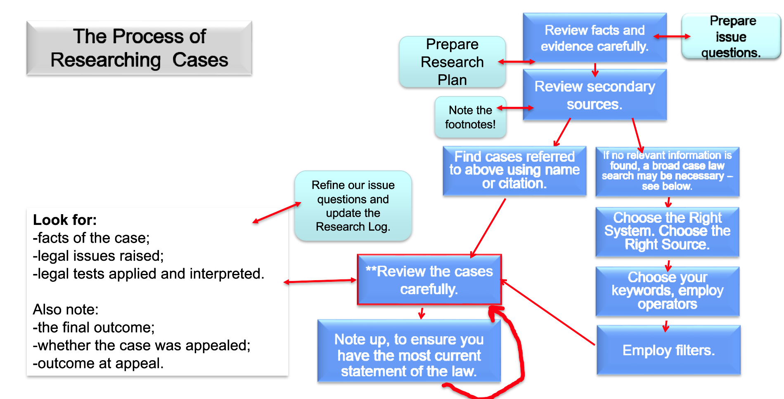

Slide 17
Case Law
Moot Problem Design:
-at least one gap/weakness for each party to address
-identify and address:
BOTH favourable and unfavourable decisions!
-read and analyze the whole case
AND its history including trial / CA / SCC
AND note up
BEFORE YOU CHOOSE TO RELY ON IT!

Slide 18
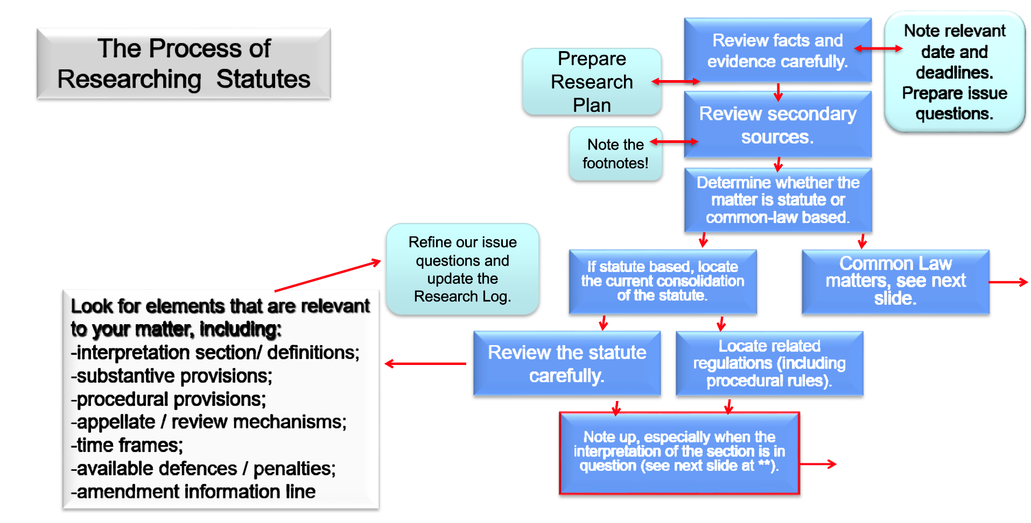
Visualizing the Research Process

Slide 19
Questions?
Resources:
Annette Demers, Reference Librarian | Don & Gail Rodzik Law Library
-these slides
-locating word definitions /interpretation
-sample research log
Sullivan on the Interpretation of Statutes (book)

Slide 20
Research Refresher for Moot Teams
By Annette Demers
Reference Librarian
ademers@uwindsor.ca

