Slide 1
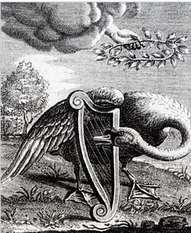
Reinvigorating Academic Law Library Standards
Notes:
The Singing Swan (1655) by Reinier van Persijn

Slide 2
About Me
Annette Demers BA LLB MLIS
Reference Librarian, Windsor Law
Past President, CALL/ACBD
Our Circ Desk Before
Our Circ Desk After

Slide 3
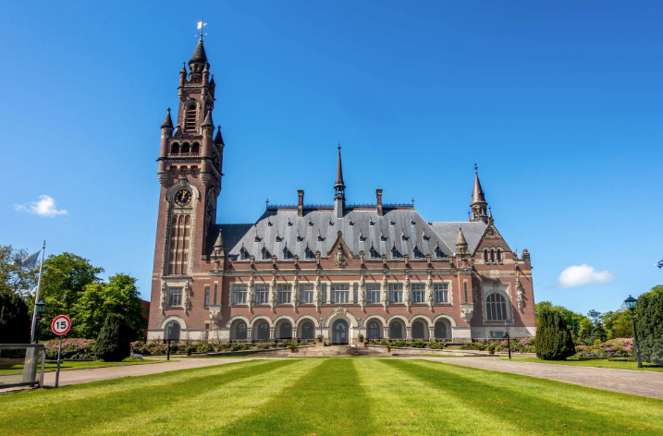

Slide 4
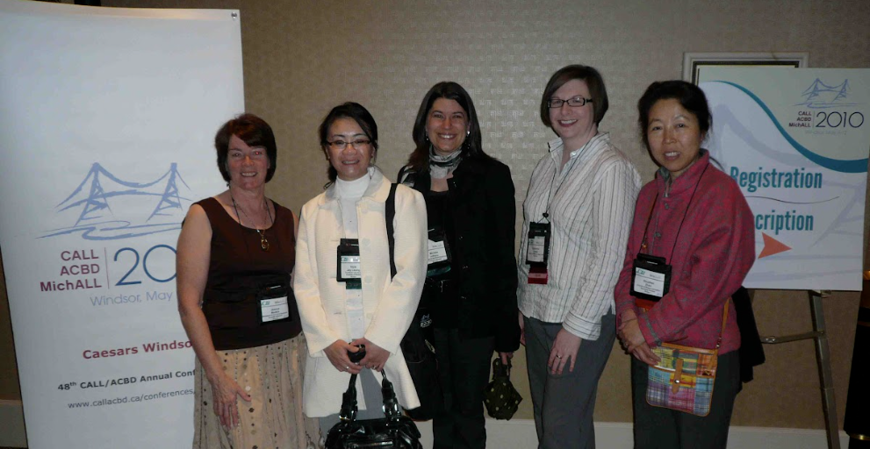

Slide 5
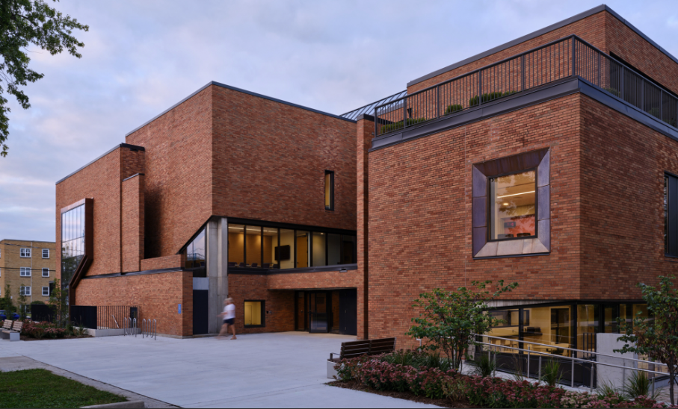
Windsor Law

Slide 6
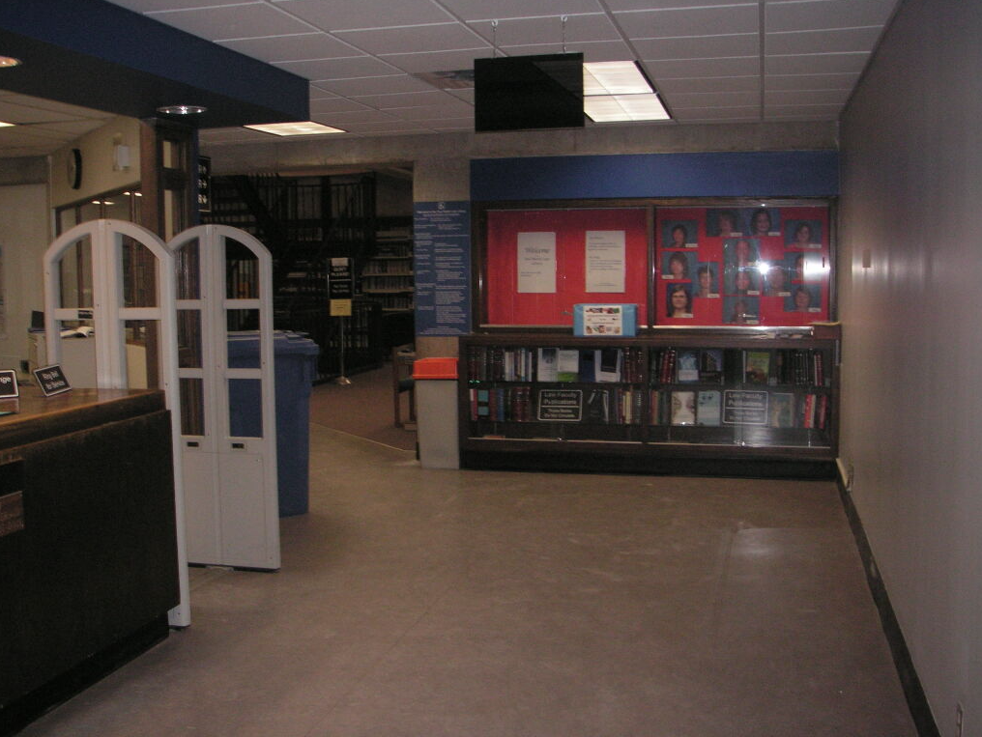
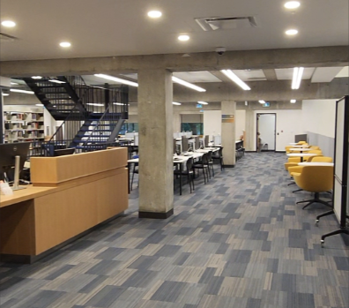
Our OLD Front Entrance
Our Front Entrance Now

Slide 7

Our Circ Desk After
Windsor Law Library Today

Slide 8
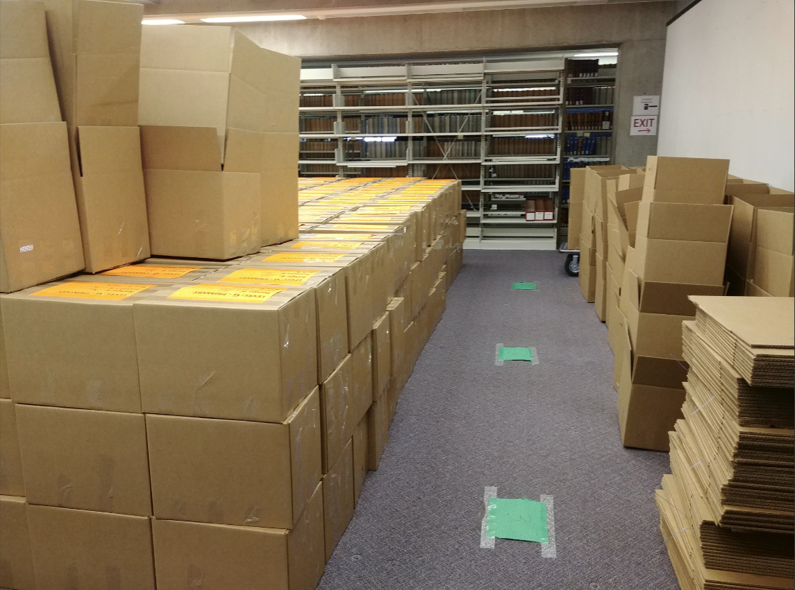
Our Circ Desk After

Slide 9
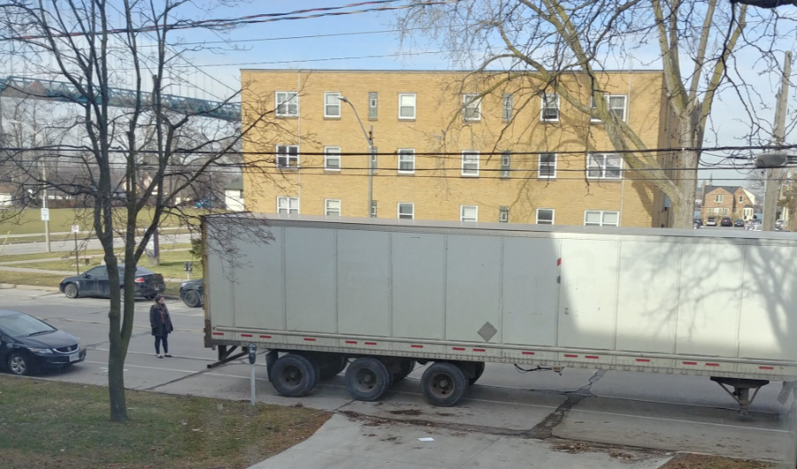
Our Circ Desk After

Slide 10
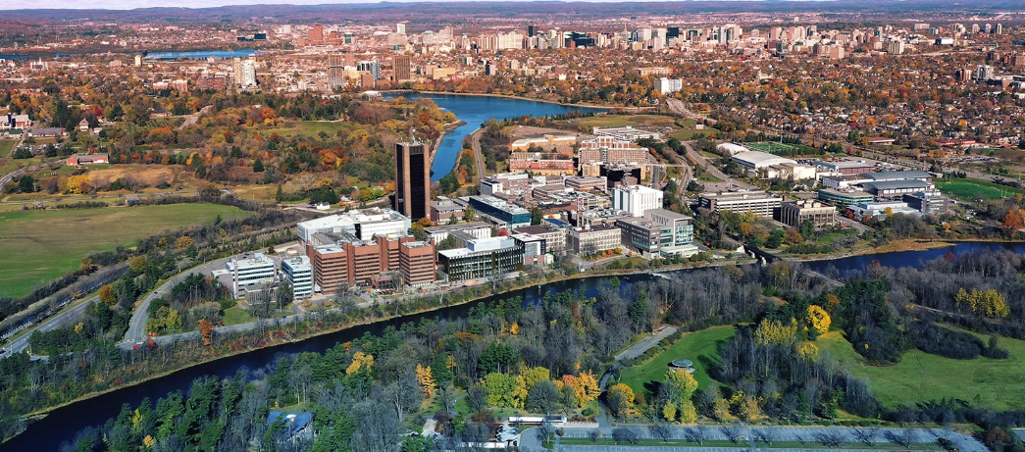
Our Circ Desk After

Slide 11
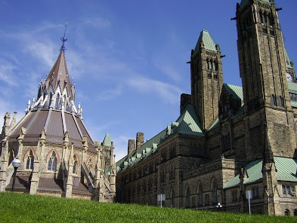
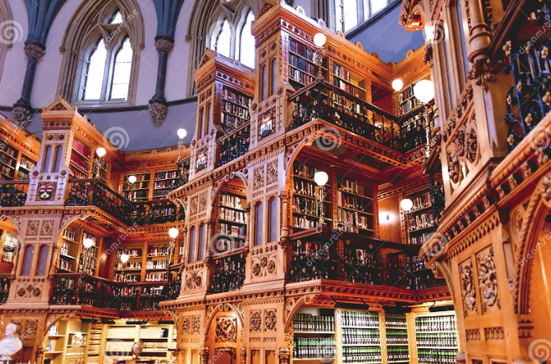
Our Circ Desk After

Slide 12
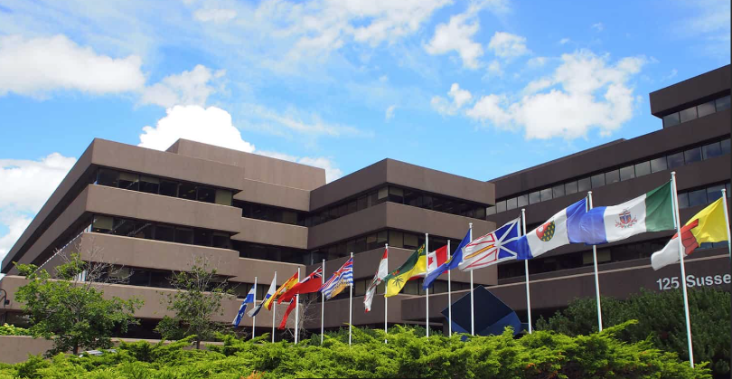
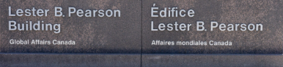
Our Circ Desk After

Slide 13
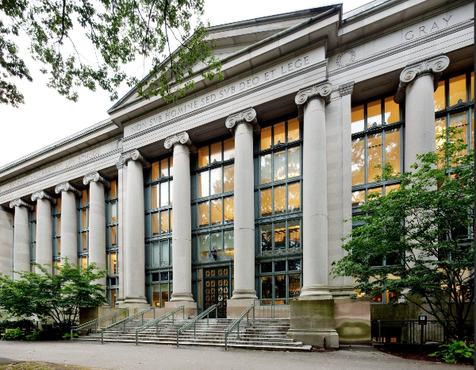
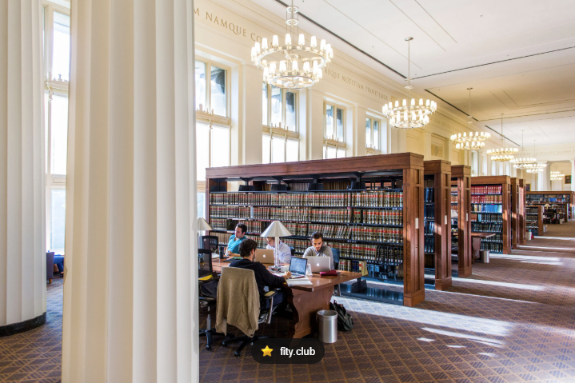
Our Circ Desk After

Slide 14


Slide 15

Write this down:
As a law librarian, my purpose is…

Slide 16

As a Law Librarian, my purpose is to:
-teach others legal research as a skill set; and
-foster the continuation of the Profession
with the ultimate goal of ensuring transparent access to legal information for all.

Slide 17
Raise your hand if these statements feel true for you:
I feel strongly that my work has value.

Slide 18
Raise your hand if these statements feel true for you:
My organization values my vision for the workplace.

Slide 19
Raise your hand if these statements feel true for you:
I feel comfortable voicing my opinion at work.

Slide 20
Raise your hand if these statements feel true for you:
I feel strongly that my work has value.
My organization values my vision for the workplace.
I feel comfortable voicing my opinion at work.
Advocacy can influence outcomes at my workplace.

Slide 21
Two Main Audiences
Law librarians
Decision makers

Slide 22


The Foundation
Democracy
Legal Research Skills
Legislators
Judges
Lawyers
Law Students
Legal Information (Law Library)
Law Librarians

Slide 23
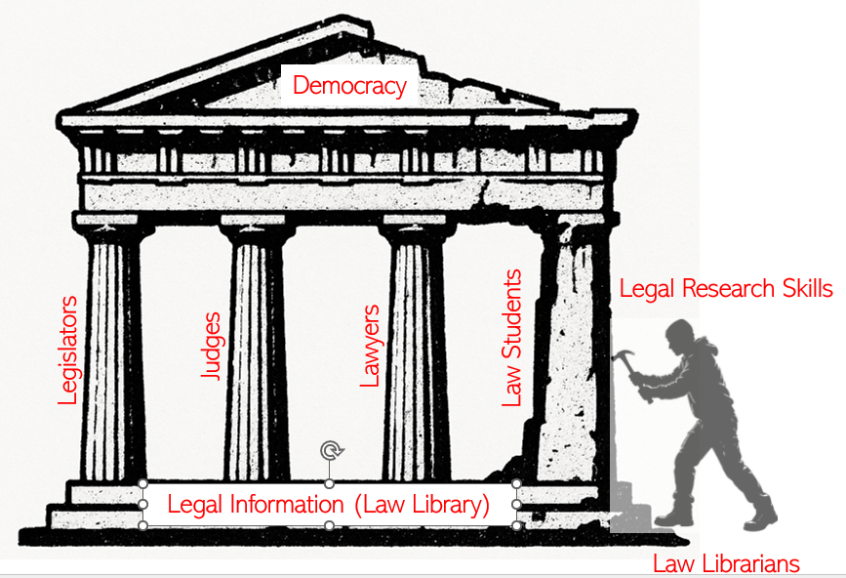
The Core of What We Do
Providing access to legal information.
Building legal research skills.

Slide 24

In the beginning…
“A large majority of the judges who answered our questionnaire were of the opinion that on the whole, and with some notable exceptions, cases came to them insufficiently prepared. …We feel convinced, however, that one explanation of bad case-preparation is to be found in the lack of proper facilities and training for research in the law schools.”
Committee on Legal Research, “Report of the Committee on Legal Research” (November 1956) 34:9 Can Bar Rev 999 at 1017 (F.R. Scott, Chairman. Adopted by the Council of the Canadian Bar Association during its 38th Annual Meeting, Sept 3, 1956).

Slide 25
Competencies are the Key
The skills competencies include a section dedicated to legal research:
Legal Research
The applicant must have demonstrated the ability to:
Identify legal issues;
Select sources and methods and conduct legal research relevant to Canadian law;
Use techniques of legal reasoning and argument, such as case analysis and statutory interpretation, to analyze legal issues;
Identify, interpret and apply the results of research; and
Effectively communicate the results of research.
Federation of Law Societies of Canada, Common Law Degree Implementation Committee: Final Report, (2011), online: https://flsc-s3-storage-pub.s3.ca-central-1.amazonaws.com/APPROVALCommitteeFinalReport2011.pdf [perma.cc/A96Q-5HZ2] at 3

Slide 26
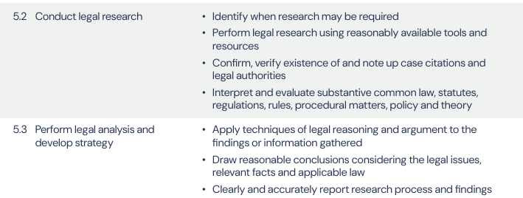
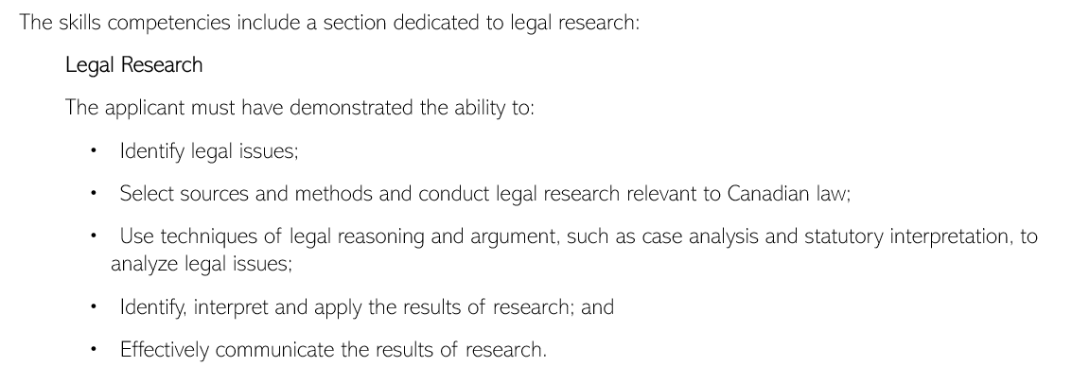
Required Research Competencies
PREP
LSO Competencies
Identifies and obtains additional information and/or resources as needed.
Conducts or delegates research and investigations related to the matter as appropriate.
Complies with all privacy legislation when gathering information.
Identifies and uses appropriate research sources.
Federation Report

Slide 27

Is your library administrator
familiar with the legal research
competencies required
by your provincial regulator?

Slide 28
Competencies are Key
Basic and advanced work with:
statutes and legislative materials
regulations
judicial decisions
Knowledge of:
the civil law system in Québec.
legal citation standards
locating court records, bylaws, practice materials, etc.
Specialized Knowledge
International law
(sources / treaties / UN documents / judicial decisions)
Foreign domestic law
Canadian Association of Law Libraries, Competencies of a Legal Research in Canada, (endorsed by CALL/ACBD Executive Board January 22, 2025), online: <https://callacbd.ca/resources/Documents/2025%20Conference/Competencies%20of%20a%20Legal%20Researcher%20in%20Canada.pdf> [perma.cc/23AX-MYXL].

Slide 29
Library Standards are the Bridge

Slide 30
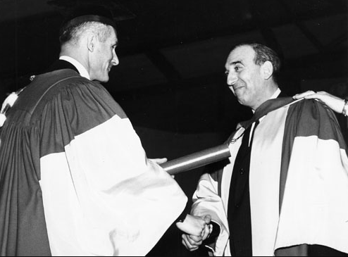
Remembering Our Roots
“In not one law school in Canada are there to be found modern, permanent buildings to house classrooms, libraries…with anything approaching the type of accommodation that frequently is available in many other professional schools…with the possible exception of McGill, Manitoba, University of British Columbia and perhaps Osgoode Hall, even the minimum integrated requirements of library and classrooms were not provided for and the faculty of law had to share barely adequate classrooms or library space with other crowded branches of the university.”
Maxwell Cohen, “The Condition of Legal Education in Canada” (1950) 28: 3 Can Bar Rev 267 at 271.

Slide 31
Reporting Structures - 1948-49
Dean of Law
University Librarian
UBC
Manitoba
Osgoode
UNB
Dalhousie
McGill
Laval
Saskatchewan
U de M
U of A
U of T

Slide 32
Library Services – prior to 1945
Providing lectures in law
Over 10,000 volumes
McGill
Dalhousie
U of T

Slide 33
Focus on Librarians with Legal Expertise
Notable examples of early leaders in our profession with American or UK law degrees include:
Dalhousie: Eunice Beeson, JD (Northeastern), MLS (1959-1966).
Osgoode: Balfour Halevy, LLB (London), MCL (Tulane), MSLS (Columbia), of the Middle Temple and the Bar of Ontario) (1967 – 1999).
U of Toronto: Diana M Priestly, LLB, MLS (Law)(Washington), Law Librarian (1964-?).
University of Windsor: Roger F Jacobs, A.B., J.D. (Detroit), A.M.L.S. Member of the Michigan Bar (1967-1973).
U Victoria: Diana M Priestly, LLB, MLS (Law)(Washington), Professor of Law (1974-1987).

Slide 34
Law Library Standards Development
“A library today is only partially efficient if it is not under the supervision of a trained librarian, preferably one also trained in law. We know of few law libraries in Canada where this requirement is met.
In the libraries, both professional and university, the lack of research personnel is seen in the paucity of trained librarians knowing the field of legal literature, which hampers both the use and rounded expansions of the collections.
The facilities for research in Canada are inadequate. This is evident in the lack of proper libraries, of research funds and endowments, and of research centers and institutes whether within or without the law schools. No researcher can work without equipment and the principal equipment for most types of legal research is good libraries.
Library budgets are usually far below those found in medical schools. The great increase in the price of law books and the cost of binding in recent years have placed some law libraries in a worse position than they were ten years ago.” (1956 CBA Report)

Slide 35




Law Library Standards Development

Slide 36

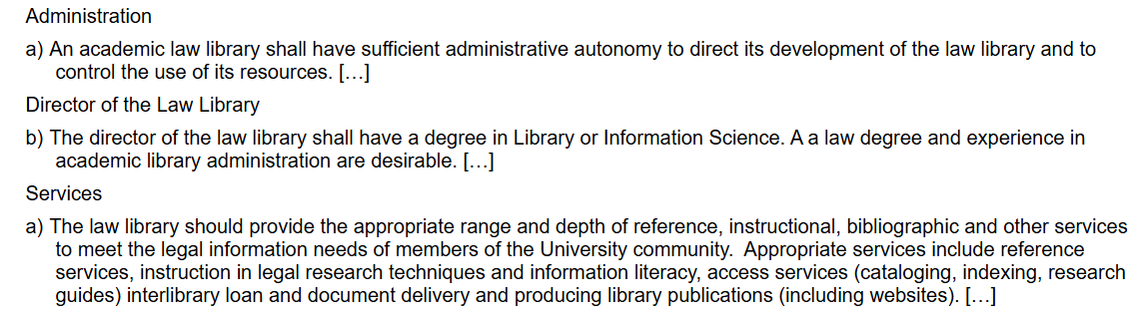
Law Library Standards Development

Slide 37
Law Library Standards Development
American Bar Association Section of Legal Education and Admissions to the Bar, Standards and Rules of Procedures for Approval of Law Schools 2023-2024, (American Bar Association, 2025-26), at 45-47, (standards 601 to 605) online: https://www.americanbar.org/content/dam/aba/administrative/legal_education_and_admissions_to_the_bar/standards/2025-2026/2025-2026-standards-chapter-6.pdf

Slide 38
Birth of CALL/ACBD
The Canadian Association of Law Libraries founders first met at the June 1961 meeting of the American Association of Law Libraries.
CALL/ACBD’s constitution and bylaws were ultimately adopted on February 8, 1963.
In September of 1970, the CALL/ACBD membership list included 40 academic law librarians, constituting 50% of all 80 members.

Slide 39
About the Survey
Protected by Research Ethics Board approvals at York, U of T and Windsor
Disseminated in English and French
Disseminated from December 5, 2022, to February 9, 2023

Slide 40
About the Survey
Target audience:
Heads of Law Libraries
Law Librarians
Responses were also sought from:
-law library / library staff
-Deans of Law or Law Administrators
-Law Faculty Members
-University Librarians and AULs
(considered useful but not critical to the outcome of the survey)

Slide 41


The Articles
Annette Demers, Yemisi Dina and Gian Medves," Trends in Canadian Academic Law Libraries: Report on the Reinvigorating Academic Law Library Standards Survey, Part One", 2025 CanLIIDocs 1371, https://canlii.ca/t/7nndz.
Annette Demers, Yemisi Dina and Gian Medves, "Trends in Canadian Academic Law Libraries: Report on the Reinvigorating Academic Law Library Standards Survey, Part Two", 2025 CanLIIDocs 1745, https://canlii.ca/t/7np09.

Slide 42
Response Rates
Target | Audience | Responses | Rate
23 | Academic law libraries | 19 | 83%
13 | Law Library Directors. | 11 | 85%
17 | Institutions with law librarians | 16 | 94%
43.5 | Law Librarians excluding Heads | 28 | 64%
(Target) | Description | Number | Percent
23 | Institutions whose UL refused permission to disseminate the survey to librarians and faculty. | 3 | 13%

Slide 43
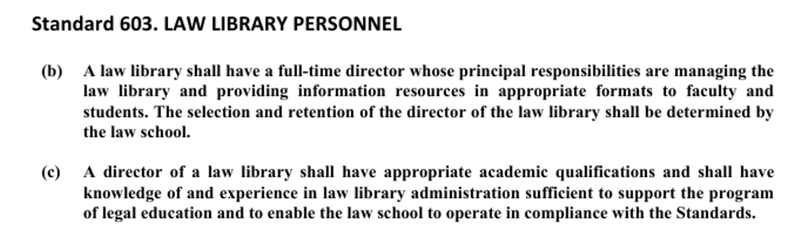
Law Library Directors – Historical Count
Includes all law libraries.
2003
17 of 20
2022
15 of 23
Today
9 of 23
67% decrease
in the past 5 years
ABA

Slide 44
Law Libraries with a Head Law Librarian(2023)
Includes all law libraries.
7 of 7 (100%)
Have a Law Library Head
8 of 16 (50%)
Have a Law Library Head
Reporting to Dean of Law
(exclusively or Dual Reporting requirement)
Reporting to UL alone

Slide 45
Law Library Directors – by Reporting Structure (2026)
Includes all law libraries.
6 of 6 (100%)
Have a Law Library Head
6 of 17 (35%)
Have a Law Library Head
Reporting to Dean of Law
(exclusively or Dual Reporting requirement)
Reporting to UL alone

Slide 46
Academic Librarians in Decline

Slide 47
Fulfilling our Mandate
“The future of law faculty libraries is certainly less encouraging than the past, judging from estimates by deans of the adequacy of library budgets for research.
Certain faculty libraries mentioned administrative problems connected with their relationship to their university library that seriously hampered their level of service, especially their ability to acquire and process rapidly essential legal materials.
Clearly, library administrative procedures ought to accommodate the particular needs of law faculties, preferably by delegating operational control to them.”
Harry William Arthurs, Consultative Group on Research and Education in Law, Law and Learning: Report to the Social Sciences and Humanities Research Council of Canada (Ottawa, ON: SSHRC, 1983) at 39 [Arthurs Report].

Slide 48
Impetus for this Survey
Legal Research Skills Training
AI
hallucinated
authorities
Degradation of Legal Information
Adverse impacts on the justice system
Legal Information Profession
under-resourced
Inadequate research skills training
Research-
incompetent legal professionals
Degradation of Legal Information

Slide 49
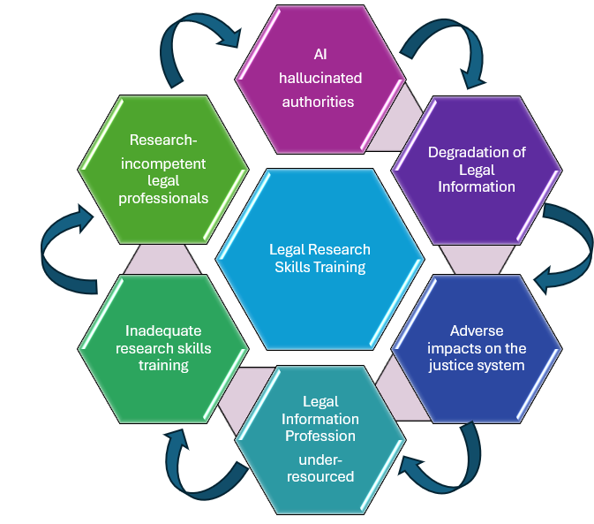
Unseen Impacts
Weakening of CALL-D (from 17 down to 9)
Erosion of the potential for joint advocacy
Declining vendor accountability and transparency
Fewer eyes holding governments accountable
Deterioration of skills of librarians serving the Faculty of Law
Legal research skills no longer sought in hiring processes
Declining options for mentorship and development
Declining relationship between the Faculty of Law and law librarians

Slide 50
Unseen Impacts
Employers unaware of what services could be offered
Declining research competency standards across the board
Deterioration of evidence-based decision making
Erosion of employer demand for legal research-competent librarians
Decline in educational pathways to obtain legal research competence
Undermining of CALL/ACBD and other professional networks

Slide 51
Unseen Impacts
Reduced co-operation in advancing and protecting access to legal information.
Examples of past collaborations:
• Index to Canadian Legal Literature^{[22]}
• KF Modified classification system and its subsequent enhancement project^{[23]}
• The Canadian Abridgment^{[24]} (and its move to digital format)^{[25]}
• The Canadian Guide to Uniform Legal Citation (McGill Guide)^{[26]}
• The Canadian Judicial Council’s Neutral Citation Standard for Case Law, and Canadian Guide to Uniform Preparation of Judgments^{[27]}
• CanLII^{[28]} and CanLII Advisory Board^{[29]}
• Large scale digitization projects such as Osgoode Digital Commons^{[30]}
• Canadian Open Access Legal Citation Guide Group, Canadian Open Access Legal Citation Guide^{[31]}
• Copyright Committee and advocacy for fair dealing as it pertains to libraries and legal materials.^{[32]}
• Report of the AI Working Group^{[33]}

Slide 52

Potential Impacts on the Profession
“Will librarians with legal expertise be eliminated entirely in academic settings in future decades, not because the expertise was not needed by users, but because the expertise was denied to them by decision makers?
Ultimately, unwitting users may have the need for legal information expertise obscured from them. Research competency, accountability and transparency in law and governance generally all stand to lose when administrators are disconnected from the core competencies required of law librarians.”
We don’t know what we don’t know.

Slide 53
Head has a Seat on Faculty Council
Includes only responding libraries.
7 of 7 (100%)
Sit on Faculty Council
5 of 10 (50%)
Sit on Faculty Council
Reporting to Dean of Law
(exclusively or Dual Reporting requirement)
Reporting to UL alone

Slide 54
Law Representation on Head Hiring Committee
Includes only responding libraries.
5 of 6 (83%)
Hiring Committee for Law Library Head
2 of 6 (33%)
Hiring Committee for Law Library Head
Reporting to Dean of Law
(exclusively or Dual Reporting requirement)
Reporting to UL alone

Slide 55
Law Representation on Librarian Hiring Committees
Includes only responding libraries.
4 of 6 (67%)
Hiring Committee for Law Librarians
3 of 6 (50%)
Hiring Committee for Law Librarians
Reporting to Dean of Law
(exclusively or Dual Reporting requirement)
Reporting to UL alone

Slide 56
Recommendations
Recommendation #1
The academic standards should be amended to give prominence to the following principle: persons employed as academic law librarians should have sufficient legal education and experience be able to competently educate law students on core legal research skills required by the Federation Report.
Recommendation #2
To ensure that appropriate levels of legal research expertise are available to faculty of law users, the standards should include new language requiring that law faculty members have representation on hiring and tenure committees for the head of the law library and for the law librarians.
Recommendation #3
The section of the Academic Law Library Standards document pertaining to the director or head of the law library should be maintained. As the data has shown, having a head of the law library is critical to ensuring sufficient communication channels between the faculty of law and the law library.
Recommendation #4
To ensure that law libraries provide appropriate levels of expertise, collections and services, the standards should include new language emphasizing the importance of maintaining some minimum reporting obligations to the Dean of Law. At minimum, law library administrators must be accountable for addressing the legal research and library resources elements of the Federation Report and of any other reporting requirements (e.g. IQAP). Having law librarians sit on Faculty Council is also desirable.c

Slide 57
Let’s Discuss
Moving forward, should the Academic Law Library Standards be curated by the Canadian Association of Academic Directors (CALL-D) or with the CALL Academic SIG?

Slide 58
Reinvigorating Academic Law Library Standards
Annette Demers BA LLB MLIS​
Reference Librarian, Windsor Law​
Past President, CALL/ACBD
Notes:
The Singing Swan (1655) by Reinier van Persijn

