Slide 1

Research Refresher for Moot Teams
By Annette Demers
Reference Librarian
ademers@uwindsor.ca

Slide 2

Agenda
Visualizing the research process
General tips for all mooters
Key tips for:
Case law research
Statutory research (including regulations)
Secondary sources
Other (bills / policy documents / international law)

Slide 3
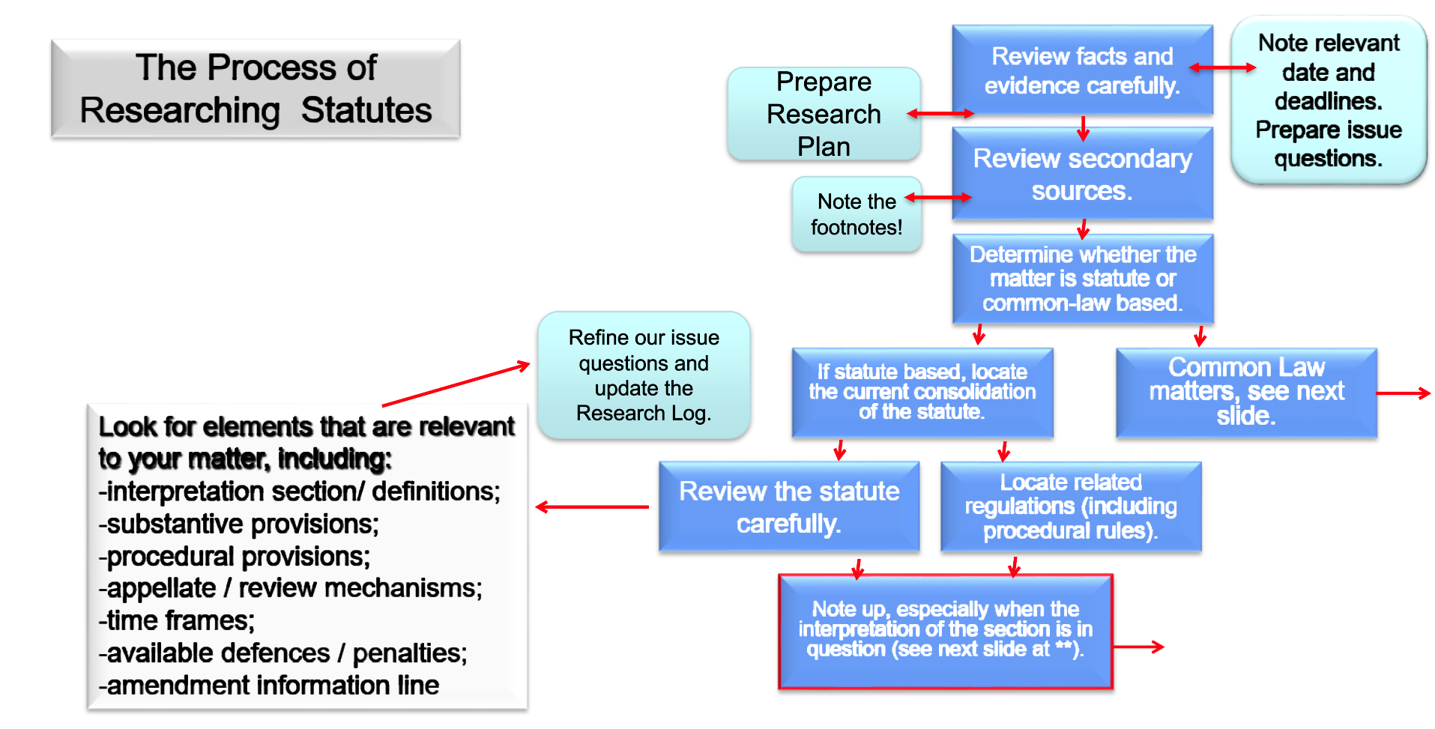
Visualizing the Research Process

Slide 4
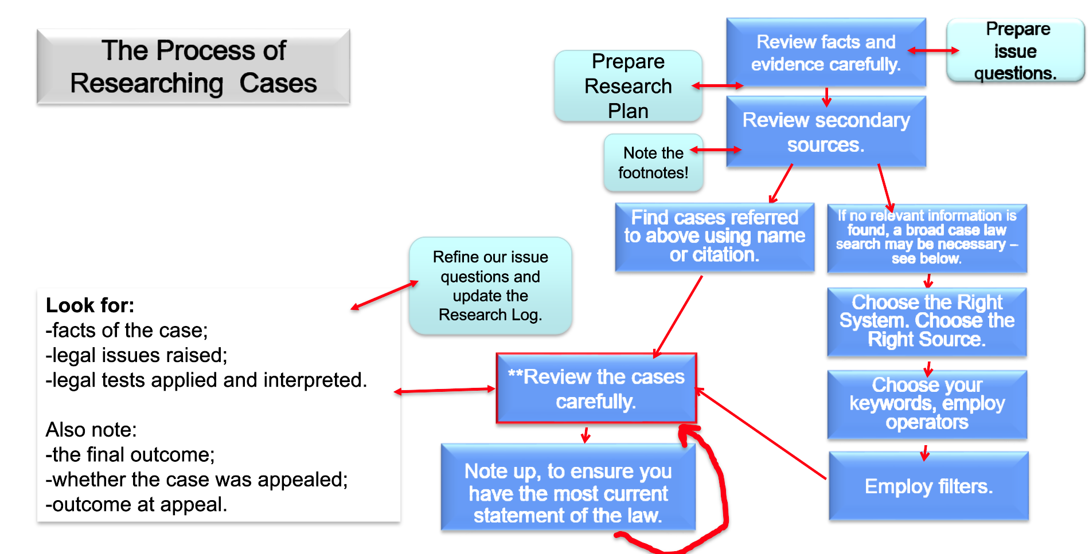
Visualizing the Research Process

Slide 5
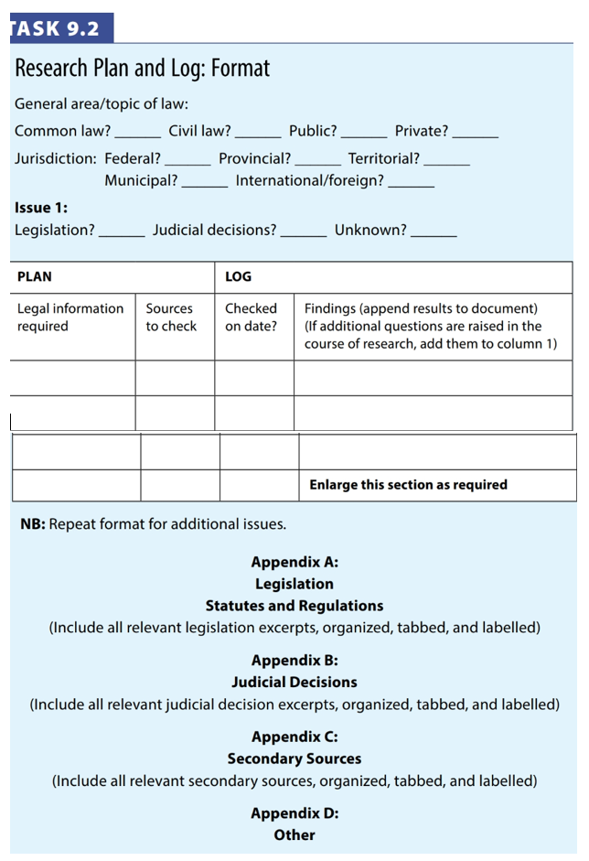
PLAN YOUR RESEARCH

Slide 6
LOG YOUR FINDINGS (Right away!)
PREPARE A PROPER CITATION FOR EVERYTHING
Keep the pinpoints WITH the citations
Use the tools (folders on Westlaw / Lexis)

Slide 7
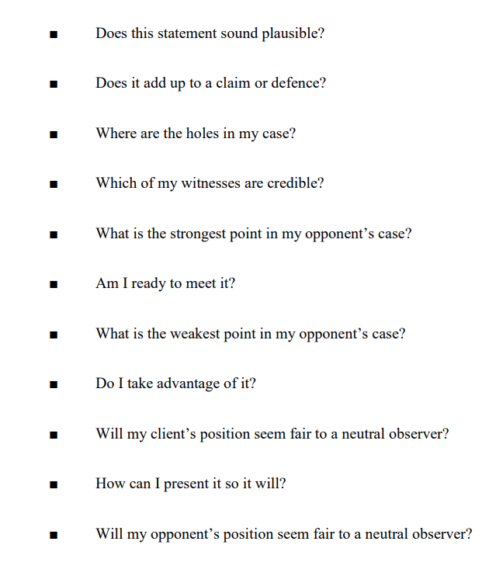
Apply the Facts to the Law to develop your THEORY OF THE CASE Read more: Martin Sclisizzi, “Theory of the Case: How and Why Developed –An Overview”

Slide 8
POLL
ABOUT YOUR MOOT PROBLEM:
Very little research (confined to specific materials)
Statutory
Legislative
Case law or common law
Secondary materials
Treaty law / international materials
Other?

Slide 9
Questions?

Slide 10
Research Refresher for Moot Teams
By Annette Demers
Reference Librarian
ademers@uwindsor.ca

