Slide 1

TRANSnational Criminal Law Research
By Annette Demers BA LLB MLIS
Reference Librarian
ademers@uwindsor.ca

Slide 2
Objectives
In this session you will learn:
-tips for organizing your work
-how to find reference materials, books and articles
-how to find and cite treaties
-how to locate UN documents
-how to locate international judicial decisions
-locating domestic laws from other jurisdictions

Slide 3
Stay Organized
Brainstorming
Framework
Research Plan / Log /
Authorities

Slide 4
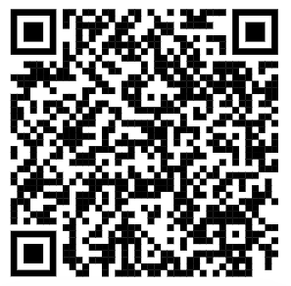
Your Starting Point
International Criminal Law Guide at University of Windsor Law Library
International Criminal Law Guide

Slide 5
Reference Materials
Sample Question:
I need to refresh my memory - what does “accession” mean?
Tools:
Encyclopedic Dictionary of International Law

Slide 6
Reference Materials
Sample Question:
I need to have a better understanding of extraterritoriality.
Tools:
Max Planck Encyclopedia of International Law

Slide 7
Books
Follow the footnotes!
Sample Question:
I need a good text on the international law of human trafficking.
Tools:
Law Library catalogue (OMNI)
or
WorldCat

Slide 8
Journal ARticles
Sample Question:
I need articles on the crime of aggression and Ukraine.
Tools:
HeinOnline
or
Westlaw –World Journals
Use Hein to get article page numbers and to export to McGill Guide citation format!

Slide 9
Treaties
Do your citations as you go!
Sample Question:
I need to find and cite the Rome Statute.
Tools:
UN Status of Treaties website
Citation Components:
Rome Statute of the International Criminal Court, 17 July 1998, 2187 UNTS 3 (entered into force 1 July 2002, ratification by Canada 7 July 2007).

Slide 10
United Nations DOcuments
Sample Question:
I need to find this UN Document:
Report of the Special Committee on the Question of Defining Aggression, UNGA, 26th Sess, UN Doc A/8525 (1971).
Tool:
UN Official Documents Collection (ODS)

Slide 11
International
Judicial Decisions
Sample Question:
I need to find The Prosecutor v. Radoslav Brđanin, IT-99-36-T (1 Sept 24, 2004) (ICTY).
Tools:
International Crimes Database
or
Oxford Reports on International Law
or
Annotated Leading Cases of International Criminal Tribunals

Slide 12
Locating Domestic Law from Other Jurisdictions
Tools:
Foreign Law Research Guide

Slide 13
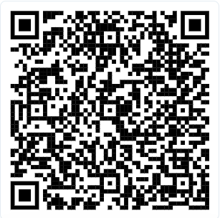
Transnational Criminal Law Research
By Annette Demers BA LLB MLIS
Reference Librarian
ademers@uwindsor.ca
Get these slides by visiting my website!
https://www.uwindsor.ca/law/library/277/annette-demers-law-reference-librarian

