Slide 1


How many work side-by-side with a colleague who wears
a hijab?

Slide 2
How many women who wear hijabs have you worked with?

Slide 3

The Numbers
There are over 1 million Muslims in Canada (Statistics Canada, 2017).
Forty-two percent reported experiencing discrimination in the past five years
(Khan, 2018).

Slide 4

The Numbers, The People
This meta-analysis estimated that Muslim women wearing the hijab are 40% less likely to be employed than otherwise similar Muslim women not wearing the hijab.

Slide 5

Hijab and Employment Discrimination
Authors: Sofia Ahmed and Kevin M. Gorey
Present by
Sofia Ahmed

Slide 6
Outline
Background
Methods
Discussion &
Implications

Slide 7

Background
Hypothesis

Slide 8
Intersecting Oppression
Muslim women can be in ‘triple to quadruple jeopardy’ of experiencing discrimination in employment and in other important structures of society.
Gender/Sex
Religion
Race
Hijab

Slide 9

Discrimination in America
Muslims made up only 2% of the USA population in 2011 but filed 25% of the religious discrimination complaints that year
Many cases involved Muslim women who wore the hijab were denied employment or discharged by their employers (Harrison, 2016).

Slide 10
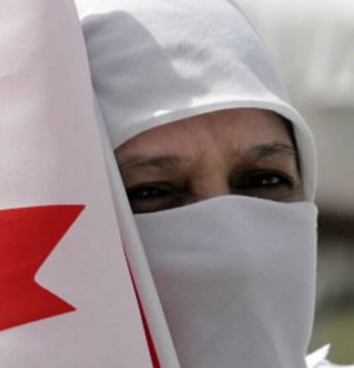
Discrimination in Canada
Quebec banned public employees from covering their faces, reducing employment opportunities for women who wear hijabs (Bilefsky, 2019).

Slide 11
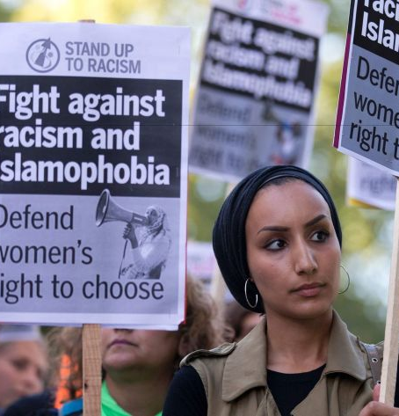
Narrative 1
Eleven of twenty people in charge of hiring educators and health care workers expressed fears of Muslims and associated the hijab with Islamic fundamentalism and being un-American.

Slide 12

Narratives
Three employers of seven hired Muslim women without Hijab described their fears in largely “anti-Muslim workplaces” (Hana-Meksem, 2012; Ireiqat, 2014; Tariq and Syed, 2017).

Slide 13

Narratives
Similarly selected Hijabies described their consistent experiences of discrimination in employment, academia and travel (Hana-Meksem, 2012; Ireiqat, 2014; Tariq and Syed, 2017).

Slide 14
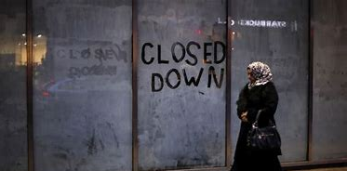
Narratives
Twenty hijab-wearing Muslim women executives, supervisors, and managers told stories about much greater workplace challenges than those of their colleagues who chose more Western or mainstream appearances (Hana-Meksem, 2012; Ireiqat, 2014; Tariq and Syed, 2017).

Slide 15


Muslim women who wear the hijab are disadvantaged in employment processes relative to their counterparts who do not wear the hijab.

Slide 16

Meta-Analytic Methods
Sample Description
Meta-Analytic Findings
Methods & Results

Slide 17

Meta-Analytic Methods
DATABASES
EconLit
Labour Source
ProQuest Sociology Collection
PsycINFO
Social Work Abstracts
ProQuest Dissertations
Theses and Google Scholar

Slide 18

Meta-Analytic Methods
Employment rate ratios
Odds ratios or relative risks (RR).
Natural logarithms of study RRs weighted by inverse variances
Computed standard errors (1/SE²)
Standard estimated by statistics.
Pooled by weighted regression models.

Slide 19
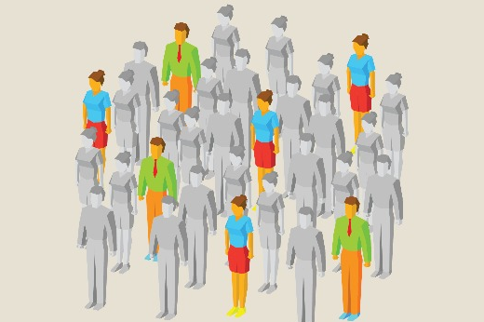
How it is conducted
The meta-analytic hypothesis tested and cross-validated by two analysts.
The seven independent primary study outcomes demonstrated substantial heterogeneity (χ² [6] = 82.60, p < .05).

Slide 20

Finding
All RRs less than 1.00 indicated that Muslim women with hijabs are disadvantages in hiring process

Slide 21
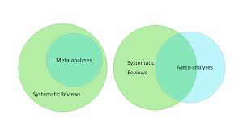
Data
A meta-analysis synthesized the findings of seven studies published between 2010 and 2019in the USA (4) or Germany (3).

Slide 22

Sample Description
Two studies were surveys (n = 2,083)
Two in laboratories, Three in the field (n = 1,474)
The jobs in question
Fictitious in 3 studies
Real in 4 studies.

Slide 23

The sample-weighted pooled estimate suggested
Chances of getting hired/ employed were 47% lower among Muslim women with hijab than not wearing the hijab
(RR = 0.53, 95% CI 0.48, 0.58).
4 study findings statistically significant
3 approached statistical significance (p < .10).

Slide 24

Meta-Analytic Findings
Only one study characteristic, research design, significantly moderated study outcomes.
Hijab disadvantage was smaller among experiments
(RR = 0.60, 95% CI 0.54, 0.67) than the surveys
(RR = 0.40, 95% CI 0.34, 0.47); z = 12.11, p < .05.

Slide 25

Discussion
&
Implications
Conclusions

Slide 26
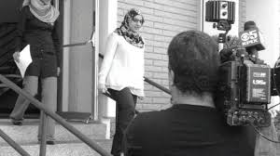
To our knowledge
This is the first synthetic study to specifically examine the influence of wearing the hijab among Muslim women seeking employment.

Slide 27
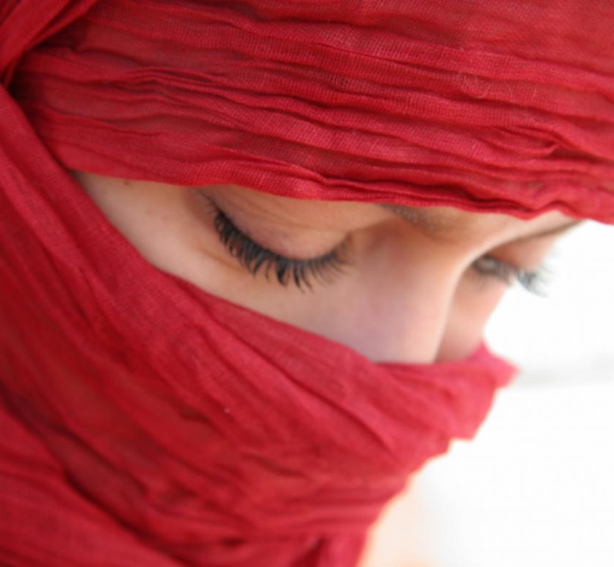
Barriers to employment
Economic dependency on their spouses makes them vulnerable to
Economic abuse
Sexual/physical abuse
Anxiety
Depression
Post-traumatic stress disorder.
I am done…

Slide 28
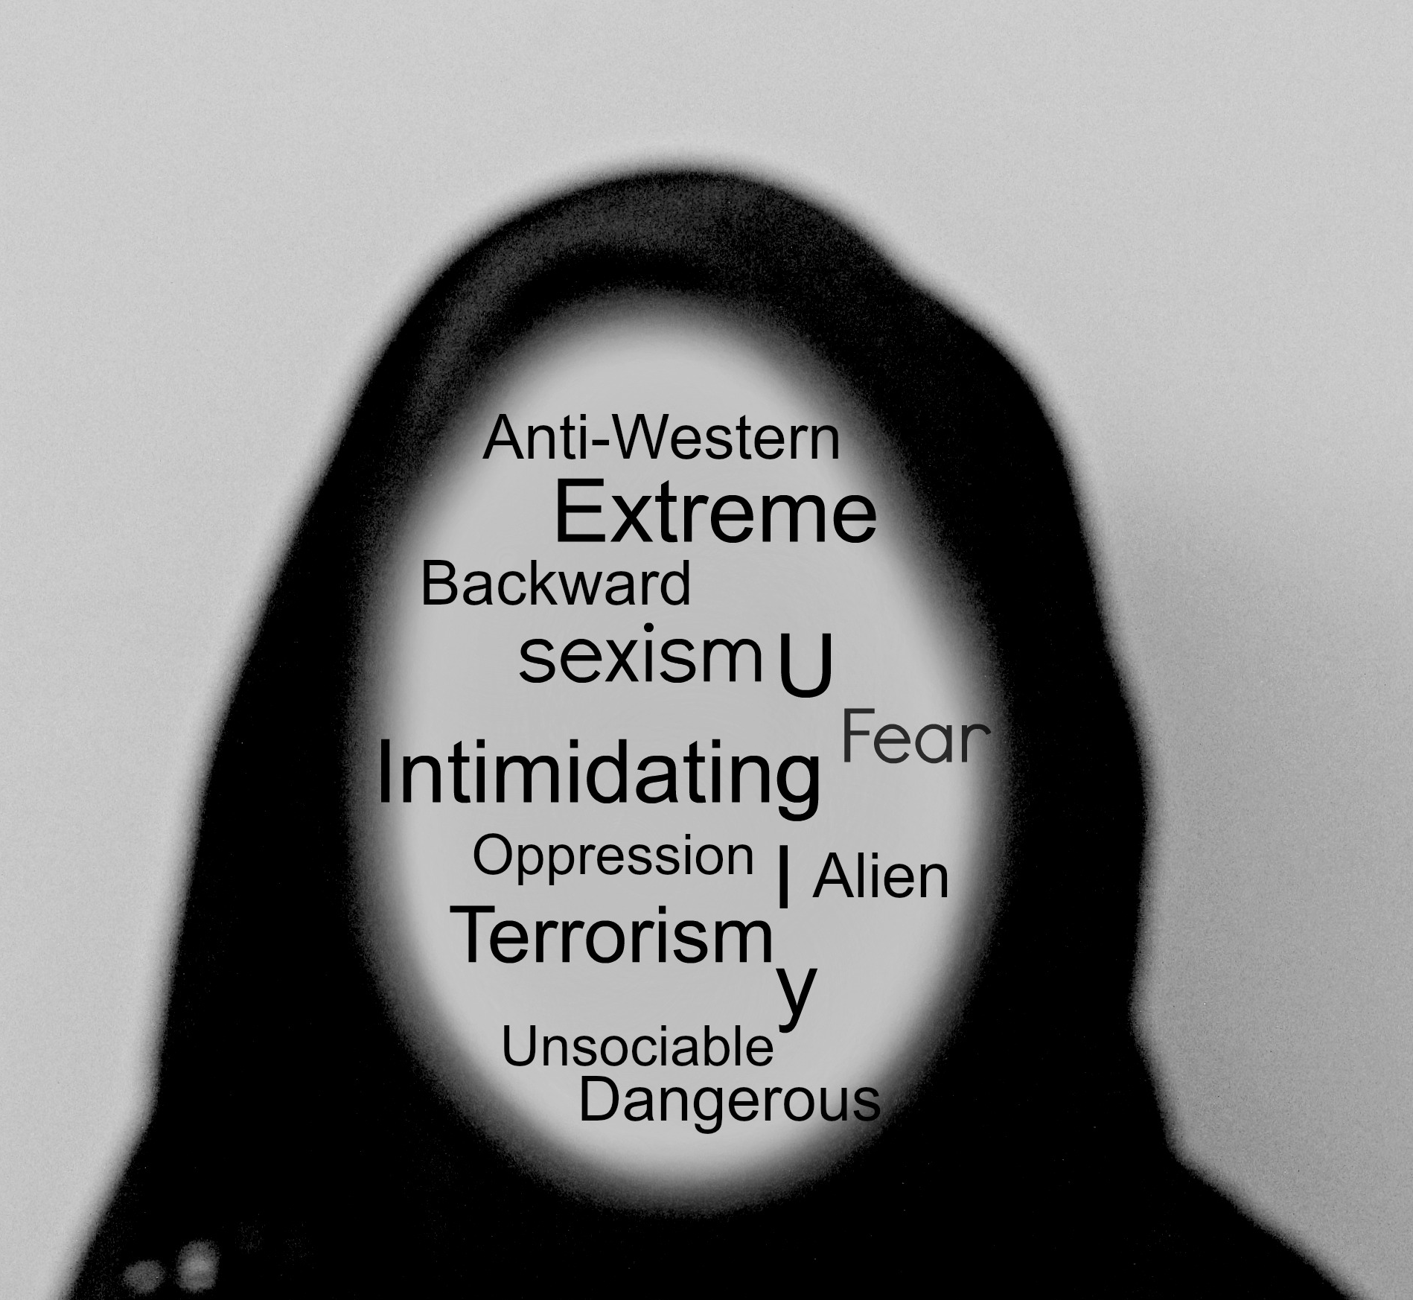
Practice and Policy Implications
Social workers/mental health professionals should learn how Muslim women feels for Hijab. People assumes,
Hijab makes them
oppressed
vulnerable
It’s a reason of male dominance

Slide 29
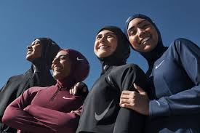
Reality
Cross-validating qualitative and quantitative studies of Muslim women in the contemporary west reported that many feel empowered in wearing the hijab.
It may even provide them with some measure of protection against depression (Hodge et al., 2017).

Slide 30
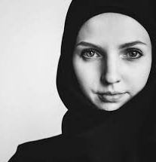
Suggestion
Muslim feminist and Muslim feminists' framework is crucial for Muslim clients.

Slide 31

Limitations
First, the data is from USA and Germany, it glaringly omitted any studies in Canada
Second, it primarily relied on relatively small surveys and experiments.
More study needed….

Slide 32

Conclusions
Millions of Muslim women in the west likely experienced such employment discrimination over the past generations and will suffer over the next generation if policy status quos are retained and not examined the relative risks or protections of diverse national, regional and local policies.

Slide 33

No conflicts of interest were declared.
Conference presentation:
Ahmed, S., & Gorey, K. M. (April, 2020). Employment discrimination faced by Muslim women wearing the hijab: Exploratory meta-analysis.
Paper accepted for presentation at the 6th annual UWill Discover undergraduate research conference at the University of Windsor, ON (Conference canceled).
Manuscript status:
Journal of Ethnic & Cultural Diversity in Social Work, in review
Acknowledgements:
We are grateful for the library science support of Sharon Munro, Leddy Library, University of Windsor.

Slide 34


