Slide 1

Renewal, Tenure/Permanence and Promotion Process (RTP/RPP)
Erika Kustra, Associate Vice-President, Academic
Blair Gagne, Executive Assistant to the Provost and AVPA
April 17 2026
Notes:
Introduce ourselves
Check-in for participants:
How many of you are on RTP/RPP Committees?
How many of you are in your first year as a new faculty member?
How many of you are preparing for renewal (usually 3 years)?
How many preparing for tenure/permanence?
How many post-tenure (review or promotion)?

Slide 2
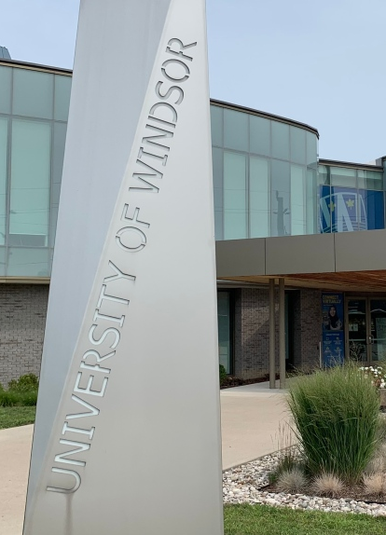
Agenda
RTP/RPP Process Overview
  Timelines
Candidate’s Role
  eCV
  Optional Self-Review
  Teaching Dossiers
Performance reviews
AAU RTP/RPP Committee
Role of UCAPT
RTP/RPP Criteria

Slide 3
Why Is RTP/RPP Process Important?
Individual
Institutional
Provides feedback on progress
Ensures university quality
Careers depend on it!
Mechanism for public accountability

Slide 4
Tenure/Permanence Timeline
1st full-year
  1st Performance Review
Contract Renewal (usually 3 years)
  2nd Performance Review
  RTP/RPP Committee Meeting & UCAPT
Tenure/Permanence (usually 5-6 years)
  3rd Performance Review
  External Reviews
  RTP/RPP Committee Meeting & UCAPT

Slide 5
Submissions for this year
(Chart)
Faculty members hired July 1, 2023, will need a contract renewal conducted this Fall of 2026
Faculty members hired July 1, 2021, will go up for tenure/permanence this Fall of 2026 for tenure July 1, 2027
Note: For those members who have tenure/permanence - performance reviews are conducted every 3 years

Slide 6
Early Tenure
Bylaw 22.4.5: can be considered for tenure after two full years of employment in the probationary appointment at the University. The faculty member initiates the process by application to the AAU Head
Bylaw 22.4.6:
A successful tenure application will automatically result in promotion eg. to Associate Professor, AAS III, Librarian III. (Only one application is required).

Slide 7

What Stops the Clock?
A sick leave or parental leave does not automatically stop the clock. However, if any one of these impacted progress then request a deferral Article 12:05(e)
If defer contract renewal, remember to submit a separate request to defer tenure/permanence if you want one
Leave of absence without pay, or exceptional circumstances can also request a deferral

Slide 8
Summary of Formal Deadlines
If there are deadline concerns, please contact Blair Gagne
July 15 C.A. 5:31 Every faculty updates eCV
September 1 Bylaw 22.4.2 AAU Head informs AAU
October 1 Bylaw 22.4.3/C.A. 5:32 Performance review (PR)
October 15 Bylaw 22.4.4 Review PR
October 31 Bylaw 22.6.5 Renewal info to UCAPT
December 15 Bylaw 22.6.5 Tenure info to UCAPT
January 31 Bylaw 22.6.5 Promotion info to UCAPT
2023 onwards: Senate motion in 2021-2022 will implement tracking of key RTP/RPP milestones to ensure transparency.

Slide 9
Managing Tenure/Permanence and Promotion Timelines
Managing Tenure/Permanence and Promotion Timeline
Recommended Revisions: starting in the spring to have time to recruit referee
April 15 Draft of package submitted by candidate to initiate process
by September 1st: Meet with AAU RTP/RPP committee to select names of external reviewers April 15-30 from lists previously gathered from i) the committee, and ii) the candidate. At least one (1) name selected from the committee’s list, one (1) from the candidate’s list, and one (1) from either the committee or candidate’s list. A total of three referees are required.
by October 1st: Documentation completed for all performance reviews by candidate.
July 15-30
by October 15th: Meet with faculty members to discuss performance reviews.
July 30
August 10 Circulate materials to external referees
by November 17th: RTP/RPP Committee meeting – must have all materials including external
Sept 30-Oct 15 With at least five 5 days notice: circulate packages to RTP/RPP committee.
Consider whether candidate should be invited to attend meeting to provide further clarification prior to RTP/RPP committee recommendation.
by November 28th: The RTP/RPP committee completed final review of applications.
by December 1st: All documentation completed by the AAU Head and reviewed by the
RTP/RPP committee members for feedback.
by December 5th: Documentation delivered to the Dean for Dean’s comments.
December 15th: Applications delivered to the Chair of the UCAPT.

Slide 10
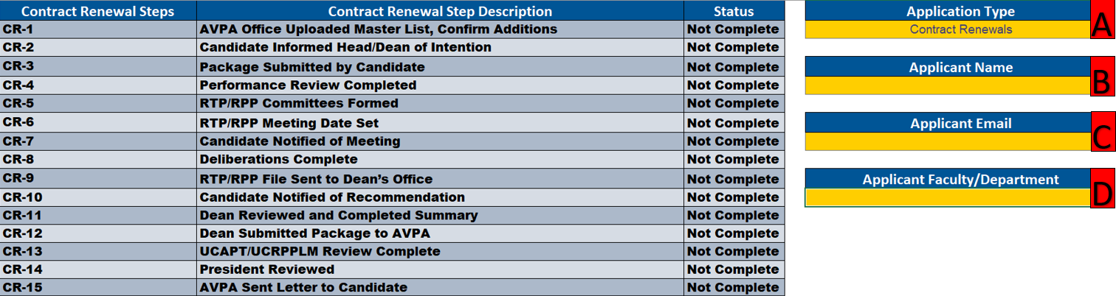
RTP/RPP Tracking
For AAU Heads/Admin
A process to raise transparency in the RTP/RPP Process
Mandated by Senate to develop a process for this Fall (voted June 2022)
Automatic emails about progress
More complete enterprise process review underway

Slide 11
Key Components: Overall Process
AAU RTP/RPP Criteria
Candidate Application Package
External Reviewer names (Only for tenure/permanence, promotion)
Candidate
AAU Head
Performance Reviews
(1 year, renewal, tenure/permanence, promotion, every 3-years post-tenure)
Coordinate Process
RTP/RPP Committee
External Reviewers
Review Application package and complete UCAPT Evaluation Form
Dean of Faculty
Comment in UCAPT Evaluation Form
UCAPT
Review package and make recommendation
NOTE 1: Not all elements apply in all situations, but most elements apply to both tenure-track, TIF, and AAS permanence positions.
President
Board of Governors
Notes:
UCAPT University Committee on Academic Promotion and Tenure

Slide 12
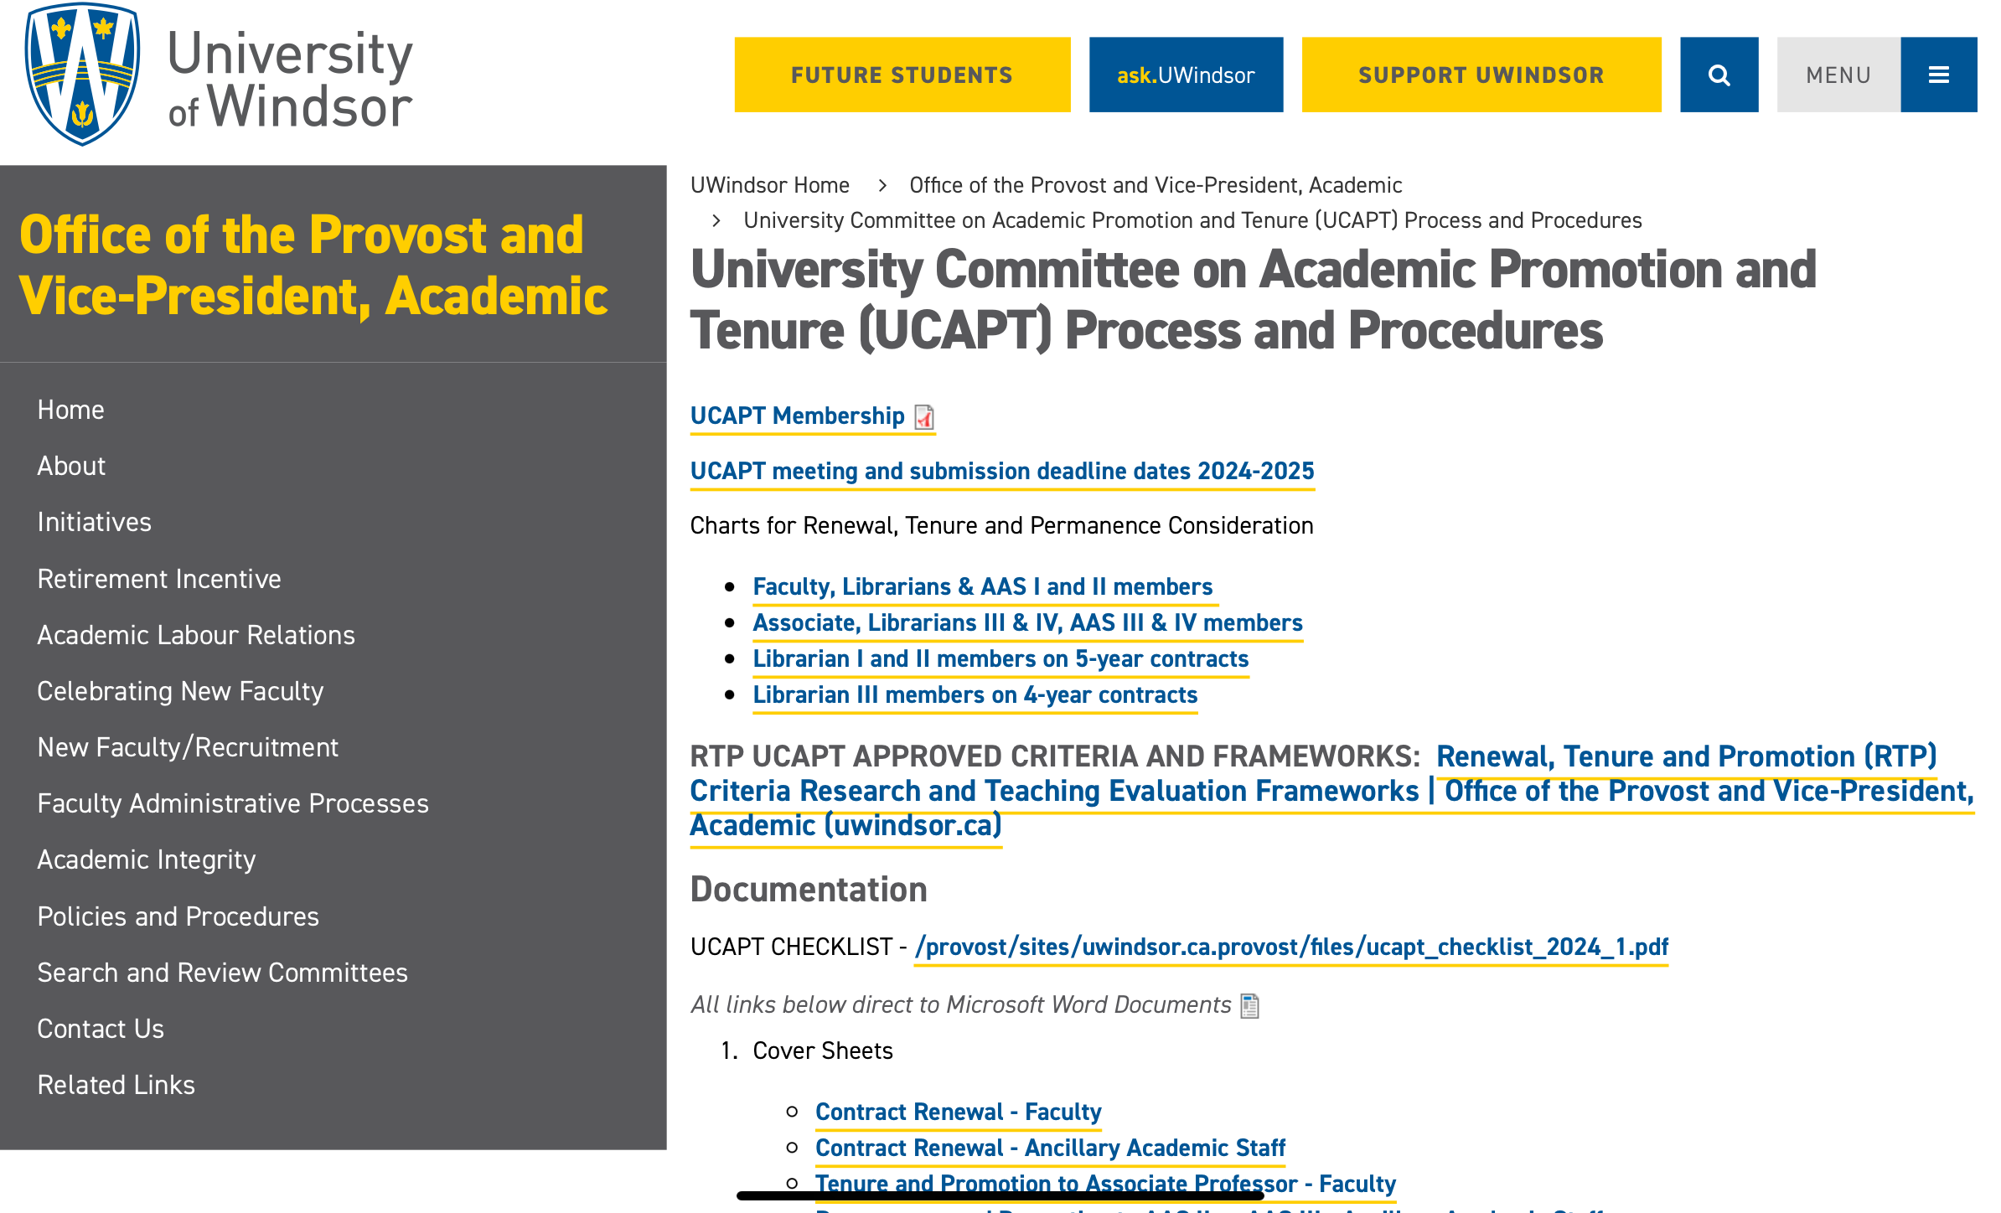
UCAPT Website Resources
https://www.uwindsor.ca/provost/336/university-committee-academic-promotion-and-tenure-ucapt-process-and-procedures

Slide 13
Key Components: Overall Process 2
AAU RTP/RPP Criteria
Candidate

Slide 14
Role of the Candidate
Select and review RTP/RPP criteria
Prepare package:
  Electronic Curriculum Vitae mandatory (CA 5.31: uwindsor.ca/ecv) - add support for in-press
    Share access with your AAU Head
  Self-Assessment (Optional?)
  Teaching Dossier (Optional?)
  Other supports based on criteria, draft Table 3
Use the cover sheet checklist, submit a final pdf package to Head

Slide 15
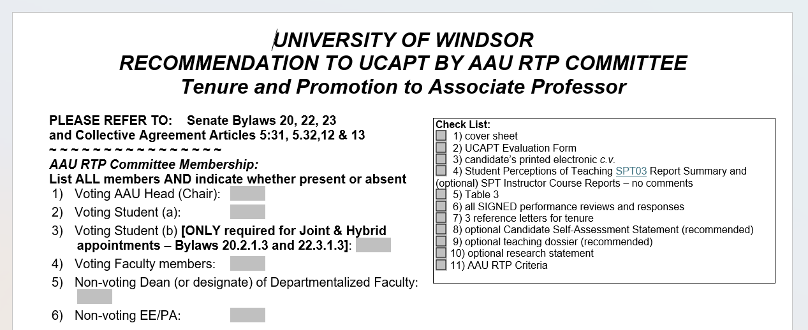
UCAPT Cover Sheet
https://www.uwindsor.ca/provost/336/university-committee-academic-promotion-and-tenure-ucapt-process-and-procedures
Notes:
Blair?

Slide 16
Select Your RTP/RPP Criteria
Candidates may follow the AAU criteria and standards in place at the time of their initial appointment or any AAU criteria and standards approved thereafter. (Bylaw 23.2.2).
Candidates can ask AAU for past criteria or look on UCAPT site for most recently approved.

Slide 17
RTP/RPP Criteria
Transparency, grounded in the discipline
Known to the candidate
Reasonable within discipline and unit
Measurable where possible
RTP/RPP criteria are reviewed annually – must have Faculty Coordinating Council and UCAPT approval. (Bylaw 22.4.1-22.4.1.2)
UCAPT approves new and updated criteria
Include dates for approvals (like Senate), to indicate what changes have been made.

Slide 18
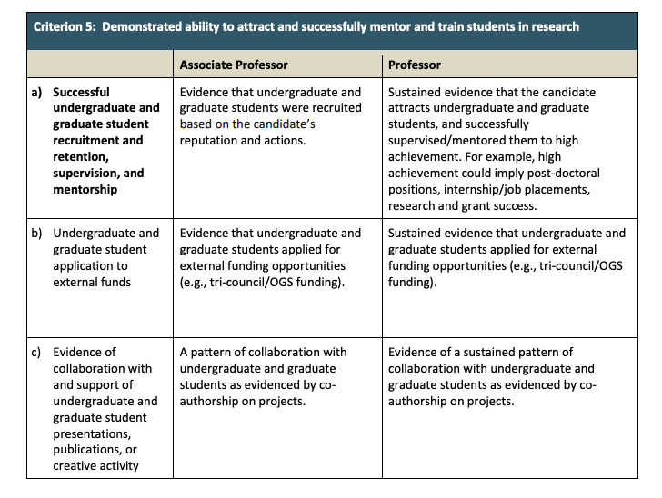
Example RTP/RPP Criteria from Kinesiology 2021
(Teaching Section)

Slide 19

Intentionally Identify Strengths and Gaps

Slide 20

Self-Evaluation
Best foot forward!
Pink Resource Guide (Page 35 or Table)
Refer to your RTP/RPP Criteria
Teaching Ability and Performance
Research, Scholarly and Creative Activity
Service: Contributions to the University and to the Academic Profession in areas exclusive of teaching and research
Overall Self Assessment

Slide 21

Teaching Dossier
Centre for Teaching & Learning https://www.uwindsor.ca/ctl/
A succinct document that provides a portrayal of your teaching:
What you believe / value?
What you do (activities, methods)?
What impact do you have?
University of Windsor Teaching Dossier guide and template

Slide 22
Triangulate Evidence
Self
Students
Colleagues
Literature
  Provide multiple sources of evidence
  New Student Perception of Teaching (SPT) – one source among others
  (Brookfield, 1995)

Slide 23

Student Feedback

Slide 24
Student Evaluations of Teaching (SET)
Reminder from COVID: Including SET Scores is instructor’s choice for Winter 2020-August 2023
- remember to let your AAU Head know your preference
SET scores were not collected for Winter 2020 during COVID
SET scores were optional to include in RTP/RPP for the entirety of the COVID-19 period March 2020-June 2022 by Senate COVID decision See message from the Provost’s office
June 2022-August 2023, SET scores were also optional as the SET Task Force completed its work and the changes were being implemented by Senate vote.
For old SET reports reach out to Department first then, reach out to IT

Slide 25
Student Perceptions of Teaching (SPT)
SPT Policy Approved May 2023 and used from Sept 2023
SPT User Manual: includes UWindsor and Faculty norms
Delivery of reports: Sent to instructors directly, and to Heads through an SPT Teams Channel for AAUs
To request a report: Submit an IT ticket for assistance
Questions: spt@uwindsor.ca
Notes:
Erika

Slide 26
Student Feedback: SPT/SET
Instructors receive SPT-01a reports for every course taught (where there are more than 3 students)
  ONLY instructors receive the written student comments
There is an SPT report (SPT-03) for RTP/RPP summary that the AAU Heads will request
Submit a ticket for assistance.

Slide 27
SPT-03 Report: Ratings for use in RTP and Performance Reviews
Semester Teaching Summary

Slide 28
SPT-03 Report- Ratings for use in RTP and Performance Reviews
Courses by Semester
Same information, same instructor sorted by course level.

Slide 29
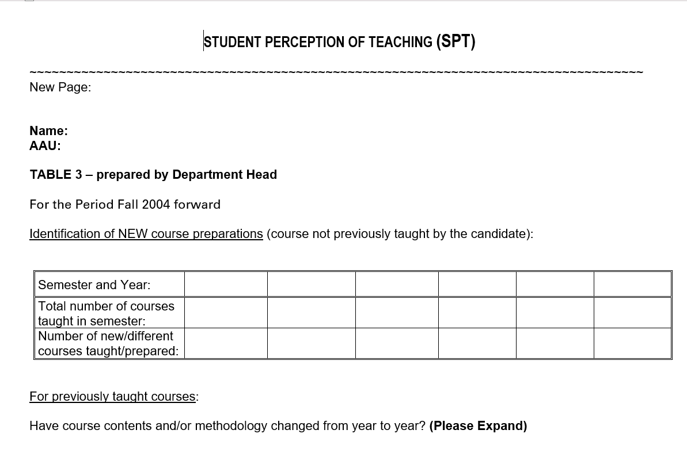
Table 3
Table 3

Slide 30
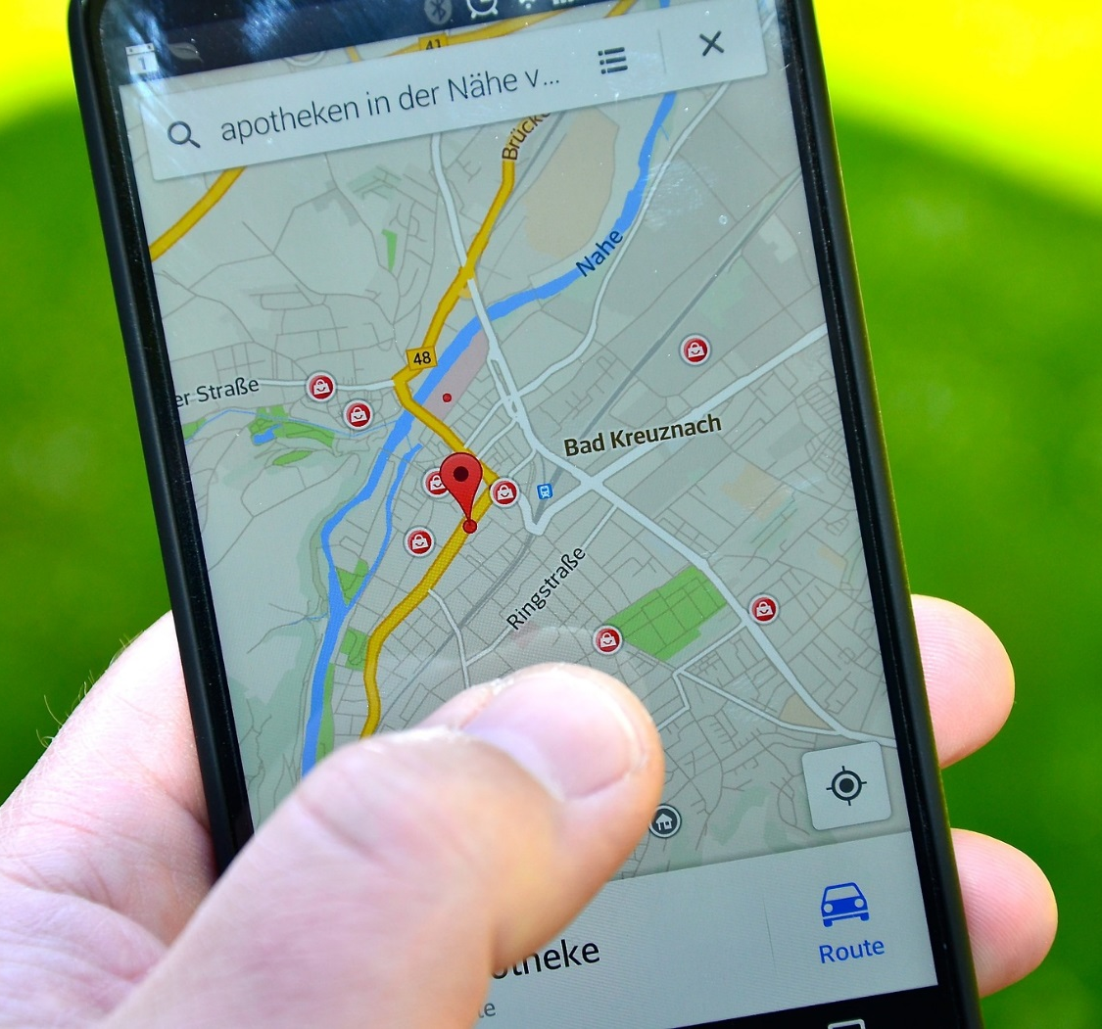
Next Steps to Prepare Your Package
Open a teaching dossier file
Schedule updates for dossier and eCV
Use electronic calendars to track details
Gather explicit evidence
Involve a colleague/critical friend
Compare with your criteria
Meet with your Head/Dean
Teaching Dossier
You are here

Slide 31
Key Components: Overall RTP/RPP Process 2
AAU RTP/RPP Criteria
Candidate
AAU Head
Performance Reviews
(1 year, renewal, tenure/permanence, promotion, every 3-years post-tenure)
Coordinate Process

Slide 32
Performance Reviews (Bylaw 22.4)
Recommend submitting at least a draft of the full package for PR
  Confirm AAU criteria since hire (Bylaw 23)
  Confirm preference for SET March 2020 – August 2023
Performance Review shared by the AAU Head in writing
  Good practice to meet to review together
  Sign the Performance Review
  Candidates have the right to make a written response that is kept with the file permanently.
Dates: Completed by the AAU Head and signed by October 1

Slide 33
Equity, Diversity, Inclusivity
WUFA Collective Agreement LETTER XI - Valuing the Service Contributions of Black, Indigenous, and Racialized Members
To allow a member’s service contributions to be devoted to service that in the member’s opinion is for the benefit of Black, Indigenous, or racialized students or their communities.
  Meet regularly (ideally every year) to discuss workloads

Slide 34
Performance Reviews Continued
Head will share their planned recommendations to be submitted to the AAU RTP/RPP Committee (Bylaw 22.4.4.2)
In cases where the AAU Head proposes not to recommend renewal of contract, promotion or tenure, the Head will advise the faculty member of this in writing within 2 working days of conducting the review in 4.4.1. (Bylaw 22.4.4.3)
Faculty member may make written application to the RTP/RPP Committee for consideration within 2 working days

Slide 35
Performance Reviews – Post-Tenure
Bylaw 22.4.3.2 - Every 3 years
By October 1, the AAU Head shall complete a Performance Review every three years for each tenured faculty member of the AAU relating to the criteria for promotion to Professor specified in Bylaw 23.
Bylaw 22.4.3 – Faculty can request one too!
By September 15, a tenured faculty member wishing a Performance Review communicates the request to the AAU Head, and the Performance Review is to be completed by October 1.

Slide 36
Procedural Fairness
Candidate has full opportunity to:
Tell your story: Complete and submit c.v., optional self-assessment statement and optional teaching dossier
Know the Head’s view of performance in writing and to respond in writing
Appear and speak at RTP/RPP meeting
View the completed UCAPT documentation (redacted for external reviewers)
Respond regarding negative recommendations

Slide 37
Key Components: Overall Process 3
AAU RTP/RPP Criteria
Candidate
AAU Head
AAU RTP/RPP Committee
External Reviewers
Review Application package and complete UCAPT Evaluation Form

Slide 38
RTP/RPP Committee [Bylaw 22.3]
Non-departmentalized Faculty
  Dean [Chair of RTP/RPP Committee]
  3 to 5 regular faculty elected by regular faculty members at AAU council – majority must be tenured
  One student (see Bylaw 22.3.1.5)
  Equity Assessor [non-voting]
  Two different genders to be represented from members, one must be female, excluding student

Slide 39
Departmentalized Faculty
…as above except:
  Dean (or delegate) of faculty [non-voting]
  AAU Head, [chair of RTP/RPP committee]
  3 to 5 regular faculty elected by regular faculty members at AAU council – majority must be tenured
  One student (see Bylaw 22.3.1.5)
  Equity Assessor [non-voting]
  Two different genders to be represented from members, one must be female, excluding student

Slide 40
Quorum for RTP/RPP Committee
Quorum is one less than the full voting membership of the AAU RTP/RPP Committee (Bylaw 22.6.1).
A student must be on the committee, but could be the one not be present, and you can still hold a meeting.
… however, meetings should not be scheduled so that they preclude certain members from being able to regularly attend.

Slide 41
Selecting External Reviewers
Options identified by the Candidate
Options identified by RTP/RPP Committee
Include bio for each suggestion to help
Select 3 Externals to provide peer review: select 1 from each list, last can be from either
Avoid Conflict of Interest – arms-length
Recommend start early!! Consider selection in Spring

Slide 42
Role of the Chair continued
Head reaches out for external reviewers for tenure/permanence or promotion to professor (candidate cannot be in contact)
Check documentation is complete. The committee should NEVER review incomplete material.
  Checklist on the UCAPT Cover sheets
At least 48 hours before the meeting, inform candidate in writing of the date and time and of their right to make personal representation to the Committee (Bylaw 22.5.2)

Slide 43
Role of the Chair continued
Chair the RTP/RPP Committee Meeting
All members except the EE/PA and the Dean (in the case of Departmentalized Faculty) will have a vote
The vote will be by secret ballot
A decision is reached by a majority vote of the voting members present
Tie vote = a positive recommendation

Slide 44
Role of the Chair after the Meeting
Complete the UCAPT Evaluation Form with the RTP/RPP committee
Complete the UCAPT Cover Sheet
Forward package for Dean’s recommendations (in departmentalized Faculties)
Inform the candidate of the recommendation
Forward package to UCAPT

Slide 45
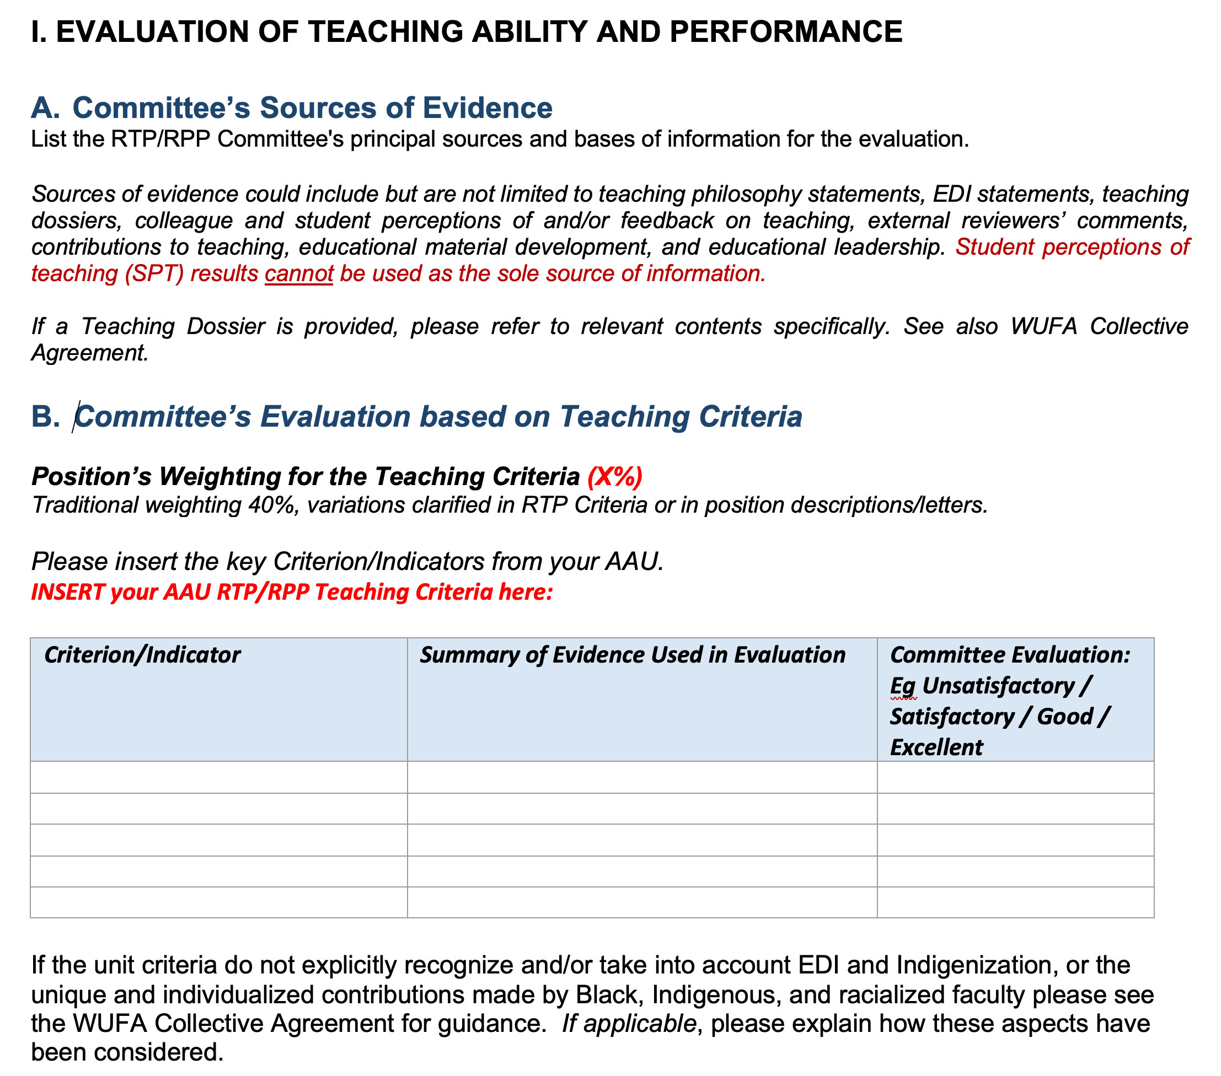
UCAPT Evaluation Form
Evaluation categories will come from AAU RTP/RPP criteria categories
Provides opportunity for insightful commentary
Template
Notes:
Erika
Examples of approved RTP/RPP Criteria https://www.uwindsor.ca/provost/325/renewal-tenure-and-promotion-RTP/RPP-research-and-teaching-evaluation-frameworks

Slide 46
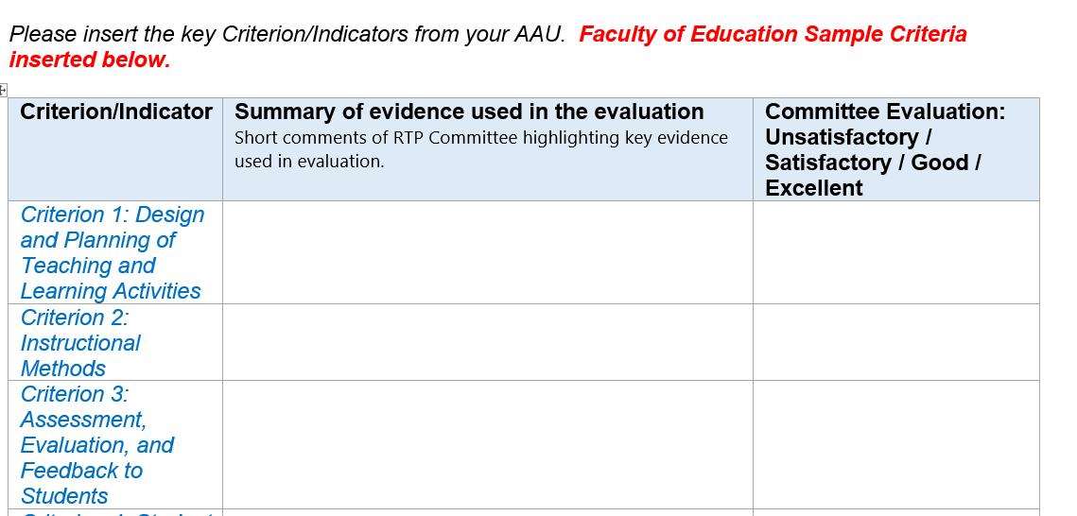
Sample UCAPT Evaluation Form
Notes:
Erika
Examples of approved RTP/RPP Criteria https://www.uwindsor.ca/provost/325/renewal-tenure-and-promotion-RTP/RPP-research-and-teaching-evaluation-frameworks

Slide 47
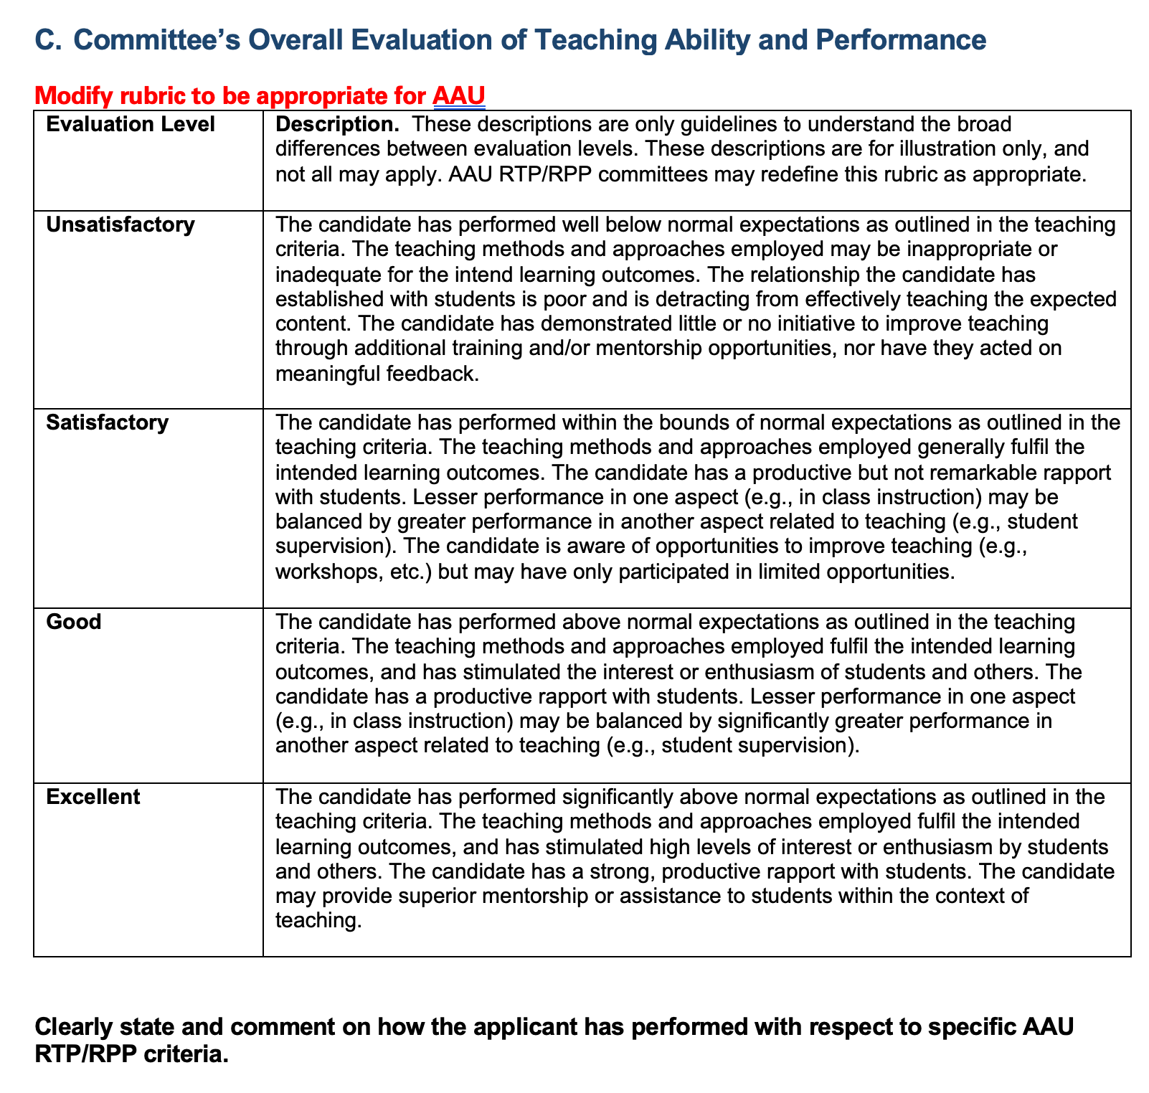
UCAPT Evaluation Rubric
Rubric provided for guidance – can be modified to reflect AAU context
Emphasis is to comprehensively review teaching, research, service
Notes:
Recommend using the new form during performance reviews

Slide 48
Key Components: Overall RTP/RPP Process 4
AAU RTP/RPP Criteria
Candidate
AAU Head
AAU RTP/RPP Committee
Dean of Faculty
Comment in UCAPT Evaluation Form
UCAPT
Review package and make recommendation

Slide 49
Role of UCAPT
University Committee on Academic Promotion and Tenure
Ensure fair process
Ensure application of the criteria/standards
Review new or revised criteria/standards
Make a recommendation to the President
Chair of UCAPT only votes to break a tie

Slide 50
Summary: Making the RTP/RPP Process
Fair and Meaningful
For applicant
  be as complete as possible
  Put your best foot forward: ensure your record is complete and accurate (e.g., avoid “double dipping” when itemizing achievements)
  If there is a discrepancy, you will be invited to present – this is a positive because this is your opportunity to present your case. It is NOT punitive
For committee members
  be objective and thorough, declare any potential or perceived conflicts
UCAPT’s purpose is to be the neutral party

Slide 51
Useful Resources
University Committee on Academic Promotion and Tenure
(UCAPT) Process and Procedures
Guides
Sample forms
Link to approved RTP/RPP Criteria

Slide 52
Teaching Dossier Resources
University of Windsor Template
University of Alberta – good examples of support documents
https://www.uwindsor.ca/ctl/502/teaching-dossiers
Teaching Dossier Academy (TDA) – first week of June each year
https://ctl2.uwindsor.ca/workshops/3/
TDA Resources
https://www.uwindsor.ca/ctl/sites/uwindsor.ca.ctl/files/tda-resource-booklet-2021.pdf
One-on-one Consultations
https://www.uwindsor.ca/ctl/347/teaching-dossier-consultation
Observations and Feedback
Peer Collaboration Network https://www.uwindsor.ca/pcn/
CTL https://www.uwindsor.ca/ctl/346/teaching-observations
Images: Pixabay

Slide 53

Thank you!
Feel welcome to stay and ask questions avpa@uwindsor.ca avpasec@uwindsor.ca

Slide 54
Managing Contract Renewal Process Timeline
Managing Contract Renewal Process Timeline
Suggested Timeline to meet October 31 deadline
by June 30th All performance review documents drafted.
by September 8th: Meet with faculty members to discuss performance reviews.
by September 15^{th:} Invite candidate to meet with RTP/RPP committee.
With at least five 5 days notice: circulate packages to RTP/RPP committee.
by September 19th: Initial review of each candidate completed by the AAU RTP/RPP committee. Consider whether candidate should be invited to attend an additional meeting to provide further clarification prior to RTP/RPP committee recommendation.
by October 3rd: The AAU RTP/RPP committee has completed its final review of each application.
by October 10th: Documentation completed by the AAU Head has been reviewed by the AAU RTP/RPP committee members.
by October 20th: Documentation delivered to the Dean for the Dean’s comments.
October 31st All applications delivered to the Chair of the UCAPT.

Slide 55
Managing Promotion Process Timeline
Managing Promotion Process Timeline
Suggested Timeline to meet January 31 deadline
Try starting in the spring – to have time to recruit referees
by October 1st: Documentation completed for all performance reviews. Meet with AAU RTP/RPP committee to select names of external reviewers (min. 3) from lists previously gathered from i) the committee, and ii) the candidate. At least one (1) name selected from the committee’s list, one (1) from the candidate’s list, and one (1) from either the committee or candidate’s list. A total of three referees are required.
by October 15th: Meet with faculty members to discuss performance reviews.
External reviewers have agreed they will serve as referees.
by November 1st: Reference materials circulated to external reviewers.
by December 20th: Candidate invited to the upcoming RTP/RPP committee meeting.
With at least five 5 days notice: circulate packages to RTP/RPP committee.
by January 7th The RTP/RPP committee met and completed its initial review.
Consider whether candidate should be invited to attend an additional meeting to provide further clarification prior to RTP/RPP committee recommendation.
by January 14th: The RTP/RPP committee completed final review of applications.
by January 17th: All documentation completed by the AAU Head and reviewed by the
RTP/RPP committee members for feedback.
by January 21st: Documentation delivered to the Dean for Dean’s comments.
January 31st: All applications delivered to the Chair of the UCAPT.

