Slide 1
Student Perceptions of Teaching (SPT)
December 2023

Slide 2
Purpose
To provide feedback on the teaching and course design
To provide one element of evidence for renewal, tenure/permanence, promotion, and career development
The SPT replaces the previous Student Evaluation of Teaching (SET) form

Slide 3
Process
Surveys are submitted online
Time will be allotted at the start of class
Survey remains open until the last class
You can provide ratings and written comments; comments are only shared with the instructor
Responses are confidential and shared with instructors only after grades are submitted

Slide 4





Grading Expectations & Feedback
Instructor Delivery
Positive Learning Environment
Survey: Areas of Focus
Facilitation of Learning
Workload & Difficulty
Student Motivation
Global Questions
Student Learning Questions

Slide 5

Example of Question Style
Please note that there are different descriptive anchors for each question
1 | For each class, the instructor was… | Poorly prepared | ○ | ○ | ○ | ○ | ○ | ○ | ○ | Well prepared
2 | Material was presented in a well-organized manner. | Almost never | ○ | ○ | ○ | ○ | ○ | ○ | ○ | Almost always
3 | Instructional time was used... | Not efficiently | ○ | ○ | ○ | ○ | ○ | ○ | ○ | Very efficiently
4 | The instructor was able to communicate complex ideas clearly. | Strongly Disagree | ○ | ○ | ○ | ○ | ○ | ○ | ○ | Strongly Agree
5 | The instructor elaborated on concepts in ways that were helpful for understanding. | Not at all true | ○ | ○ | ○ | ○ | ○ | ○ | ○ | Very true
6 | The instructor's knowledge about the content of this course was… | Poor | ○ | ○ | ○ | ○ | ○ | ○ | ○ | Exceptional

Slide 6
Constructive Feedback
Feedback should "feed-forward”
Note, feedback can be influenced by unconscious or unintentional biases - try to focus your answers on the content of the course and your opinions about the quality of instruction
Demographic questions are asked to help the University understand the impact of different factors on the ratings - instructors will not be able to see this information

Slide 7
Please take ~10 minutes to complete the survey
Go to: ask.Uwindsor.ca → “How do I access and complete an online SPT?”
The system may have slight delays loading as we work through the initial implementation phase
Questions? Reach out to spt@uwindsor.ca
Thank you!

Slide 8
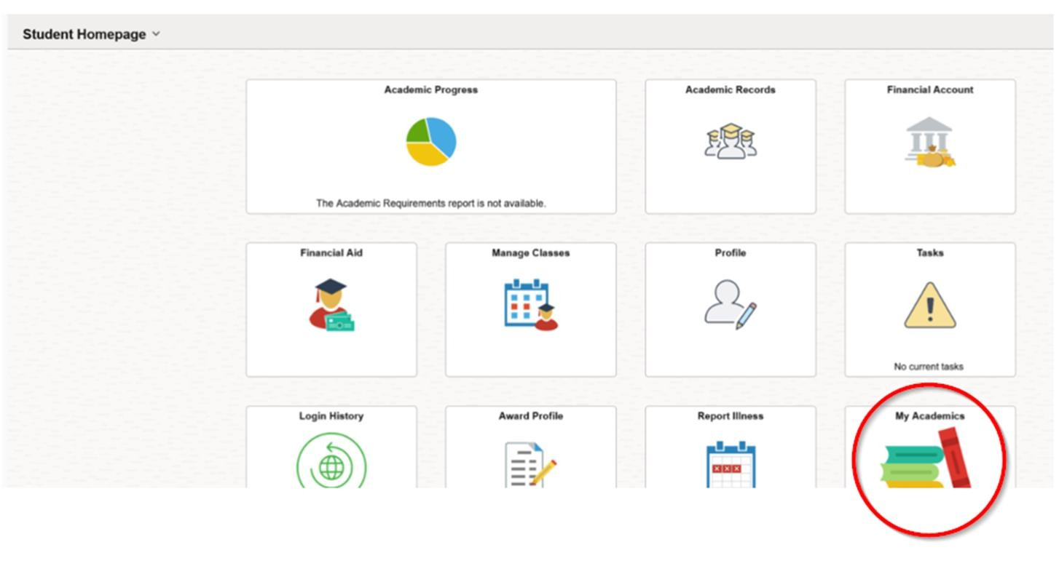
Log into UWinsite and select My Academics

Slide 9
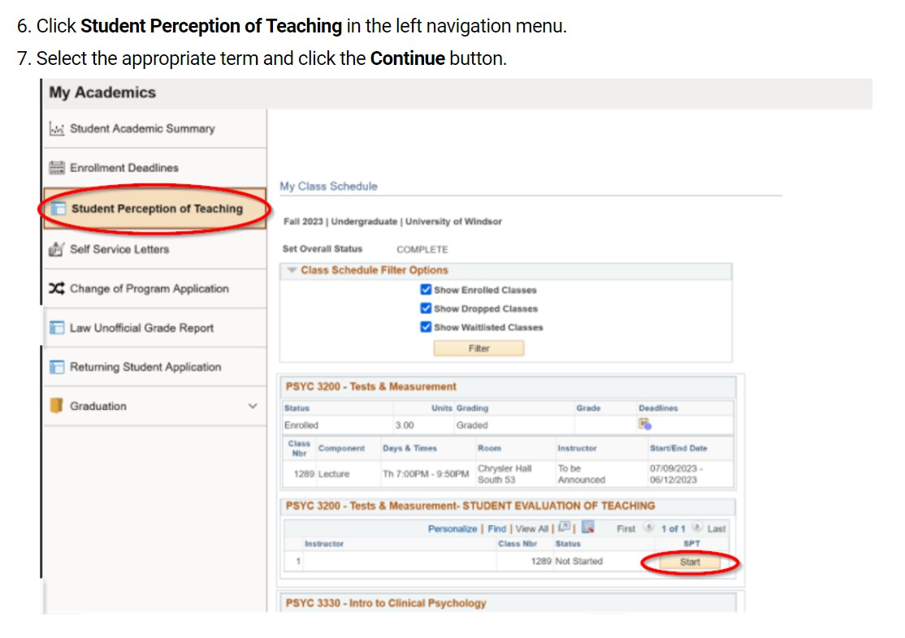
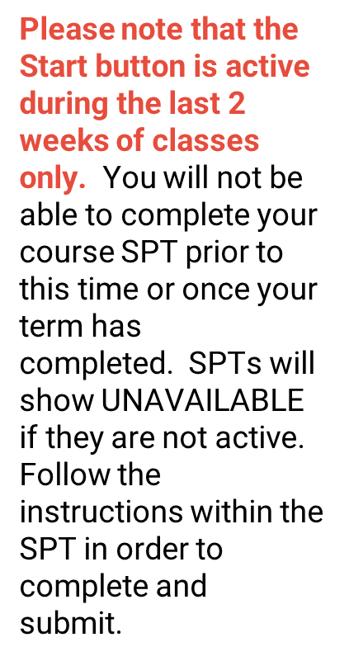
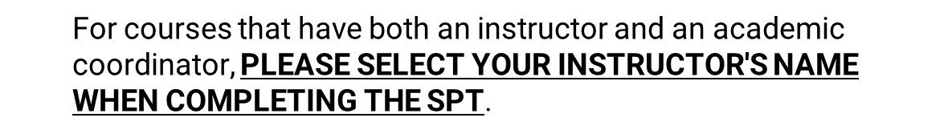
Select Student Perception of Teaching
from the menu and press Start

Slide 10
Resources
Step by step guide to access SPTs:
https://ask.uwindsor.ca/app/answers/detail/a_id/176/~/how-do-i-access-and- complete-online-student-perceptions-of-teaching-%28spt%29%3F
Technical issues? Submit a ticket: Service - Student Perception of Teach... (teamdynamix.com)
Questions? spt@uwindsor.ca

