Slide 1
Qualtrics Security
Author: Mathew Chandler

Slide 2
Data Residence
Qualtrics owns data servers within Canada.
Surveys created under the University of Windsor account will reside on a server within Canada.
Surveys and the accompanying data is backup to a secondary server within Canada.
In case of catastrophic server failure, data is backup to a server within Ireland.

Slide 3
Data Access
The IT administrator within the University of Windsor does not have access to individual user surveys or data.
Administrators employed by Qualtrics sign agreements to the effect that they will not access individual surveys or data without express consent from the account owner. Uwin Administrator cannot give this consent, only the owner of the account that created the survey.
Groups can be created for collaboration purposes, but surveys and their data can only be shared with the group by the permission of the owner of the survey. The amount of access those in a group have with regards to a shared survey and its data can be customized.
Members of a group with which a survey has been shared cannot give permission to a Qualtrics employee to access a survey or its data. Only the server owner can do this.

Slide 4
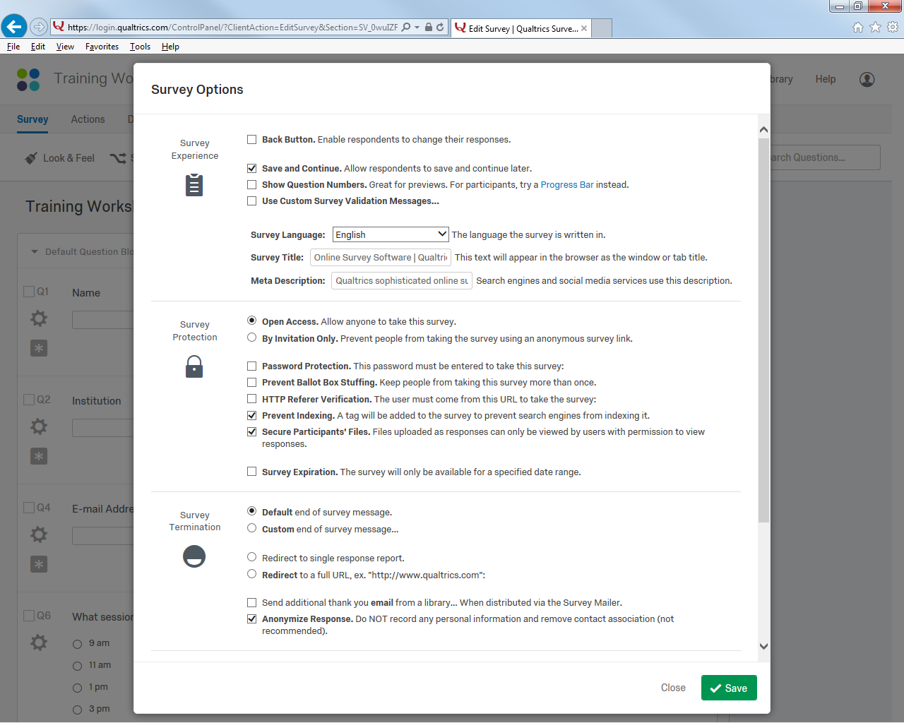
Anonymizing of Data
Qualtrics has survey options that make the data collected anonymous, so data such as IP Address or location of the respondent is not collected.
This does not prevent a survey to ask question needed as part of the study, just that no additional data will be collected automatically (such as IP address or location data).
This option is found under Survey Options in Qualtrics.

Slide 5
Respondent Restrictions
Surveys can be created such that there are restrictions on the respondents.
Can limit the number of respondents take a survey.
An opening and closing date can be set for a survey.
Can set a password that must be entered to take a survey.
Can prevent respondents from taking a survey multiple times.

Slide 6
Withdrawal from Study
If a person starts a survey, then decides to withdraw, it is simply a matter of including a question (or questions) that indicates the respondents desire to withdraw.
Response data can be filtered so that those who desire to withdraw are identified and their data can be deleted.

Slide 7
Data Management
As stated before, only the owner of the survey has access to the data (unless the owner has shared the survey and granted access to analyze data to the anyone in the group).
Each account is password protected.
If data is exported from the account, owners should follow their data management plan, as agreed upon with the Research Ethics Board when seeking study approval.
In general, data that is anonymous (no identifying information and nothing that can be traced back to individual respondents) can be stored on the cloud.
Any other data should be stored in a secure local location.

