Slide 1

BSW Professional Years Application Info Session
Internal Applicants

Slide 2
Topics of Discussion
Admission Requirements
Application Process
FAQ
Contact Information

Slide 3
Who is this application process for?
Students who started in social work from semester 1 or who transferred into social work during their first year
Must have 2 or fewer transfer credits

Slide 4
4-Year Program Options
Honours BSW Degree
Combined Honours BSW and Women’s Studies Degree
Combined Honours BSW and Disability Studies Degree
Notes:
Must indicate which one you select in UWinsite

Slide 5
Admission Requirements
Successful completion of 20 courses towards your degree (as laid out in academic plans) by August 31, 2027
Minimum 70% GPA in social work courses (if in combined major then this includes Women’s Studies or Disability Studies courses)
Minimum 67% cumulative average

Slide 6
Internal Application Process
Deadline: December 1st, 2026
Apply for “Change of Program” from pre-BSW to BSW in UWinsite Student
Submit brief application package to UWinsite***
  Three-page application form (ensure its signed and equity section is completed) + Checklist
  Study plan worksheet
Attend workshop in Winter semester and complete reflective writing piece
***Application materials can only be submitted AFTER the Change of Program request has been accepted and processed!***
https://www.uwindsor.ca/socialwork/460/bsw-application-and-admissions-process

Slide 7
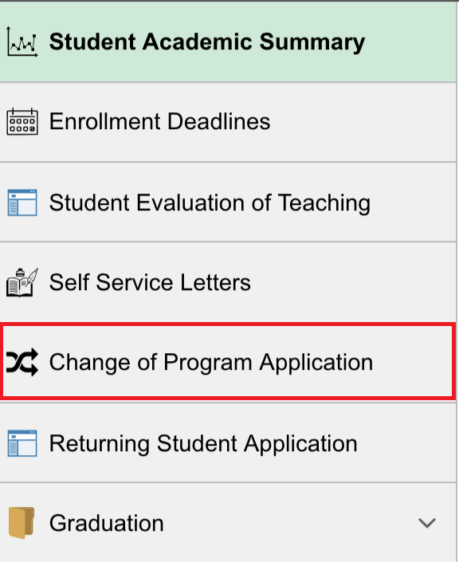
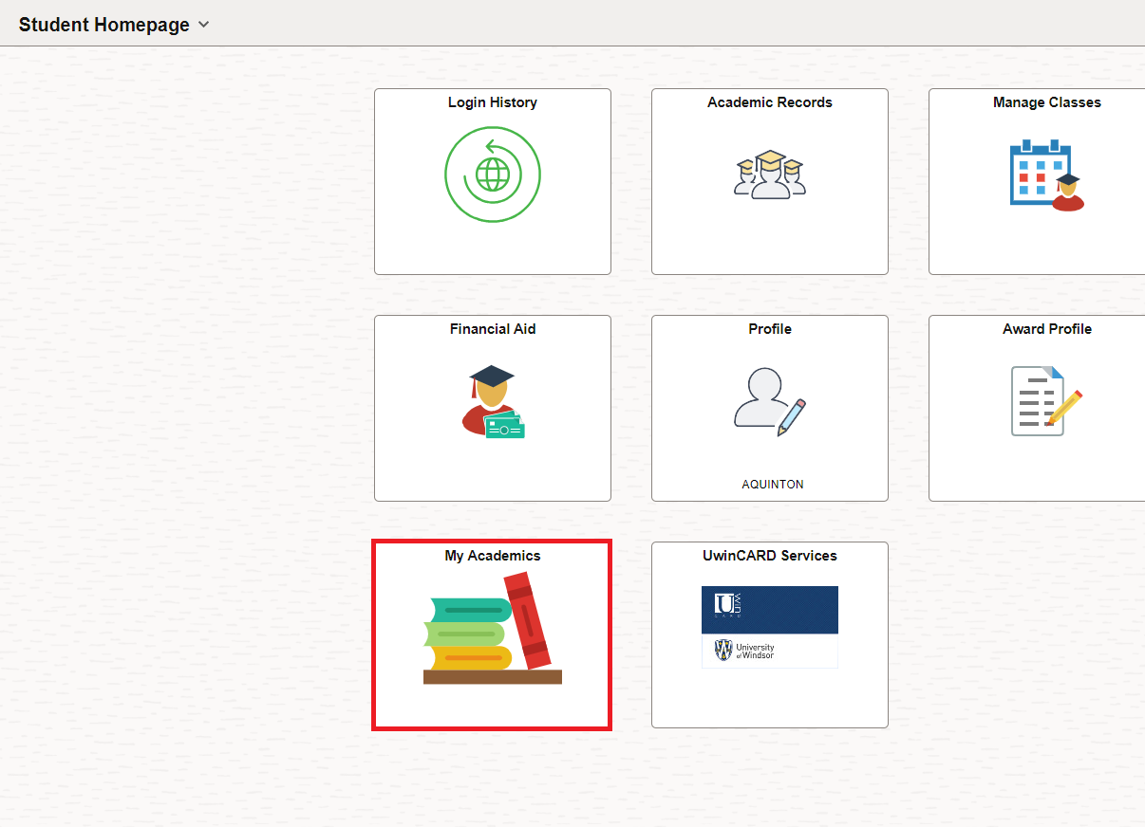
Submitting a Change of Program Request ask.UWindsor - How can I change my program?

Slide 8
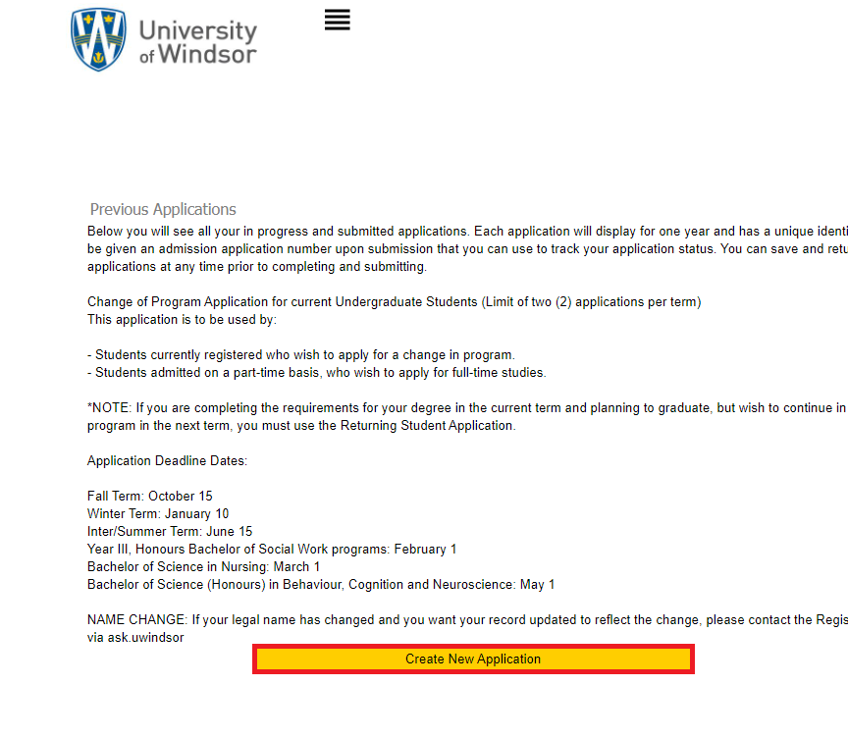
Go to Create a New Application
Complete the required fields
Click Save and then Continue to move on to the next page
Click Submit Application

Slide 9
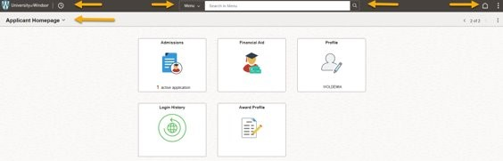
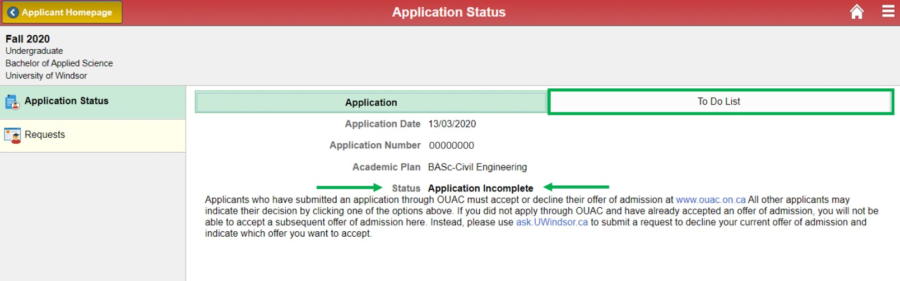
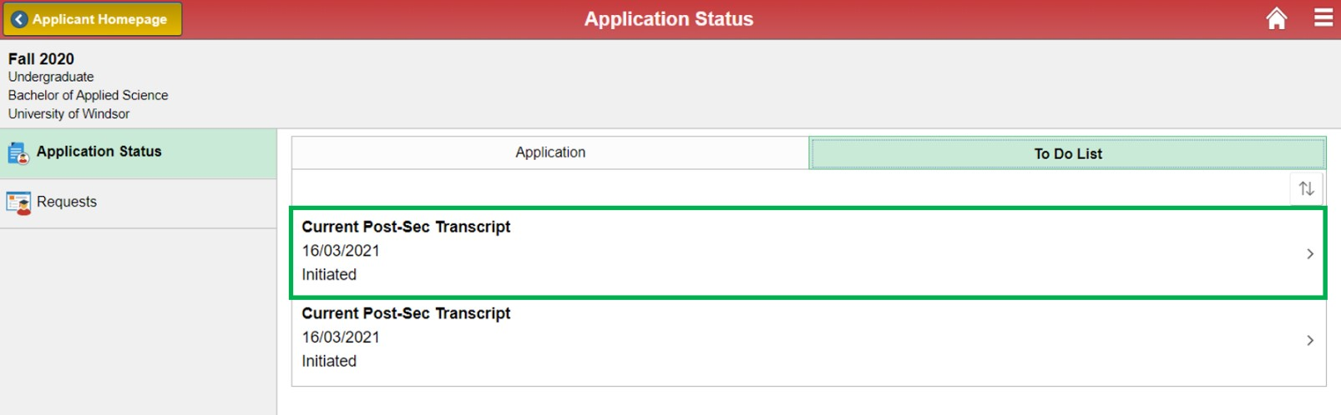
How to submit application files
ask.UWindsor - How do I upload documents into UWinsite Student to support my undergraduate admission application(s)?

Slide 10
Important information
All parts of the application must be submitted by December 1st, 2026!!!
Note: To Do List items will remain “Received” and the application status will remain “Incomplete” until UWindsor’s Office of the Registrar verifies the documents.
Do not upload multiple copies of the same document as it slows our processing. Upload documents as one single pdf file. Your patience is appreciated while we process your documents.
On the Application Status page, the status may never appear “Complete” even after document verification if you do not meet all the requirements (ex: insufficient language score, or lack of passport), but UWindsor will still evaluate your application.

Slide 11
Frequently Asked Questions
When will I know if I have been accepted?
  All applications will be received by the school for review in mid-January, invitations to the workshop will go out in early February
  Admission decisions will be sent to the registrar’s office for processing after the workshops in February
  Offers of admission are conditional upon your GPA meeting the minimum requirements!
What if I don’t get into the Professional Years?
  Increase your GPA by retaking courses
  Consider your “discipline” as a degree completion option
How many students are admitted?
  130-180 apply each year, 100 are admitted

Slide 12
Questions?
Kristina Nikolova, BSW Program Coordinator: Nikolova@uwindsor.ca
Diane Abi-Samra, BSW Program Secretary: bsw@uwindsor.ca
Erica Coulter, BSW Peer Mentor: rushlow@uwindsor.ca

