Slide 1

2024/2025 MSW & MSW/JD Application Information Session
School of Social Work

Slide 2
Land Acknowledgment
The University of Windsor sits on the traditional territory of the Three Fires Confederacy of First Nations, comprised of the Ojibwa, the Odawa, and the Potawatomi.

Slide 3
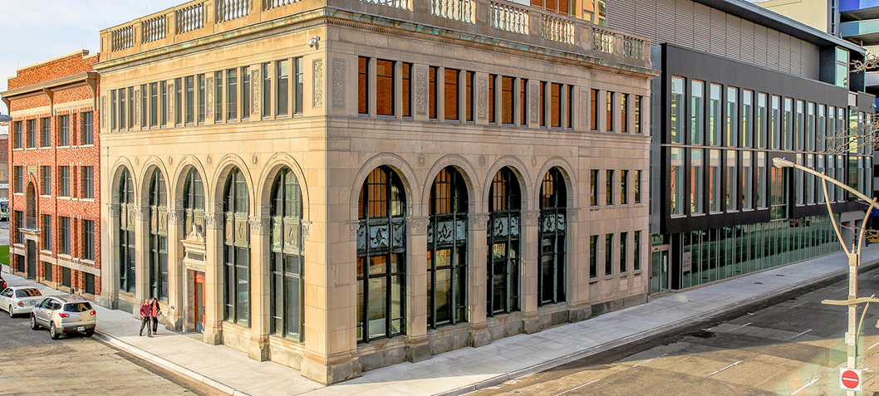
Agenda
Introduction
Requirements for MSW & MSW/JD
Application Procedure
Q&As

Slide 4
A note about professional communication
We are here to help support you through the application process.
The expectation is that all correspondence related to the application process or the MSW program is polite and professional.
Please include your name, student number and program you are applying to (i.e. MSW Advanced Standing On Campus program) in your email correspondence.
Should any inappropriate, informal, or impolite correspondence sent to the Graduate Secretary will be forwarded to the Coordinator.

Slide 5
MSW – On Campus and MSW-Working Professionals (MSW-WP)
The University has two different MSW programs. The MSW-On Campus program is a FULL TIME MSW that you can complete in 12-20 months.
The MSW-WP is offered on the weekends and is administered separately from the on-campus MSW. The MSW-WP takes between 16-32 months to complete.
When you are applying, in the application portal, make sure you pick the right program!
Admissions information for the MSW-WP is available here: https://www.uwindsor.ca/msw/401/admission-requirements

Slide 6
Admission Requirements
Please read the instructions!!!
http://www.uwindsor.ca/socialwork/386/master-social-work-program-options
The application includes the following
Transcripts (from all institutions, including the University of Windsor).
Prerequisites (Two Required Courses):
One statistics course
One research methods course
Two Reference Letters
Personal Statement
Professional Experience Form (full-time, part-time, relevant work, volunteer, or practica experience, etc.)
The MSW application form for 2024/2025 is currently available.

Slide 7
Application Process
Apply Online
Build Your Application
Non-refundable application fee is $125 CAD
www.uwindsor.ca/graduate-studies/apply
Confirmation email from Faculty of Graduate Studies
UWinsite Student
https://ask.uwindsor.ca/app/answers/detail/a_id/914/kw/how%20to%20graduate%20studies?_gl=1*r2qynf*_gcl_au*MTEzMzc5Mjg5My4xNzI2MTYxMzA4*_ga*MTUyNzUxNzc5MS4xNzI2MTYxMzA4*_ga_TMHVD0679R*MTcyNzM1OTM0OS44LjEuMTcyNzM2MDU3OS42MC4wLjA.
Notes:
Need help?
https://ask.uwindsor.ca/app/answers/detail/a_id/914/kw/how%20to%20graduate%20studies?_gl=1*r2qynf*_gcl_au*MTEzMzc5Mjg5My4xNzI2MTYxMzA4*_ga*MTUyNzUxNzc5MS4xNzI2MTYxMzA4*_ga_TMHVD0679R*MTcyNzM1OTM0OS44LjEuMTcyNzM2MDU3OS42MC4wLjA.

Slide 8
Admission Requirements
GPA
To be considered for admission to the MSW program, the School of Social Work requires applicants to have a grade point average of 73% or above, calculated based on the last two years/ 20 courses of their qualifying Honours degree.
Applicant must upload ALL transcripts to the application portal. This includes all University of Windsor transcripts.
Transcripts must have your name, the institution, the degree awarded (or enrolled), the credit weighting and the grade awarded for each class.
Unofficial transcripts are accepted for the application
Official transcripts need to be submitted after an offer of admission is made.

Slide 9
Admission Requirements
Statistics and Research Methods Courses
At the time of application, applicants are required to provide evidence of successful completion of one undergraduate course in statistics and one undergraduate course in research methods.
If an applicant has not completed one or both of the required courses at the time of application, the applicant must submit a transcript or proof of enrolment in the required course(s), to the School of Social Work prior to March 1st.

Slide 10
Admission Requirements
Statistics and Research Methods Courses
The research methods and statistics requirement MUST be satisfied prior to the start of the program.
A list of pre-approved research and statistics courses is on our website. If your course(s) is not on the list you will need to provide a copy of your course syllabus for approval.
https://www.uwindsor.ca/socialwork/sites/uwindsor.ca.socialwork/files/msw_approved_research_methods_stats_courses_febr2024_0.pdf

Slide 11
Admission Requirements
Reference Letters
The School of Social Work requires two references with your MSW application:
1) Academic Reference
2) Employer Reference from an employer/supervisor who has overseen your work in a paid, volunteer, or a practice/internship or field placement capacity, preferably in the social services
References from colleagues, peers, friends, and relatives will not be accepted.
Please make sure to provide your referee with the referee instruction sheet found on our application website (https://www.uwindsor.ca/socialwork/469/msw-admission-application)
References are due by the SSW due date.

Slide 12
Admission Requirements
Personal Statement
Please complete an 800-word personal statement that answers specifics about your motivation, experience, and area of interest.
The instructions for writing this statement are included in the “Personal Statement” section of the application.

Slide 13
Admission Requirements
Professional Experience
Please complete the Professional Experience Form outlining your work, volunteer, and practica/internship experiences;
Publications, thesis, other professional activities where you were the presenter or author;
Any professional associations, training sessions, or workshops you attended.

Slide 14
Deadlines
MSW -
One-Year Advanced Standing MSW Program for May 2025 admission – November 15th 2024
Two-Year Regular-Track MSW Program for September 2025 admission – January 15th 2025
MSW/JD –
Faculty of Law - November 1st, 2024
School of Social Work – January 15th 2025
You are responsible to make sure all required documents
are included in your application

Slide 15
Technical Problems?
If you have problems with the application portal, please create and IT Ticket and notify the Graduate Secretary (gradsw@uwindsor.ca)
If you have issues with reference submission, email your assigned Graduate Specialist (http://www.uwindsor.ca/registrar/540/contact-us) and cc gradsw@uwindsor.ca
Please note, the Registrar’s office cannot extend the deadline. Application due dates are set by the School of Social Work.
Don’t forget to hit submit when you’ve completed your application!

Slide 16
FAQ
Many frequently asked questions are addressed on our FAQ webpage.
Please review our FAQ before you email the SSW.
https://www.uwindsor.ca/socialwork/579/msw-campus-application-frequently-asked-questions

Slide 17
MSW/JD Additional Information
Admissions Instructions
http://www.uwindsor.ca/socialwork/454/mswjd-application-process
Note – Apply to the Law Program through OLSAS. The MSW portion of the MSW/JD application is submitted to the Registrars Office. DO NOT apply to the MSW/JD program through the application portal.
MSW/JD – JD Liaison
Dr. C. Tess Sheldon, MSc, JD, LLM, PhD
Assistant Professor and Externship Director
Email: tess.sheldon@uwindsor.ca
Phone: (519) 253-3000 x 2943
JD Admissions
Admissions Counselling: 519-253-3000 ext. 4230
Email: uwlaw@uwindsor.ca

Slide 18
Questions?
Dr. Elizabeth A. Donnelly
Coordinator, On-Campus MSW Programs
Associate Professor Office: 213, 167 Ferry Street Windsor, ON N9A 0C5 Phone: (519) 253-3000 ext: 4096 E-mail: donnelly@uwindsor.ca
Ms. Jasmine Mahmood
Graduate Secretary Office: Room 205-A, 167 Ferry Street
Windsor, ON N9A 0C5
Phone: (519) 253-3000 ext. 6096
Email: gradsw@uwindsor.ca

