Slide 1


FINANCING YOUR EDUCATION
SAFA Indigenous Student Support Presentation
Student Awards & Financial Aid (SAFA)
Presenter: Laura Pepper -Student Awards Outreach Coordinator

Slide 2
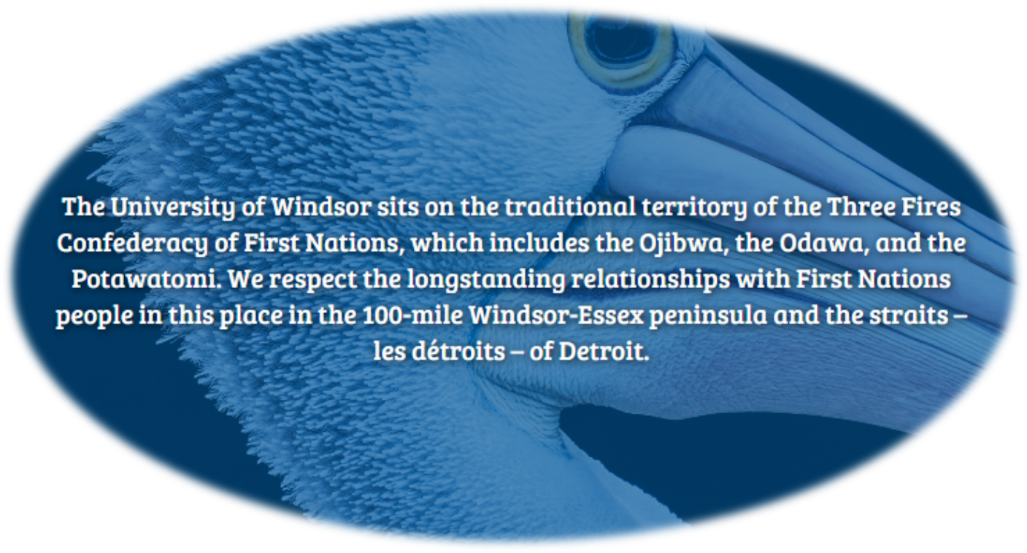


Slide 3


Content
1
Budgeting for University
2
Types of Loans
3
OSAP
4
Types of Scholarships
5
How to apply for UWindsor Scholarships
6
Working on Campus -Ignite
7
Financial Literacy Program -Enriched Academy
8
Questions & Contact Information

Slide 4

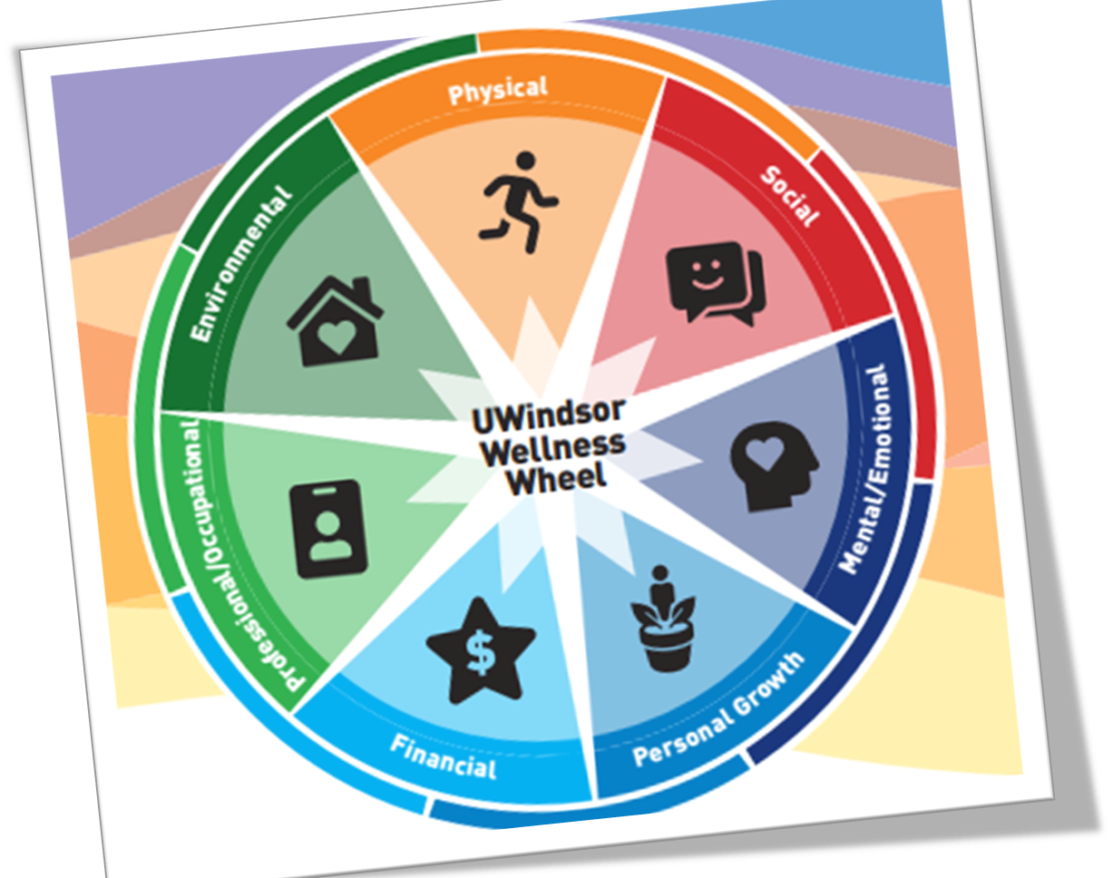
DIMENSIONS
OF
WELLNESS
Many factors that affect your wellness directly correlate with your finances.

Slide 5


BUDGETING FOR YOUR EDUCATION
LOANS
SCHOLARSHIPS
EMPLOYMENT
SAVINGS
HOUSING, FOOD
TUITION, BOOKS
TRANSPORATION
CHILDCARE,
ENTERTAINMENT
WE
CAN
HELP!

Slide 6



LOANS
borrowing
money
UWINDSOR
SAFA OFFICE
YOU
OSAP
Out-of-Province and U.S. Federal Aid
Bank loans,
Professional Line of credit, Family Loans
Loan from your country of residence
Ontario Student Assistant Program

Slide 7

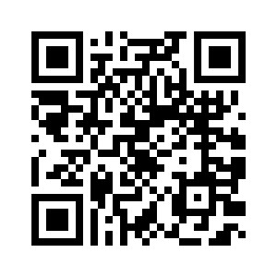
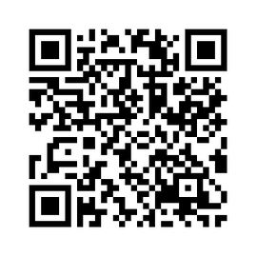

ONTARIO STUDENT ASSISTANCE PROGRAM
OSAP
OSAP is offered by the Government of Ontario to Ontario residents, which provides financial assistance to students to help them attend university.
OSAP offers funding through:
  grants - money you don’t have to pay back
  a student loan - money you need to repay once you’re done school
Our office will help answer your questions regarding your application!
Online Estimator

Slide 8

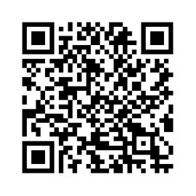

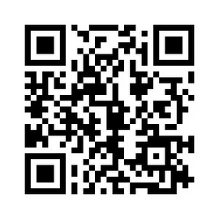
TYPES OF SCHOLARSHIPS
Internal Scholarships
  Awarded from the University of Windsor
  Use our Award Search tool to look up our scholarships
  Financial need-based, merit-based, and student groups
  Visit the Aboriginal Education Centre website to learn more
about specific awards in this department as well
UWinAward Search
External Scholarships
  Awarded from a group or company such as your parent’s employer, church, or club
  Visit our website to start your search

Slide 9
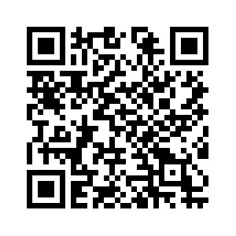
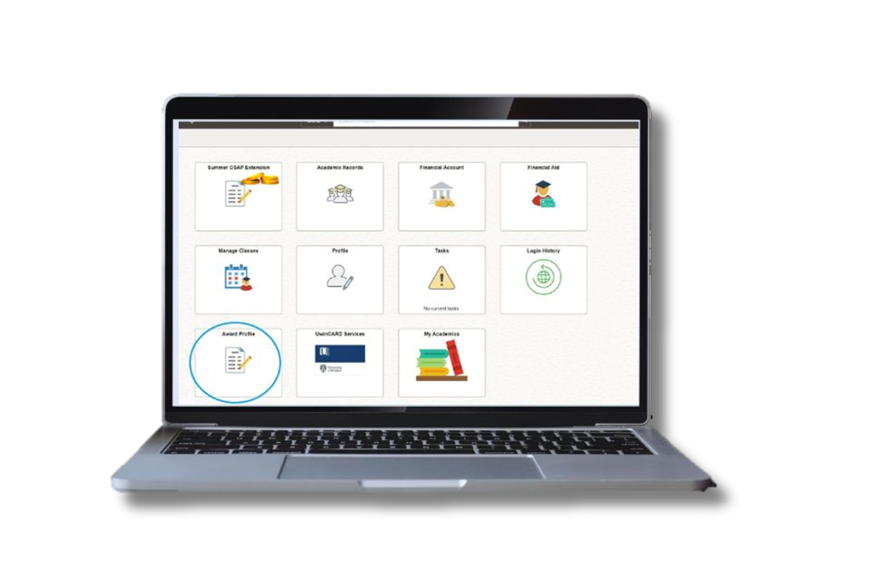

Internal Scholarships:
How to Apply for Scholarships @ UWindsor
Applications open August 1st!
UWinAward Profile/Application
Step 1
Watch our YouTube video to learn how to fill out your application.
Step 2
Complete your profile and application(s) on UWinsite. You can save your application while you are working, but be sure to submit once it is complete.

Slide 10
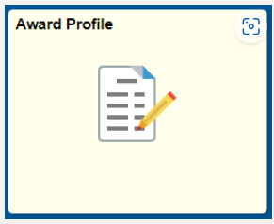
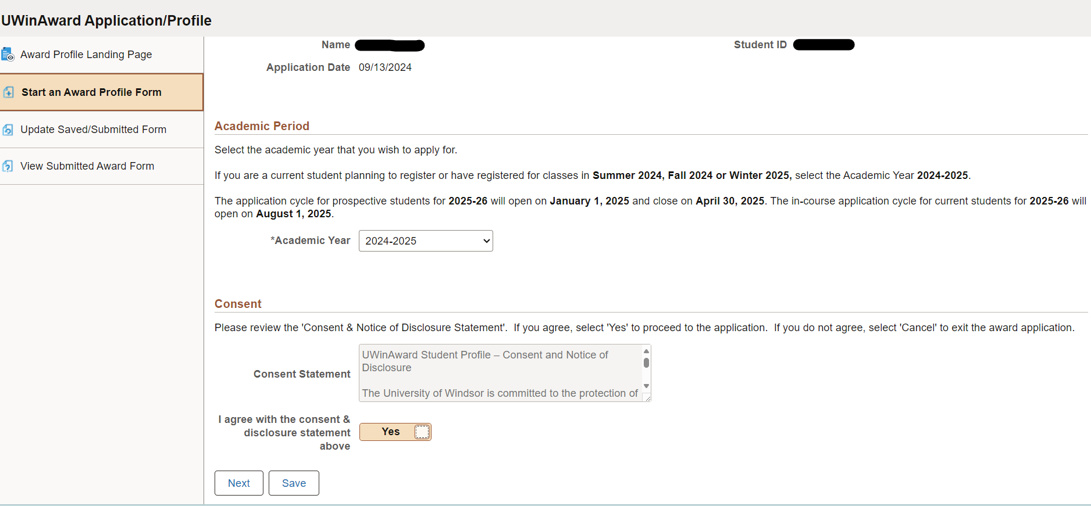
Award Profile Application

Slide 11
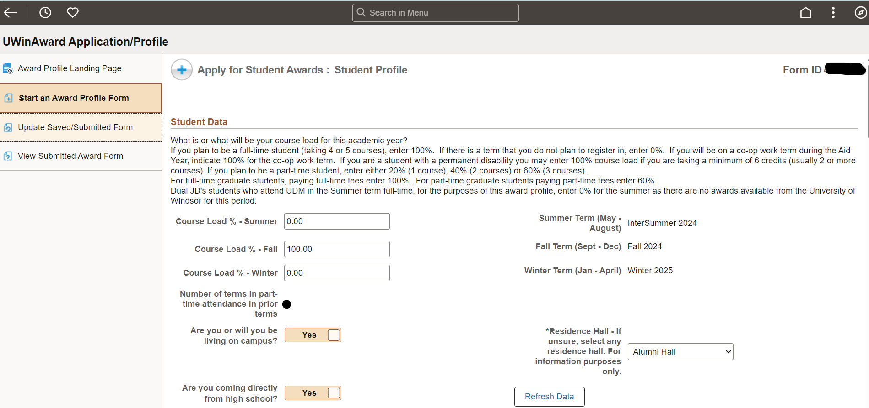
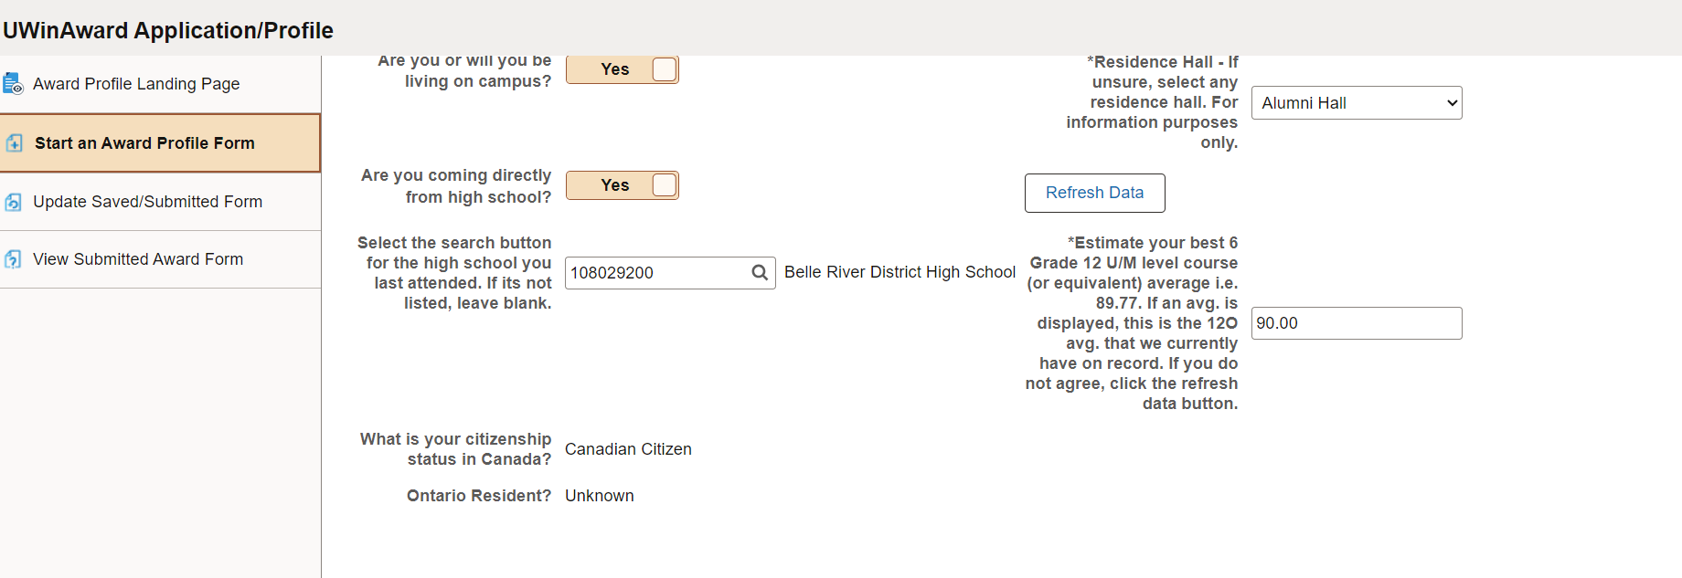
Award Profile Application

Slide 12
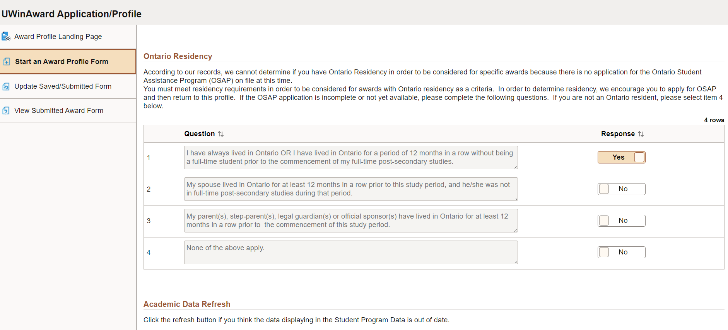
Award Profile Application

Slide 13
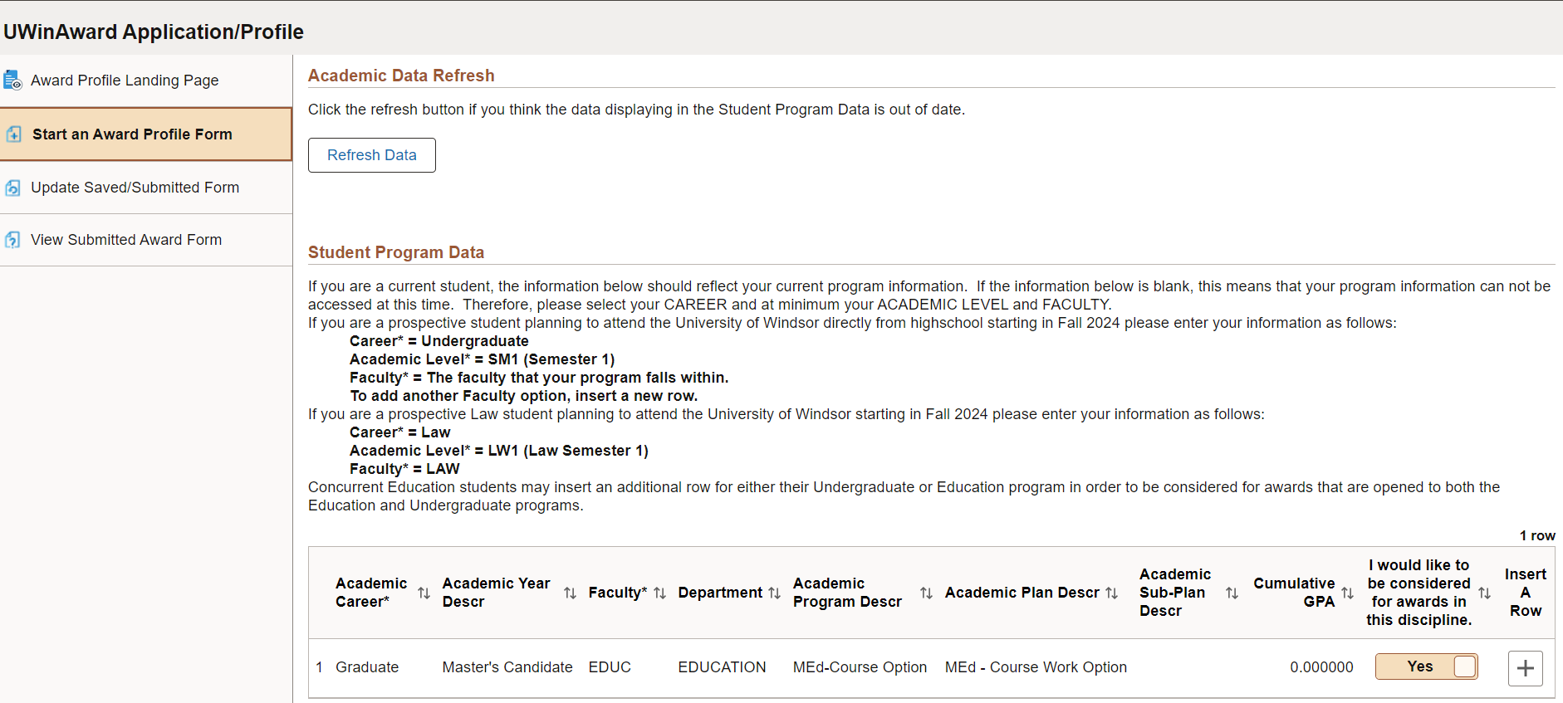
Award Profile Application

Slide 14
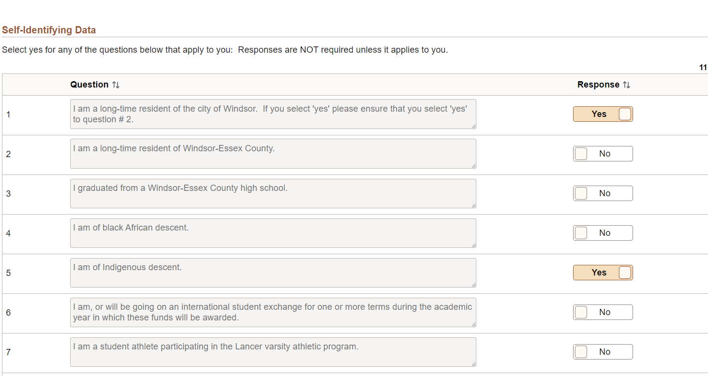
Award Profile Application

Slide 15
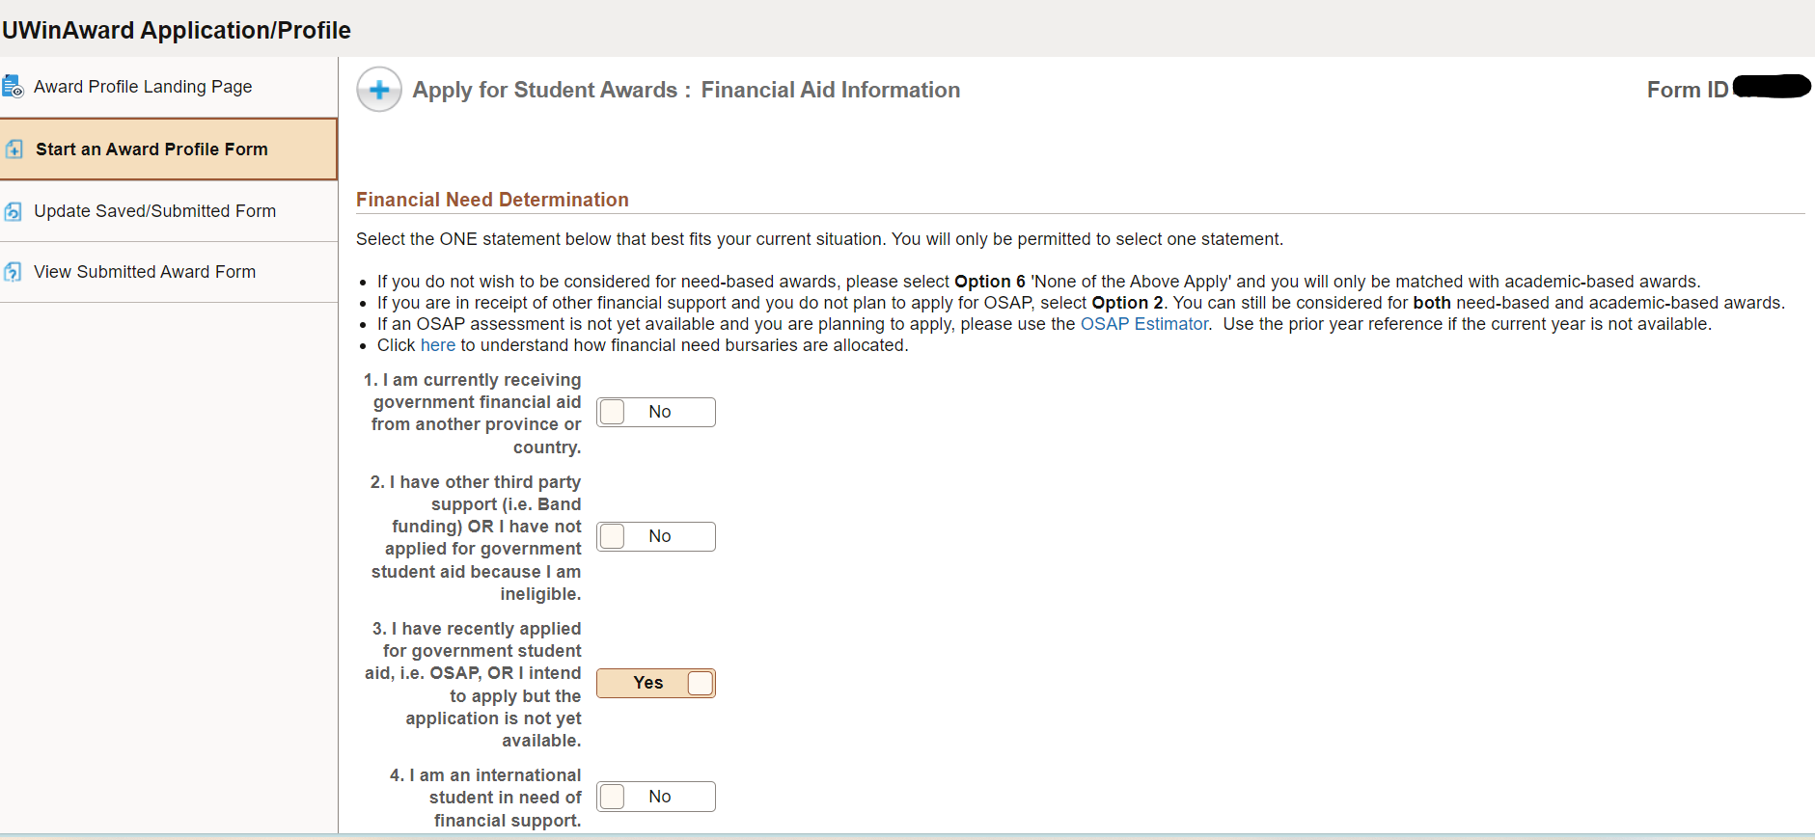
Award Profile Application

Slide 16
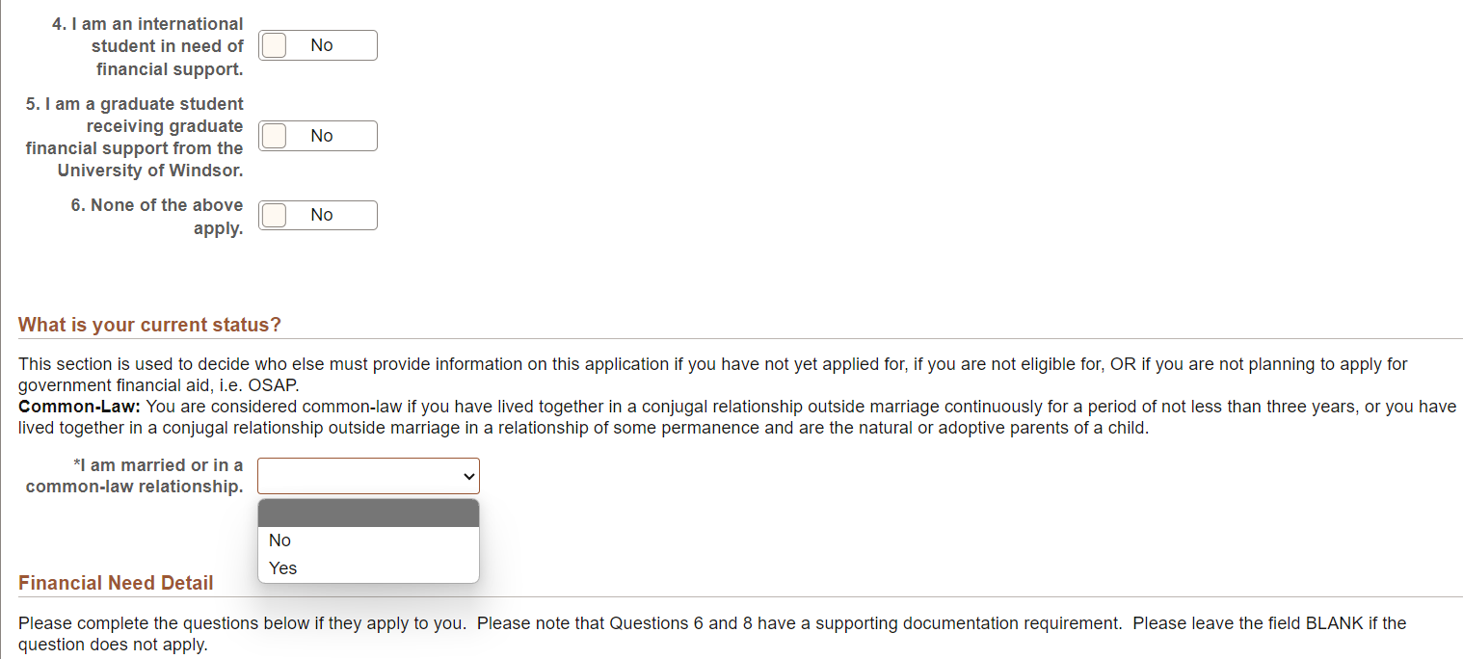
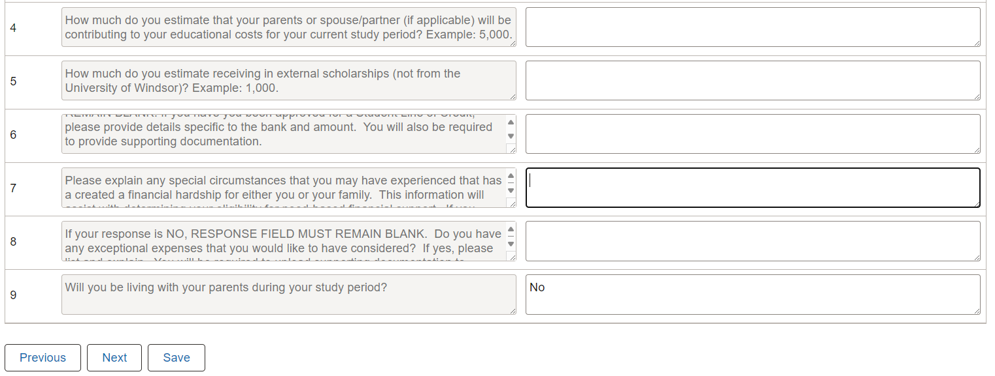
Award Profile Application

Slide 17
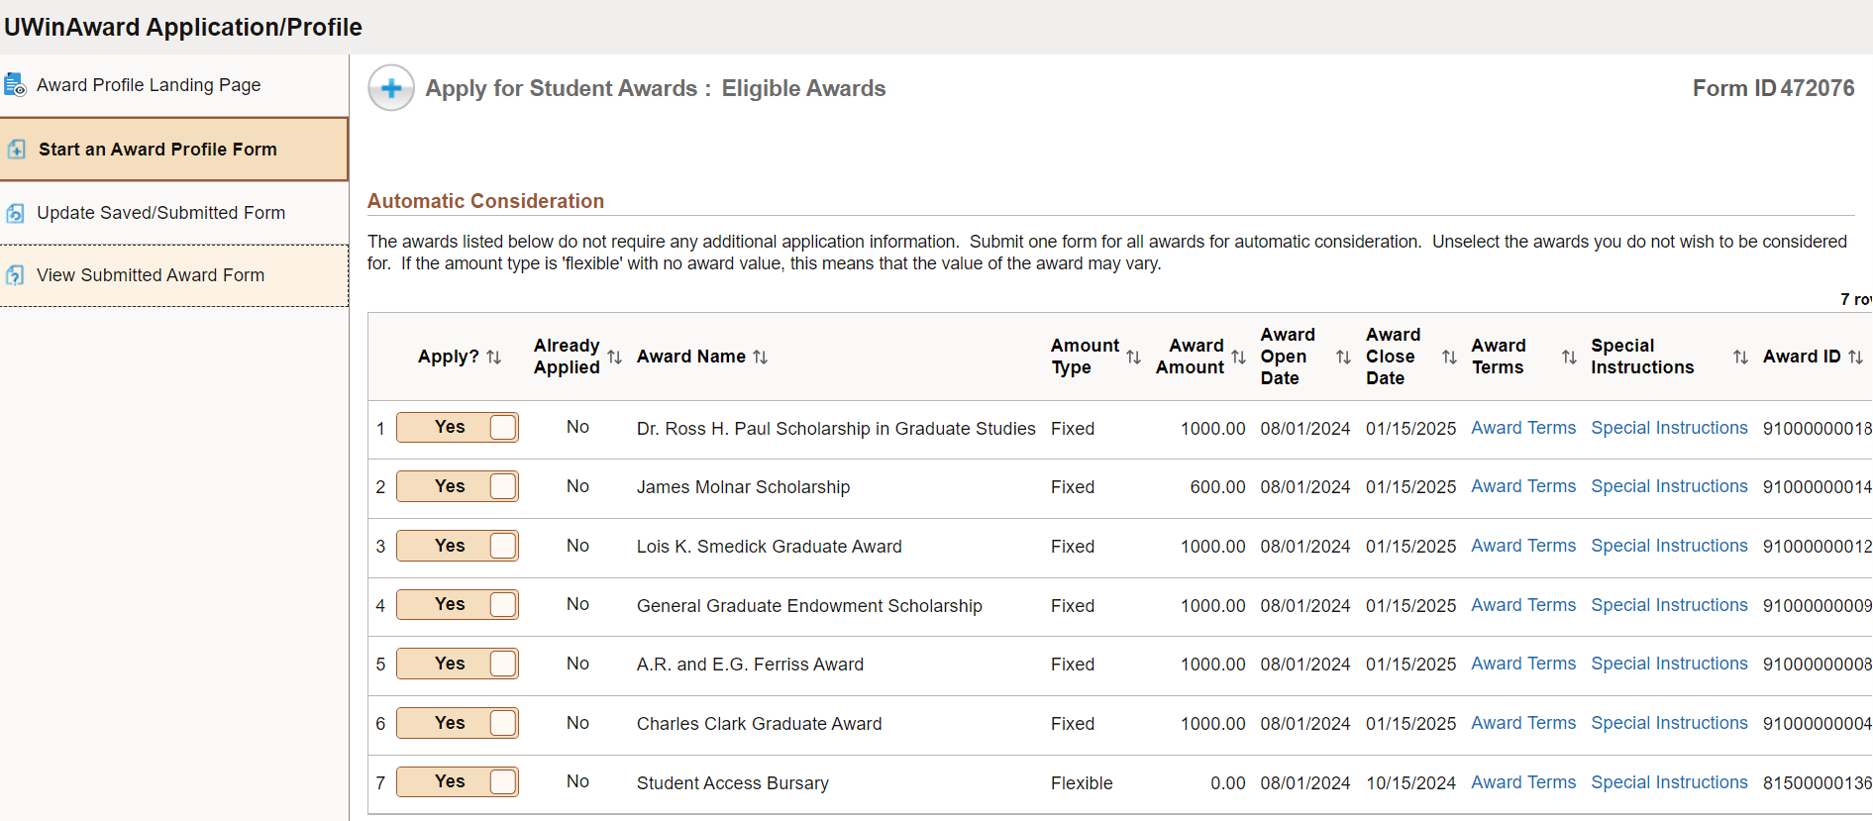
Award Profile Application

Slide 18
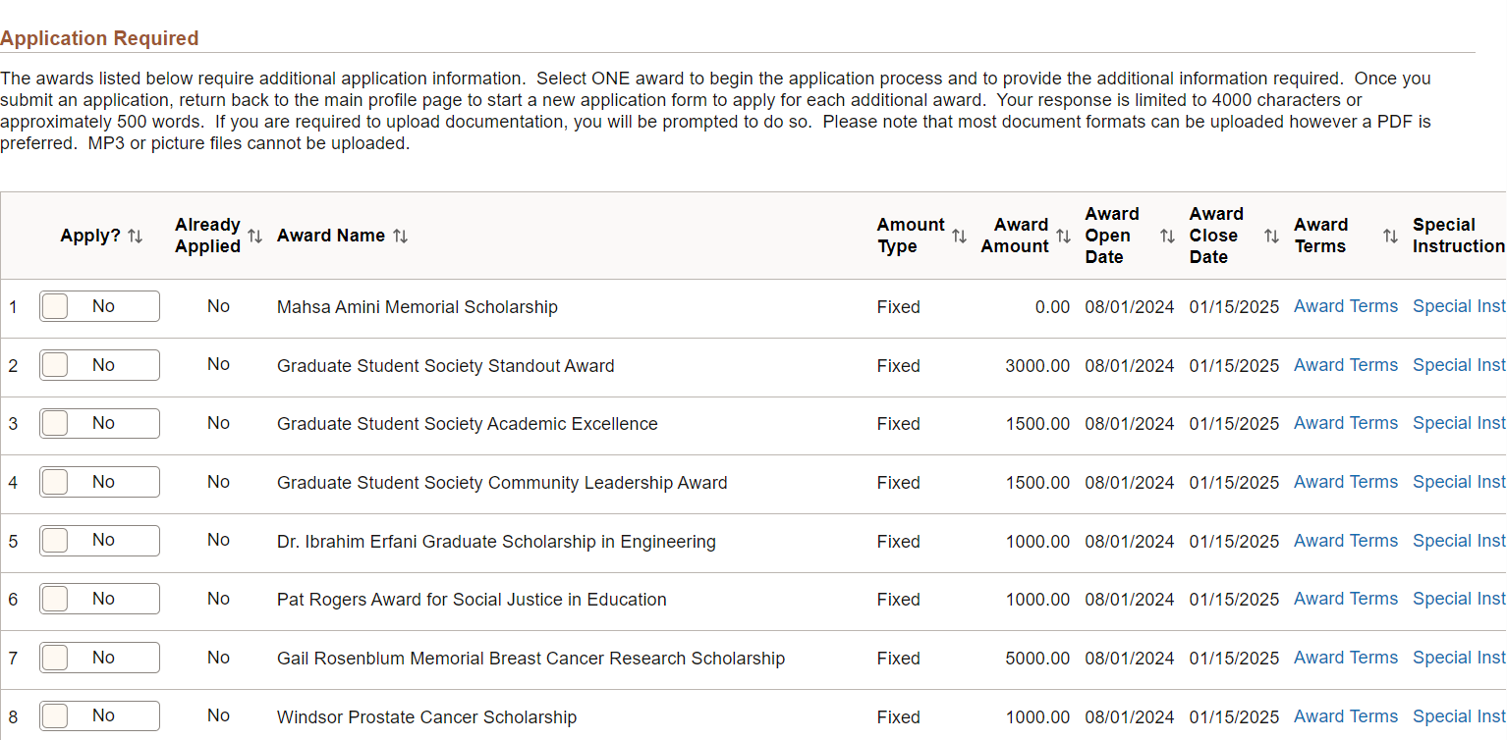
Award Profile Application

Slide 19
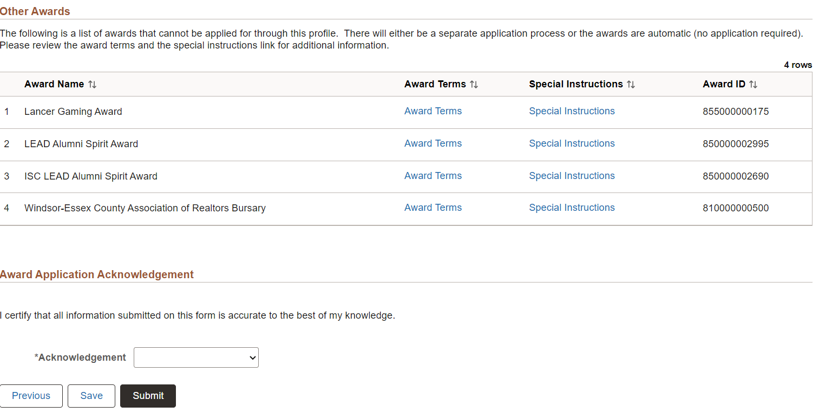
Award Profile Application

Slide 20
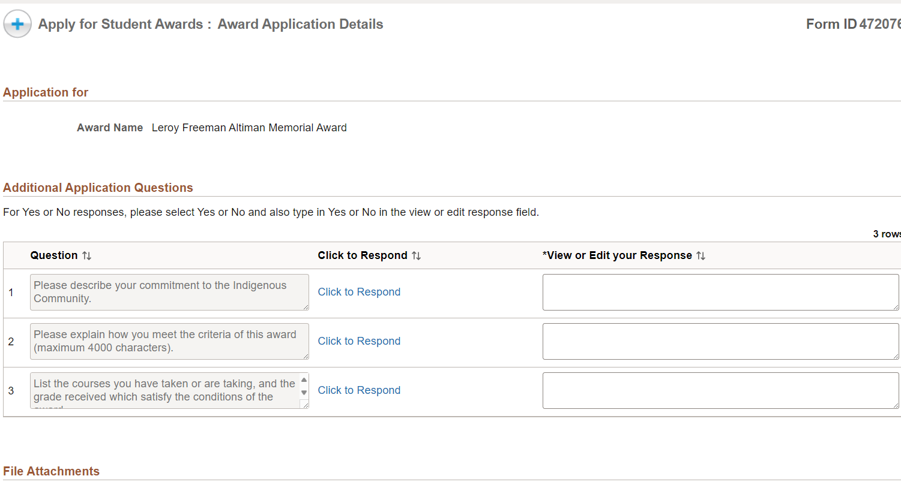
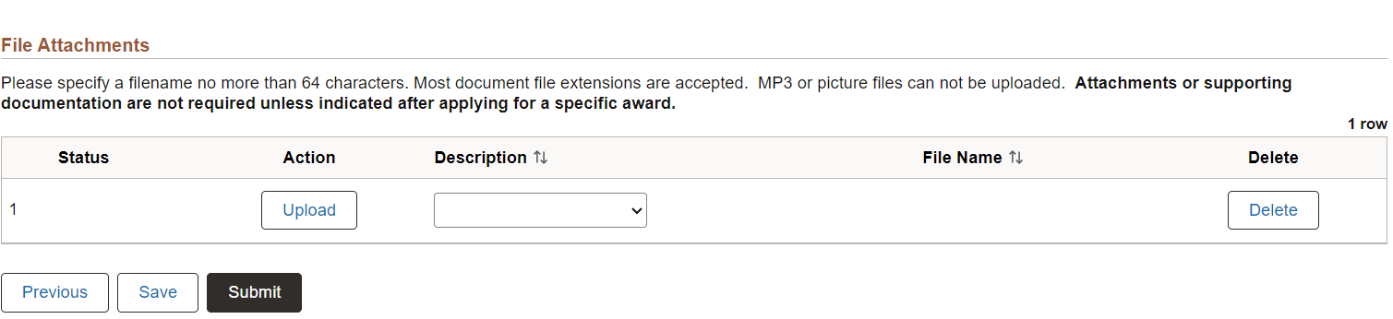
Award Profile Application

Slide 21
ENTRANCE AWARDS FOR INDIGENOUS STUDENTS
(EXTENDED TO SEPTEMBER 30)
LC Memorial Award for FNMI in STEM ($20,000 x 4 years)
The LC Memorial Award for FNMI Students in STEM has been established to encourage the study of science, technology, engineering, and math among students who identify themselves as members of First Nation, Metis and Inuit communities. The award is to be granted to any FNMI, who demonstrates financial need and who is enrolls full-time in a science, technology, engineering or math program at the University of Windsor. Students must have a minimum admission average of 75% and must maintain a minimum of a 75% scholarship average in the program of study to be eligible for renewal for up to 3 additional years. As part of the application process, students must submit a self-reflection statement indicating the effect that the award will have on their academic career. Preference will be given to FNMI students from the province of Ontario. Apply on-line.
Wawiiahtana Ziibii Entrance Scholarship ($2,500 x 8 terms)
Up to 4 scholarships available annually valued at $5,000, renewable over the 4 years provided that a minimum scholarship average of 75% is met to support indigenous students entering year 1 of any first-entry, undergraduate program directly from secondary school studies. Students must be Canadian citizens and demonstrate financial need. Apply on-line.

Slide 22


UWinAward Profile/Application
Let’s take a quick look at our website!

Slide 23

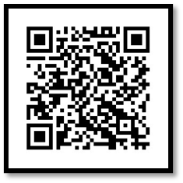
The main objective of Ignite is for students to:
  Gain career ready skills through experiential learning
  Find jobs related to their curricular studies
  Explore other interests and career paths​
  Stay involved with on-campus activities​
  Practice job search and interview skills​
  Build their resume with a new experience​
Career & Skills
Development
All students can view the jobs in Ignite on mySuccess.

Slide 24

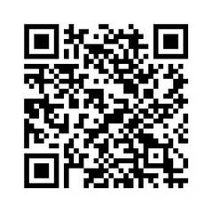

FINANCIAL LITERACY PROGRAM
Set yourself up for financial success with Enriched Academy a free program for UWindsor Students!
  Are you concerned about managing your own budget for the first time?
  Are you concerned about repaying your student loan upon graduation?
  Are you thinking about saving for your future?
Through a series of fun, insightful videos, Enriched Academy will help you:
  steer away from poor money management traps
  avoid credit card traps that can bury you in debt
  understand the fundamentals of saving and investing early
There are also several scholarships that are awarded to students who have completed the program and enter to win!

Slide 25


PROOF OF ENROLMENT
OFFICE OF THE REGISTRAR
This proof may be required by financial institutions, government agencies, insurance companies or employers.
  Students can generate their own Enrolment Verification Letter in UWinsite Student free of charge if they are registered in classes.
  These letters confirm: Current registration Year and program of study Full- or Part-time status
  For step-by-step instructions on generating an Enrolment Verification Letter in UWinsite Student, please read this ask.UWindsor article.
RESP

Slide 26
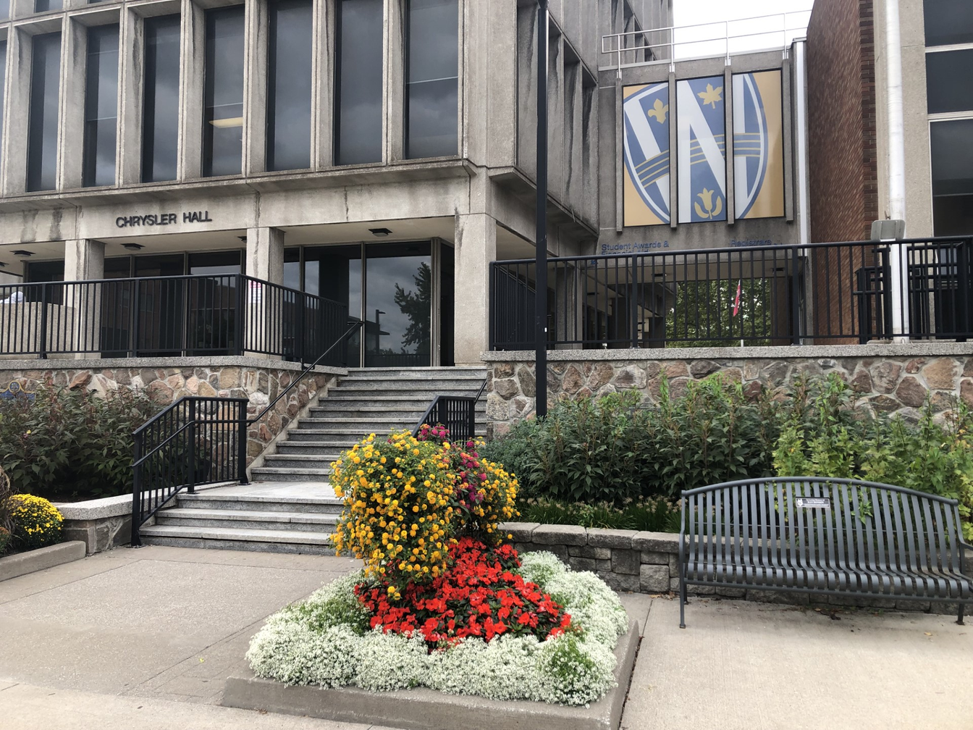
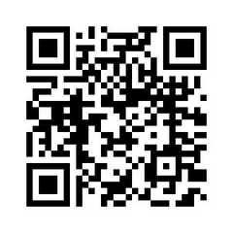
QUESTIONS?
Do you have questions regarding your application or eligibility?
Please contact our office.
Website: www.uwindsor.ca/studentawards
Phone: 519-253-3000 Ext. 3300
Email: award1@uwindsor.ca
Location: Chrysler Hall Tower, 1st Floor
Online Support: Weekly Microsoft Teams Sessions

