Slide 1
Student Awards & Financial Aid Guide for High School Students

Slide 2
Automatic Entrance Scholarships
Students are automatically considered for university open entrance scholarships.
Conditional offers are made based on a student’s final grade 11 and minimum 3 interim and/or final U/M level grades. Students will receive an early financial aid offer with their offer of admission if their early admission average falls within our scholarship range. Conditional offers do not translate to final offers if a student does not maintain the average that is required for a final offer to stand.
Final offers are made based on a student’s interim and/or final Grade 12 (12O) courses generally available in May.
Final offers are reviewed at the end of July, once final grades are in. If final grades improve, scholarship offers will be increased. Final offers communicated in May will not be adjusted if final grades go down.
Minimum levels of support:
85% - 89.99% $1000 University of Windsor Entrance Scholarship ($1,000)
90% - 94.99% $10,000 Dean’s Level Entrance Scholarship ($1,250 x 8 terms)
95% - 100% $16,000 President’s Level Entrance Scholarship ($2,000 x 8 terms)
What happens if we receive a student’s 12O prior to May?
The first 12O average we receive is the average that sets the scholarship offer.
It may change in May, then again in July only if the average goes up.

Slide 3
Automatic Entrance Scholarships
For an entrance scholarship to pay to the Student Account:
Domestic students must register in a minimum of 60% of a full course load in either the Fall or Winter terms to activate the scholarship (or 40% for students with a permanent disability).
To comply with student VISA requirements, the definition of full-time for scholarship eligibility for international students is 80% or more of a full course load.
To renew a scholarship that is payable over 8 semesters or 4 years, students must meet the scholarship average required at the end of their second semester – generally Winter.
A student’s scholarship average is calculated as follows:
To renew into year 2 - top 6 courses from semesters 1 and 2;
To renew into year 3 - top 12 courses from semesters 1 through 4;
To renew into year 3 - top 18 courses from semesters 1 through 6.
Only undergrad courses are considered. Students in Concurrent Educ programs will only receive their scholarships in their undergraduate terms only, with the exception of the final BEd year where applicable – there is an exception however, with the BA, BEd, ECE program.

Slide 4
Automatic Entrance Scholarships
What if a student wants to defer their offer of admission?
We encourage students to still apply for admission so that their admission application is in our system.
If students defer for one year, we will honour students open entrance scholarship offer provided that they have not attended another post-secondary institution (some exceptions apply, i.e., only attended for one week).
Application based institutional or donor-sponsored entrance scholarships, including the Outstanding Scholars Candidate scholarship are not eligible for deferral – students must apply again for these scholarships.
Students who do not apply and simply take a gap year, will have to contact us directly to request a review of their eligibility and will have to provide documentation to prove that they completed secondary school in June, and will have to provide an attestation that they didn’t attend elsewhere.

Slide 5
Special High Skills Major Scholarship
$1,000 Scholarship
Application Opens: August 1st
Application Deadline: September 15th
Eligibility:
Students who have completed the Specialist High Skills Major Program and are entering directly from full-time high school studies into Year 1 of a full-time, first-entry, undergraduate program at the University of Windsor with an entering average of 80% or greater may be considered for this scholarship
Proof of completion of the Specialist High Skills Major Program is required
Apply on-line
Refer to the uWinAward Application instructions

Slide 6
IB/Advanced Placement Scholarship
Scholarship Values: $5,00 or $1,000
Application Opens: August 1st
Application Deadline: September 15th
Eligibility:
Students who have completed the International Baccalaureate (IB) Program who are entering a full-time undergraduate program at the University of Windsor directly from full-time high school studies with a minimum entering average of 80% will be considered for this scholarship.
Proof of completion of the International Baccalaureate (IB) Program is required (6 courses: $1000).
Students who have completed a minimum of 3 International Baccalaureate (IB) or Advanced Placement (AP) courses who are entering a full-time undergraduate program at the University of Windsor directly from full-time high school studies with a minimum entering average of 80% may be considered for this scholarship.
Proof of courses completion of a minimum of 3 International Baccalaureate (IB) or 3 Advanced Placement/Enriched (AP) courses is required. (3 courses: $500) IB students can not receive both. Apply on-line. Refer to the UWinAward Application instructions.

Slide 7
Applying for Scholarships, Bursaries and Awards
With the student’s offer of admission, there will be a financial aid letter with the link to apply for entrance scholarships and bursaries.
Entrance award by application portal (UWinAward Profile/Application) opened January 1All application-based scholarships and bursaries – Deadline: April 30
Over 140 additional scholarships and bursaries that students can be considered for ranging from $500 to $80,000 (over 4 years).

Slide 8
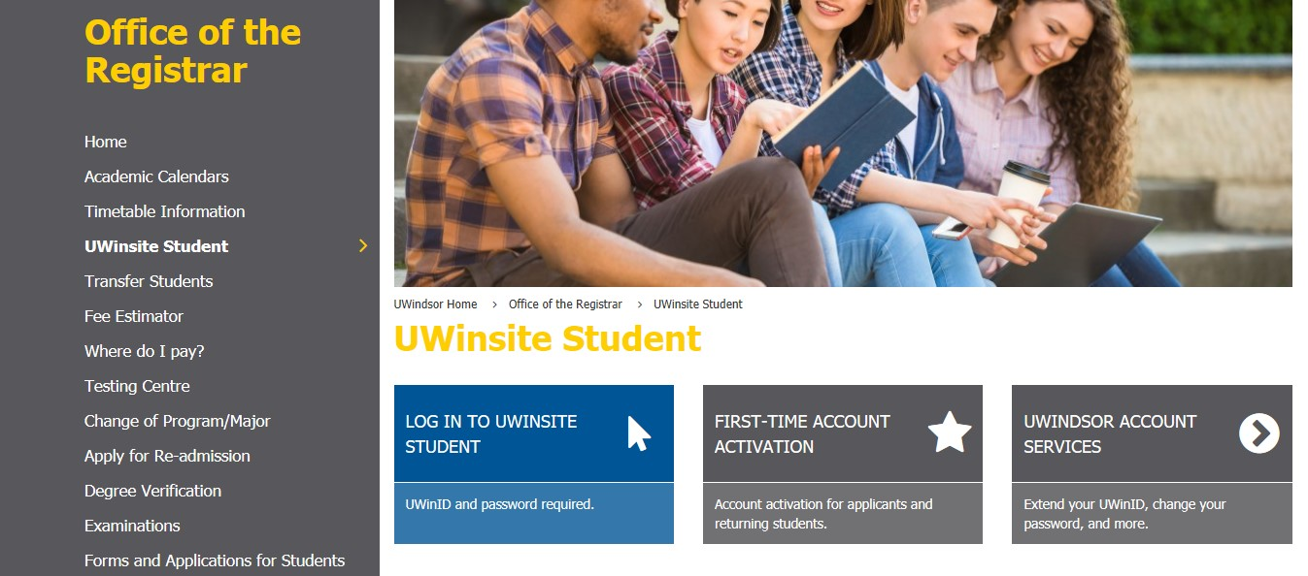
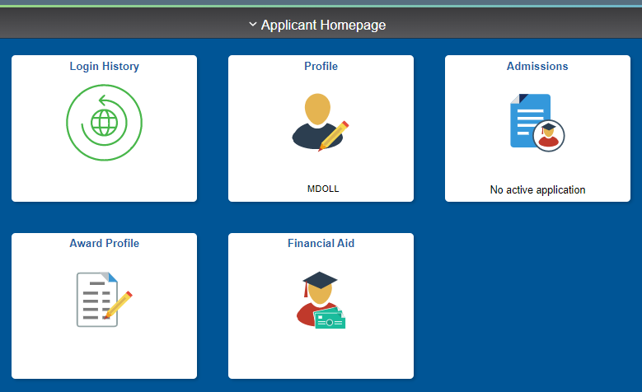
Activate UWIN ID to Access Award Profile
Students must activate their UWIN ID to access the UWinAward Profile/Application.
Instructions on how students can activate their UWIN ID can be found here:
www.uwindsor.ca/registrar/uwinsite-student

Slide 9
Questions & Answers
If students have a specific question regarding entrance awards, they can submit a service request through:
http://ask.uwindsor.ca/
Additional information specific to student financial support can be found on our webpage:
www.uwindsor.ca/studentawards
Drop-in Classes are available to help students with questions regarding award profile application and can be found on the below link:
https://www.uwindsor.ca/studentawards/381/uwinawardapplication

Slide 10
Student Awards and Financial Aid Office
Contact Us
By email: Award1@uwindsor.ca
By phone: (519) 253-3000 ext. 3300
For more information, please visit our website
https://www.uwindsor.ca/studentawards/

