Slide 1
Essential Tools
Winter Orientation 2025
Notes:
Hello and welcome to the essential tools presentation.
If you have any questions after this video, feel free to reach out to us by email at orientation@uwindsor.ca

Slide 2
Today’s Agenda
UWinSite Student
Bright Space
Microsoft Outlook
MySuccess
Leddy Library
Notes:
Today we will be taking an in depth look at the following uwindsor supports.

Slide 3
Steps to Personal Accountability
Utilizing essential tools & supports
Academics
Employment Opportunities
Notes:
The Essential Tools we will discuss will help you to be personally accountable for your success in University
These are the nuts & bolts that every student uses and needs to access within the first 6 weeks of being a student
This presentation will review a number of essential tools that will need to utilize in order to be successful in university
They will help you with your academics and the various employment opportunities available you at UWindsor

Slide 4
UWinSite Student
What
When
Where
How
Why
Notes:
WHAT: UWinsite Student is basically an online one-stop-shop. This is the website you will use to register for classes, view your transcripts and grades, see your financial matters, and keep up to date with your academic progress
WHEN: you should check your uwinsite account quite often, but ESPECIALLY when it comes time to register for classes, around the Voluntary Withdrawal date, and when you need to check your exam schedule
WHERE: you can access UWinsite Student through the Office of the Registrar's website by clicking on the tab called "UWinsite Student" on the left hand side of the screen
HOW: you will need your uwin ID and password to log in. The website has a lot of different tabs under each section on the homepage, so take your time to explore the website and see what you're able to find. If you have any trouble using the website, our Central Academic Advisors would be happy to help you
WHY: UWinsite Student is how you will track your academic progress all the way from your first day to the day you graduate. It's important to keep track of your progress and stay up to date on any possible changes to make sure you aren't falling behind and that you are on your way to a successful academic career

Slide 5
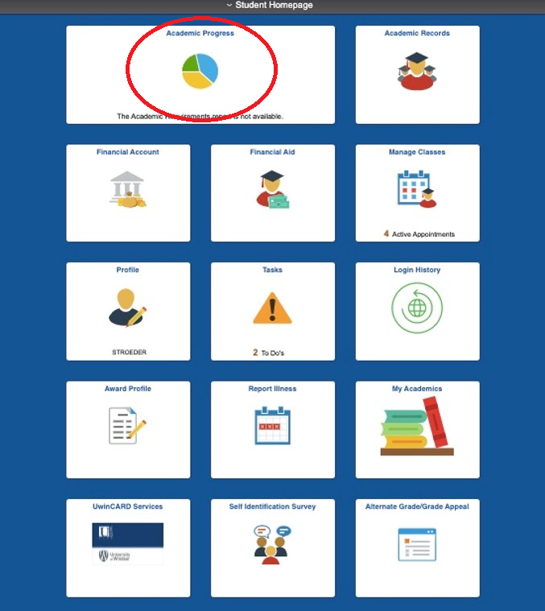
UWinsite Student Homepage
Notes:
This is what your UWinsite Student Homepage looks like
From the homepage of Uwinsite Student you will be able to access tabs: Academic Progress, Academic Records, Financial Account, Financial Aid, Manage Classes, My Academics, and Tasks.
For a quick example, let's see what happens when we click on the top tab: Academic Progress (with the pie chart)

Slide 6
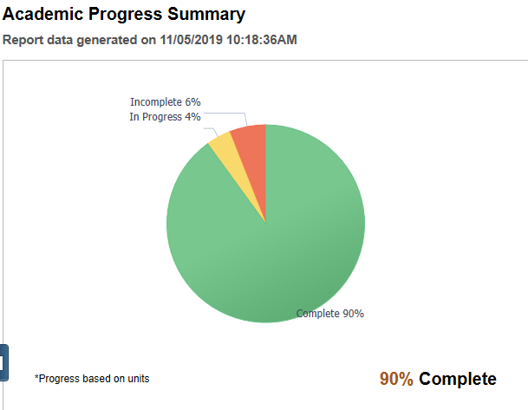
Academic Progress Summary
Notes:
Here’s a visual example of the Academic Progress function: You can view how many courses you’ve completed, see your progress in current courses, and see how many you still need to take
Here, you'll be able to see your academic progress in a more detailed report of the courses you've taken so far, the courses you still need to take, and how these courses satisfy your degree requirements

Slide 7
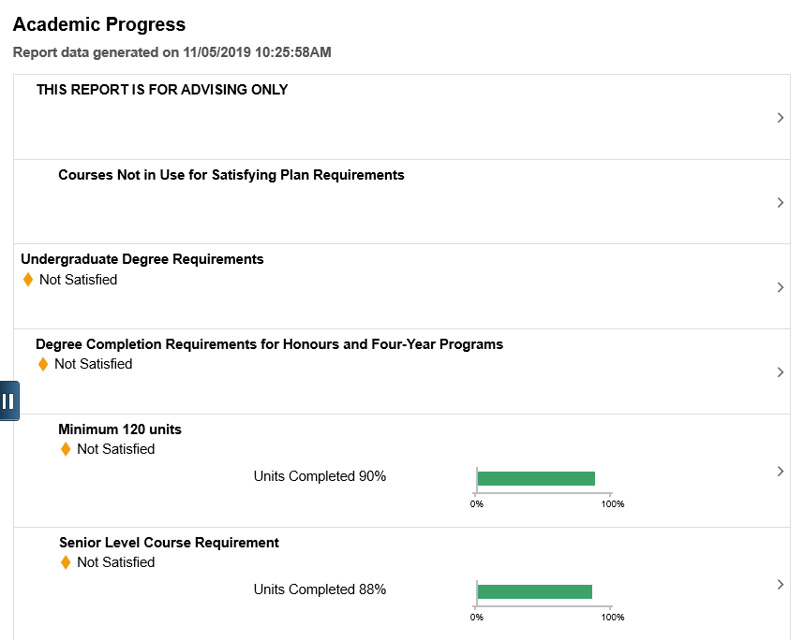
Notes:
Another function of the top pie chart tab is a more detailed report of your academic progress
This function will help you determine how many courses you have completed and what you still need to complete in order to graduate from your program
This is where you'll be able to see how your courses fit into your degree. In this example, 88% of the senior level courses for this student have been completed, so they have 12% left to satisfy their degree

Slide 8
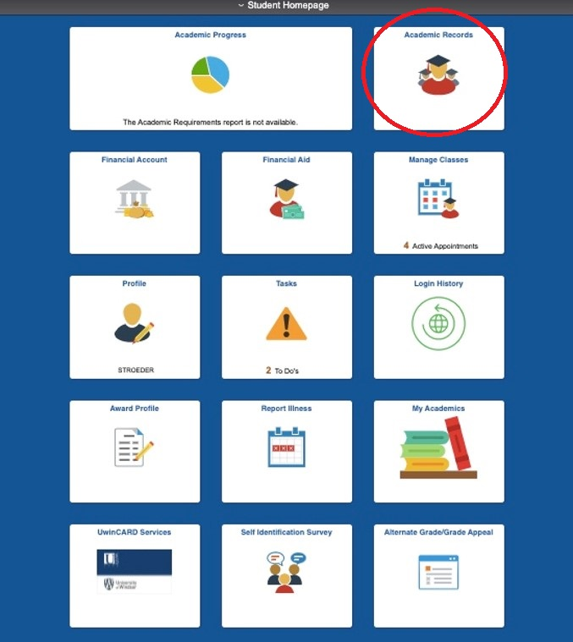
UWinsite Student Homepage
Notes:
Lets say we clicked the Academic Records button, the top right tile (with the 3 university student icons)

Slide 9
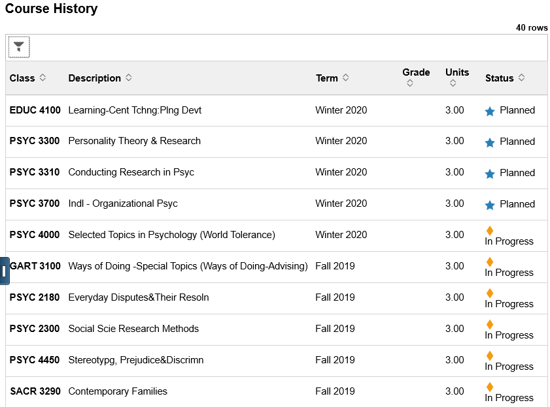
Academic Records
Notes:
Here you can view your academic record; including your planned courses and the courses you are currently taking. Once you have completed a class, your grade will appear in the "Grade" column
This is where you view your unofficial transcript for free
You can also request a copy of your official transcript if you need one. Each official transcript costs $12

Slide 10
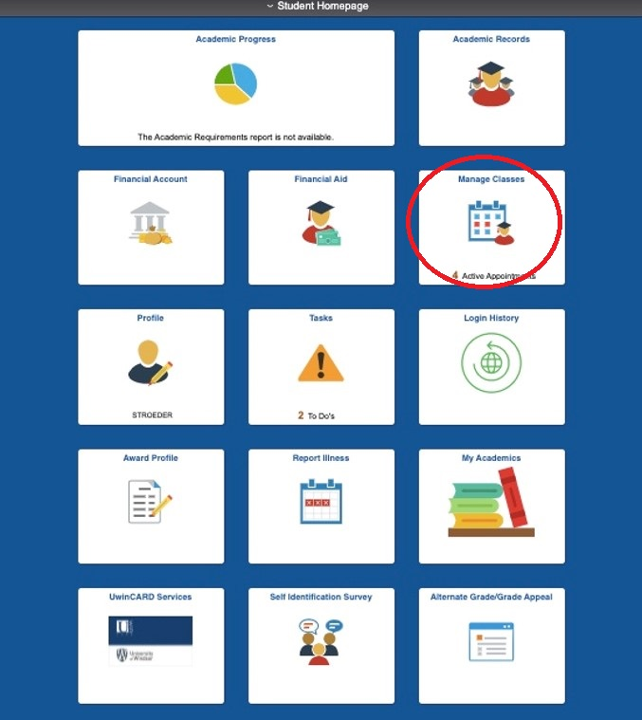
UWinsite Student Homepage
Notes:
Lets say we clicked the Manage Classes tab with the calendar icon

Slide 11
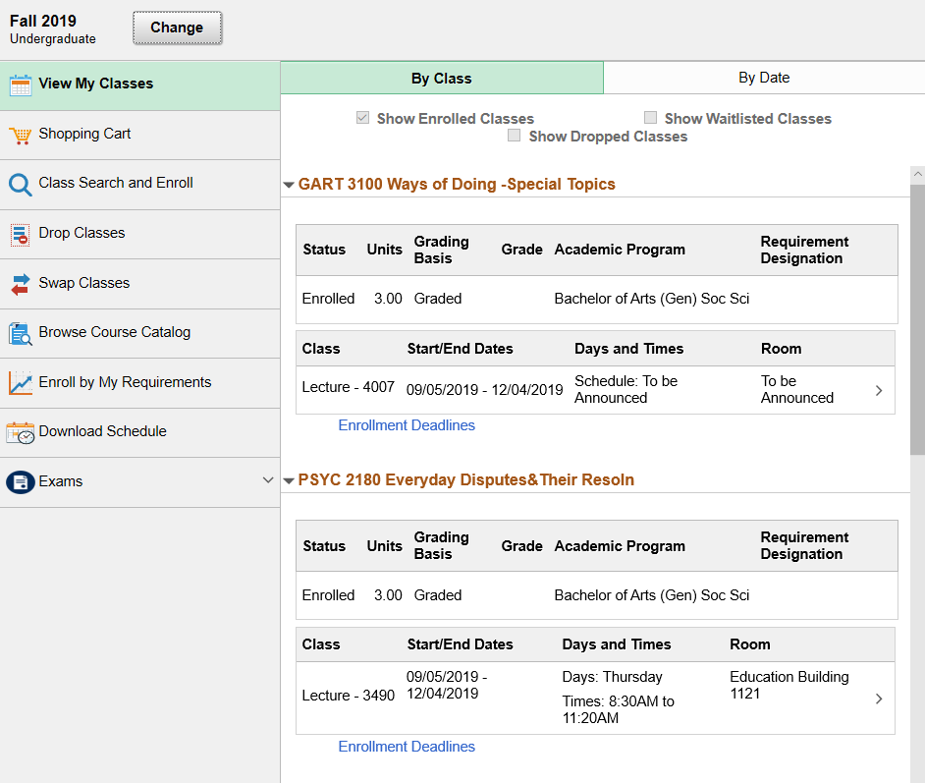
Manage Classes
Notes:
Here you can view your courses that you are currently taking, as well as planned courses (to see planned courses for your next semester, just click the "Change" tab and select the term you wish to view. Ex. Fall 2021 or Winter 2022).
Each course will be shown in its own box, with basic info like the meeting dates and times, the location of the class, and the course code. For more details on each course, you can click on the little arrow icon to see further information
This is also the tab you will use to register for classes. I recommend planning your courses out by putting them into your "Shopping Cart". That way when it comes time to register for classes, you can simply select all of your planned courses and register for them all at once. It is also a good idea to put yourself on the waiting list for each class before you register, just in case you don't get into it on the first try
Dropping courses can be done online, but I HIGHLY RECOMMEND SEEING AN ACADEMIC ADVISOR FIRST IF YOU AREN'T SURE. You can also swap courses. If you have yourself on a waiting list, you should register for another class in the meantime. Using the Swap Classes function, you can switch one of your registered classes out for your wait listed class
Finally, when exam schedules are released, they will be posted under the "Exams" tab at the bottom. Just click the drop down arrow and select "view my exams" to see the date, time, and location of each exam.

Slide 12
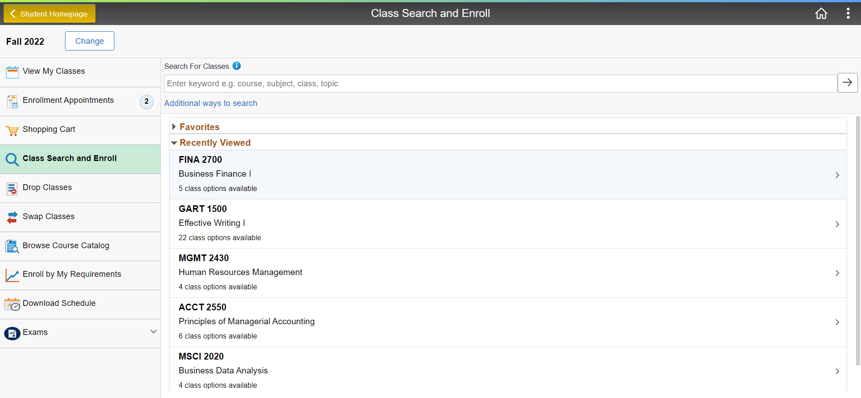
Class Search and Enroll
Notes:
Here you can view your courses that you are currently taking, as well as planned courses (to see planned courses for your next semester, just click the "Change" tab and select the term you wish to view. Ex. Fall 2021 or Winter 2022).
Each course will be shown in its own box, with basic info like the meeting dates and times, the location of the class, and the course code. For more details on each course, you can click on the little arrow icon to see further information
This is also the tab you will use to register for classes. I recommend planning your courses out by putting them into your "Shopping Cart". That way when it comes time to register for classes, you can simply select all of your planned courses and register for them all at once. It is also a good idea to put yourself on the waiting list for each class before you register, just in case you don't get into it on the first try
Dropping courses can be done online, but I HIGHLY RECOMMEND SEEING AN ACADEMIC ADVISOR FIRST IF YOU AREN'T SURE. You can also swap courses. If you have yourself on a waiting list, you should register for another class in the meantime. If your desired waiting list course becomes available, you will receive an email that there is an available seat in that class and you will have a limited time offer of swapping into that class. Using the Swap Classes function, you can switch one of your registered classes out for your wait listed class
Finally, when exam schedules are released, they will be posted under the "Exams" tab at the bottom. Just click the drop down arrow and select "view my exams" to see the date, time, and location of each exam

Slide 13
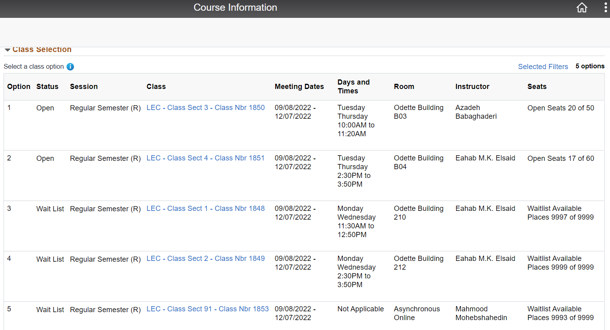
Class Search and Enroll
Notes:
Here you can view your courses that you are currently taking, as well as planned courses (to see planned courses for your next semester, just click the "Change" tab and select the term you wish to view. Ex. Fall 2021 or Winter 2022).
Each course will be shown in its own box, with basic info like the meeting dates and times, the location of the class, and the course code. For more details on each course, you can click on the little arrow icon to see further information
This is also the tab you will use to register for classes. I recommend planning your courses out by putting them into your "Shopping Cart". That way when it comes time to register for classes, you can simply select all of your planned courses and register for them all at once. It is also a good idea to put yourself on the waiting list for each class before you register, just in case you don't get into it on the first try
Dropping courses can be done online, but I HIGHLY RECOMMEND SEEING AN ACADEMIC ADVISOR FIRST IF YOU AREN'T SURE. You can also swap courses. If you have yourself on a waiting list, you should register for another class in the meantime. If your desired waiting list course becomes available, you will receive an email that there is an available seat in that class and you will have a limited time offer of swapping into that class. Using the Swap Classes function, you can switch one of your registered classes out for your wait listed class
Finally, when exam schedules are released, they will be posted under the "Exams" tab at the bottom. Just click the drop down arrow and select "view my exams" to see the date, time, and location of each exam

Slide 14
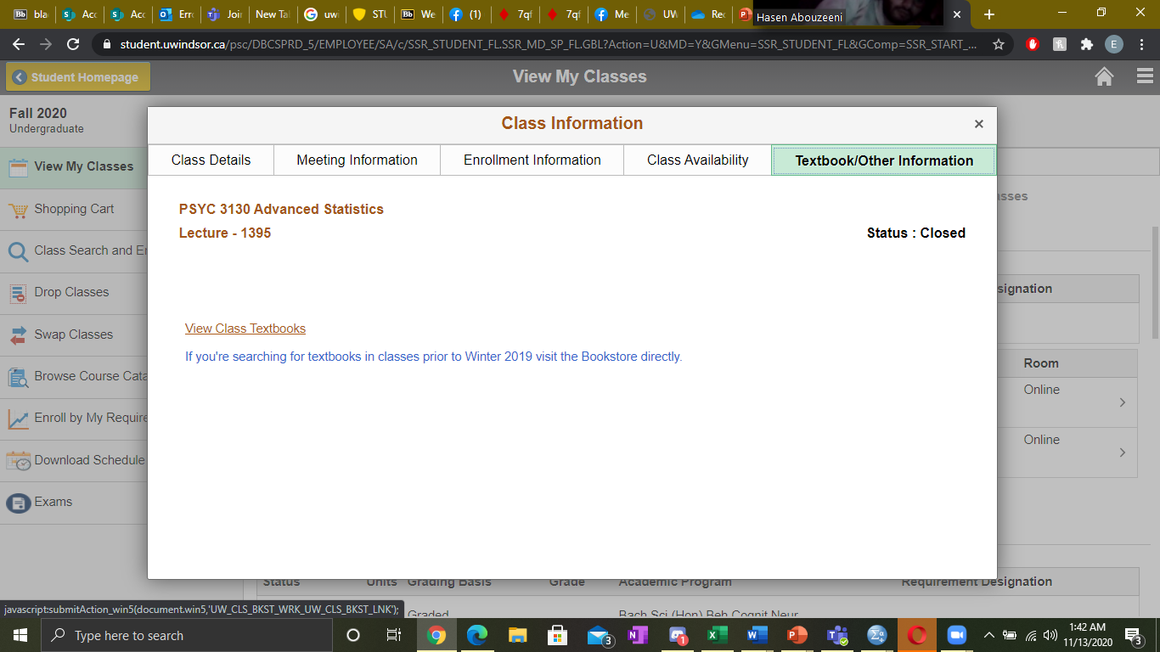
How Do I Know Which Textbooks to Buy?
Notes:
If you click on a course in the Manage Courses Tab, a textbox like this one will pop up with lots of valuable information about that class. One of these important tabs is the textbook/other information tab. Here you will find any course materials you will be required to purchase for your class. By clicking the “View Class Textbooks” link at the bottom left of the textbox, you will be brought to the Campus Bookstore website with all course materials for that class and links to purchase them from the bookstore.

Slide 15
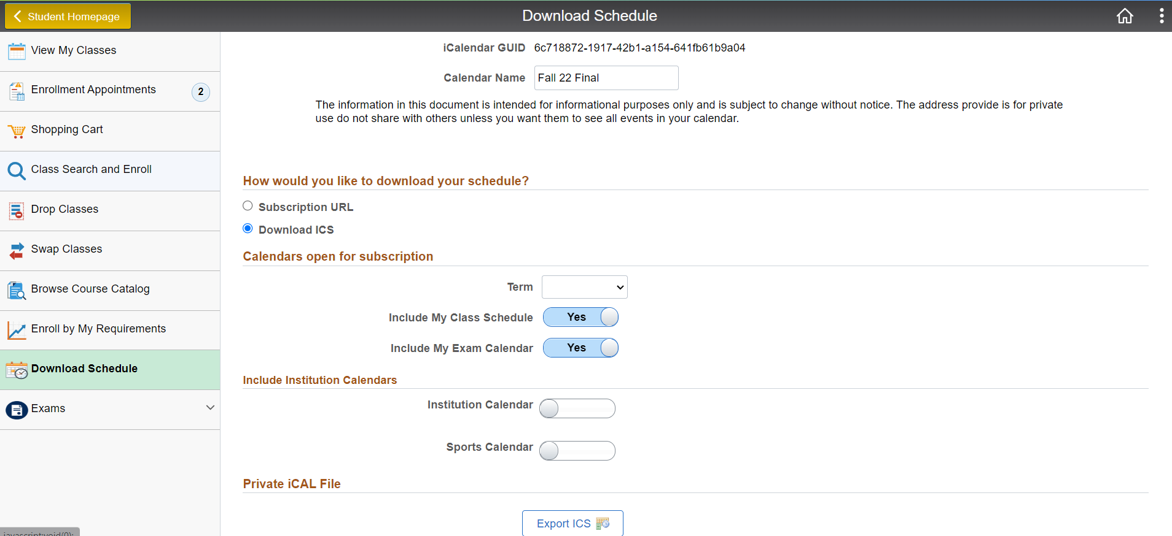
Downloading Schedule
Notes:
You can download your schedule at this tab. The file you download can be imported into the calendar of your choice (apple, google, microsoft).

Slide 16
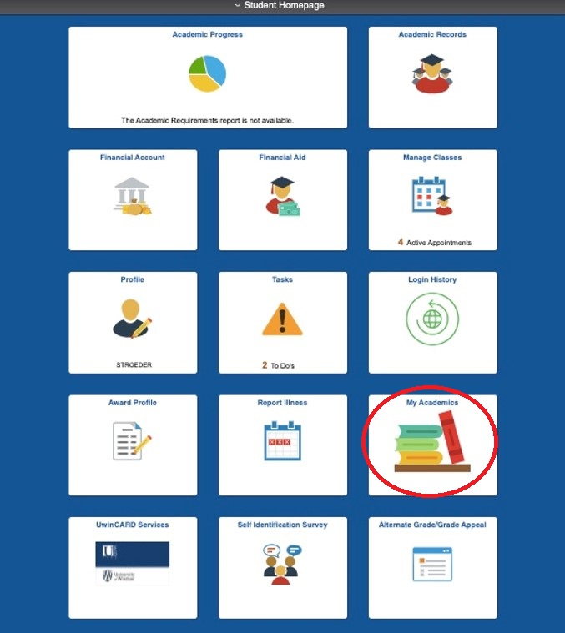
UWinsite Student Homepage
Notes:
Finally, lets say we clicked the My Academics tab

Slide 17
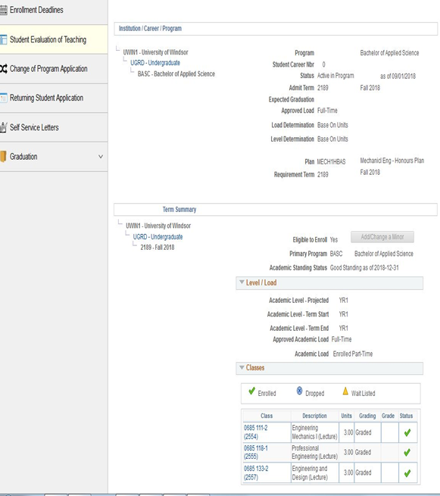
My Academics
Notes:
The My Academics function allows users to view
An academic summary of the courses they've taken and their other required courses
Option to add/change a minor or certificate
enrollment deadlines for registering for classes
change of program major application (DO THIS WITH AN ACADEMIC ADVISOR)
returning student application, if you've already been a student with the University of Windsor
apply to graduate!

Slide 18
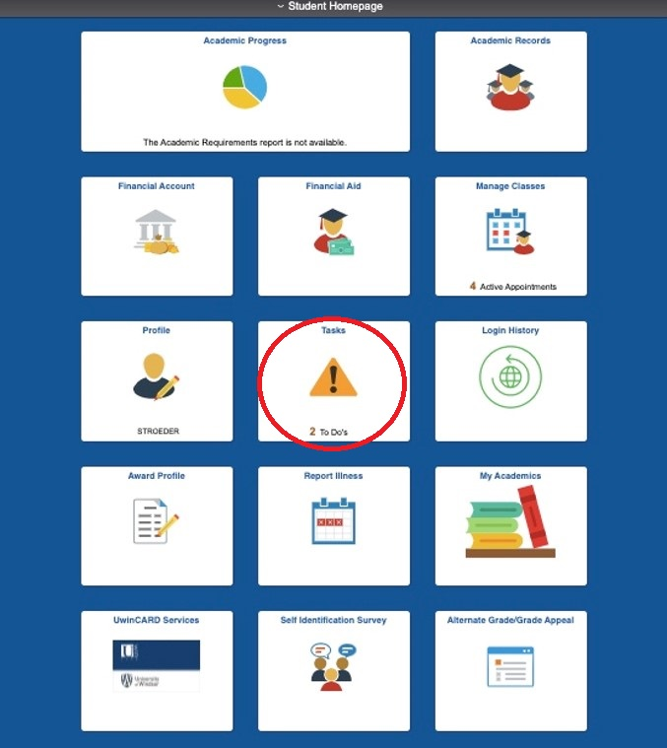
UWinsite Student Homepage
Notes:
Lets say we clicked the Tasks Tile

Slide 19
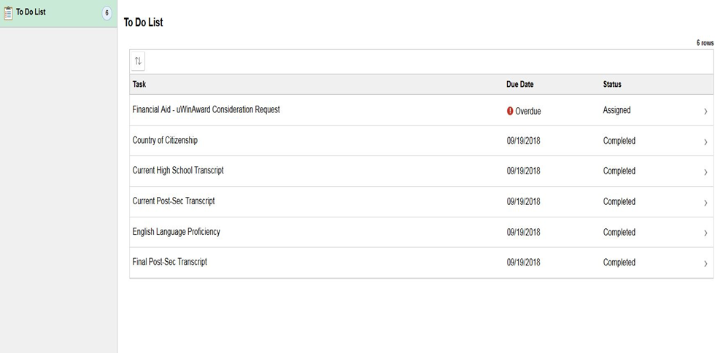
Notes:
This is basically just a to-do list of tasks that you should complete
Most of them are optional, but I recommend doing them. Some examples could be filling out an award profile in order to be considered for awards and bursaries, filling out your profile information, or completing any other assessments that may pertain to you
If you are going to fill out only one, STRONGLY recommend that you do the award profile to allow you to be considered for awards and bursaries. Otherwise, you may not be able to apply

Slide 20
Bright Space
What
When
Where
How
Why
Notes:
WHAT: Bright Space is going to be something that you use everyday. Through Bright Space you can see announcements from your professors for each class, view and submit assignments, find contact info for your profs/GAs/TAs, see your grades, find the syllabus for each class, etc.
WHEN: check Bright Space daily. You never know when an announcement will be made about a deadline for an assignment, info about midterms and exams, study guides, etc.
WHERE: login at brightspace.uwindsor.ca , you will need your uwin ID and password
HOW: Typically, you will be looking at each course individually to see the announcements, syllabus, assignments, and resources (like powerpoints and study guides). You will likely also be looking at the section where you can view your grades
WHY: you will use Bright Space literally everyday. It's the home for everything you could ever need when it comes to your courses. Make sure to use it often!
Bright space is University of Windsor’s learning management system. Bright Space is completely web-based, and therefore you will need an internet connection to access its features.

Slide 21
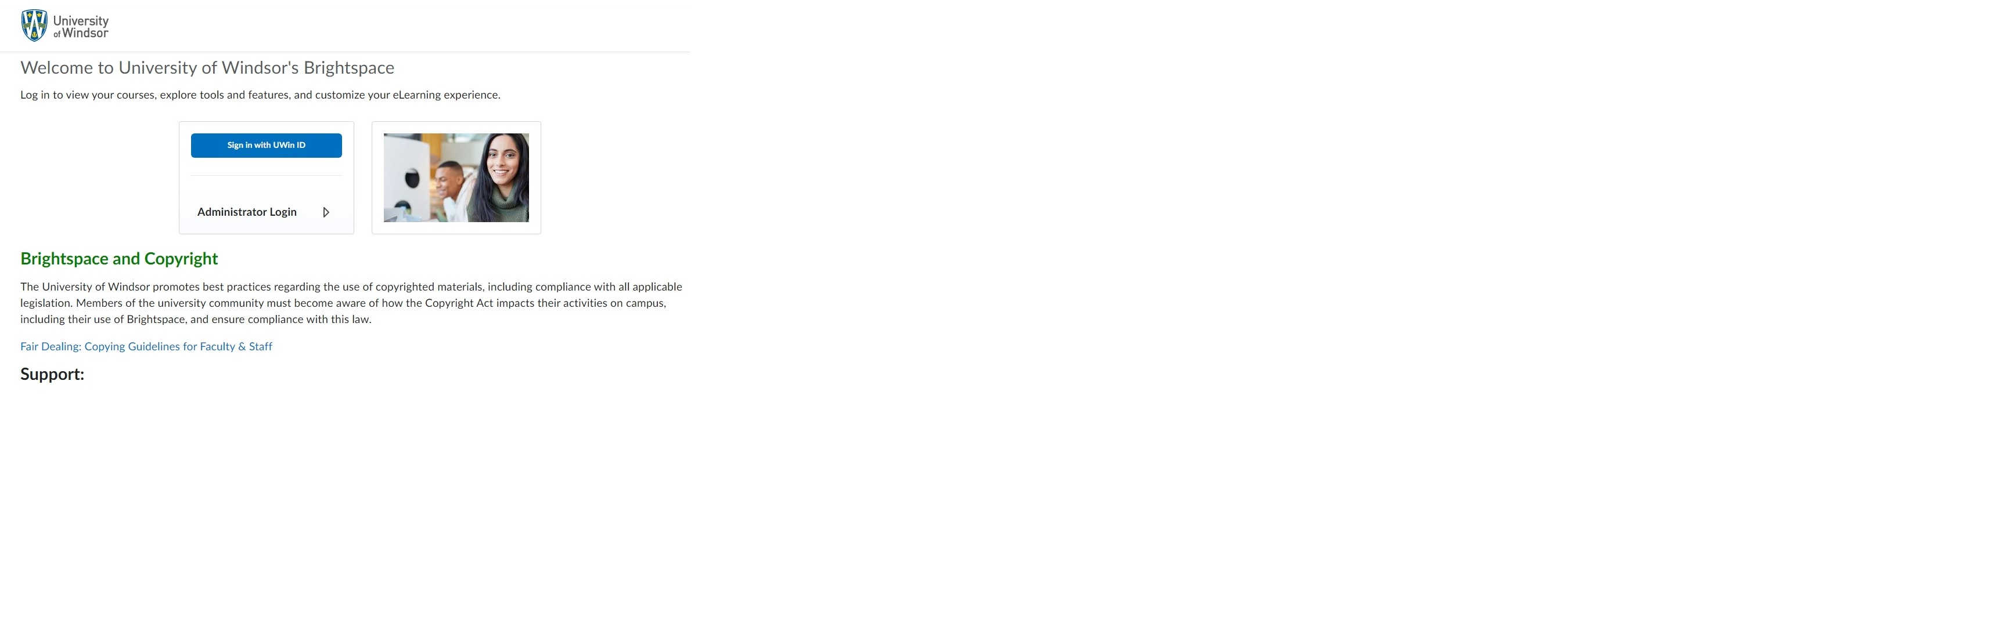
Login Page
Notes:
Login at brightspace.uwindsor.ca
Use your UWin ID with @uwindsor.ca email and password to access the site. Be sure to see if any new information or news has been added to the log-in page.

Slide 22
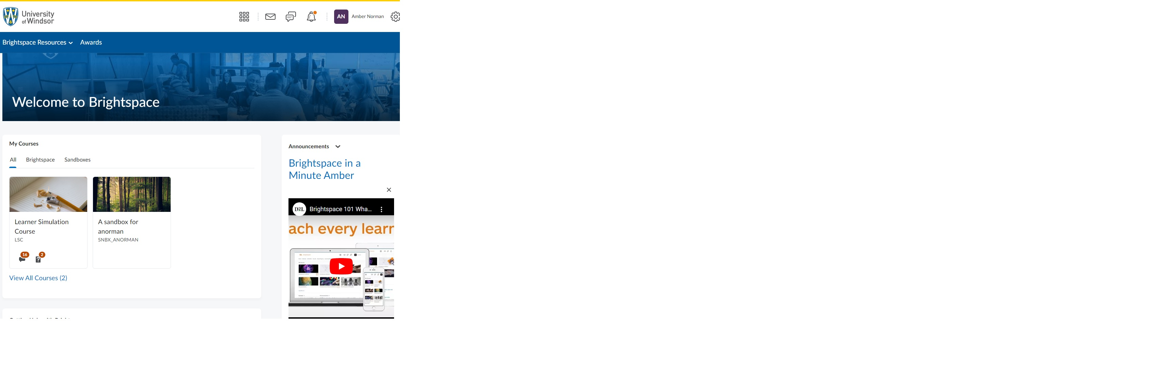
Bright Space Dashboard
Notes:
Important information is at the forefront with useful widgets.
Navigating Bright Space: Brightspace offers common elements or tools that you can access no matter where you are on the site.

Slide 23
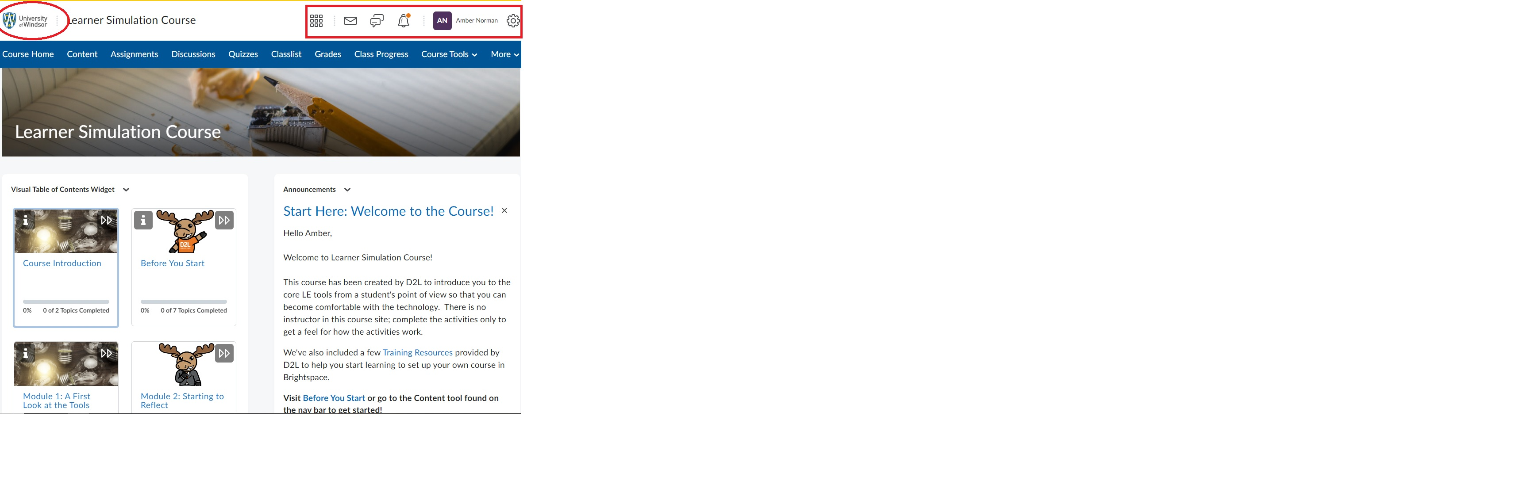
Mini Bar
Notes:
No matter the page you are on, you’ll find the minibar at the top.
When you select the UWindsor logo, you’ll be taken back to this UWindsor’s Brightspace homepage.

Slide 24
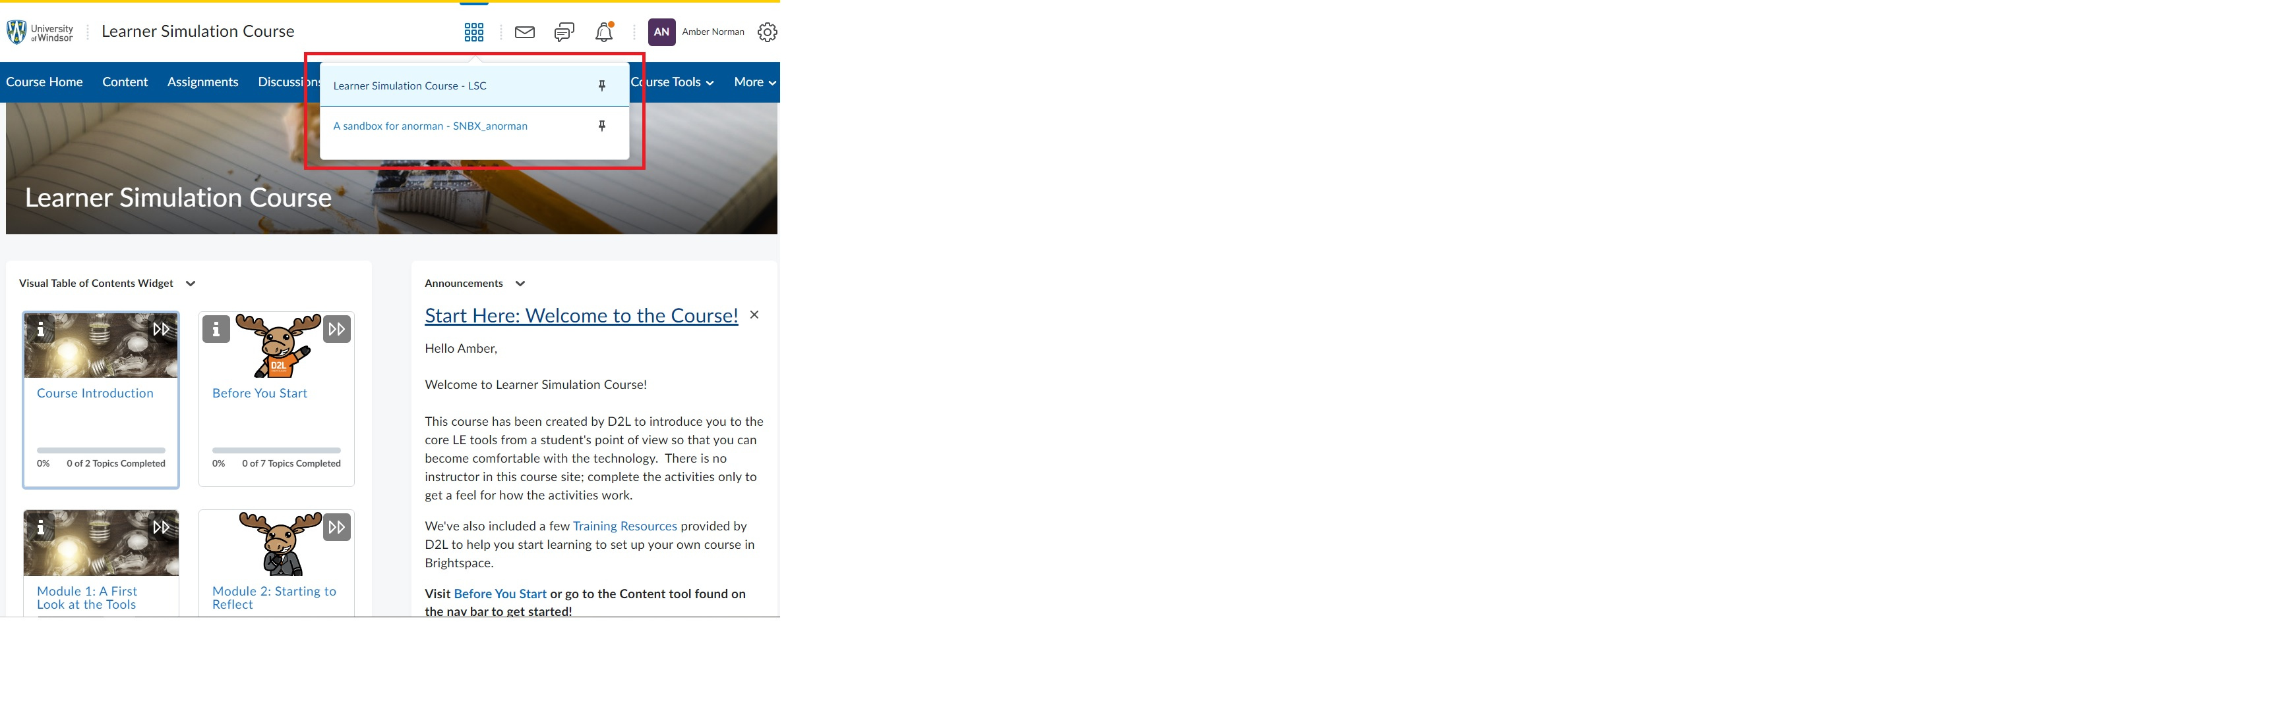
Course Selector
Notes:
Find the course selector, listing all your current courses.

Slide 25
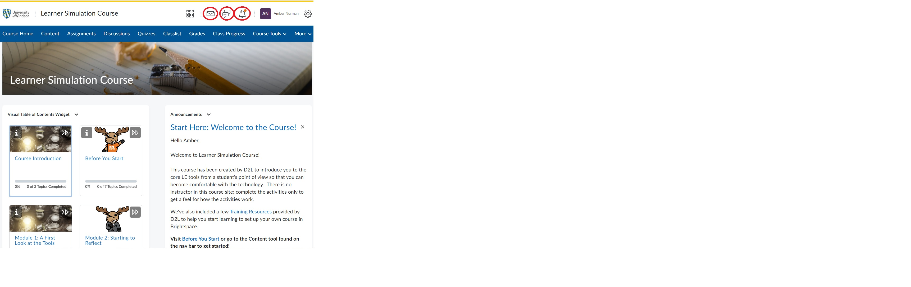
Alerts
Notes:
Next to the course selector are the Alerts. Any of the icons with an orange dot mean you have a new notification, instant messages or announcement.
The Message Alerts, or envelope, is for instant messages. Emails are sent to your UWin account so you will not be notified here.
The speech bubbles are for subscription notifications, discussions, and Activity Feed.
The Update Alert bell is for updates related to announcements, due and end dates, and grades.

Slide 26
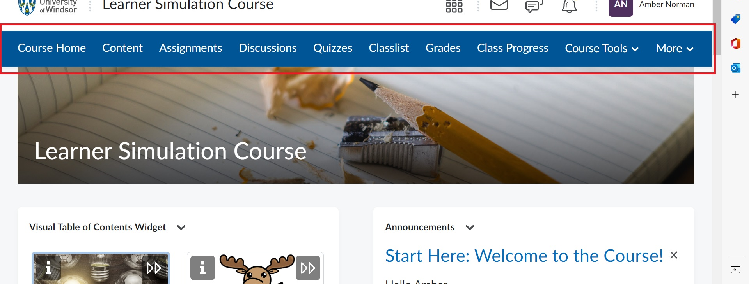
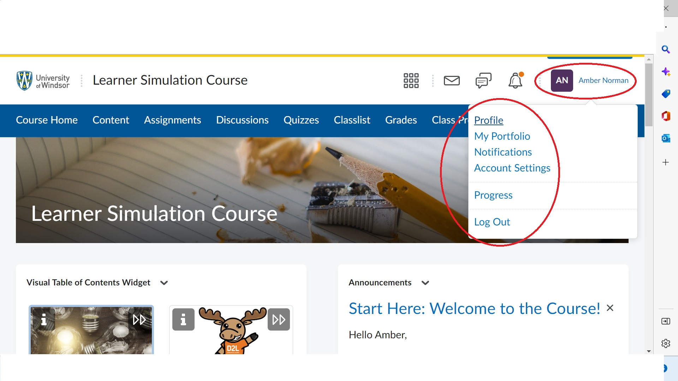
Navigation
Notes:
Your course nav bar is found below the mini bar. Access course specific tools here. Note the nav bar may change from course to course.
Next select your name to locate your Profile, Avatar, Notifications, Accounts Settings, Progress and to Log Out. Keep this top of mind when using public computers.
You can update your profile with a photo that will appear near your comments along with other info.
Notifications allow you to adjust the methods and timing of your notifications, and Settings allows you to adjust things like font size video settings.
You’re encouraged to have a look and customize the notifications and settings to your preference.

Slide 27
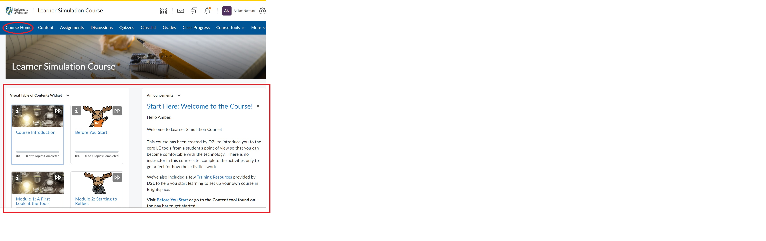
Course Home Page
Notes:
The course homepage will likely change from course to course. Important information is generally found on this page like course Announcements, the content modules of your course, and the calendar.

Slide 28
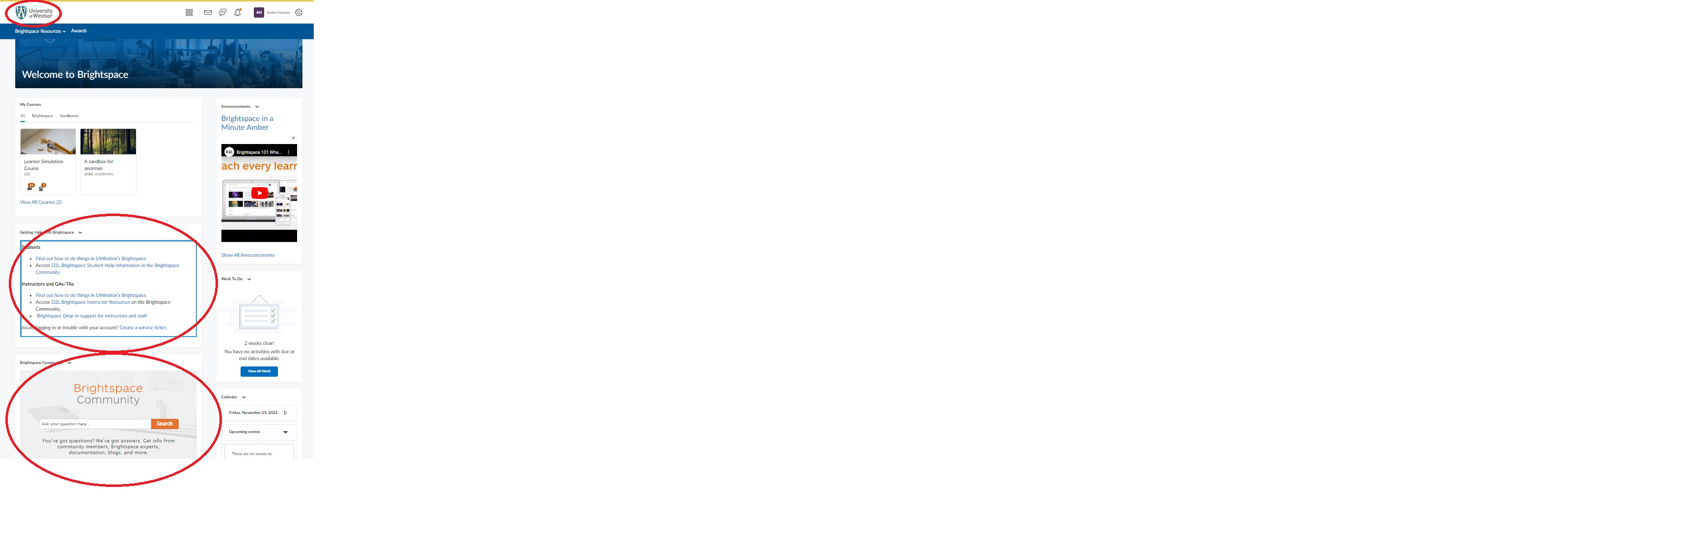
Resources & Support
Notes:
Have a look at your Brightspace account and get familiar with it. Find more information about how to use Brightspace in the Student FAQs on the UWindsor's Brightspace help site.

Slide 29

Microsoft 365
Portal.office.com
Outlook
OneDrive
Word
Excel
PowerPoint​
OneNote​
SharePoint
Teams
Notes:
With Microsoft 365, you can download all of these apps for free using your UWindsor account on up to 5 devices! Go to portal.office.com and use your UWinID email and password to access this.
OneDrive allows you to store all of your documents in the cloud and share documents with others.
Word allows you to create and edit text documents, like essays.
Excel allows you to create spreadsheets and analyze statistics.
PowerPoint is how you will create your presentations.
OneNote is a notetaking app to help you organize your course content.
Teams is a meeting application to meet online and keep your calendar organized.

Slide 30
UWindsor Outlook
What
When
Where
How
Why
Notes:
WHAT: the same as a usual outlook account, but tied to your uwindsor account
WHEN: this is another web platform that you should check at least once per day, if not more often. Turn on your notifications to make sure you never miss anything important!
WHERE: log in the same way you would normally log into any other outlook account through the Google home page
HOW: log in using your UWin ID and password
WHY: professors and the University of Windsor overall will ONLY use and communicate with uwindsor email accounts, they won't send emails to your personal email.

Slide 31
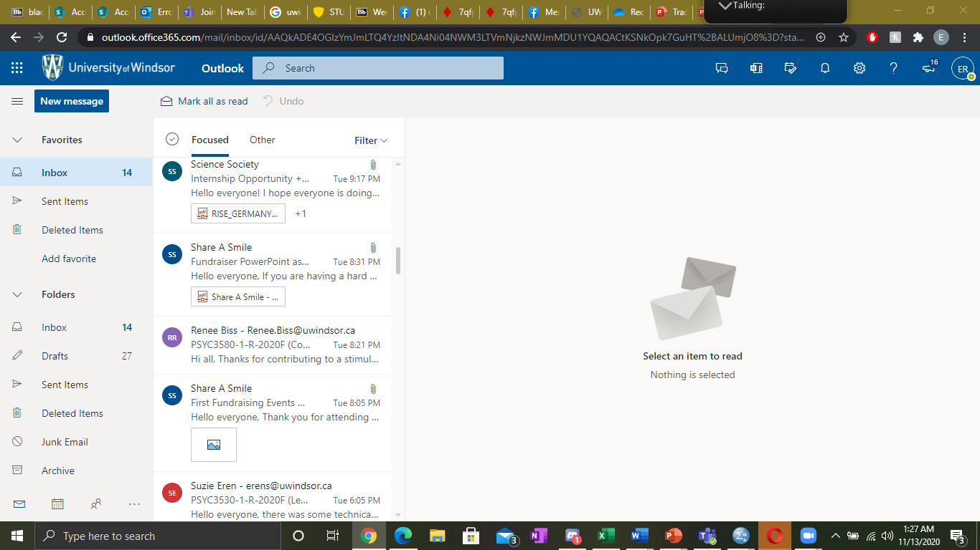
UWindsor Outlook
Notes:
Here is an example of what your uwindsor outlook will look like.
You'll get emails from professors, other students, groups and clubs, student societies, the University of Windsor overall, etc.

Slide 32
mySuccess
What
When
Where
How
Why
Notes:
WHAT: mysuccess is an online portal that you can use for a variety of things including setting up appointments with academic advisors, signing up for Ignite Work Study, searching for jobs (on and off campus), sign up work workshops like the Bystander Initiative, make appointments with Writing Support Desk, etc.
WHEN: you should use this webpage to make an appointment with an Academic Advisor at least once per semester to make sure you are on track with your courses.
WHERE: the website is success.uwindsor.ca, it is completely online. The Student Success and Leadership Centre is located in the lower level of Dillon Hall, however is closed at the present time. You may only access advisors and other staff via online drop in hours or by setting up an appointment online with them.
HOW: log in using your uwin ID and password and select which tab you'd like more information about (next couple slides show how to use it)
WHY: important to keep up with your academics by visiting academic advisors relatively often. Also helps enrich your experience at university by completing workshops like Bystander, Ignite Work Study, visiting Writing Support Desk, etc.

Slide 33
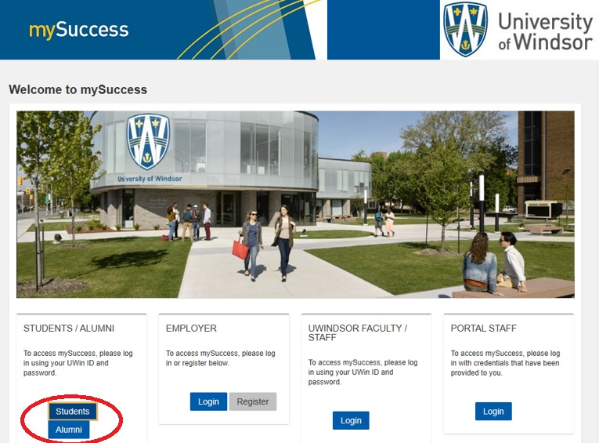
mySuccess Login Page
Notes:
This is the login page, select “Student”
Once you select "Student", you will be redirected to another page. Here you can sign in with your uwin ID and password.

Slide 34
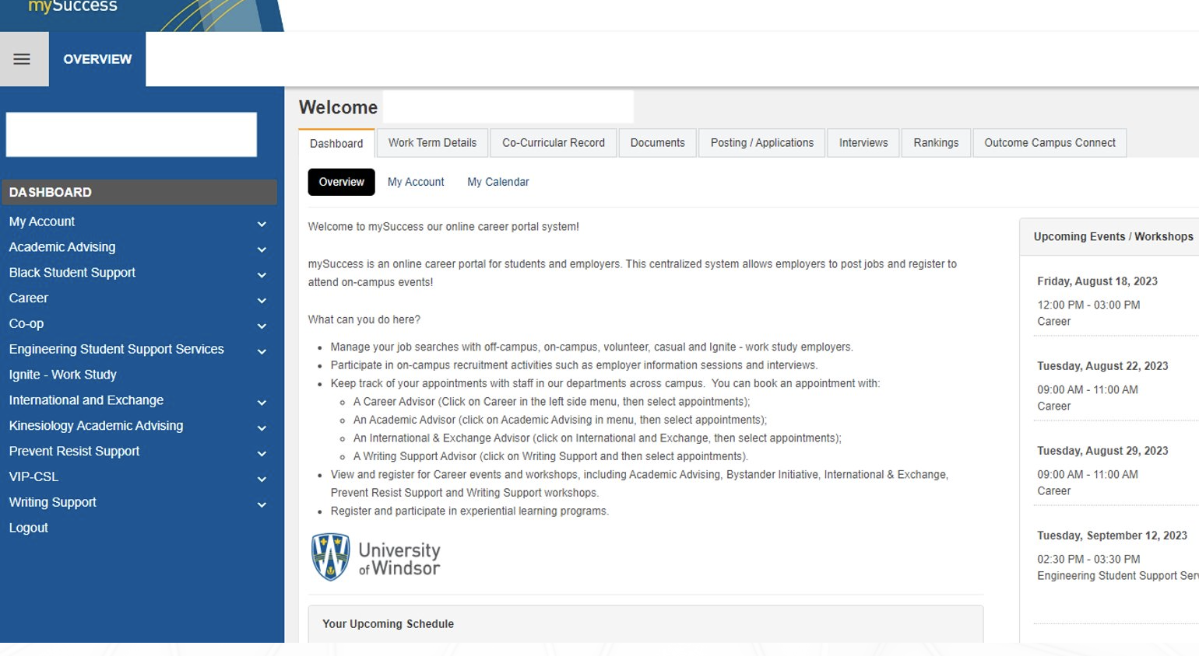
Notes:
This is what the main page looks like
On the side you can see various tabs like: Academic Advising, Ignite Work Study, Bystander Initiative, and Writing Support
Functions include:
Academic Advising: important!! Though academic advisors do take virtual walk ins, it is a better idea to make an appointment online to ensure that you are guaranteed to be seen. See their website for details about virtual drop in hours
IGNITE Work Study: allows you to work a part time job on campus (10 hours a week max). Gets you valuable work experience and an income while placing your main emphasis on classes
Bystander Workshop: workshops aimed at preventing and recognizing sexual violence. Students can get a certificate for participating in the workshops online.
Writing Support Desk: located in Leddy Library. Allows students to make appointments to go over their assignments and papers before submitting them. They won't edit your spelling and grammar, but they will help you with the overall quality of your assignment by suggesting ways to make your work stronger, showing you how to form a good thesis or hypothesis, and providing helpful information on formatting and references

Slide 35
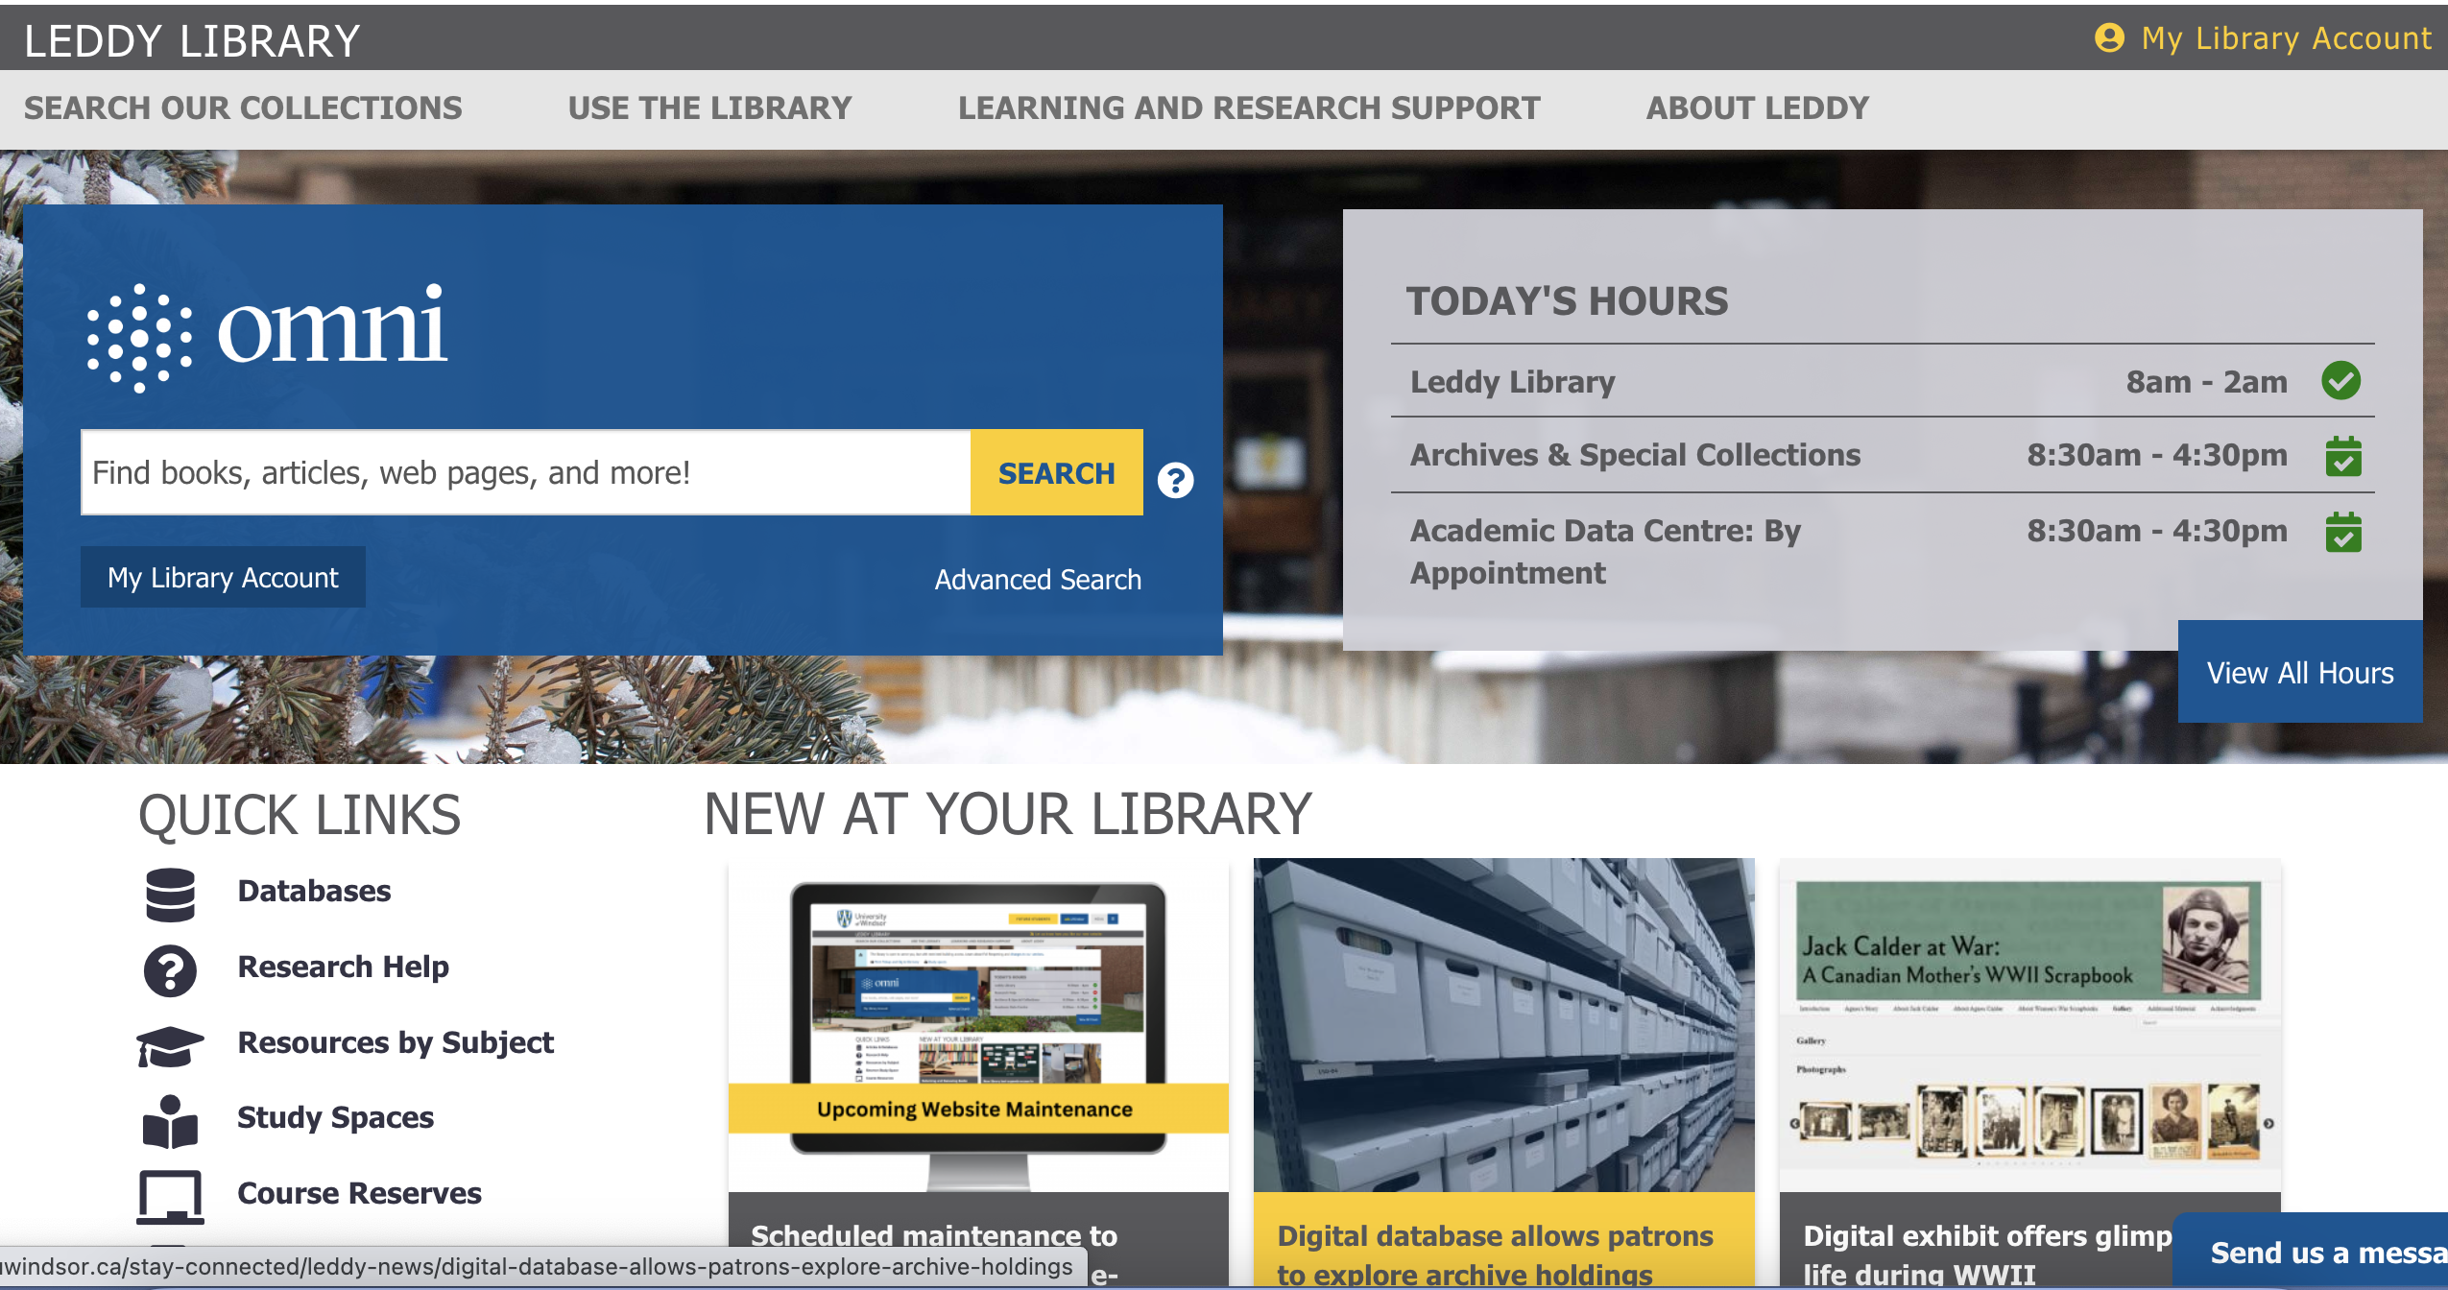
Notes:
Lastly, the Leddy Library Website is an essential resource for all students. Here you can access resources like research help. To access this, go to the leddy library home page as shown here and then click journal articles and research tools on the left hand side. From here you will be able to access nearly all research for free. For additional help you can set up an appointment with the research help staff.

Slide 36
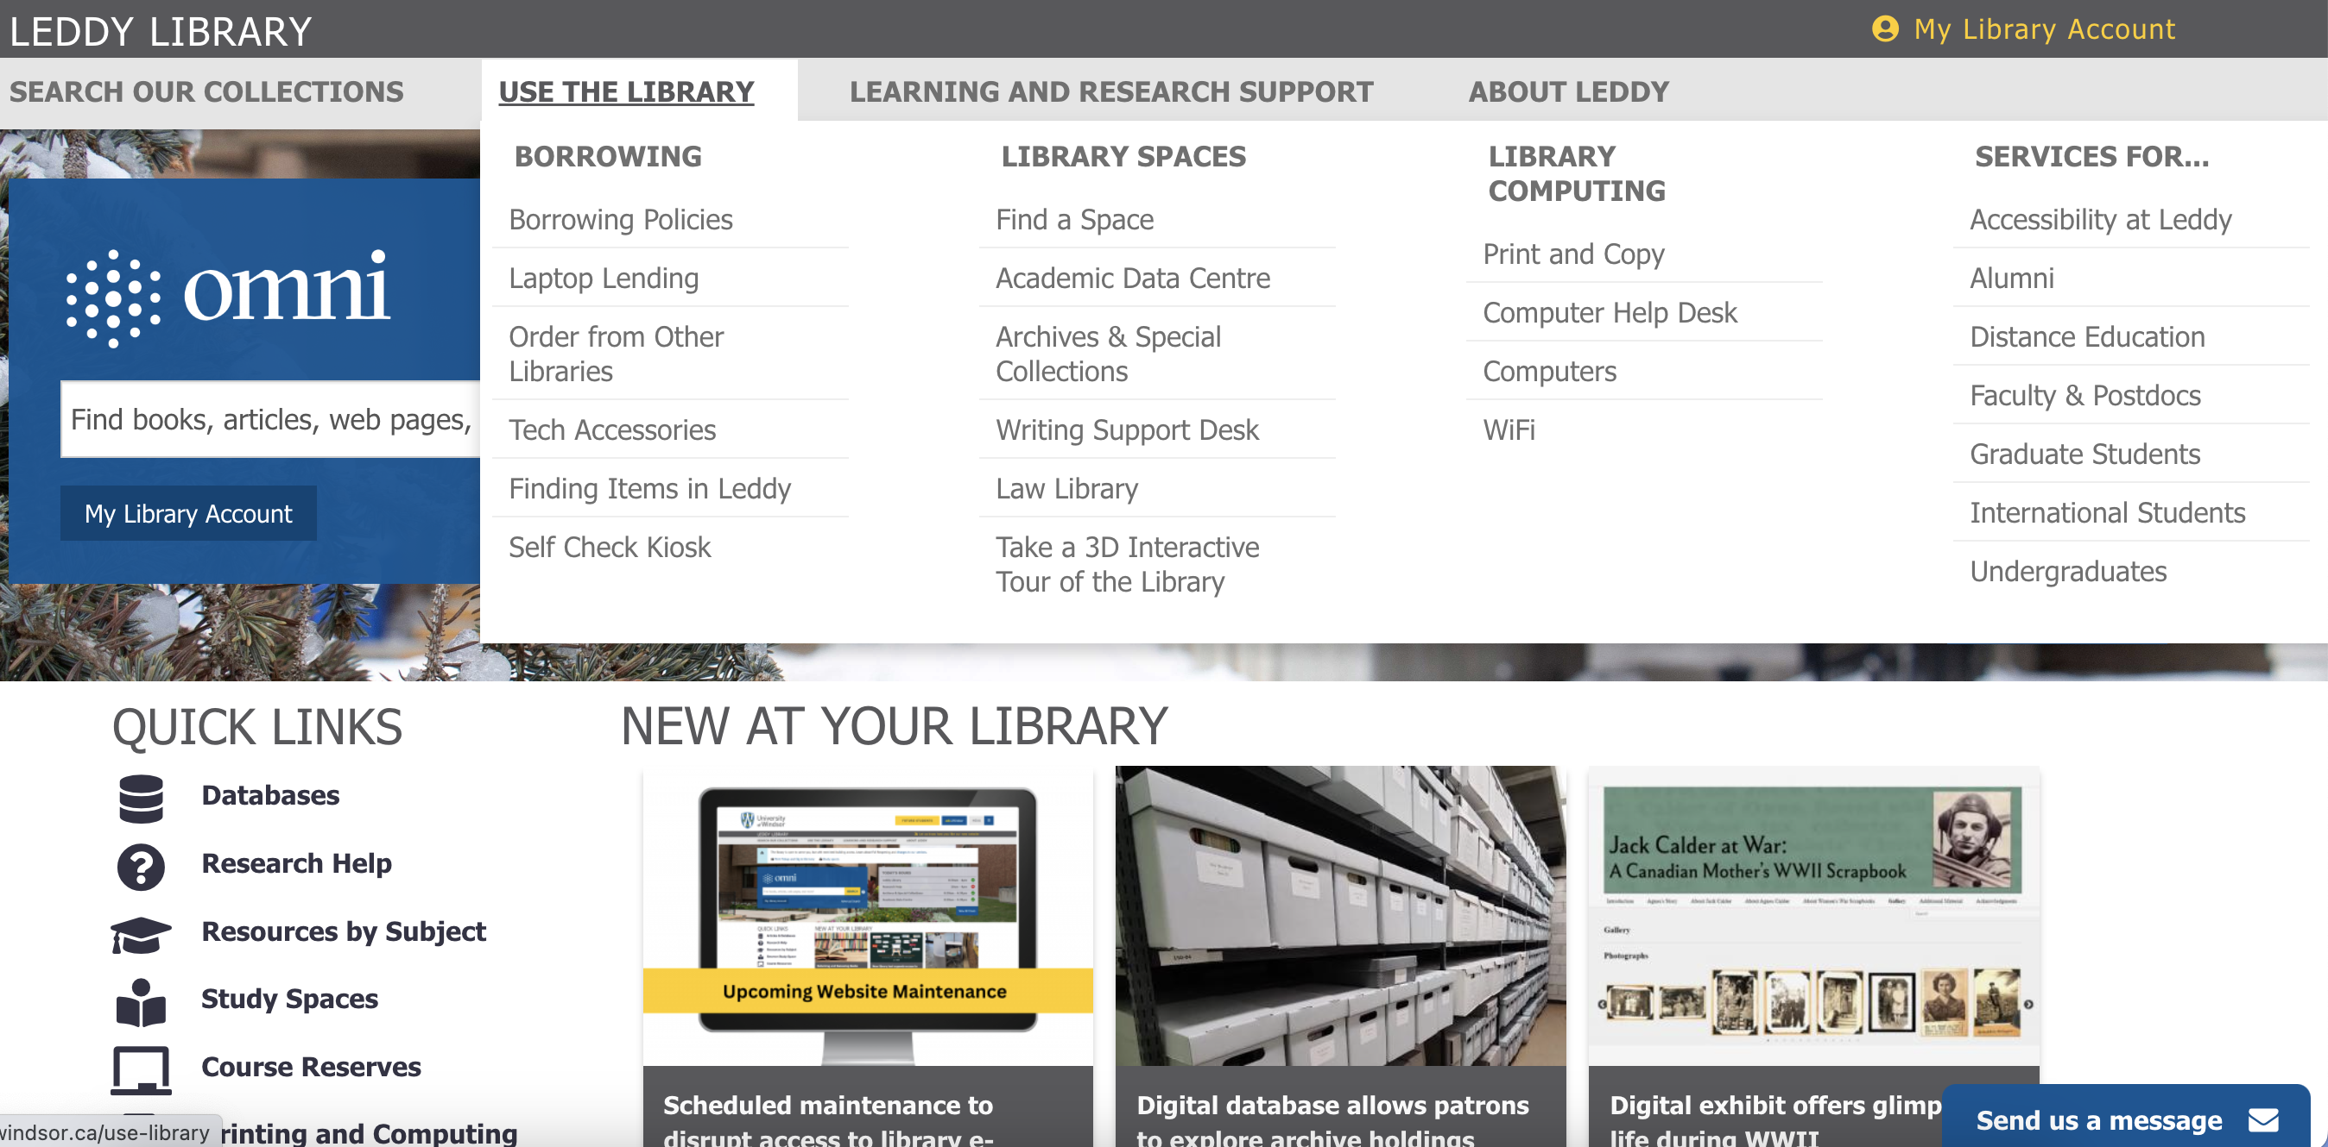

Slide 37
Campus Apps
Lancers Go - Athletics and Rec
Schedules: Facility, pool, fitness and intramural schedules
Member ID: allows you to access the Toldo Lancer Centre
Varsity sports schedule
Online registration
Wellness tips
SafeLancer
Campus Alert - will alert you to any emergency situations
Mobile Blue Light - calls campus police
Friend Walk or Virtual Walk
Report a tip - to report suspicious activity
Safety toolbox - Chat with campus police, flashlight, and loud alarm features

Slide 38
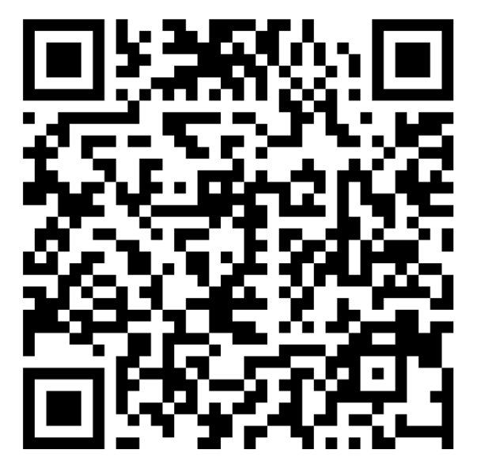
Sign Up for JumpStart!
Designed to support first-year students with key academic skills for success in a skills-lab format.
Topics include:
Create Your Own Schedule
How to Take Notes
Studying Smarter, Not Harder

Slide 39

Questions?
Thank You!
Notes:
As you can see UWindsor has many tools and supports available to students. We know this was a lot of information to absorb about these tools. The more that you make use of these tools, the more fluent/comfortable you will become using them.
That concludes our essential supports and services presentation. We hope you now feel a little more confident navigating all the essential supports Uwindsor has to offer! Are there any questions?
Thank you for your time and good luck on your new academic journey!

