Slide 1

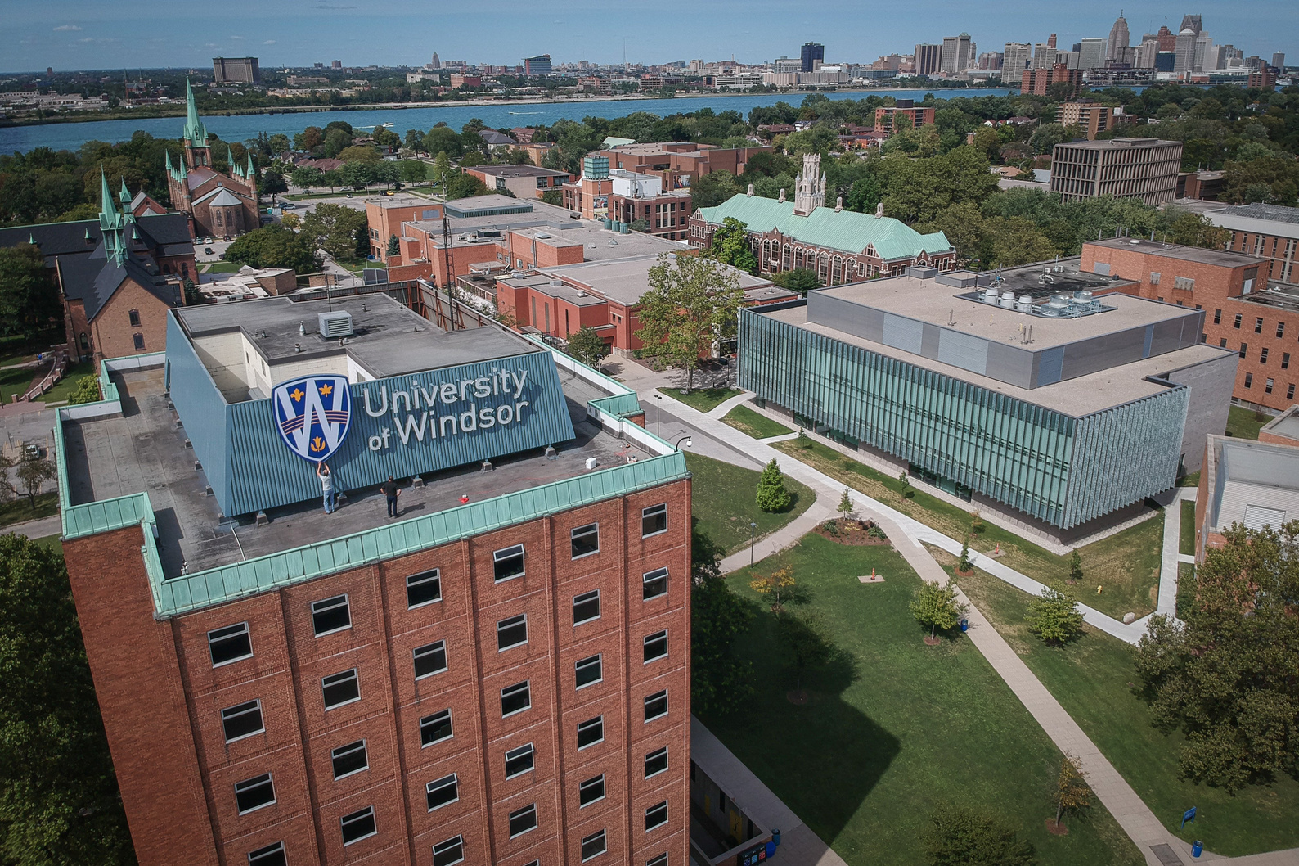

Winter Orientation
Student Panel

Slide 2

Alumni Story

Slide 3


Courses
  A mandatory course I need to register in is full. What should I do?
  What is the process of changing a major?​​
  How do I know what courses to take?​
  What does it mean when I have to sign up for a lab?
  What does it mean to voluntarily withdraw from a course?
  How do I find courses/electives?

Slide 4

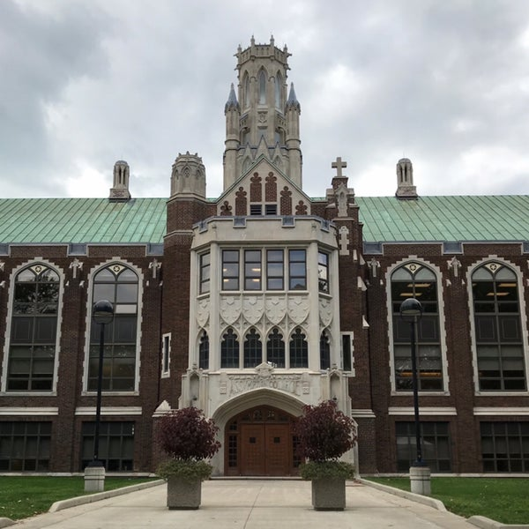
Campus Services
  Where can I purchase textbooks?
  How can I purchase a parking pass?
  I received a scholarship/bursary. Why does it not show up on my tuition statement?
  How do I withdraw from my drug and dental plan?
  How do I get my UWinCARD and put money on it?
  How do I learn about/join clubs?

Slide 5

Student Exchange
  Why should I participate in an exchange program?
  Do I get academic credit from my studies abroad?
  If I only speak English, can I go on exchange?
  How do I apply for exchange?
  Will going on exchange delay my graduation?
  Who can I contact if I have questions?

Slide 6
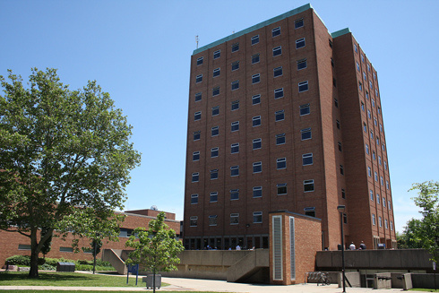
Residence
  Can I select my preferred building and/or a roommate?​
  Can a first year student have a single room?​
  What is it like living in residence?​
  What is it like to live on an all gender community?​
  Can I have friends/guests over?​
  When can I move in?

Slide 7
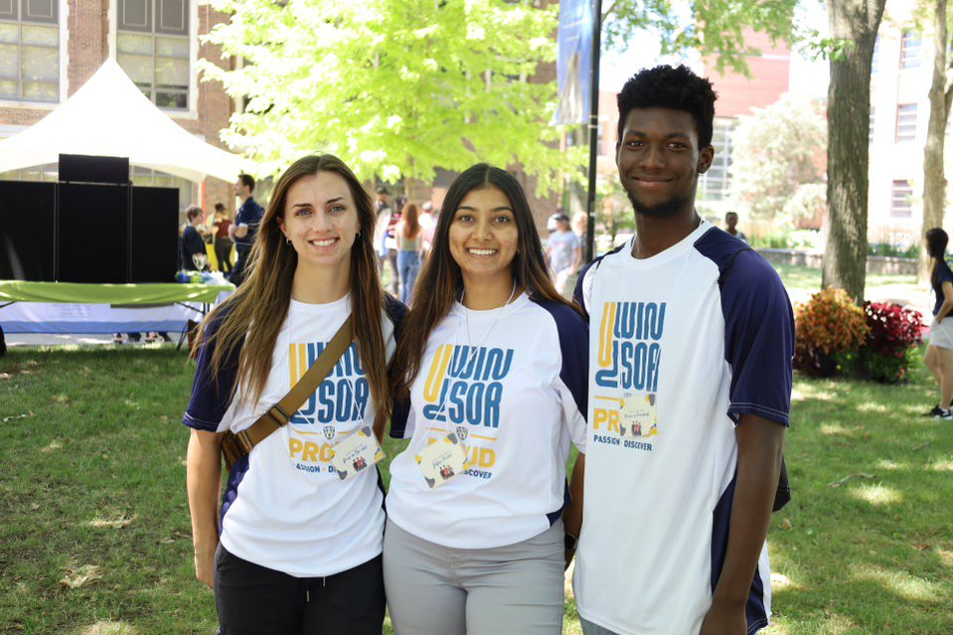
Student
Life
  How do I make friends?
  What are the benefits of being involved on campus?
  What extra-curricular activities are there on campus?
  What are clubs and societies and how do I get involved?
  Who should I talk to if I'm not doing well in school?

Slide 8



Finances
  How can I apply for awards and bursaries offered at the University of Windsor?​
  How can I save money while living on Campus?
  Can I work on campus?
  What other opportunities are there on campus for my student to earn money?

Slide 9
Have a question? Visit ask.uwindsor.ca!

Slide 10

Giveaway Winner!
$500 TUITION

Slide 11

Afternoon Schedule
  Optional Afternoon Activities
    Meet with an academic advisor
    UWin Card photo
    Campus and Library tours

Slide 12
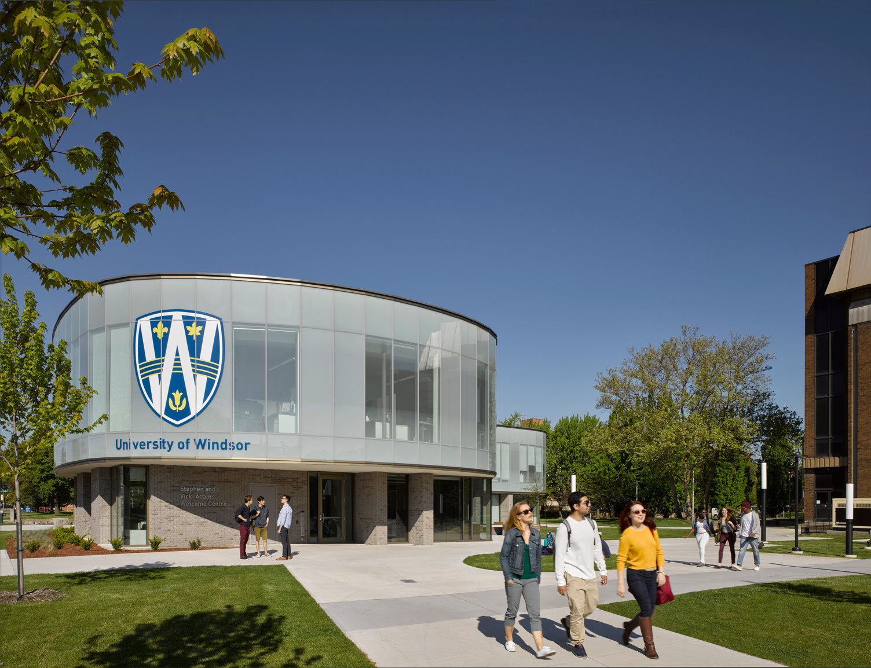
Thank You!

