Slide 1
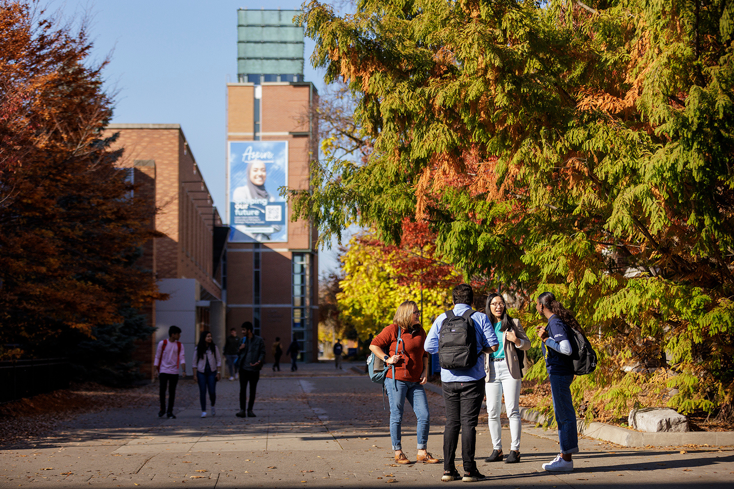



Welcome to
Winter Orientation
WELCOME TO HEAD START

Slide 2

Land Acknowledgement
The University of Windsor sits on the traditional territory of the Three Fires Confederacy of First Nations, which includes the Ojibwa, the Odawa, and the Potawatomi. We respect the longstanding relationships with First Nations people in this place in the 100-mile Windsor-Essex peninsula and the straits – les détroits – of Detroit.

Slide 3
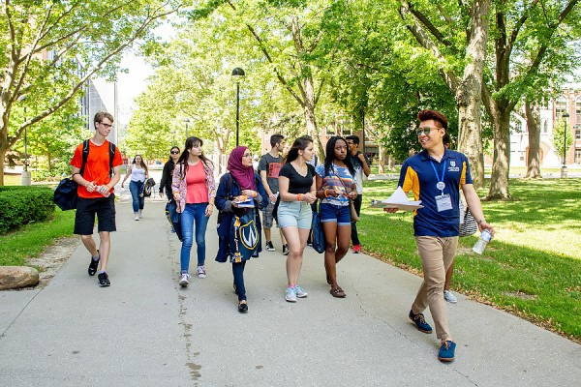

Where Are You From?

Slide 4

Stay Connected
Text keyword “UWindsor” to the number 1-833-338-7626 to activate your guest wireless account.

Slide 5

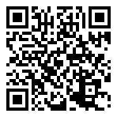
Winter Orientation Schedule
  Presentations
    UWin101
    Essential Tools & Student Panel
  Optional Afternoon Activities
    Meet with an academic advisor
    UWin Card photo
    Campus & Library tours

Slide 6

Prize Giveaway
$500 TUITION

Slide 7



All presentations from Winter Orientation will be emailed to you!

Slide 8


Follow Us on Instagram!
  More giveaways
  Updates about events on campus
  Free food
  Support services
  .. and more!
@uwinstudentexp

Slide 9


Thank you!
AND WELCOME TO UWINDSOR

Slide 10
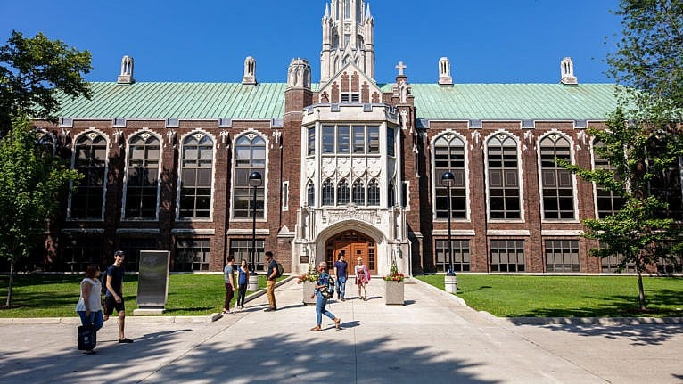
UWIN
101

Slide 11
Agenda
During this session, we will
1
Discuss common experiences for students transitioning to University
2
Outline key information and strategies that will help you succeed
3
Highlight campus support services that are here to support you

Slide 12

Why Are You Here?
1
2
3
SELF-DEVELOPMENT
CAREER
SKILLS
  Improve career prospects
  Pursue a job you love
  Increase earning potential
  Increase knowledge in your subject of study
  Develop confidence and independence
  Exciting new experiences
  Social connections and networking
Develop transferable skills, including:
  Communication
  Problem-Solving
  Organization
  Leadership

Slide 13

High School Vs. University
FLEXIBLE SCHEDULE
RIGHTS AND RESPONSIBILITIES
SELF-ADVOCACY
  At this point you may be asking yourself - what did I sign up for?
  Students have more freedom, but also more responsibility.
TESTS AND ASSIGNMENTS
SOCIAL ENVIRONMENT
Notes:
Make script based on this
https://uwaterloo.ca/future-students/missing-manual/applying/seven-differences-between-high-school-and-university
Keep it positive

Slide 14

Social Environment
High School | University
Your community is created for you. Social groups are well-advertised and involved your existing friends. | The student population is much larger and more diverse. You may not know anyone in your classes.
How to Deal:
  Participate in Welcome Week and other orientation events
  Join student clubs and societies, participate in intramural sports
  Attend campus community events
Notes:
Attend campus community events, like conferences, sports games, and cultural celebrations! *Insert your favourite campus event*

Slide 15

Tests and Assignments
High School | University
Frequent assignments and tests that make up small % of overall grade. Flexible deadlines. | Fewer assignments for larger % of marks. Hard deadlines.
How to Deal:
  Start preparing for tests and exams early
  Review content regularly by doing practice problems and testing yourself
  Use the course syllabus to plan your study and preparation time
Notes:
Make script based on this
https://uwaterloo.ca/future-students/missing-manual/applying/seven-differences-between-high-school-and-university
Keep it positive

Slide 16
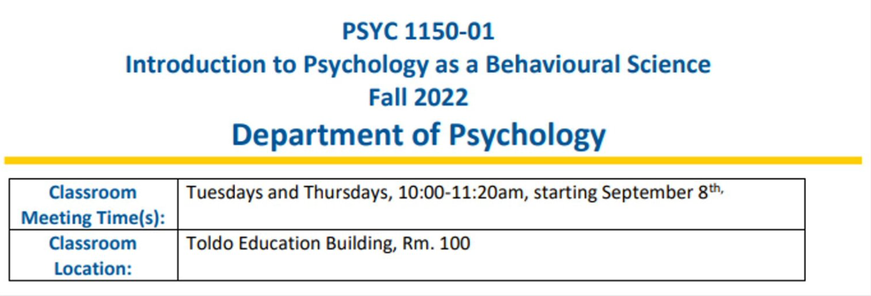
PSYC 1150 Syllabus
Notes:
Make script based on this
https://uwaterloo.ca/future-students/missing-manual/applying/seven-differences-between-high-school-and-university
Keep it positive

Slide 17
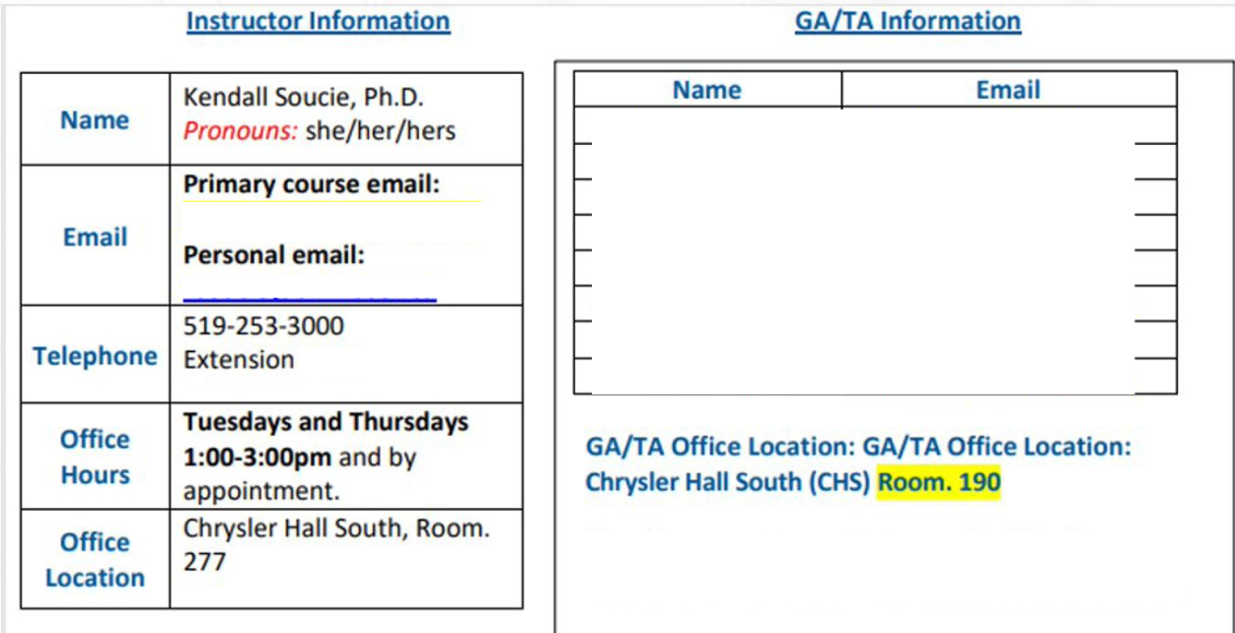
Professor & Teaching Assistant Information
Notes:
Make script based on this
https://uwaterloo.ca/future-students/missing-manual/applying/seven-differences-between-high-school-and-university
Keep it positive

Slide 18
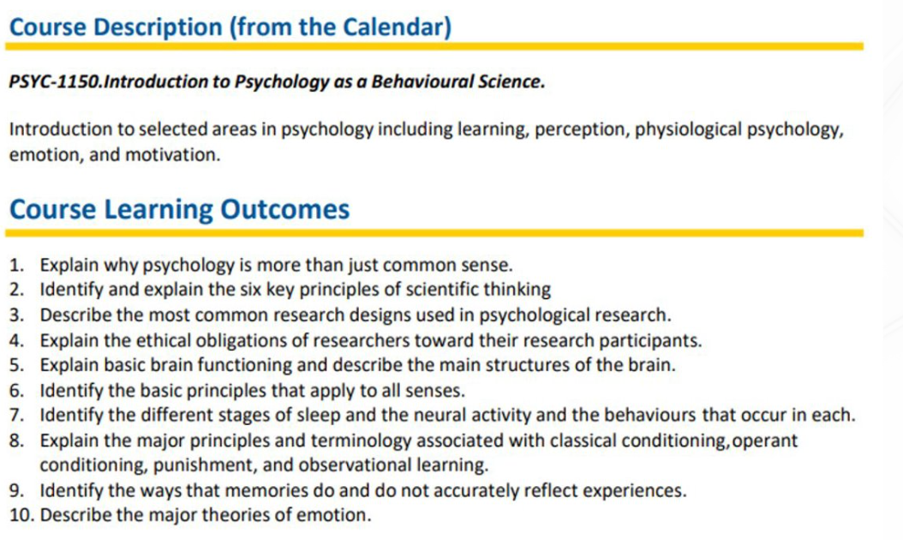
Key Learning Outcomes
Notes:
Make script based on this
https://uwaterloo.ca/future-students/missing-manual/applying/seven-differences-between-high-school-and-university
Keep it positive

Slide 19
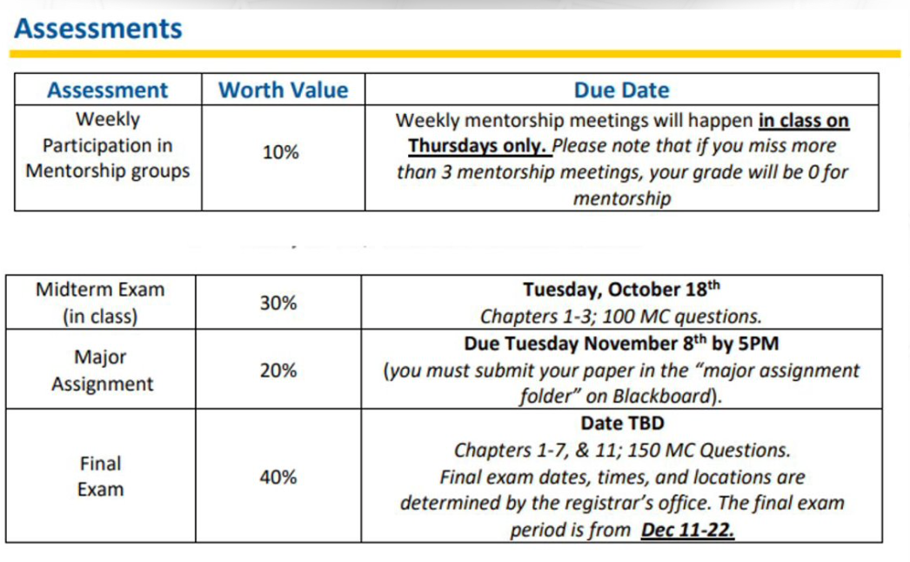
Assessments & Grade Determination
Notes:
Make script based on this
https://uwaterloo.ca/future-students/missing-manual/applying/seven-differences-between-high-school-and-university
Keep it positive

Slide 20
Flexible Schedule
High School | University
School was at the same time every day of the week. Everyone had the same schedule. | Your schedule will change each day, and you will often have breaks in between classes.
How to Deal:
  Create a detailed schedule with time blocks
  Utilize breaks in between classes
Notes:
Make script based on this
https://uwaterloo.ca/future-students/missing-manual/applying/seven-differences-between-high-school-and-university
Keep it positive

Slide 21

Notes:
Make script based on this
https://uwaterloo.ca/future-students/missing-manual/applying/seven-differences-between-high-school-and-university
Keep it positive

Slide 22
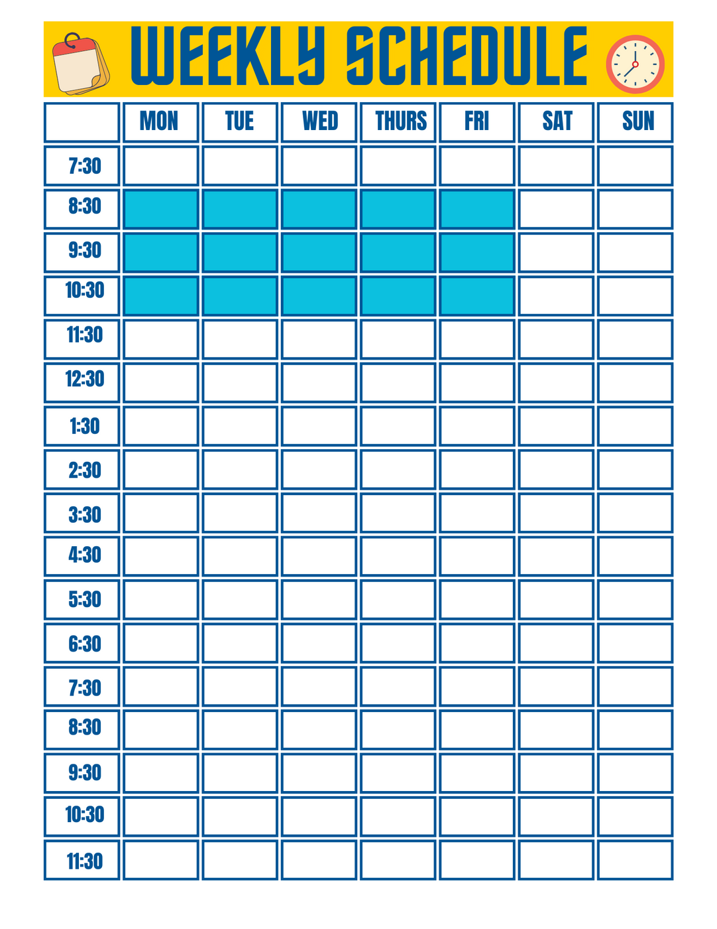
LECTURE
Notes:
Make script based on this
https://uwaterloo.ca/future-students/missing-manual/applying/seven-differences-between-high-school-and-university
Keep it positive

Slide 23
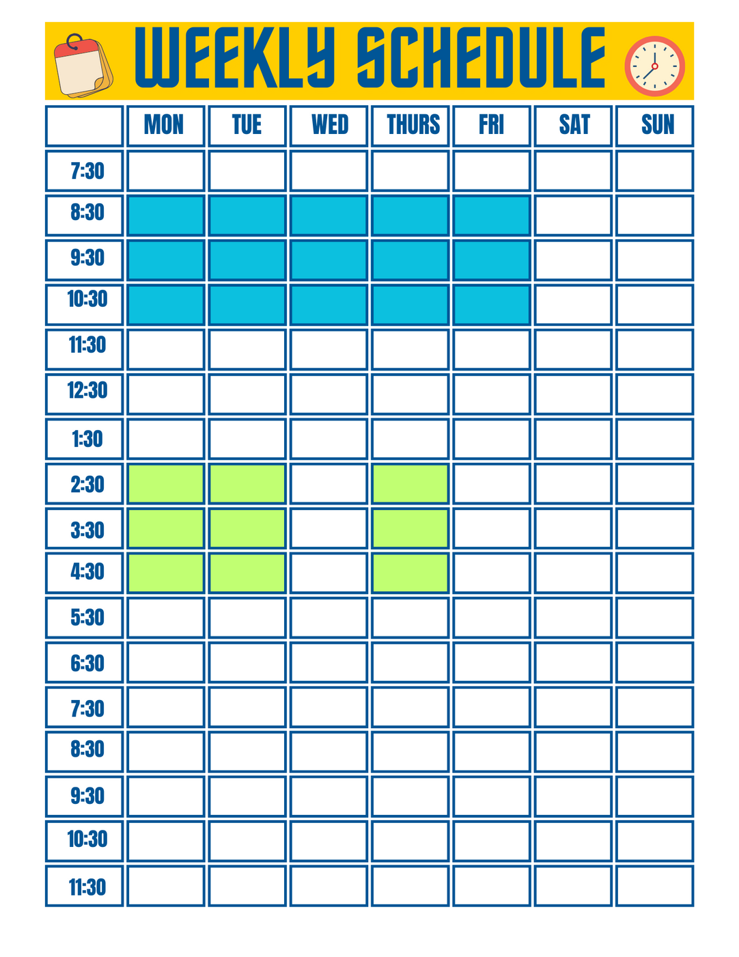
LECTURE
LAB/TUTORIAL
Notes:
Make script based on this
https://uwaterloo.ca/future-students/missing-manual/applying/seven-differences-between-high-school-and-university
Keep it positive

Slide 24
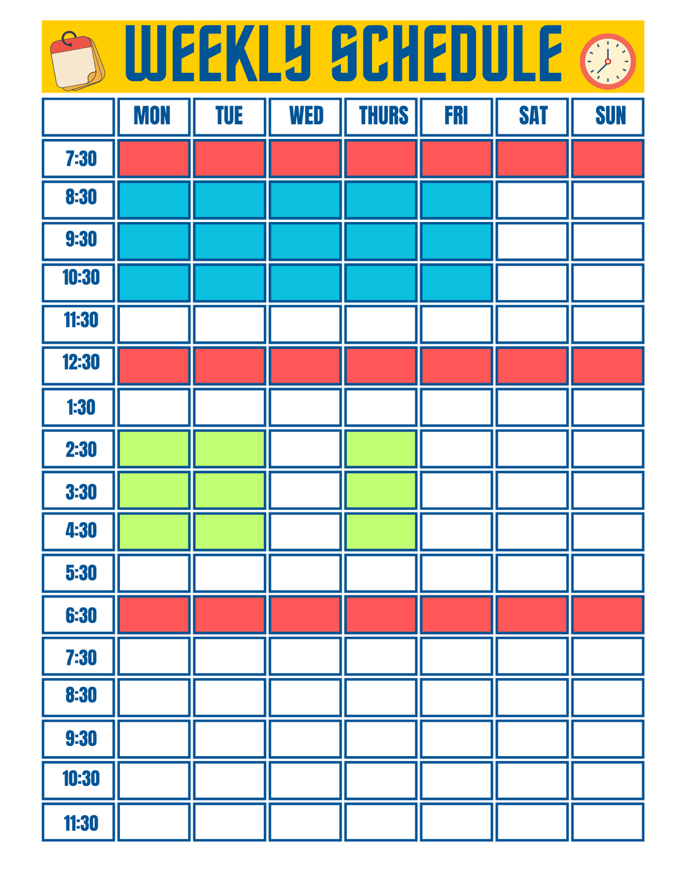
LECTURE
LAB/TUTORIAL
MEALS
Notes:
Make script based on this
https://uwaterloo.ca/future-students/missing-manual/applying/seven-differences-between-high-school-and-university
Keep it positive

Slide 25
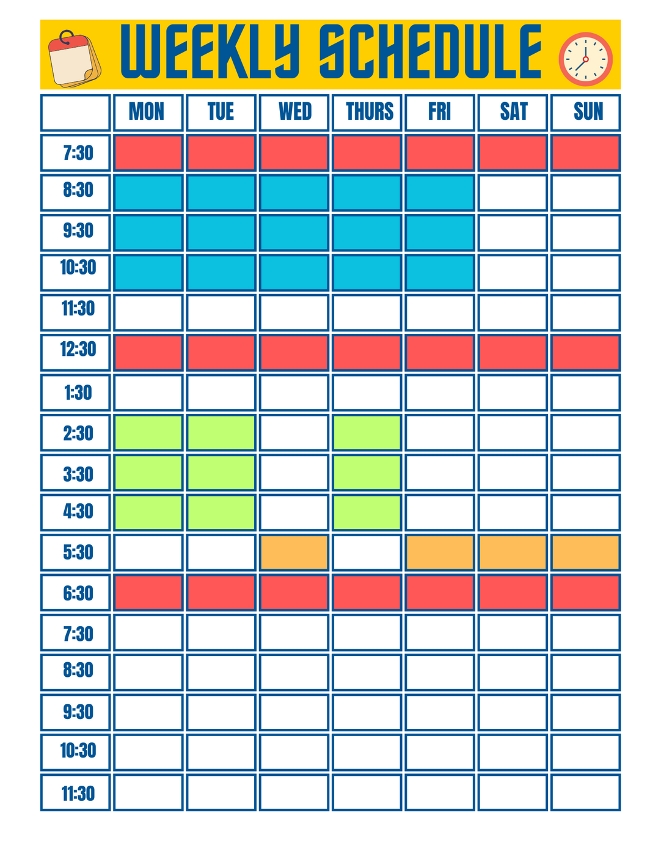
LECTURE
LAB/TUTORIAL
MEALS
MOVEMENT
Notes:
Make script based on this
https://uwaterloo.ca/future-students/missing-manual/applying/seven-differences-between-high-school-and-university
Keep it positive

Slide 26
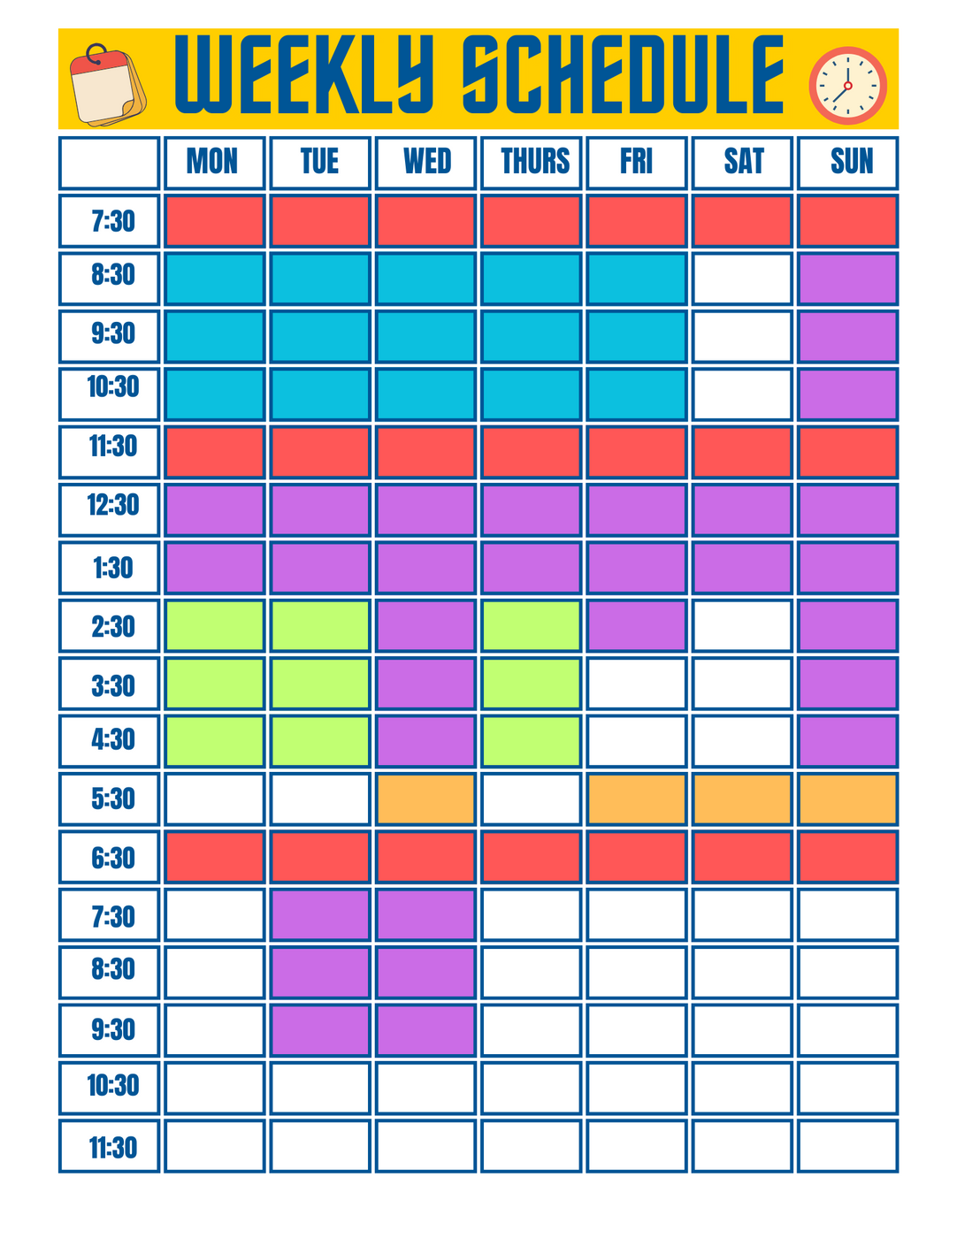
LECTURE
1:2
LAB/TUTORIAL
MEALS
MOVEMENT
STUDY
Notes:
Make script based on this
https://uwaterloo.ca/future-students/missing-manual/applying/seven-differences-between-high-school-and-university
Keep it positive

Slide 27
Rights and Responsibilities
High School | University
School rules and policies are laid out and repeated often. Issues can be resolved fairly easily. | You are responsible for knowing your rights and responsibilities. Ignoring them can lead to serious consequences.
How to Deal:
  Familiarize yourself with the Student Code of Conduct
  Pay attention to the University’s Important Dates
  Meet with an academic advisor regularly
Notes:
Make script based on this
https://uwaterloo.ca/future-students/missing-manual/applying/seven-differences-between-high-school-and-university
Keep it positive

Slide 28
Self-Advocacy
High School | University
Classes are small. Teachers develop relationships with students and check in with parents. | Classes are generally larger. Students must initiate relationships with their professors.
How to Deal:
  Go to class and professors’ office hours
  Talk to your support system about what is going on
  Seek out resources early if you are struggling
Notes:
Make script based on this
https://uwaterloo.ca/future-students/missing-manual/applying/seven-differences-between-high-school-and-university
Keep it positive

Slide 29




Central Resources
Student Health, Counselling & Wellness
Academic Advising
Student Accessibility Services
Office of Sexual Violence Prevention, Resistance & Support

Slide 30
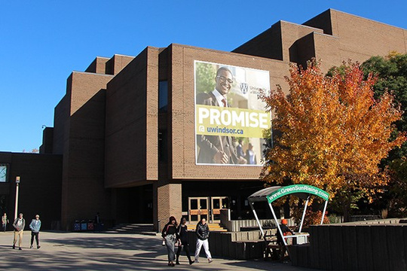

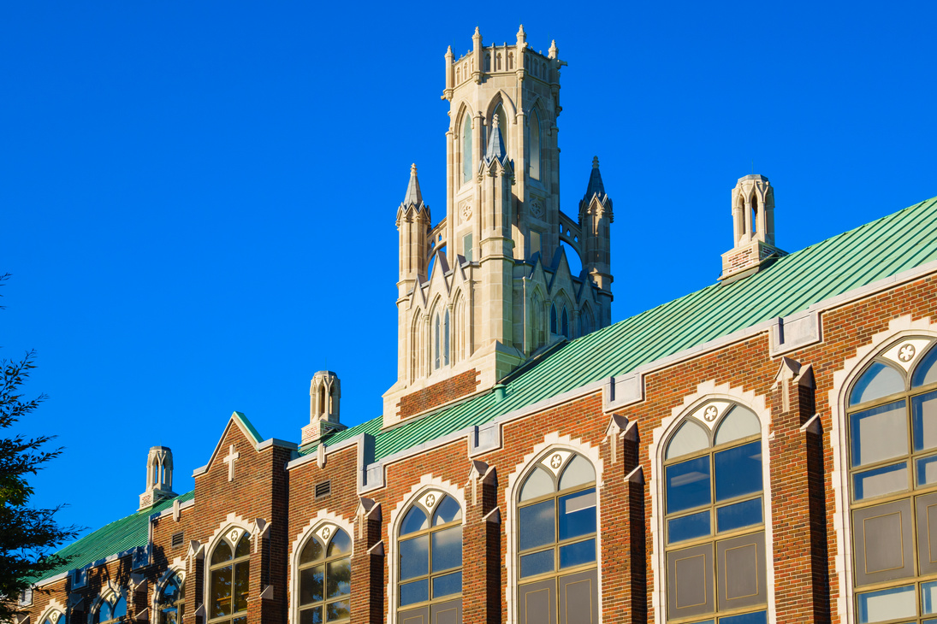

Academic Resources
Math & Stats Learning Centre
Leddy Library
Student Success & Leadership Centre
Writing Support Desk

Slide 31




Cultural & Community Resources
Black Student Support Coordinator
Turtle Island - Aboriginal Student Centre
UWin Pride
International Student Centre

Slide 32
Student Government
Your student unions are your main contact for your health and dental plans, and your universal bus pass.
University of Windsor Student Alliance
(UWSA)
Organization of Part-Time University Students (OPUS)
Provides support to full-time students (4+ courses)
  Student Rights & Empowerment Office
  Afrofest
  Wxmen’s Centre
  Peer Support Centre
  Food Pantry
Provides support to part-time students (1-3 courses)
  Mind Beacon mental health app
  Scholarships & bursaries
  Lounge, study and kitchen area
  Free pizza Fridays
  Volunteer opportunities
  Walksafe
  Pride Center
  150+ student groups
  Scholarships

Slide 33

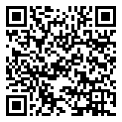
For More Details - Check Out Our Student Resource Guide!
Notes:
Make script based on this
https://uwaterloo.ca/future-students/missing-manual/applying/seven-differences-between-high-school-and-university
Keep it positive

Slide 34


Coming Up Next
  Essential Tools Presentation!

