Slide 1



UWinsite
Introduction to the New Campus ERP
March 22nd, 2017
Engage. Renew. Advance.

Slide 2
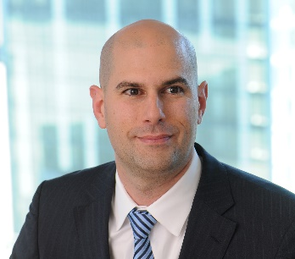


Today’s Presenters
Engage. Renew. Advance.
Deloitte.
Mark DiNello– Deloitte Project Director
Key Clients
Director in our Technology Practice focused on Higher Education
Over the past 14 years he has led the implementation of applications, technical assessments and strategies, and service management engagements for Higher Education
University of B.C.
McMaster University
Queen’s University
Ryerson University
Seneca College
Bruce Adams – Deloitte Project Manager
Key Clients
Director in Deloitte’s National Education Practice with 6 years of PSFT implementation experience and 10+ years Strategic Advisory for Higher Ed and K-12
Experience in organizational and operational effectiveness as well as innovation incubators and student recruitment in Higher Ed..
Georgian College
Ryerson University
Windsor University
Northern Ontario School of Medicine

Slide 3
Agenda
Engage. Renew. Advance.
Project Background
The Vision
The Solution
Project Management
Governance
The Team
Risk Management
Change Management

Slide 4

Project Background
Where are we now? Why this project?
UWinsite
Engage. Renew. Advance.

Slide 5


Where are we now?
Why an enterprise technology project?
Engage. Renew. Advance.
Aging systems lack features and functionality
Manual workarounds in place are not sustainable; uptime, security, performance and privacy
Higher risk due to unsupported system (e.g. Finance)
Decreased student engagement and enrollment

Slide 6


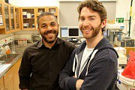
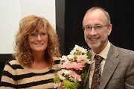

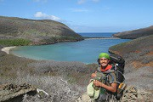
University of Windsor Strategy
Alignment of Uwinsite priorities
Engage. Renew. Advance.
Provide an Exceptional Undergraduate Experience
More consistent and improved user experience for students
Stronger student network to support learning and transitioning
Complement to other initiatives to enhance student services
Pursue Strengths in Research and Graduate Education
More robust tracking of student progress
Enhanced tools to manage research grants more efficiently
Flexibility and visibility allows for more focus on research
Recruit and Retain the Best Faculty and Staff
More cohesive view of relevant, timely and accurate data
Less administrative burden through workflow and self-service
Supports goal of providing increased value-added services
Engage in Community Partnerships
Improved ability to track and provide insight to partner data
Strengthens campus relationships with community stakeholders
Supports efforts to enhance regional social / economic health
Promote International Engagement
Flexibility to meet varying student profiles and programs
Improved experience and services to International students
Enhanced communication tools, tracking and reporting

Slide 7

The Vision
What is the final destination?
UWinsite
Engage. Renew. Advance.

Slide 8


Where are we going?
Guided by key principles
Engage. Renew. Advance.
Strategic Alignment
Best Practice Driven
Scalable
Student-centric
Sustainable

Slide 9

The art of the possible
Through the eyes of a student
Engage. Renew. Advance.
https://vimeo.com/174287707
Notes:
highereducation

Slide 10



The vision simplified
Objectives and a destination
Engage. Renew. Advance.
We believe that each of these words are both Objectives and Actions and that they are aligned with the UWindsor’s vision
Engage. Renew. Advance.

Slide 11

The UWinsite Solution
It’s all about the experience
UWinsite
Engage. Renew. Advance.

Slide 12

What is in Scope
Replace and redesign
Engage. Renew. Advance.
The following Oracle PeopleSoft and Cloud solutions will be implemented for this project:
System | Scope | Product
Student Information System (SIS) | Replacement | PeopleSoft Campus Solutions 9.2
Financial Information System (FIS) | Replacement | Oracle Fusion Hyperion
Customer Relationship Management (CRM) System | New | Oracle CX Eloqua Service Cloud

Slide 13

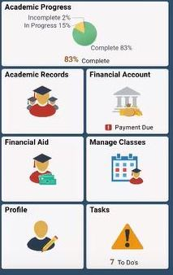
Student-centric solution
Making your academic life easier
Engage. Renew. Advance.
PeopleSoft Campus Solutions
Accept an Offer
Class Search – add favorites
Class Search – add to shopping cart
Shopping Cart – enroll
View My Classes – see conflicts
Course Requirements Alerts
Drop Class
View Class Schedule
Student Finance – make a payment
Financial Aid – see disbursements
Task Lists
Etc…

Slide 14
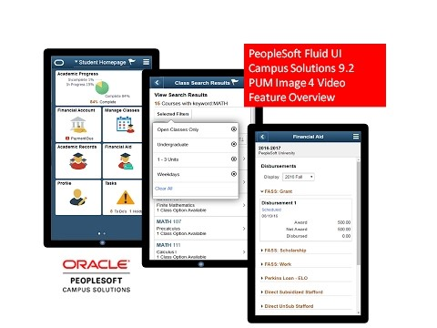
Student-centric solution
Making your academic life easier
Engage. Renew. Advance.
https://youtu.be/qIyo1nfol9E

Slide 15
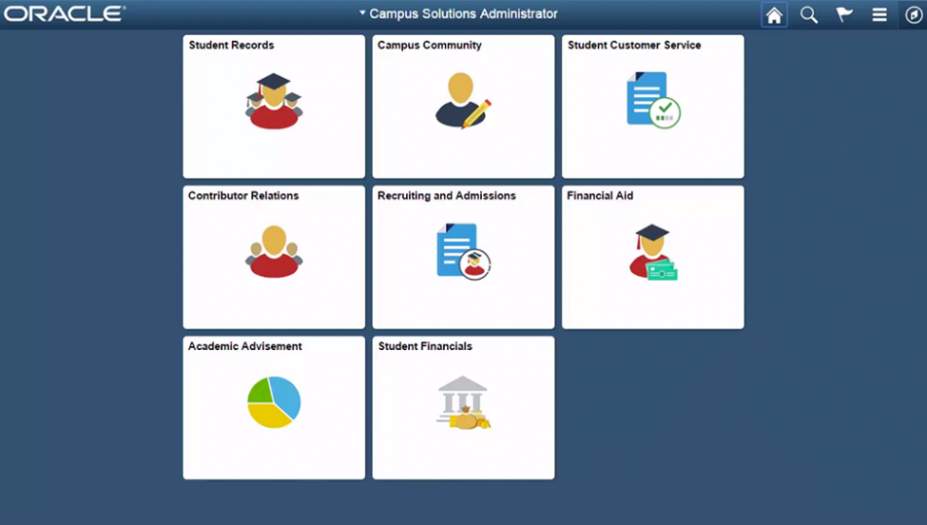
Campus Administration
Modernizing your workplace
Engage. Renew. Advance.
Campus Solutions
Block enroll students
Automated class waitlist processing
Integrated real-time degree audit
Effective Dating – maintains full history of all changes
Integrated transfer credit articulation rules and evaluation
Accessible anywhere/anytime

Slide 16

University Financials, Planning & Budgeting
Creating capacity, insight and foresight
Engage. Renew. Advance.
Fusion & Hyperion Cloud
Modern, Intuitive User Experience
Mobile Financial Management Tools
Integrated business intelligence and compliance reporting
Real-Time, Self-Service Reporting and Analysis
Integrated University-wide Planning, Budgeting and Management Reporting Process
Control over Costs and Visibility into Commitments

Slide 17



Customer Relationship Management
Relevant and timely engagement
Engage. Renew. Advance.
CX Cloud
Eloqua Marketing Cloud
Personalize communication using Digital Body Language
Manage Events and send calendar invites
Create multi channel communication based on audience preference
Track and monitor campaigns to improve ROI
Service Cloud
Provide Multi Channel comprehensive Inquiry Management
Provide integrated Knowledge Management
Integrate Student Campus Information

Slide 18

Project Management
Approach & Timelines
UWinsite
Engage. Renew. Advance.

Slide 19

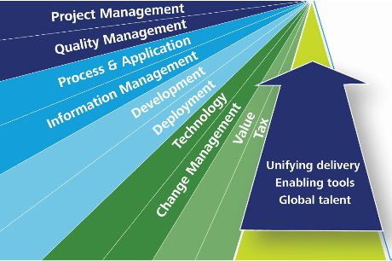
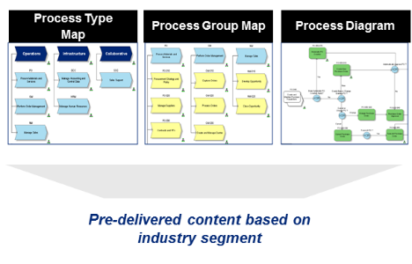
The Deloitte Methodology A partnership model supported by a proven approach
Engage. Renew. Advance.
Tools & Accelerators
Method: Total Campus Methodology TM
Leading Processes: IndustryPrint TM
Provides work products, deliverables
Total Campus is structured in disciplines and phases
Tools to accelerate the solution design, test and deployment
Industry-specific process modeling solution
Comprehensive tool

Slide 20

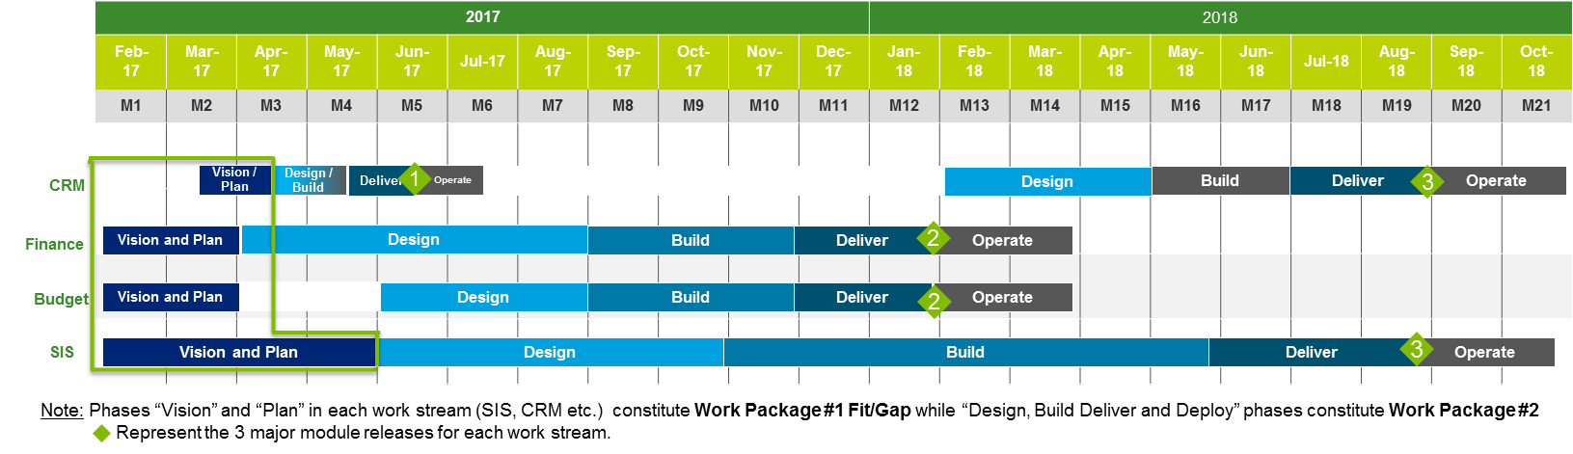
High-level Project Timeline
An intense multi-threaded approach
Engage. Renew. Advance.
Fit-Gap

Slide 21

Phase 1: Visioning and Fit-Gap
Measuring the distance between us and our vision
Engage. Renew. Advance.
Key Activities
Executive and Business Workshops
Focus Groups
Fit-Gap Analysis
Key Deliverables
Fit-Gap assessment
Technology Assessment
Application map with integration requirements strategy
Process and control requirements
Business Process Analysis
Scoping Tables, RICE,
Project Estimation Tool
Rollout plan and strategies
Evaluate Options
Scope Definition
Implementation Plan
Budget Summary
Project Plan
Resourcing model
Project plan
Benefits analysis
Communicate and Approve
Functional and technical scope
Roles and responsibilities
Strategy for identified Gaps
Project
Charter
(WP2)
Proven approach and toolset to define scope, timeline, and resources
Hands-on with stakeholders and project team
Seamless across all business requirements
Stakeholder alignment
Delivering a foundation for the implementation project to succeed

Slide 22

How will we get there?
Strengthening success through governance
UWinsite
Engage. Renew. Advance.
Notes:
Brian

Slide 23

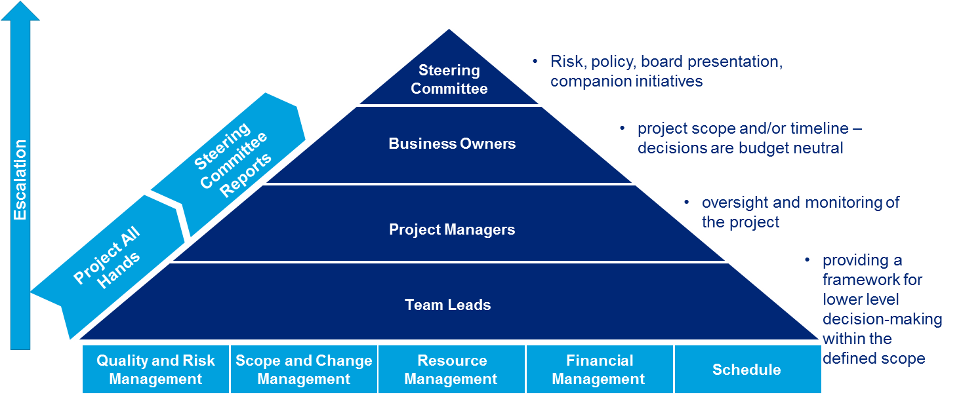
Project Governance Model
Clear lines of accountability
Engage. Renew. Advance.
Model will establish clear framework for decision making and escalation
Notes:
Brian? Talks though this?

Slide 24

Project Team
Deliberate Design
UWinsite
Engage. Renew. Advance.
Notes:
Bruce

Slide 25

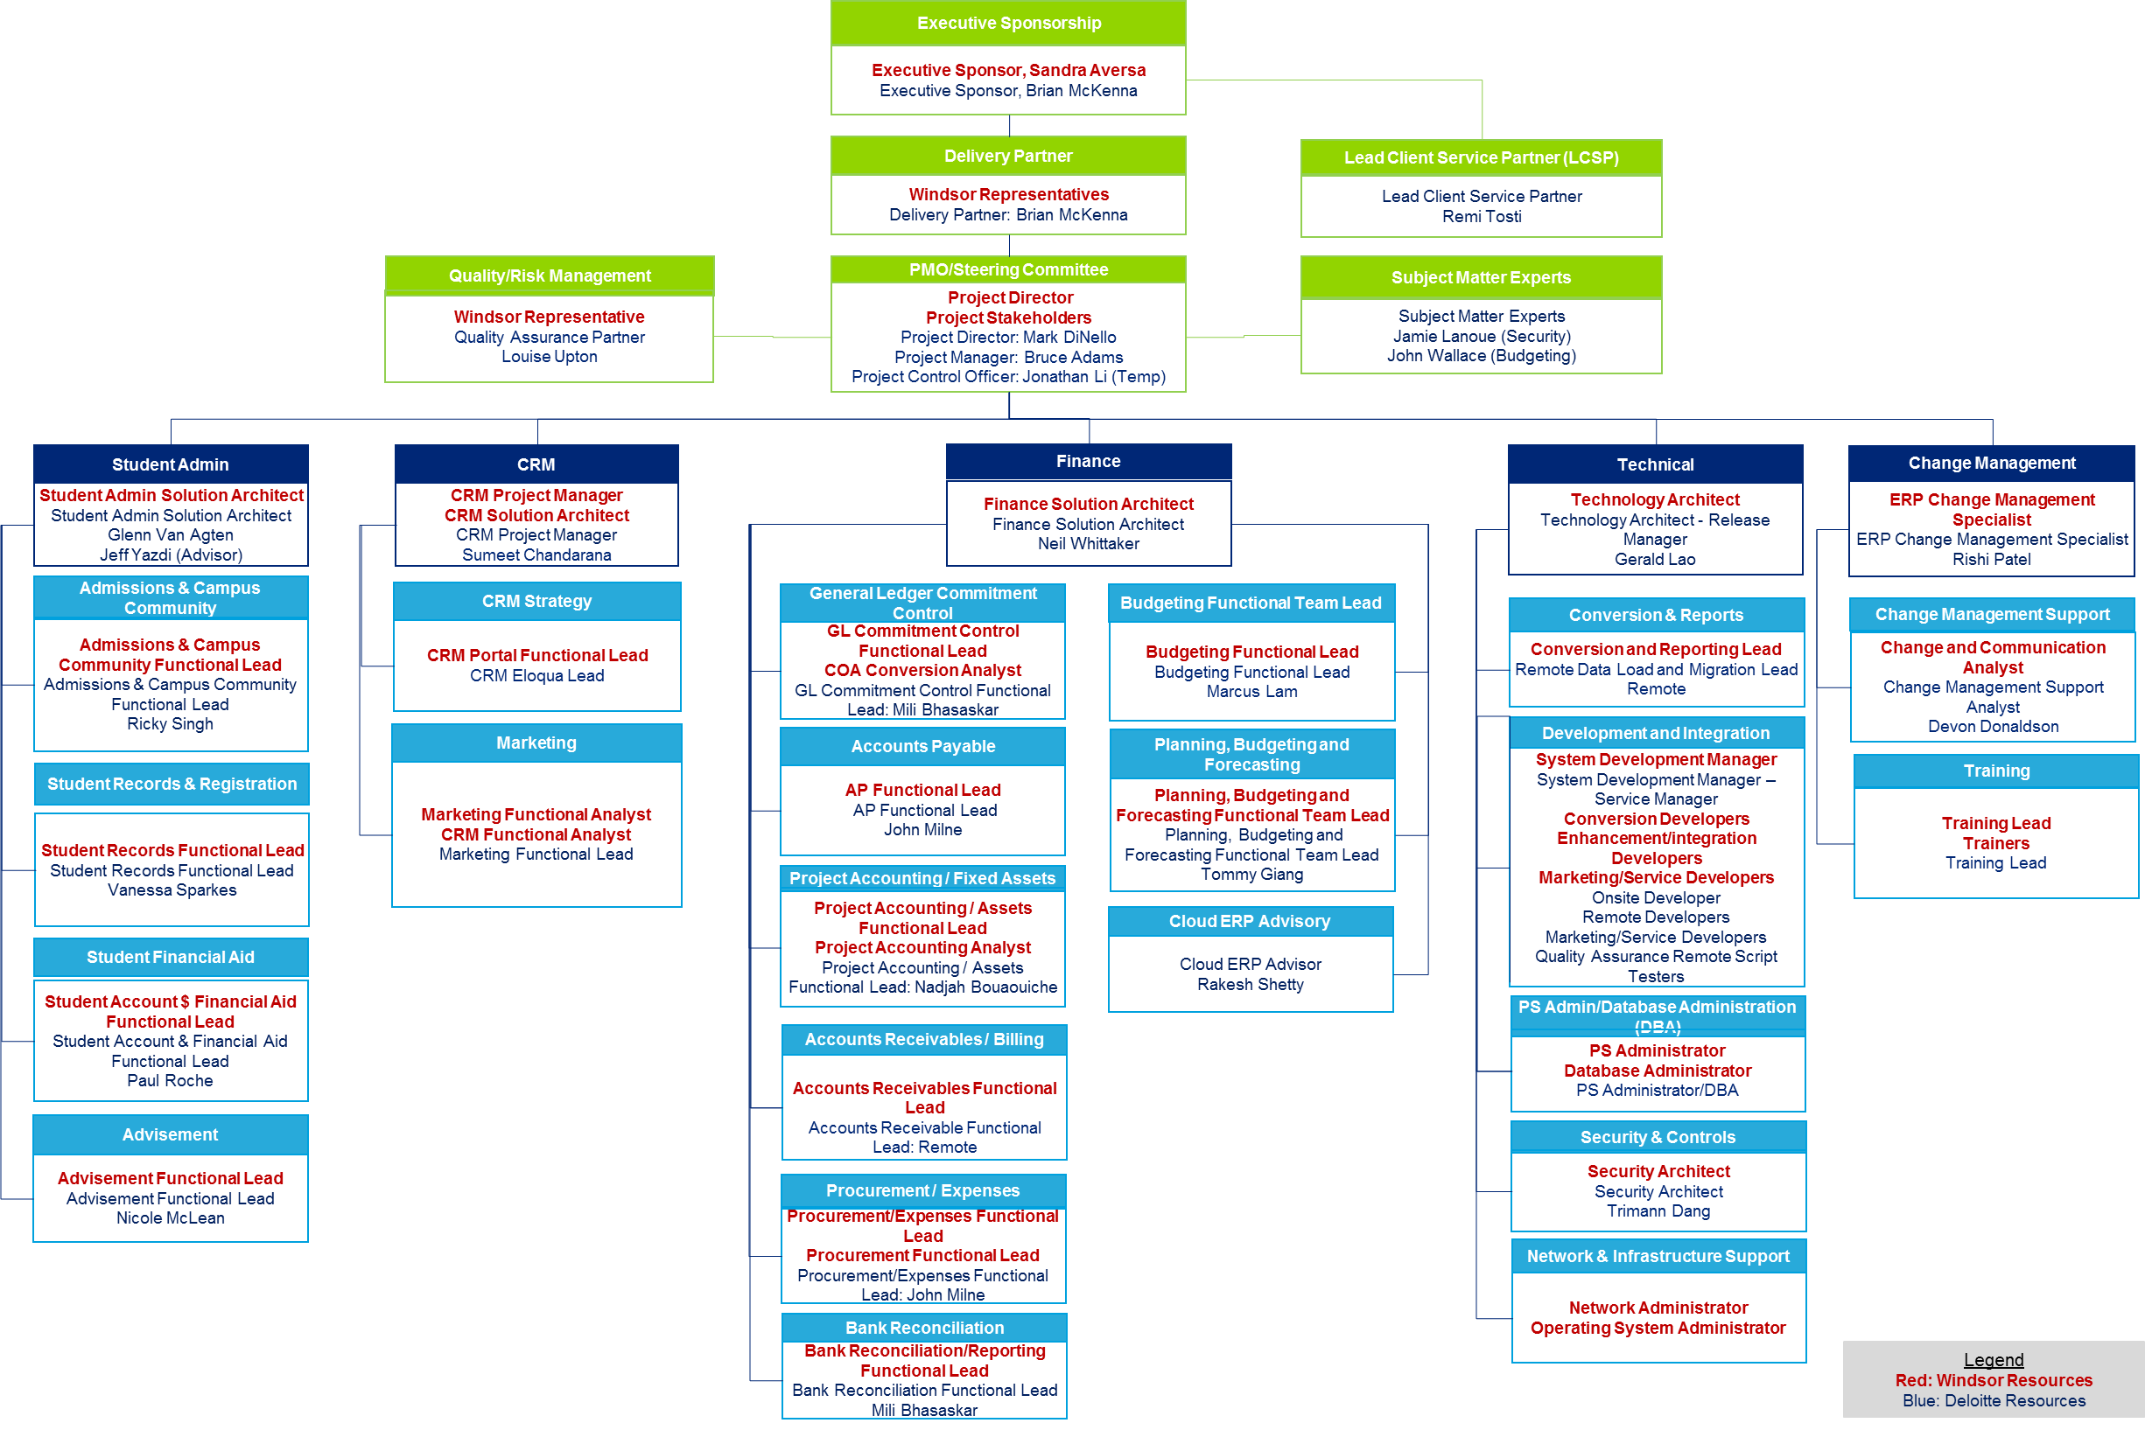
Project Team Design
“Two in a Box”
Engage. Renew. Advance.

Slide 26

Risk Mitigation & Management
Anticipation, planning and culture
UWinsite
Engage. Renew. Advance.

Slide 27



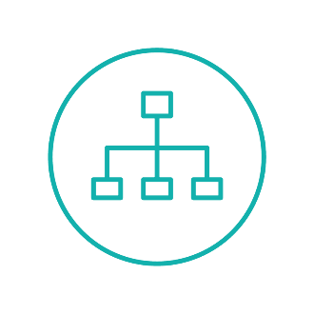


Risk Mitigation & Management Safeguarding all program dimensions
Engage. Renew. Advance.
Technology
Process / Policy
Management
Project
Change
Data quality & Conversion
3rd System Integration
Complex Reporting
System Performance
Redundant Process
Disparate Approvals Process
Lack of Standardization
Legacy Policies
Leader endorsement
Executive Decisions
Empowerment of staff
Skillset/Turnover
Sustainment Model readiness
Project timelines
Dependency with other streams
Critical Path Execution
Business Cycle Changes
Timely Escalations
Resistance to Change
Timely Communication
Knowledge transfer
Lack of Stakeholder Consultation during Design
UWinsite

Slide 28

Change Management
Scope and Approach
UWinsite
Engage. Renew. Advance.

Slide 29

Managing Change
Transition across multiple areas
Engage. Renew. Advance.
People
Process
Policy
Technology
New skills required
Tasks eliminated for a role
Change in behavior/culture
Change in accountability or reporting relationship
Change in where work is completed
Change in how work gets done
Change in data sources/inputs
Change in reports/outputs
Change in frequency of work
Change in communication or interaction
Change in customer/vendor interaction?
Change in the rules required to guide decisions, behaviors
Change in procedure for completing tasks, processes
Change in contract or policy
Change in application or tools required to complete tasks
Features being added or removed
Change from a manual task to automated

Slide 30
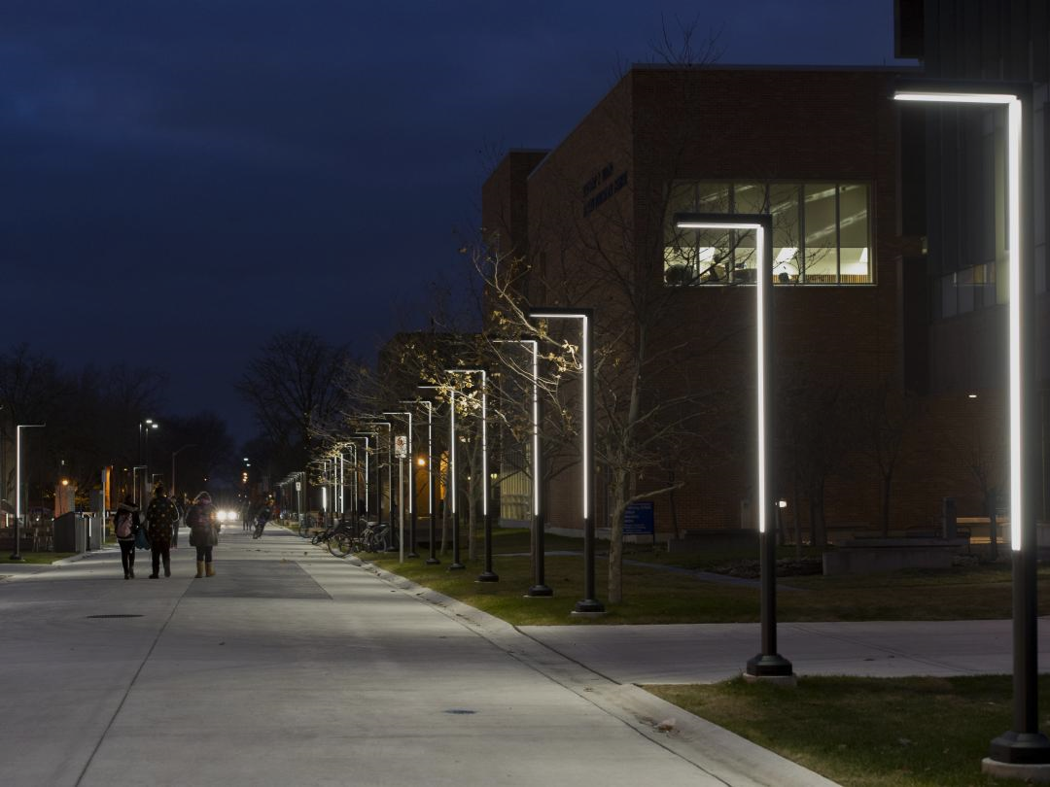
Next Steps
Starting the journey together
UWinsite
Engage. Renew. Advance.

Slide 31




UWinsite
Engage. Renew. Advance.
Deloitte.

